Slide 1
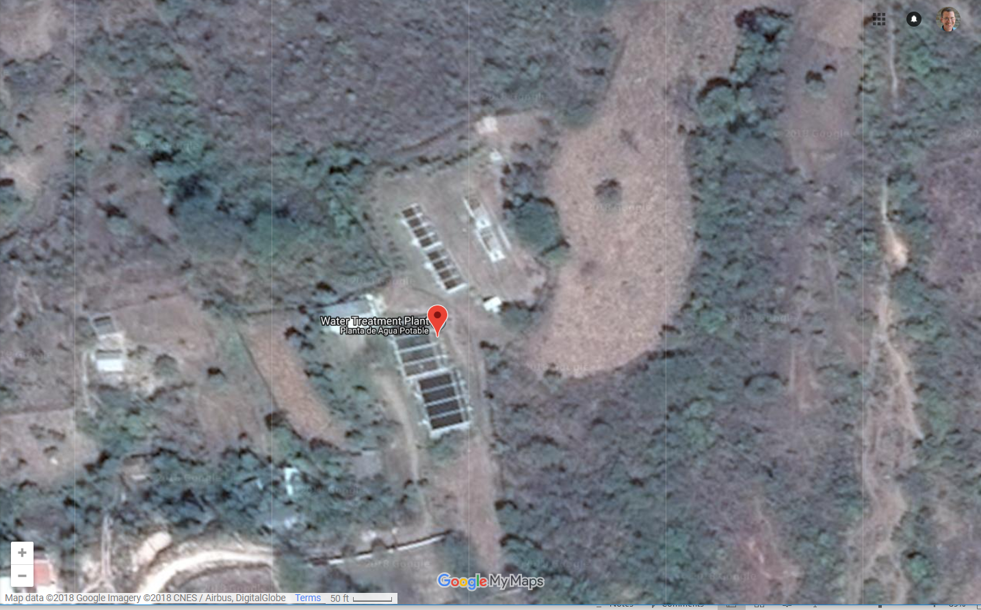
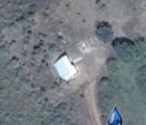
20 L/s Multiple Stage Filtration Plant
Dynamic filters
Roughing filters
Slow sand filters
20 L/s AguaClara Plant

