Slide 1
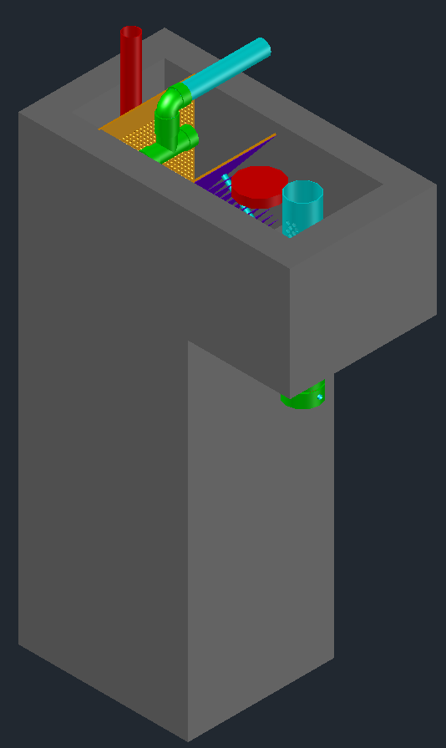
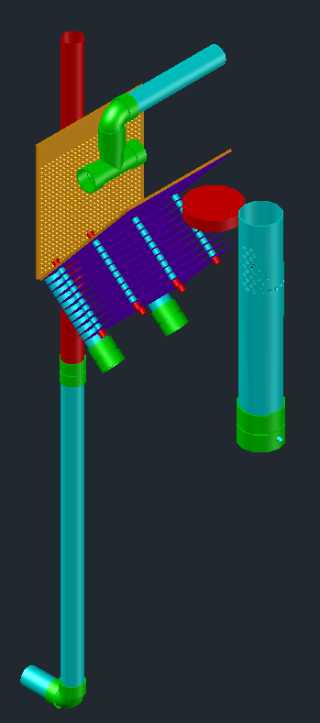
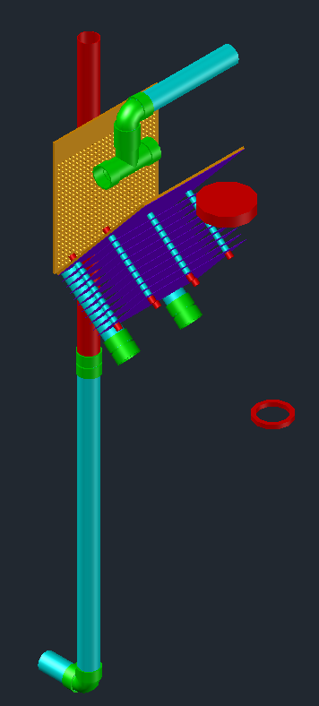
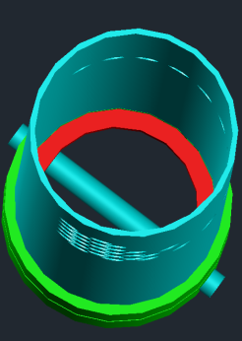
Rapid Mix orifice
Drain plug
CDC Float
Plate settlers for grit removal
Inlet
LFOM
Rapid mix orifice
Pin to keep plate in place

