Slide 2



Free Body Diagram
terminal_velocity_FBD.png
$$F_{buoyant}$$
$$F_{drag}$$
$$W_{floc}$$

Slide 3
drag_coeff_Re_base.png
Stokes Law

Slide 4
drag_coeff_Re_full.png
Stokes Law
laminar
turbulent
turbulent boundary

Slide 5
terminal_velocity_floc_diam.png
Floc blanket velocity
AguaClara plate settler capture velocity
Primary particle terminal velocity

Slide 6
horizontal_flow_tank_base.png
W
H
entrance
exit
L

Slide 7


horizontal_flow_tank_capture.png
W
H
$$v_{H}$$
exit
entrance
$$v_{c}$$
L

Slide 8
horizontal_flow_tank_small_capture.png
W
H
$$v_{H}$$
exit
entrance
$$v_{c}$$
L

Slide 9
vertical_flow_tank_base.png
exit
L
W
H
entrance

Slide 10
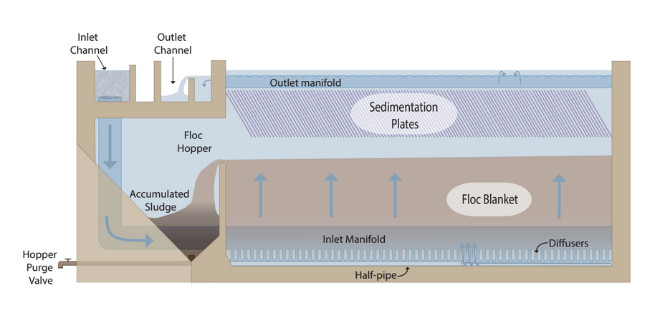





sed_tank_overview.png

Slide 11


sed_tank_flow_conserve.png
“lost triangle”
$$L_{SedActive}$$
$$L_{SedFloc}$$

