Slide 1

NUTRITION GUIDE
Eating well, from first milk to family table
A guide. Tap a card to explore, then take the quiz.
Start exploring
Take the quiz
Notes:
Run this deck in Slide Show mode so the cards, buttons and quiz answers are clickable. Based on the Nutrition section of the REdbook notes.

Slide 2






Pick a topic to explore
Take the quiz ›
Breastfeeding
Duration and benefits
Starting solids
Principles and textures
Iron
Who needs it, how much
Vitamin A and zinc
Doses and why
Deworming
Drugs, timing, cautions
Iron deficiency anemia
Who to test, and when

Slide 3





Breastfeeding: how long and why
Menu
6 months
Easy to digest and absorb
Contains antibodies
Exclusive breastfeeding
DHA fats support brain development and intelligence
Promotes emotional bonding
2 years+
Continue breastfeeding alongside food
Protects mom from breast, uterine and ovarian cancer, obesity and bleeding
Earlier return to pre-pregnancy weight, and big family savings
‹ Back
Next ›
Notes:
Exclusive breastfeeding up to 6 months, continued up to 2 years and beyond.

Slide 4


Starting solids at 6 months
Menu
Timely
Adequate
Safe
Properly fed
Introduce complementary foods at 6 months.
Plan with the PSRGN Dietary Prescription Food Guide Pyramid.
Do not add salt before one year of age.
Practice responsive feeding.
‹ Back
Next ›
Notes:
Principles: timely, adequate, safe and properly fed. Give supplements of iron, zinc, calcium and vitamin B12 if the diet is deficient.

Slide 5
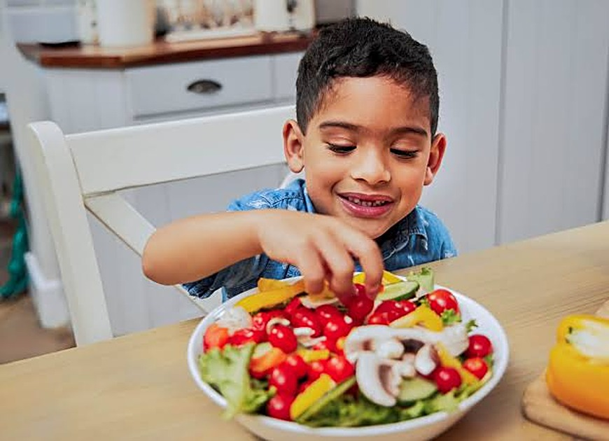

Textures and how often
Menu
6
8
10
12
Pureed food
at 6 months
Finger foods
at 8 months
Lumpy or chopped
at 10 months
Table food
at 12 months
Go slowly
How often
One new food at a time, for 3 days. Start with 1 to 2 teaspoons a day of lugaw or cereals, fruits or vegetables.
2 to 3 times a day at 6 to 8 months. 3 to 4 times a day from 9 to 24 months.
‹ Back
Next ›

Slide 6

Iron supplementation
Menu
Who | Preparation | Dose and duration
Low birth weight | Drops: 15 mg iron per 0.6 mL | 0.3 mL once a day, from 2 to 6 months of age
Infants 6–11 months | Drops: 15 mg iron per 0.6 mL | 0.6 mL once a day for 3 months
Children 1–5 years | Syrup: 30 mg iron per 5 mL | 1 tsp once a day for 3 months, or 30 mg once a week for 6 months
Girls 10–19 years | Coated tablet: 60 mg iron with 400 mcg folic acid | One tablet once a day
Why it matters
Low iron is linked to problems with thinking and movement skills.
‹ Back
Next ›

Slide 7
Vitamin A and zinc
Menu
100,000 IU
200,000 IU
Infants 6 to 11 months. One dose only, usually given at 9 months.
Children 12 to 59 months. One capsule every 6 months.
Zinc
Zinc supplements help prevent pneumonia and diarrhea.
‹ Back
Next ›

Slide 8

Deworming every 6 months
Menu
Albendazole
Mebendazole
200 mg for ages 12 to 23 months. 400 mg for 24 months and above.
500 mg for ages 12 months and above.
Who and when
Do not deworm if
All children aged 1 to 12 years (DOH). A single dose every 6 months, taken on a full stomach.
The child has high-grade fever, profuse diarrhea or abdominal pain.
‹ Back
Next ›

Slide 9
Iron deficiency anemia
Menu
It is associated with cognitive and psychomotor problems in children.
At-risk children should have a complete blood count (CBC) at least once at:
6–24 months
2–6 years
10–19 years
Also at risk: actively menstruating adolescent girls and fad dieters. A CBC is recommended at each stage of adolescence.
‹ Back
Quiz ›

Slide 10
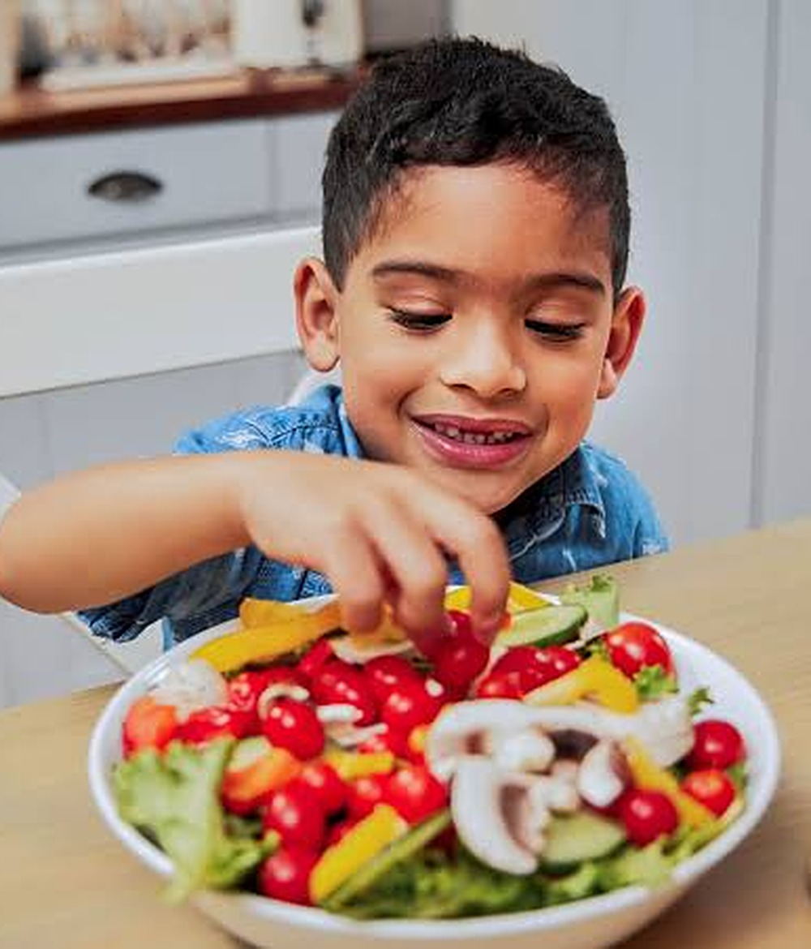
QUICK QUIZ
Test what you learned
4 questions. Tap an answer to see if you got it right. Wrong answer? You can try again.
Start quiz
Menu

Slide 11
Question 1 of 4
Menu
BREASTFEEDING
How long is exclusive breastfeeding recommended?
A Up to 6 months
B Up to 3 months
C Up to 12 months
Notes:
Correct answer: A. Exclusive breastfeeding up to 6 months, then continued up to 2 years and beyond alongside food.

Slide 12

Correct!
Up to 6 months
Exclusive breastfeeding up to 6 months, then continued up to 2 years and beyond alongside food.
Menu
Next question ›

Slide 13

Not quite
Hint
Think about the age when solid foods begin.
Menu
Try again

Slide 14
Question 2 of 4
Menu
STARTING SOLIDS
How should new foods be introduced to a 6-month-old?
A Several new foods at the same time
B A new food at every meal, every day
C One new food at a time, for 3 days
Notes:
Correct answer: C. Introduce one new food at a time for 3 days, starting with 1 to 2 teaspoons a day.

Slide 15
Correct!
One new food at a time, for 3 days
Introduce one new food at a time for 3 days, starting with 1 to 2 teaspoons a day.
Menu
Next question ›

Slide 16
Not quite
Hint
Go slowly so you can tell how each food agrees with the baby.
Menu
Try again

Slide 17
Question 3 of 4
Menu
TEXTURES
At what age is table food introduced?
A 6 months
B 12 months
C 8 months
Notes:
Correct answer: B. Pureed at 6 months, finger foods around 8 months, lumpy or chopped at 10 months, table food at 12 months.

Slide 18
Correct!
12 months
Pureed at 6 months, finger foods around 8 months, lumpy or chopped at 10 months, table food at 12 months.
Menu
Next question ›

Slide 19
Not quite
Hint
It is the last step on the texture timeline.
Menu
Try again

Slide 20
Question 4 of 4
Menu
DEWORMING
When should deworming be skipped?
A When the child has just eaten
B When the child is 5 years old
C When there is high-grade fever, profuse diarrhea or abdominal pain
Notes:
Correct answer: C. Do not deworm with high-grade fever, profuse diarrhea or abdominal pain. Otherwise, dose every 6 months on a full stomach.

Slide 21
Correct!
When there is high-grade fever, profuse diarrhea or abdominal pain
Do not deworm with high-grade fever, profuse diarrhea or abdominal pain. Otherwise, dose every 6 months on a full stomach.
Menu
Finish ›

Slide 22
Not quite
Hint
Think of signs that a child is already unwell.
Menu
Try again

Slide 23

WELL DONE
Good food, good start
Breast milk only to 6 months, then keep going
One new food at a time, for 3 days
No salt before age 1
Keep iron, vitamin A and deworming on schedule
Back to menu
Retake quiz
Notes:
Wrap-up. Source: Nutrition section of the REdbook notes.

