Slide 1
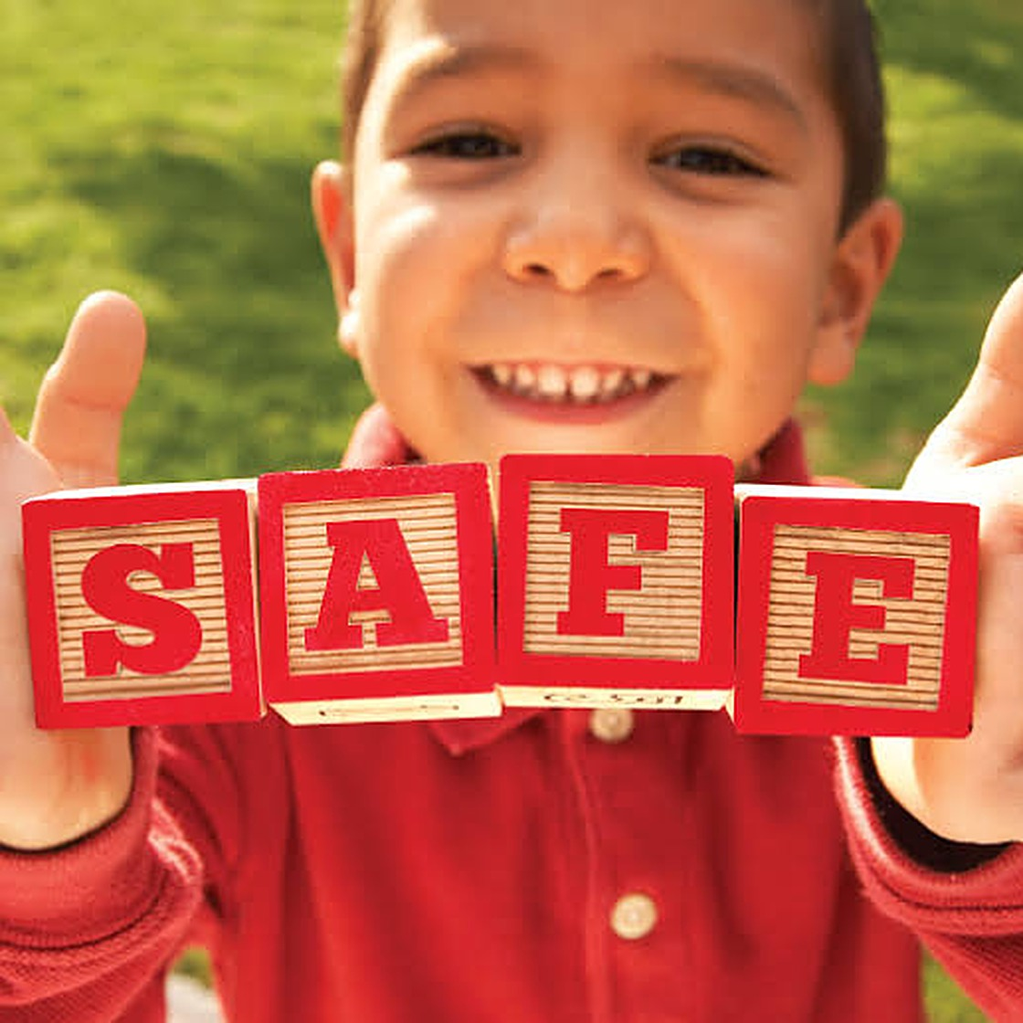
SAFETY GUIDE
Keeping babies and children safe at home
A guide. Tap a card to explore, then take the quiz.
Start exploring
Take the quiz
Notes:
Run this deck in Slide Show mode so the cards, buttons and quiz answers are clickable. Based on the Safety text you pasted plus the Safety section of the REdbook notes.

Slide 2






Pick a topic to explore
Take the quiz ›
Choking
Mealtimes and small objects
Safe sleep
Back to sleep, every time
Around the home
Hands on, locks, gates, windows
Water and baths
Drowning and burn risks
Baby gear
Crib, highchair, car seat
Active and protected
Lead, injuries, child protection

Slide 3
Keep small objects out of reach
Menu
Babies learn by putting things in their mouth. Keep these away:
At mealtimes
Marbles
Batteries
Jewelry
Hold your baby when you feed them
Do not prop them up or give strained food in a bottle
Never leave a small child alone during meals
Crawling or walking? No spoons, lollipops or Popsicle sticks in the mouth
Magnets
Nuts and seeds
Grapes
Candy
Ear buds
Balloons
Plastic bags
Coins
‹ Back
Next ›

Slide 4

Safe sleep for every nap
Menu
Back to sleep
Crib or bassinet
Always place your baby on their back. Never on their side or stomach, which can cause suffocating or choking.
The safest place to sleep. Bed-sharing raises the chance of SUID.
Room-sharing
Breastfeeding in bed
Baby sleeps in your room in their own sleep space, like a crib. This helps prevent SUID.
That is fine. When baby stops nursing, put them back in their sleep space, on their back.
‹ Back
Next ›

Slide 5
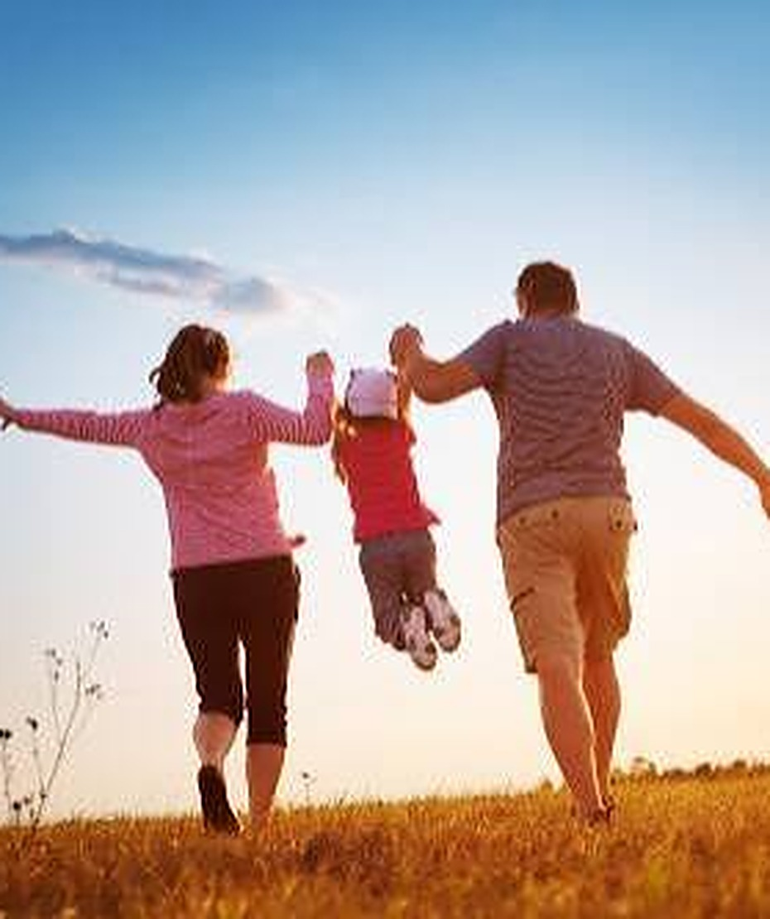

Hands on, always
Menu
Always keep 1 hand on your baby. Never leave them alone:
In a vehicle
During a bath
In a shopping cart
With pets or other animals
On a raised surface: changing table, counter or chair
Never hit or shake your baby. Overwhelmed? Take a break with someone you trust.
‹ Back
Next ›

Slide 6






Childproof the home
Menu
Lock it up
Cover outlets
Gate the stairs
Safety locks on cabinets with cleaning products or medicine. Keep medicine, cigarettes and lighters out of reach.
Safety covers on electric outlets that are not in use.
Baby gates at the top and bottom of any stairs.
Windows
Air and smoke
Plants and poisons
Screens are not strong enough. Lock windows, open from the top, use guards, and keep furniture away.
Never smoke around baby. Check smoke and carbon monoxide detectors every month.
Check houseplants for poison. If a child eats one, call your local poison center.
‹ Back
Next ›
Notes:
From the text: if a window is open, do not put low tables, couches, chairs or baby gates in front of it, because a child could climb up and fall. Install window guards on windows that open from the bottom. The pasted text lists a US poison hotline; use your local poison center number.

Slide 7
Water safety and bath time
Menu
1–2 inches
At bath time
of water is enough for a baby to drown.
Never leave them alone in a bathtub, hot tub or pool
Use a sink or infant tub with a non-skid mat
Keep most of the body and all of the face out of the water
No bath seats: they tip once baby can pull up or stand
Keep supplies in reach so 1 hand stays on baby
Below 120°F
Empty or cover water outside: buckets, trash cans, inflatable pools, recycling bins, coolers with melted ice and large water bowls.
Water heater setting (48.9°C). Test bath water with your elbow.
‹ Back
Next ›

Slide 8
A safe crib
Menu
Fixed sides
Under 10°
Bare crib
Never use drop-side cribs. Babies and toddlers can get trapped.
Do not incline the crib past 10 degrees. An angled mattress is not safe.
No soft bedding, comforters, loose sheets, blankets, pillows, sheepskins, toys or bumpers.
Snug sheet
No cords
2⅜ inches
Use tight-fitting sheets over the crib mattress.
Keep cords from blinds, lamps or mobiles away from the crib.
Maximum gap between spindles, about as wide as a soda can.
‹ Back
Next ›

Slide 9


Highchair and infant swing
Menu
Highchair
Infant swing
Once baby can sit up without support.
The motion often soothes a baby who cries a lot.
Keep it away from tables and countertops: baby could push off and tip it
Make sure the tray latches securely
Always use the 5-point harness, and never leave baby alone in it
Always use the 5-point harness
If baby falls asleep, gently move them to the crib, on their back
‹ Back
Next ›

Slide 10


Car seat and baby gear
Menu
Car seat
Playpen
Sides locked. No pillows, comforters, blankets, bumpers or stuffed animals.
Rear-facing
Baby walkers: do not use
In the back seat, until at least 2 years old or the seat’s height or weight limit
Do not let baby sleep in it when not traveling
As a carrier, set it on a hard, flat floor
Children do not need them to learn to walk, and many babies are hurt in falls.
Baby gates
Block unsafe areas. Place them at the top and bottom of stairs.
‹ Back
Next ›

Slide 11


Clothes and pacifiers
Menu
Cut the strings
Take strings off sleepers so baby cannot wrap them around the neck or toes.
Check every outfit
Look for loose buttons that could be swallowed, and strings that could wrap around the neck, fingers or toes.
Free pacifier
Do not tie a pacifier to clothes or around the neck.
‹ Back
Next ›

Slide 12
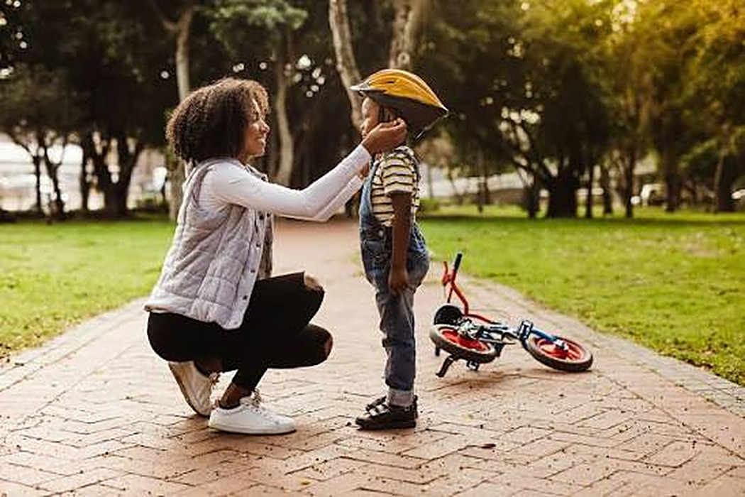

Active and protected
Menu
60 minutes
of age-appropriate physical activity daily, or on most days of the week.
Lead poisoning
Injury prevention: use protective gear for sports, like a helmet.
Lead is an everyday environmental toxicant that can harm many organ systems. In children, its best-studied effect is cognitive impairment.
‹ Back
Next ›

Slide 13




Child protection strategies
Menu
Laws that are enforced
Norms and values
Safe environments
Parent and caregiver support
Income and economic strengthening
Response and support services
Education and life skills
No single risk factor predicts abuse
Reporting: doctors and nurses report a child who appears abused to the DSWD within 48 hours, orally or in writing. Suspected cases also go to the Local Barangay Council for the Protection of Children (BCPC) and the Local Government Unit.
‹ Back
Quiz ›

Slide 14
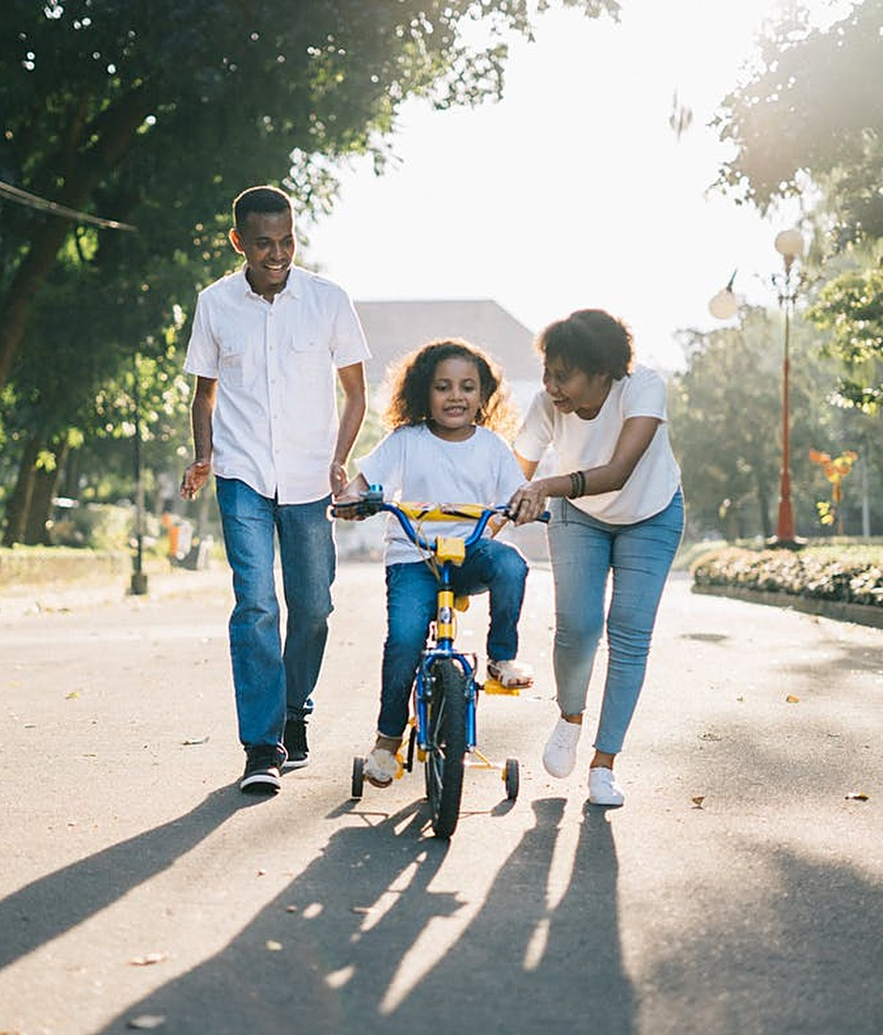
QUICK QUIZ
Test what you learned
4 questions. Tap an answer to see if you got it right. Wrong answer? You can try again.
Start quiz
Menu

Slide 15
Question 1 of 4
Menu
SAFE SLEEP
How should a baby be placed to sleep?
A On their side
B On their back
C On their stomach
Notes:
Correct answer: B. Always place baby on their back. Side or stomach sleeping can cause suffocating or choking.

Slide 16

Correct!
On their back
Always place baby on their back. Side or stomach sleeping can cause suffocating or choking.
Menu
Next question ›

Slide 17

Not quite
Hint
Think of the position that keeps the airway clear.
Menu
Try again

Slide 18
Question 2 of 4
Menu
WATER SAFETY
How much water can a baby drown in?
A At least one foot of water
B Only a full bathtub
C Just 1 to 2 inches
Notes:
Correct answer: C. Babies and young children can drown in just 1 to 2 inches of water, so never leave them alone near water.

Slide 19
Correct!
Just 1 to 2 inches
Babies and young children can drown in just 1 to 2 inches of water, so never leave them alone near water.
Menu
Next question ›

Slide 20
Not quite
Hint
It is far less water than you might think.
Menu
Try again

Slide 21
Question 3 of 4
Menu
CAR SEAT
How long should a baby ride in a rear-facing car seat?
A Until at least 2 years old, or the seat’s limit
B Until 6 months
C Until they can walk
Notes:
Correct answer: A. Babies ride rear-facing in the back seat until at least 2 years old, or the height or weight limit of the seat.

Slide 22
Correct!
Until at least 2 years old, or the seat’s limit
Babies ride rear-facing in the back seat until at least 2 years old, or the height or weight limit of the seat.
Menu
Next question ›

Slide 23
Not quite
Hint
It is measured in years, not months.
Menu
Try again

Slide 24
Question 4 of 4
Menu
BABY GEAR
Which of these must not be used for babies?
A A rear-facing car seat
B A playpen with locked sides
C A baby walker
Notes:
Correct answer: C. Baby walkers are very dangerous. Children do not need them to learn to walk, and many babies are hurt in falls.

Slide 25
Correct!
A baby walker
Baby walkers are very dangerous. Children do not need them to learn to walk, and many babies are hurt in falls.
Menu
Finish ›

Slide 26
Not quite
Hint
One of these is linked to many fall injuries each year.
Menu
Try again

Slide 27
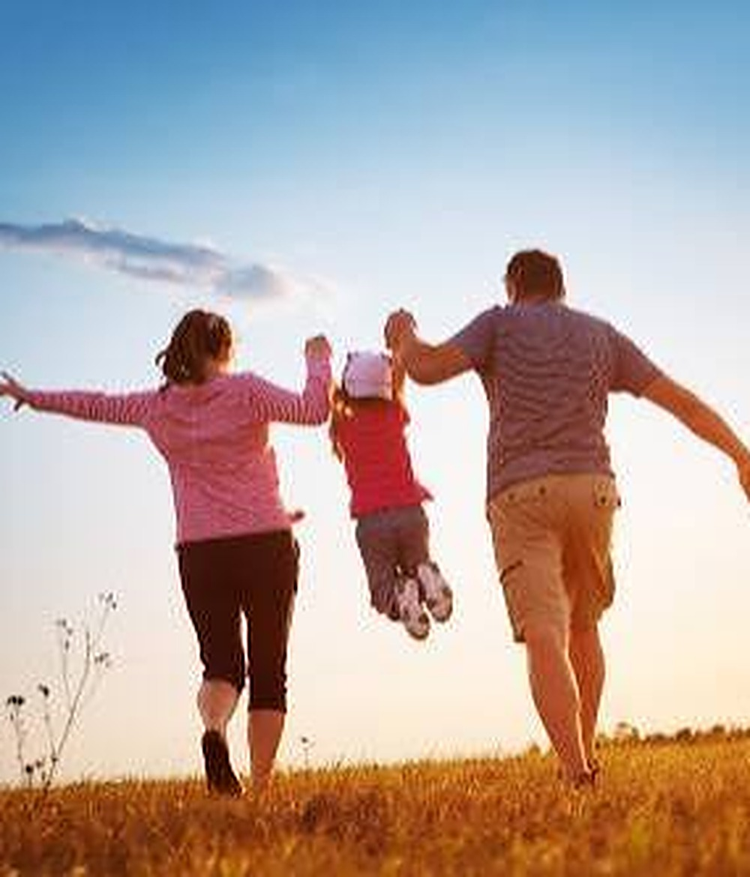
WELL DONE
Safe home, curious child
Back to sleep, in a crib or bassinet
One hand on baby, near water and heights
Small objects, cords and poisons out of reach
Rear-facing car seat, and no baby walkers
Back to menu
Retake quiz
Notes:
Wrap-up. Source: Safety text provided, plus the Safety section of the REdbook notes.

