Slide 1

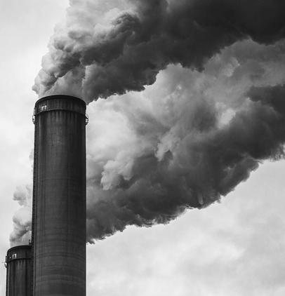

Does HDI have an impact on air pollution?
By Aayushi Gupta

Slide 2

Introduction
Air pollution is a major concern as it deeply impacts the health, nature, and economy of a nation.
Bad air quality directly impacts climate change.
There has been a wide discussion on economic growth impacting air pollution.
I wanted to see if HDI, a widely used proxy for social economic status, could have an effect on air pollution
I have used panel data to investigate this question. The initial methodology employed is fixed effects.
My model faces the problem of simultaneous causality bias. I deal with this by using instrumental variable methodology.

Slide 3

Main variables of the study
One of the most widely used measure of air pollution is Particulate Matter 2.5 (PM 2.5) which is the main dependent variable of the study.
The main independent variable of the study is Human Development Index (HDI). HDI is a composite score from 0 (low) to 1 (high) that considers three dimensions: (1) health, which is assessed by life expectancy at birth, (2) education, which is measured by mean years of schooling for people aged 25, and (3) standard of living, which is measured by gross national income per capita.
The study introduces Programme for International Student Assessment (PISA) as an instrumental variable to account for the problem of simultaneous causality. It is an international student assessment test conducted after every 3 years to assess the learning outcome of 15-year-old children.

Slide 4
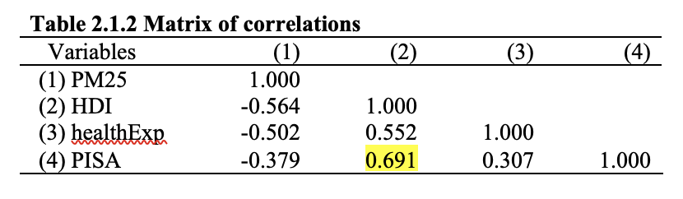
Why PISA
The two main conditions for a variable to be considered an instrumental variable are:-
Instrument Relevance: corr (Zi ,Xi ) ̸= 0 ; Zi = instrumental variable, Xi = main explanatory variable
Instrument Exogeneity: corr (Zi ,ui ) = 0 ; ui = error term
The fulfilment of first condition can be observed from table 2.1.2. The second condition is not very strong as it is not random. However, it can be considered an IV because the PISA test reveals the learning outcome of 15-year-old children, who in general, do not study for the test with an aim of reducing air pollution. Similarly, this test is also not designed to assess students’ ability to reduce air pollution. Furthermore, environmental tobacco smoke (ETS), not so common in children, is one of the primary sources of PM2.5. Moreover, after performing various correlations between possible omitted variables and PISA, I only find low correlation coefficient which is a good indication for the second condition

Slide 5

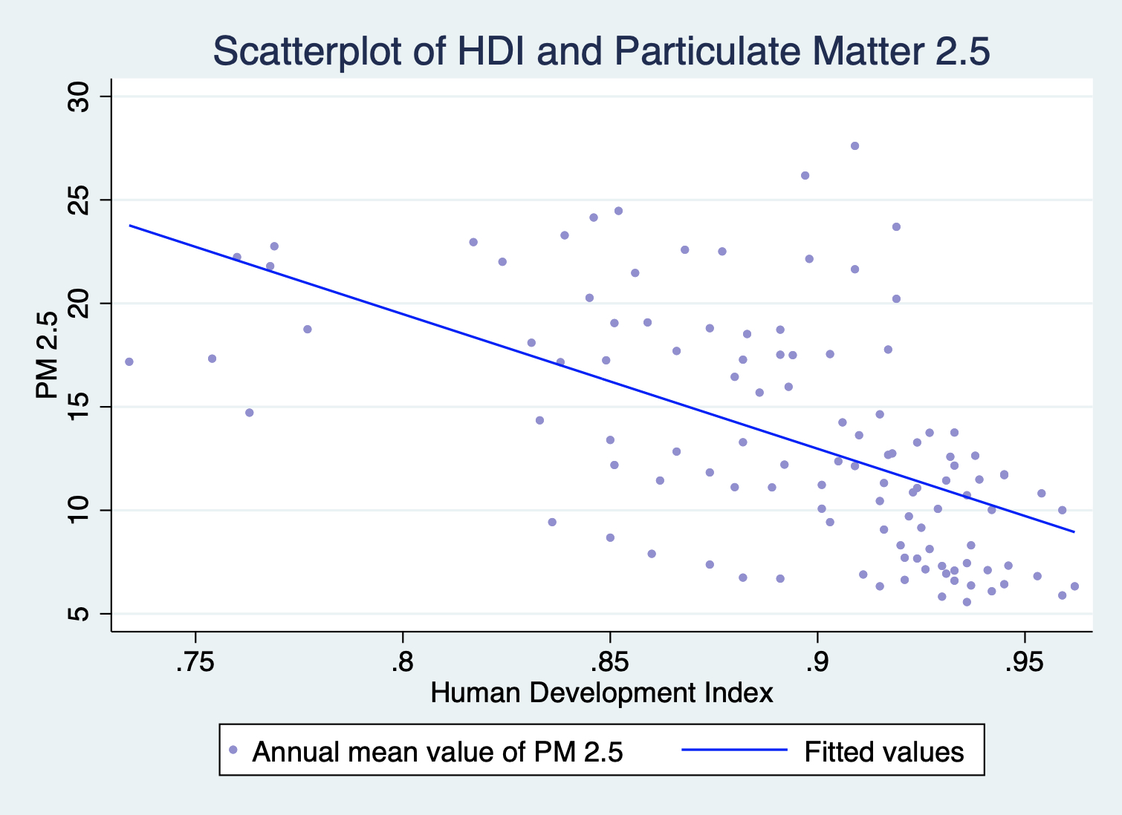
Graphical display of the relationship between HDI and PM2.5

Slide 6

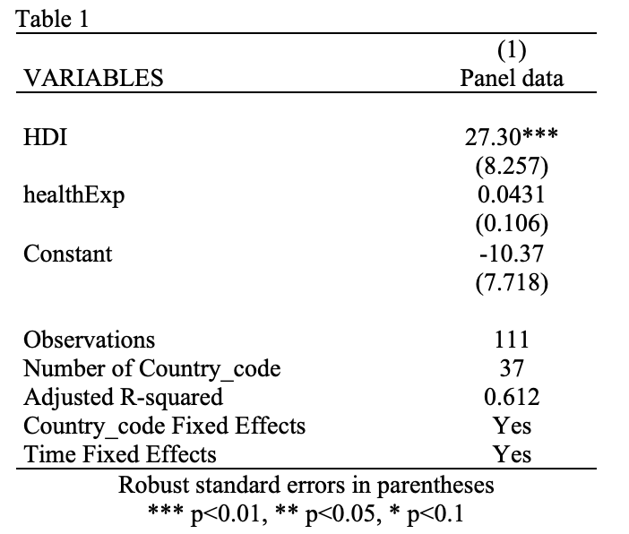
Results
Fixed effects
On an average, increase in the HDI of a country by .1 HDI score, i.e., moving towards a country with higher HDI, would lead to an increase in air pollution by 2.7 ug/m3 (microgram per cubic meter)

Slide 7


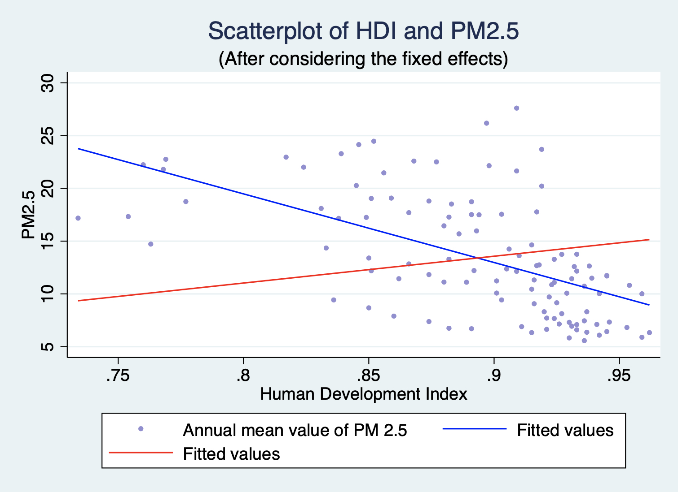
Graphical display of the relationship between HDI and PM2.5
The red line is the predicted line after considering two-way fixed effects

Slide 8
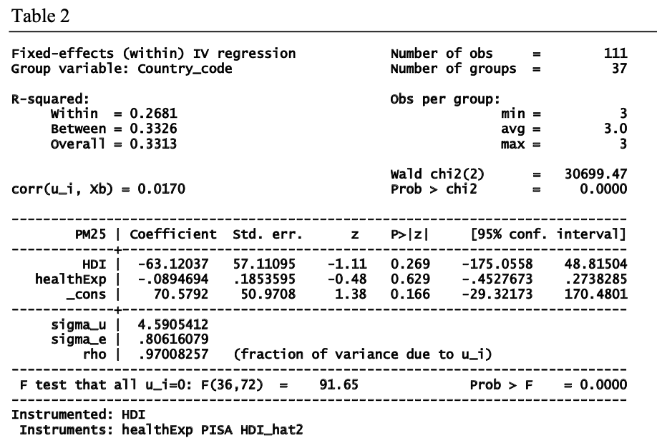
RESULTS (Contd.)
Instrumental variable using Panel data
INSTRUMENTAL VARIABLE
My results are not statistically significant and opposite to the results obtained in previous table - OVB
Another reason why PISA could be a good IV is because it is time and country variant which is being taken care of by using two-way fixed effects method. Furthermore, the F-statistic is greater than 10 which is a thumb rule for validating a good IV.

Slide 9
Conclusion
After performing my regression analysis, I found out different results when used IV on panel data and when simply fixed effects were used. However, results derived from IV method were not statistically significant.
The results obtained from using fixed effects method indicate an increase in increase in air pollution by 2.7 ug/m3 with .1 increase in HDI of a country, on average.
This could imply that in the initial stages as the level of HDI of a country increases, the air pollution also increases, which is what the found literature says. This could also justify to the fact as to why developing nations have a higher air pollution as compared to developed nations.
This study is one of its kind. There isn’t much previous literature that investigates this question by using IV method.

Slide 10
Some limitations and future possibilities
I have only used health expenditure as a control variable. I need to include many other control variables to account for the problem of omitted variable bias.
Since the IV in this study is not randomly distributed, it is possible that the insignificant results are due to this problem.
As observed in the fixed effects method that air pollution is increasing with increasing HDI. However, this study only considers OECD countries. By using countries with low income, one could get better results maybe signifying increasing air pollution in the initial years of development and then decreasing air pollution. One might have to consider quadratic form of HDI for such model.

Slide 11
Thank you!

