Slide 1
White and Black Anglerfish
IMPRESS - Stock Structure Analysis

Slide 2
Proposal of Stock Structure Analysis
How were the stocks defined?. Spatial-temporal: initial, revisions (benchmarks; ICES WG Stock Identification Methods), current.
Summary of results of stock identification studies (published).
New analysis from available information.
Potential impact on the assessment and management.

Slide 3
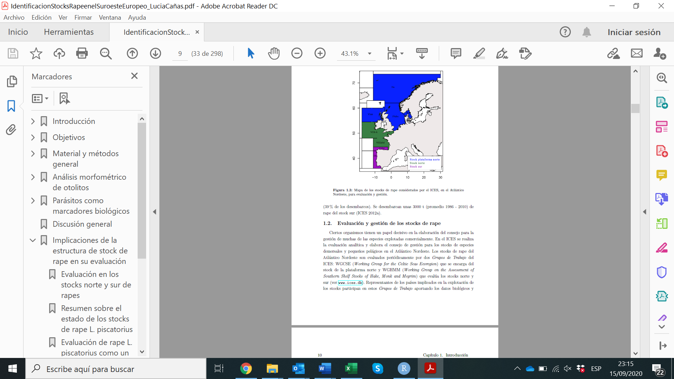
Stock structure defined by ICES for assessment
The black and white anglerfish in the Northern East Atlantic are assessed by ICES since 1990.
Three different stocks units for both species:
Southern stock of the southern shelf: Divisions 8c and 9a
Northern stock of the southern shelf: Divisions 7a–k and 8abd.
Stock on the northern shelf: Division 3a, Subareas 4 and 6

Slide 4
Stock structure defined by ICES for assessment
Southern shelf: assessment of both species is done separately for the southern stock (since 2007) and for the northern stock.
Northern shelf both species are considered as one stock and thus they are assessed together. However, survey catches of L. budegassa are negligible in Area IV (<1%), and generally low in Area VI (<10%) (WKANGLER,WD03 ).
Taxonomic identity and Stock Identity is still non resolved. Ideal the fully match population - assessment - management

Slide 5
Why the actual stock structure?. Southern shelf
Populations of anglerfish from western and southern European waters were considered to be different stocks, not because of biological features but due to agreements on boundaries and considering the Cape Breton Canyon as a possible geographical barrier.
The same geographical limits was defined also for the other commercially important stocks caught under the deep-water fisheries such us hake and megrims.

Slide 6
Why the actual stock structure?. Northern shelf
Since 1990, ICES provided advice for anglerfish to the West of Scotland (4a) but as the fishery expanded, advice was also requested for the North Sea and 3a.
For a number of years, assessments were conducted for each area separately and for a combined area.
Current stock definition dates from 2003, when ICES provided an assessment and advice for the combined area of 3a, 4 and 6. This decision was based on fishery data and some analysis based on the biology of anglerfish :

Slide 7
The fishery operates continuously along the shelf edge suggesting a continuous stock distribution in this area.
Individual assessment by area and joint assessment provided similar results (ICES, 2003).
Based on otolith daily increment analysis, the pelagic and demersal spatial distribution of anglerfish, and the application of a particle tracking model (Hislop et al. 2001).
Results of microsatellite DNA analysis showed no structuring of anglerfish into multiple genetic populations within or among samples from Divisions 4a, 6a or 6b and in fact also from Division 7b (Gordon, 2001).

Slide 8
Many papers were published about the stock structure of anglerfish. What do they say?

Slide 9
Stock identification studies
Body morphometrics and meristic (2004): White: segregation between the areas ICES Divisions 7cj/8abd/8c. Black: high segregation of Div 9a from other areas.
Tag-recapture (2008): White: four moved from Southern Stock to Northern Stock, 1 on the opposite way. Displacement distances until 300 km. Black: 1 moved from 8c to 8abd.
Genetic structure (2006-08): White and black: Two different studies suggesting that the boundary between northern and southern stocks is not genetically supported. Populations were not genetically homogeneous.

Slide 10
Stock identification studies
Otolith morphometrics (2012): White: Differences found in the otolith shape between stocks were not large enough to hold the current status, although homogeneous mixing between both stocks is not expected.
Parasitology (2012): White: Similarity between the levels of infestation of 4 parasites does not support the current stock structure. A fully panmictic monkfish population is not expected either.
Genetic analysis (in prep): White anglerfish genetic analysis do not show any significant differences between the 3 stocks.

Slide 11
New stock identification analysis
White and Black: Comparison of growth parameters. Information used in the assessment, and that was obtained from LFA+MR for White.
White: Comparison of length/age composition of both stocks. Using the outputs of the model assessment (a4a and SS3).
White: Trends in Biomass of both stocks. Using the outputs of the model assessment (a4a and SS3).

Slide 12
One unique stock identity of White and black anglerfish? (Impact)
Spatial mismatches between biological populations and the definition of stock units used in assessment and management can lead to a bias stock assessment and impede sustainable fisheries management.
The primary ecological concern is the potential for overexploitation of unique spawning components, which can lead to loss of productivity and reduced biodiversity along with destabilization of local and regional stock dynamics.
Furthermore, ignoring complex population structure and
stock connectivity can lead to misperception of the magnitude of fish productivity, which can translate to suboptimal utilization of the resource.

Slide 13
Impact of changing the stock structure of white and black anglerfish
Following the guidelines of Kerr et al. (2016) for the integration of biological population structure into assessment and management:
Holistic review of available stock identity information
2 ) Identification of alternative assessment and management
options that consider biological structure
3) Consideration of the practical limitations of alternative
approaches, and
4) Quantitative evaluation of outcomes of alternative assessment and management options relative to biological, economic, and social objectives through MSE.

Slide 15
2) Alternative assessment and management options should be identified considering only one unique stock structure:
changing the scale of the stock assessment or parsing
“mixed” data prior to use in the assessment
changing the scale of management, or
changing both the scale of assessment and management.
The ideal it would be that both the scale of assessment and management should be change. However, now also there is a mismatch between the assessment and managment units. The TAC is given for both species toghether and it does not consider the actual definitions of stock units.

Slide 16
Alternative assessment model:
Comparative análisis of the biological characteristics of anglerfish between different áreas would be necessary for the development of a new model considering the stock identity.
Survey and CPUEs available should be analysed how to introduce them due to the differences in the areas that they covered.
The fleet structure also should be thought. However, the fleets are already identified by areas and therefore, fleets could follow maintaining the same structure as now in different áreas. This structure could also facilitate the management of the stock.

Slide 17
Impact of changing the stock structure of white and black anglerfish
Practical considerations:
Before incorporating additional complexity into the fisheries management system, the practical costs and anticipated benefits must be evaluated.
Difficult to say anything about this before starting to work in the assessment model. The limitation for the complexity probably will be the data available.

Slide 18
Impact of changing the stock structure of white and black anglerfish
Practical considerations:
Before incorporating additional complexity into the fisheries management system, the practical costs and anticipated benefits must be evaluated. Difficult to say anything about this before starting to work in the assessment model. The limitation for the complexity probably Will be the data available.

Slide 19
Impact of changing the stock structure of white and black anglerfish
(iv) Quantitative evaluation of alternative assessment and
management approaches
Developing spatially-explicit operating models that incorporate population structure and movement can provide a basis for determining how ignoring spatial structure may detrimentally impact the entire resource and fishery. However, the development of an MSE tool can be very time consuming.

