Slide 1

Preliminary analysis of assessment with spict for white anglerfish in Divisions 7, 8 abd
Authors: Agurtzane Urtizberea and Dorleta García

Slide 2
DATA
Data
Catch data (landings+discards) without seasonal resolution.
FR_IE_IBTS survey: the joint index of the French EVHOE survey and the Irish IBTS survey. Both are conducted between the third and forth quarter.The French EVHOE survey is conducted in the Bay of Biscay and the Irish IBTS in the Celtic Sea.
The Spanish survey in the Porcupine Bank began in 2001 and covers ICES Divisions VIIb-k corresponding to the Porcupine Bank and adjacent area in western Irish waters. The survey takes place in the third quarter (September) and covers depths between 170 and 800 m.
Monkfish survey is in the beginning of the year, but is considered the end of the previous year and it’s conducted in the Celtic Sea.
In addition of the three surveys,here we also include the standarized LPUE from the trawlers of Vigo.

Slide 3
1-Base case settings
From 1986 to 2019.
Annual
Indices: LPUE_Vigo, IR-FR-IBTS joint index, SP-Porc index, Irish monkfish survey

Slide 4
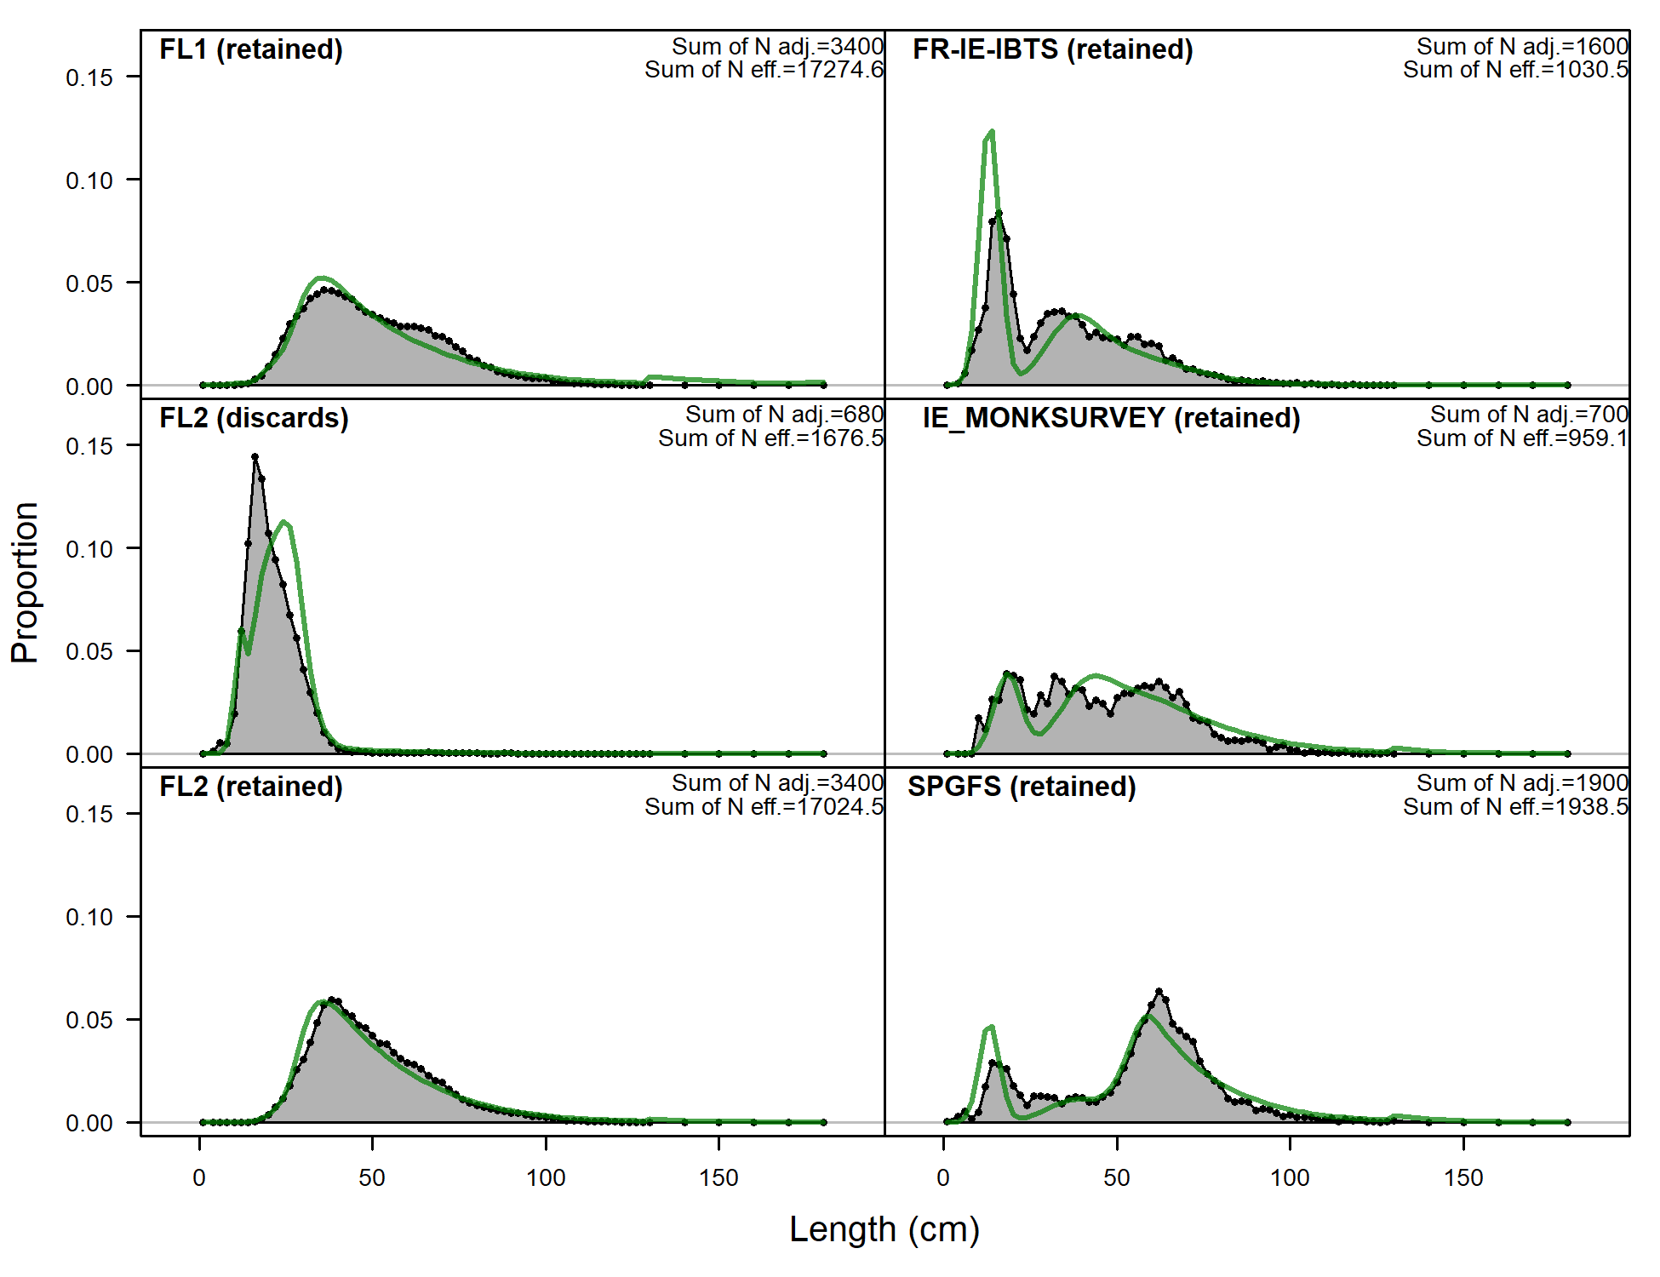
Length frequency, harvestable biomass?

Slide 5
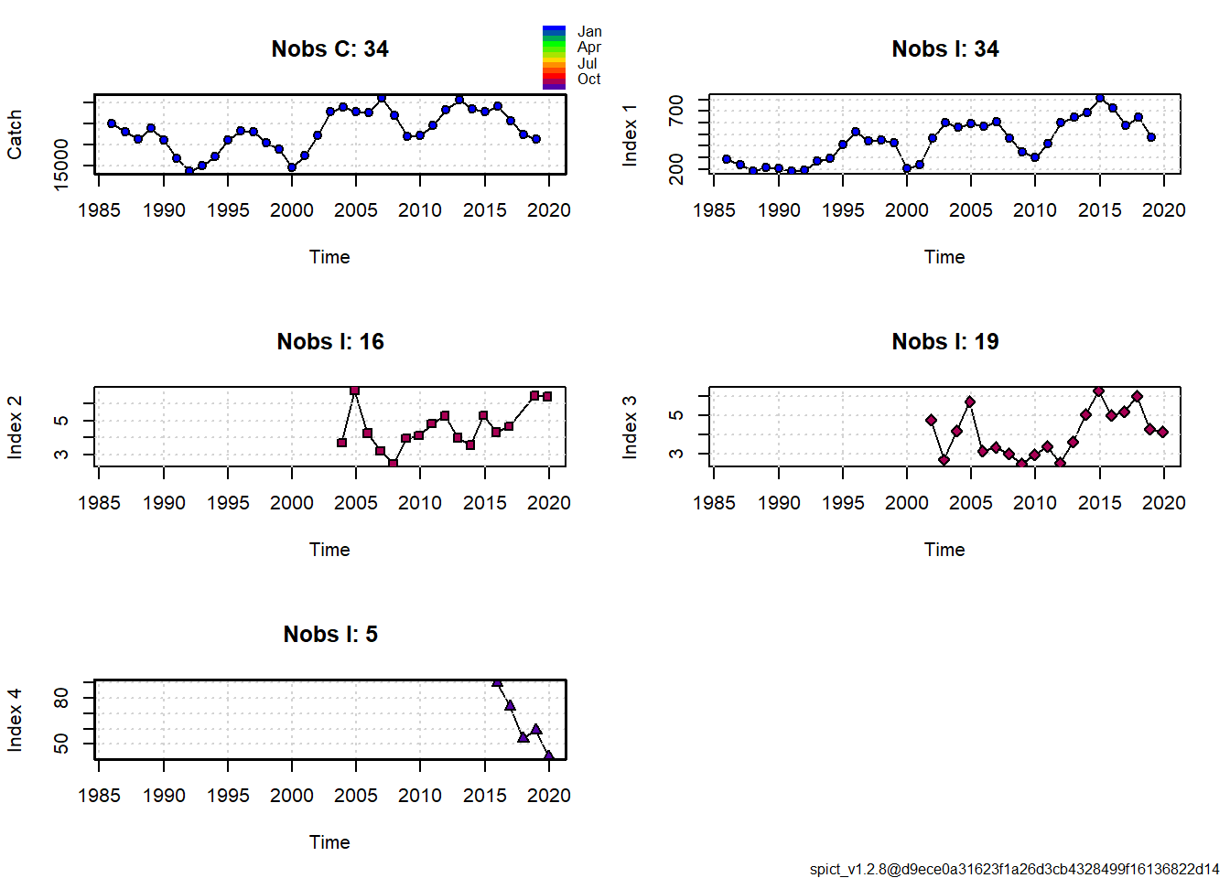
LPUE VIGO AND SURVEYS

Slide 6
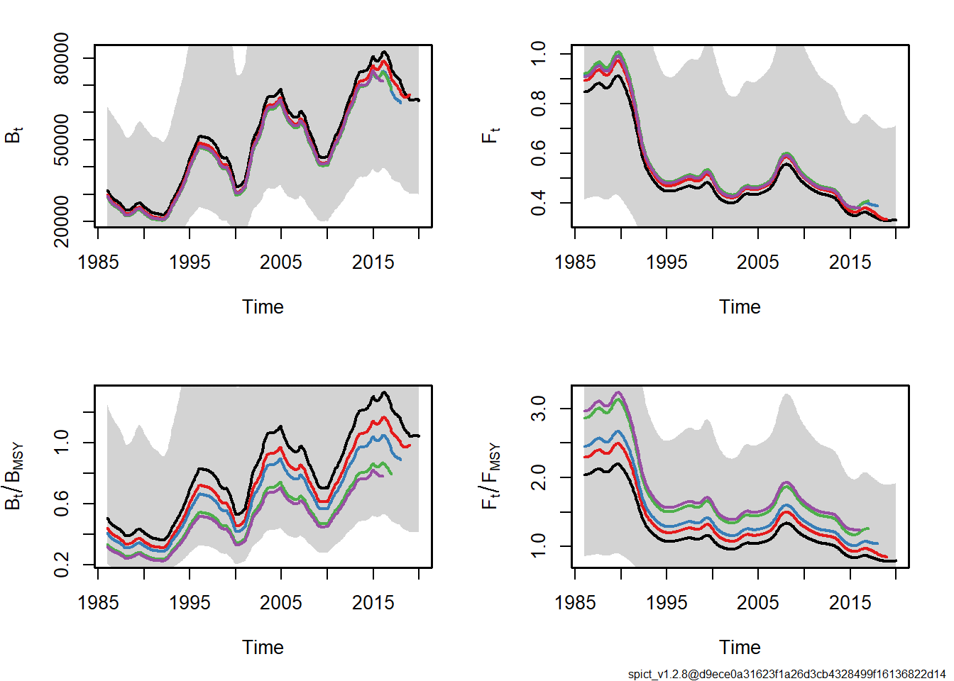
LPUE VIGO AND SURVEYS AND OUTPUT SPICT
Output of retrospective pattern of spict model

Slide 7
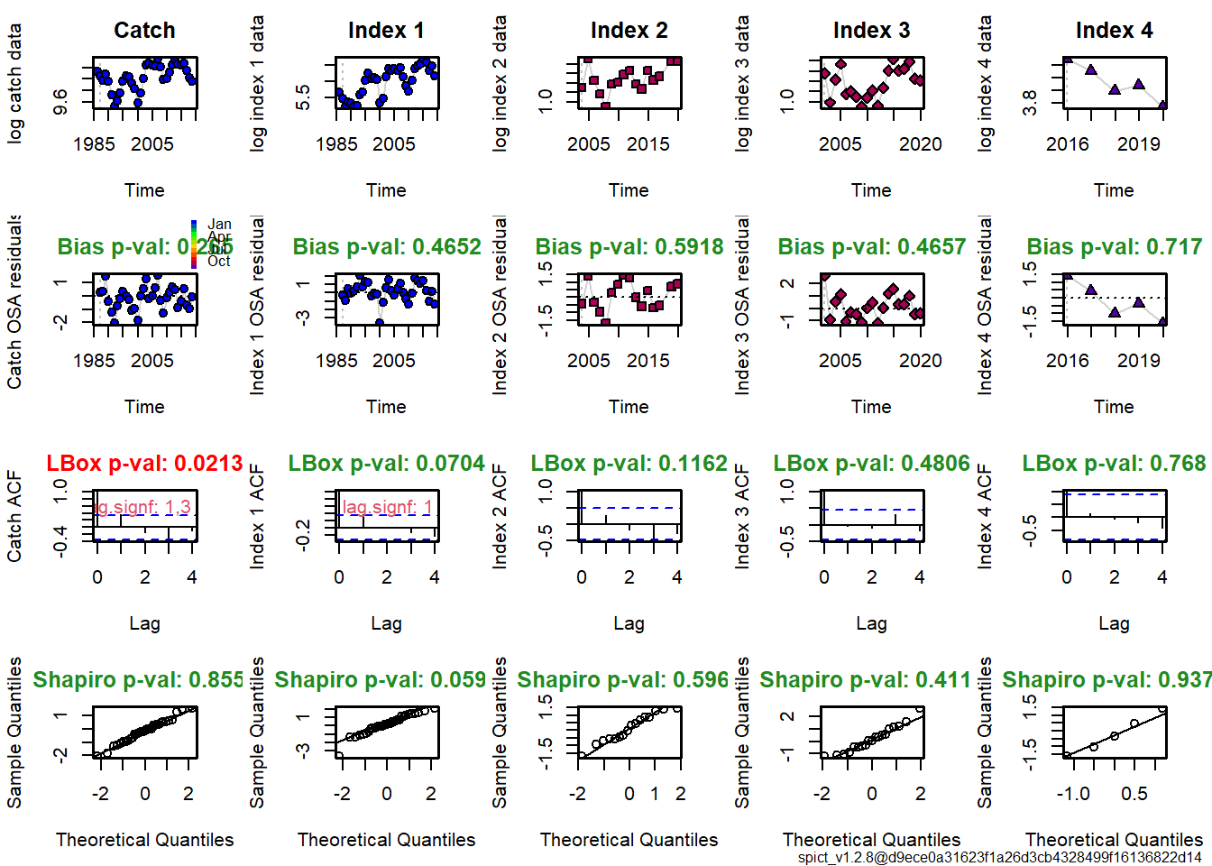
DIAGNOSTICS

Slide 8
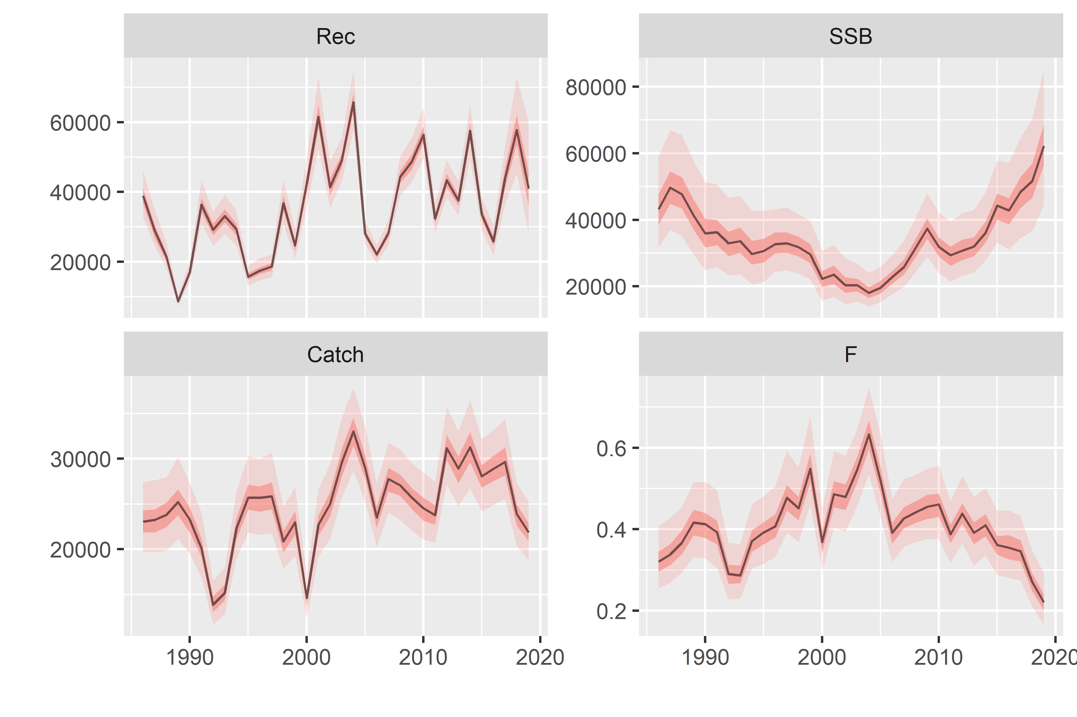
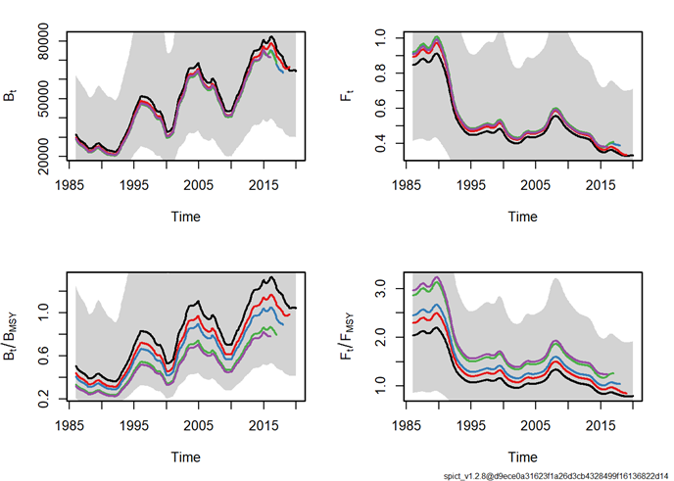
Comparison results of a4a and spict
Output a4a model
Output of retrospective pattern of spict model

Slide 9
DISCUSSION
Problem between survey and harvestable biomass.
Why the same pattern as the LPUE?
Why the difference in the Bmsy and Fmsy in the retrospective pattern?

