Slide 1
Finding Errors in .NET with Feedback-Directed Random Testing
Carlos Pacheco (MIT)
Shuvendu Lahiri (Microsoft)
Thomas Ball (Microsoft)
July 22, 2008

Slide 2
Outline
Motivation for case study
Do techniques based on random test generation work in the real world?
Feedback-Directed Random Test Generation
Technique and Randoop tool overview
Case study: Finding errors in .NET with Randoop
Goals, process, results
Insights
Open research problems based on our observations

Slide 3
Motivation
Software testing is expensive
Can consume half of entire software development budget
At Microsoft, there is a test engineer for every developer
Automated test generation techniques can
Reduce cost
Improve quality
Research community has developed many techniques
E.g. based on exhaustive search, symbolic execution, random generation, etc…

Slide 4
Research and Practice
Random vs. non-random techniques
Some results suggest random testing based techniques less effective than non-random techniques
Other results suggest the opposite
How do these results translate to an industrial setting?
Large amounts of code to test
Human time is a scarce resource
A test generation tool prove cost-effective vs. other tools/methods
Our goal: shed light on this question for feedback-directed random testing.

Slide 5
Random testing
Easy to implement, fast, scalable, creates useful tests
But also has weaknesses
Creates many illegal and redundant test inputs
Example: randomly-generated unit tests for Java’s JDK:
Useful test
Set t = new HashSet();
s.add(“a”);
assertTrue(s.equals(s));
Redundant test
Set t = new HashSet();
s.add(“a”);
s.isEmpty();
assertTrue(s.equals(s));
Useful test
Date d = new Date();
assertTrue(d.equals(d));
Illegal test
Date d = new Date();
d.setMonth(-1);
assertTrue(d.equals(d));

Slide 6
Feedback-directed random testing
Incorporate execution into the generation process
Execute every sequence immediately after creating it
If sequence reveals an error, output as a failing test case
If sequence appears to be illegal or redundant, discard
Build method sequences incrementally
Use (legal, non-redundant) sequences to create new, larger ones
E.g. don’t use sequences that raise exceptions to create new sequences

Slide 7
Feedback-directed random testing
Useful test
Set t = new HashSet();
s.add(“a”);
assertTrue(s.equals(s));
Redundant test
Set t = new HashSet();
s.add(“a”);
s.isEmpty();
assertTrue(s.equals(s));
Useful test
Date d = new Date(2007, 5, 23);
assertTrue(d.equals(d));
Illegal test
Date d = new Date(2007, 5, 23);
d.setMonth(-1);
assertTrue(d.equals(d));
Illegal test (extends above test)
Date d = new Date(2007, 5, 23);
d.setMonth(-1);
d.setDay(5);
assertTrue(d.equals(d));
do not output
never create

Slide 8
Randoop
Violating C# Test Cases
.Net dll or .exe
Extract Public API
Method Sequence/ Input Generator
Execute
Method
Sequence
Examine
output
Good C# Test Cases
Feedback Guidance
Generates tests for .Net assemblies
Input: an assembly (.dll or .exe)
Output: tests cases, one per file, each an executable C# program
Violating tests raise assertion or access violations at runtime

Slide 9
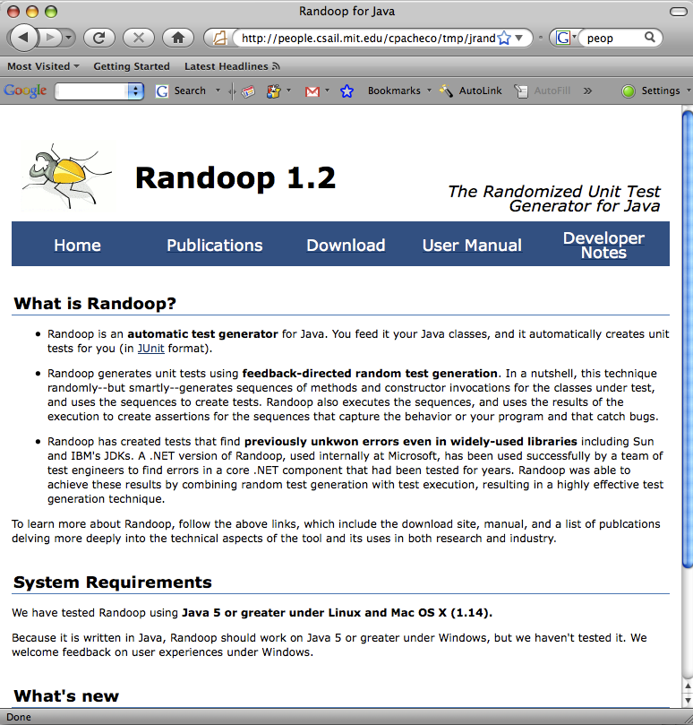
Randoop for Java: try it out!
Google “randoop”
Has been used in research projects and courses
Version 1.2 just released

Slide 10
Randoop: previous experimental evaluations
On container data structures
Higher or equal coverage, in less time, than:
Model checking (with and without abstraction)
Symbolic execution
Undirected random testing
On real-sized programs (totaling 750KLOC)
Finds more errors than
JPF: Model checking, symbolic execution [Visser 2003, 2006]
jCUTE: concolic testing [ Sen 2006]
JCrasher: undirected random testing [Csallner 2004]
Notes:
For coverage, discuss why the result. For bugs, talk about the sparse sampling of very large space.

Slide 11
Goal of the Case Study
Evaluate FDRT’s effectiveness in an industrial setting
Will the tool be effective outside a research setting?
Is FDRT cost-effective? Under what circumstances?
How does FDRT compare with other techniques/methods?
How will a test team use the tool?
Suggest research directions
Grounded in industrial experience
Notes:
How would they use it? What will their requirements be? Enough to be adopted? Can create redundant tests
Can create illegal tests
May fail to create interesting tests

Slide 12
Case study structure
Ask engineers from a test team at Microsoft to use Randoop on their code base over 2 months.
Provide technical support for Randoop
Fix bugs, implement feature requests
Met on a regular basis (approx. every 2 weeks)
Ask team for experience and results
Amount of time spent using the tool
Errors found
Ways in which they used the tool
Comparison with other techniques/methodologies in use

Slide 13
Subject program
Test team responsible for a critical .Net component
100KLOC, large API, used by all .Net applications
Uses both managed and native code
Heavy use of assertions
Component stable, heavily tested: high bar for new technique
40 testers over 5 years
Many automatic techniques already applied
Fuzz, robustness, stress, boundary-condition testing
Concurrently trying research tool based on symbolic execution

Slide 14
Results
Human time spent interacting with Randoop | 15 hours
CPU time | 150 hours
Total distinct tests cases generated by Randoop | 4 million
New errors revealed by Randoop | 30
Error-revealing test sequence length | average: 3.4 calls min: 1 call max: 15 calls
Notes:
Mention the thing about how long it would take a tester

Slide 15
Human effort with/without Randoop
At this point in the component’s lifecycle, a test engineer is expected to discover ~20 new errors in one year of effort.
Randoop found 30 new errors in 15 hours of effort.
This time includes:
interacting with Randoop
inspecting the resulting tests
discarding redundant failures

Slide 16
What kinds of errors did Randoop find?
Randoop found errors:
In code where tests achieved full coverage
By following error-revealing code paths not previously considered
That were supposed to be caught by other tools
Revealed errors in testing tools
That highlighted holes in existing manual testing practices
Tool helped institute new practices
When combined with other testing tools in the team’s toolbox
Tool was used as a building block for testing activities

Slide 17
Errors in fully-covered code
Randoop revealed errors in code in which existing tests achieved 100% branch coverage
Example: garbage collection error
Component includes memory-managed and native code
If native call manipulates references, must inform GC of changes
Previously untested path in native code caused component to report a new reference to an invalid address
Garbage collector raised an assertion violation
The erroneous code was in a method with 100% branch coverage

Slide 18
Errors in testing tools
Randoop revealed errors in the team’s testing and program analysis tools
Example: missing resource
When exception is raised, component finds message in resource file
Rarely-used exception was missing message in file
Attempting lookup led to assertion violation
Two errors:
Missing message in resource file
Error in tool that verified state of resource file

Slide 19
Errors highlighted holes in existing practices
Errors revealed by Randoop led to other testing activities
Write new manual tests
Instituting new manual testing guidelines
Example: empty arrays
Many methods in the component API take array inputs
Testing empty arraycase left to the discretion of test creator
Randoop revealed an error that caused an access violation on an empty array
New practice: always test empty array

Slide 20
Errors when combining Randoop with other tools
Initially we thought of Randoop as an end-to-end bug finder
Test team also used Randoop’s tests as input to other tools
Feature request: output all generated inputs, not just error-revealing ones
Used test inputs to drive other tools
Stress tester: run input while invoking GC every few instructions
Concurrency tester: run input multiple times, in parallel
Increased the scope of the exploration and the types of errors revealed beyond those that Randoop could find.
For example, team discovered concurrency errors this way

Slide 21
Summary: strengths and weaknesses
Strengths of feedback-directed random testing
Finds new, critical errors (not subsumed by other techniques)
Fully automatic
Scalable, immediately applicable to large software
Unbiased search finds holes in existing testing infrastructure
Weaknesses of feedback-directed random testing
No clear stopping criterion can lead to wasted effort
Spends majority of time on subset classes
Reaches a coverage plateau
Only as good as the manually-created oracle

Slide 22
Randoop vs. other techniques
Randoop revealed errors not found by other techniques
Manual testing
Fuzz testing
Bounded exhaustive testing over a small domain
Test generation based on symbolic execution
These techniques revealed errors not found by Randoop
Random testing techniques are not subsumed by
non-random techniques

Slide 23
Randoop vs. symbolic execution
Concurrently with Randoop, test team used a test generator based on symbolic execution
Input/output similar to Randoop’s, internal operation different
In theory, the tool was more powerful than Randoop
In practice, it found no errors
Example: garbage collection error not discoverable via symbolic execution, because it was in native code.

Slide 24
Randoop vs. fuzz testing
Randoop found errors not caught by fuzz testing
Fuzz testing’s domain is files, stream, protocols
Randoop’s domain is method sequences
Think of Randoop as a smart fuzzer for APIs

Slide 25
The Plateau Effect
After its initial period of effectiveness, Randoop ceased to reveal errors
Randoop stopped covering new code
Towards the end, test team made a parallel run of Randoop
Dozens of machines, hundreds of machine hours
Each machine with a different random seed
Found fewer errors than it first 2 hours of use on a single machine
Our observations are consistent with recent studies reporting a coverage plateau for random test generation

Slide 26
Future Research Directions
Overcome coverage plateau
New techniques will be required
Combining random and non-random generation a promising approach
Richer oracles could yield more bugs
Regression oracles: capture the state of objects
Test amplification
Take advantage of existing test suites
One idea: use existing tests as input to Randoop

Slide 27
Conclusion
Feedback-directed random test generation finds errors
In mature, well-tested code
When used in an real industrial setting
That elude other techniques
Randoop still used internally at Microsoft
Added to list of recommended tools for other product groups
Has revealed dozens more errors in other products
Random testing techniques are effective in industry
Find deep and critical errors
Randomness reveals biases in a test team’s practices
Scalability yields impact

