Slide 1
Directed Random Testing Evaluation

Slide 2
FDRT evaluation: high-level
Evaluate coverage and error-detection ability large, real, and stable libraries tot. 800KLOC.
Internal evaluation
Compare with basic random generation (random walk)
Evaluate key ideas
External evaluation
Compare with host of systematic techniques
Experimentally
Industrial case studies
Minimization
Random/enumerative generation

Slide 3
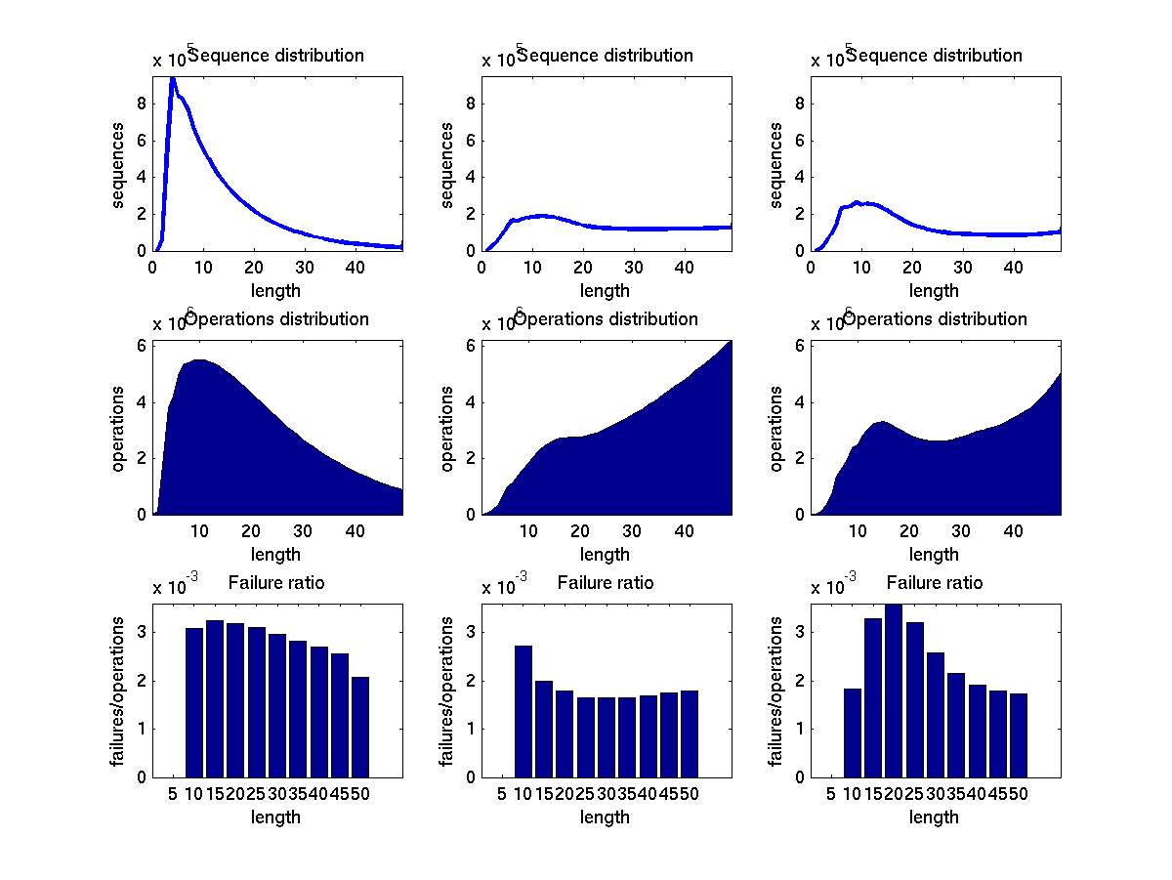
Internal evaluation
Random walk
Vast majority of effort generating short sequences
Rare failures: more likely to trigger by a long seq.
Component-based generation
Longer sequences, at the cost of diversity
Randoop
Increases diversity by pruning space
Each component yields a distinct object state

Slide 4
External evaluation
Small data structures
Pervasive in literature
Allows for fair comparison...
Libraries
To determine practical effectiveness
User studies: individual programmers
single (or few) users, MIT students
unfamiliar with testing, test generation
Industrial case study

Slide 5
Xie data structures
Seven data structures (stack, bounded stack, list, bst, heap, rbt, binomial heap)
Used in previous research
Bounded exhaustive testing [ Marinov 2003 ]
Symbolic execution [ Xie 2005 ]
Exhaustive method sequence generation [Xie 2004 ]
All above techniques achieve high coverage in seconds
Tools not publicly available

Slide 6
FDRT achieves comparable results
data structure | time (s) | branch cov.
Bounded stack (30 LOC) | 1 | 100%
Unbounded stack (59 LOC) | 1 | 100%
BS Tree (91 LOC) | 1 | 96%
Binomial heap (309 LOC) | 1 | 84%
Linked list (253 LOC) | 1 | 100%
Tree map (370 LOC) | 1 | 81%
Heap array (71 LOC) | 1 | 100%

Slide 7
Visser containers
Visser et al. (2006) compares several input generation techniques
Model checking with state matching
Model checking with abstract state matching
Symbolic execution
Symbolic execution with abstract state matching
Undirected random testing
Comparison in terms of branch and predicate coverage
Four nontrivial container data structures
Experimental framework and tool available

Slide 8
FDRT: >= coverage, < time
feedback-directed
best systematic
feedback-directed
best systematic
undirected random
undirected random
feedback-directed
feedback-directed
best systematic
best systematic
undirected random
undirected random
Notes:
On binary tree and fibonacci heap, randoop achieves higher coverage than both systematic and undirected generation. On binomial heap and tree map, randoop achieves the same coverage as systematic generation, but does so faster.

Slide 9
Libraries: error detection
 | LOC | Classes | test cases output | error-revealing tests cases | distinct errors
JDK (2 libraries) | 53K | 272 | 32 | 29 | 8
Apache commons (5 libraries) | 150K | 974 | 187 | 29 | 6
.Net framework (5 libraries) | 582K | 3330 | 192 | 192 | 192
Total | 785K | 4576 | 411 | 250 | 206

Slide 10
Errors found: examples
JDK Collections classes have 4 methods that create objects violating o.equals(o) contract
Javax.xml creates objects that cause hashCode and toString to crash, even though objects are well-formed XML constructs
Apache libraries have constructors that leave fields unset, leading to NPE on calls of equals, hashCode and toString (this only counts as one bug)
Many Apache classes require a call of an init() method before object is legal—led to many false positives
.Net framework has at least 175 methods that throw an exception forbidden by the library specification (NPE, out-of-bounds, of illegal state exception)
.Net framework has 8 methods that violate o.equals(o)
.Net framework loops forever on a legal but unexpected input

Slide 11
Comparison with model checking
Used JPF to generate test inputs for the Java libraries (JDK and Apache)
Breadth-first search (suggested strategy)
max sequence length of 10
JPF ran out of memory without finding any errors
Out of memory after 32 seconds on average
Spent most of its time systematically exploring a very localized portion of the space
For large libraries, random, sparse sampling seems to be more effective

Slide 12
Comparison with external random test generator
JCrasher implements undirected random test generation
Creates random method call sequences
Does not use feedback from execution
Reports sequences that throw exceptions
Found 1 error on Java libraries
Reported 595 false positives

Slide 13
Regression testing
Randoop can create regression oracles
Generated test cases using JDK 1.5
Randoop generated 41K regression test cases
Ran resulting test cases on
JDK 1.6 Beta
25 test cases failed
Sun’s implementation of the JDK
73 test cases failed
Failing test cases pointed to 12 distinct errors
These errors were not found by the extensive compliance test suite that Sun provides to JDK developers

Slide 14
User study 1
Goal: regression/compliance testing
Meng. student at MIT, 3 weeks (part-time)
Generated test cases using Sun 1.5 JDK
Ran resulting test cases on Sun 1.6 Beta, IBM 1.5
Sun 1.6 Beta: 25 test cases failed
IBM 1.5: 73 test cases failed
Failing test cases pointed to 12 distinct errors
not found by extensive Sun compliance test suite

Slide 15
User study 2
Goal: usability
3 PhD students, 2 weeks
Applied Randoop to a library
Ask them about their experience (to-do)
How was the tool easy to use?
How was the tool difficult to use?
Would they use the tool on their code in the future?

Slide 16
quotes

Slide 17
FDRT vs. symbolic execution

Slide 18
Industrial case study
Test team responsible for a critical .NET component
100KLOC, large API, used by all .NET applications
Highly stable, heavily tested
High reliability particularly important for this component
200 man years of testing effort (40 testers over 5 years)
Test engineer finds 20 new errors per year on average
High bar for any new test generation technique
Many automatic techniques already applied

Slide 19
Case study results
Human time spent interacting with Randoop | 15 hours
CPU time running Randoop | 150 hours
Total distinct method sequences | 4 million
New errors revealed | 30
Randoop revealed 30 new errors in 15 hours total human effort.
(interacting with Randoop, inspecting results)
A test engineer discovers on average 1 new error per 100 hours of effort.

Slide 20
Example errors
library reported new reference to an invalid address
In code for which existing tests achieved 100% branch coverage
Rarely-used exception was missing message in file
That another test tool was supposed to check for
Led to fix in testing tool in addition to library
Concurrency errors
By combining Randoop with stress tester
Method doesn't check for empty array
Missed during manual testing
Led to code reviews

Slide 21
Comparison with other techniques
Traditional random testing
Randoop found errors not caught by previous random testing
Those efforts restricted to files, stream, protocols
Benefits of "API fuzzing" only now emerging
Symbolic execution
Concurrently with Randoop, test team used a method sequence generator based on symbolic execution
Found no errors over the same period of time, on the same subject program
Achieved higher coverage on classes that
Can be tested in isolation
Do not go beyond managed code realm

Slide 22
Plateau Effect
Randoop was cost effective during the span of the study
After this initial period of effectiveness, Randoop ceased to reveal new errors
Parallel run of Randoop revealed fewer errors than it first 2 hours of use on a single machine

Slide 23
Minimization

Slide 24
Selective systematic exploration

Slide 25
Odds and ends
Repetition
Weights, other

