Slide 1
Revolution Analytics
R
and
Data Science
Joseph B Rickert
September 25, 2014

Slide 2
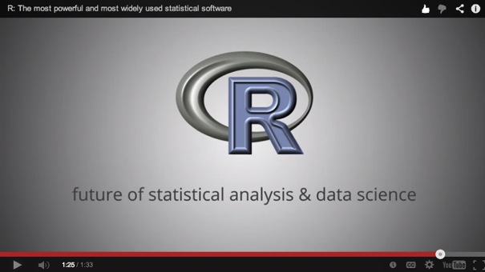

What is R?
Most widely used data analysis software
Used by 2M+ data scientists, statisticians and analysts
Most powerful statistical programming language
Flexible, extensible and comprehensive for productivity
Platform for beautiful and unique data visualizations
As seen in New York Times, Twitter and Flowing Data
Thriving open-source community
Leading edge of analytics research
www.revolutionanalytics.com/what-r
Notes:
Image reference:
http://www.facebook.com/notes/facebook-engineering/visualizing-friendships/469716398919

Slide 3
Open source r

Slide 4
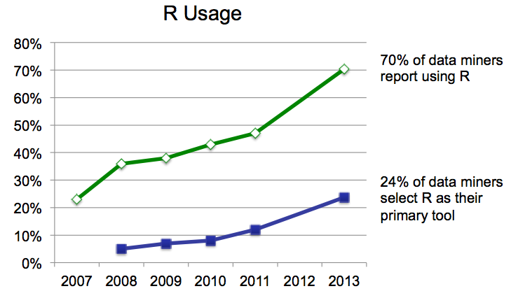
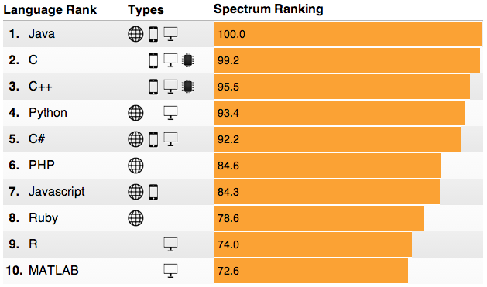
R’s popularity is growing rapidly
R Usage Growth
Rexer Data Miner Survey, 2007-2013
Language Popularity
IEEE Spectrum Top Programming Languages
#9: R
Rexer Data Miner Survey
IEEE Spectrum, July 2014

Slide 5
Poll Question #1
What are the statistical programming languages/platforms you are most familiar with? (choose all that apply)
A) R
B) SAS
C) SPSS
D) KXEN
E) Statistica

Slide 6
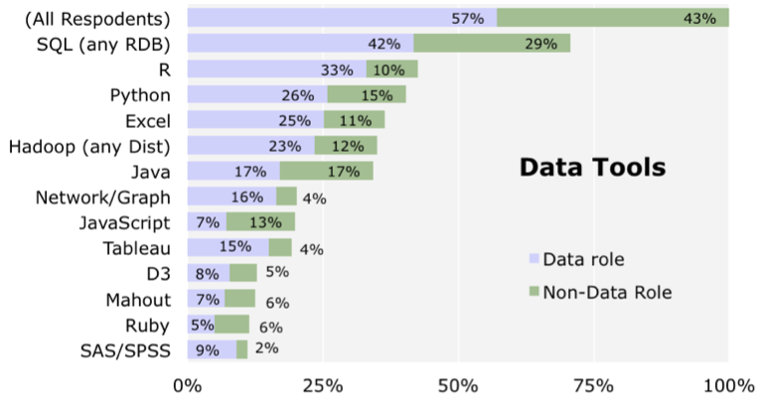
Tools for Data Science
Source: O’Reilly Data Science Survey

Slide 7
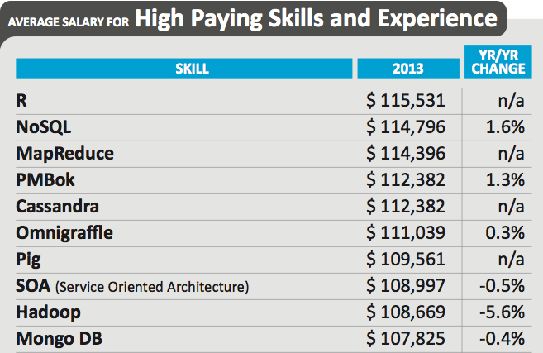
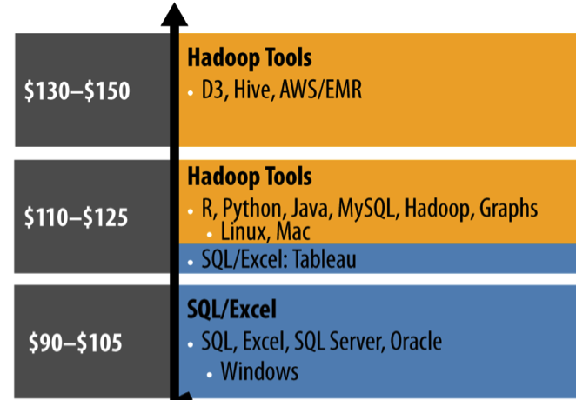
R is among the highest-paid IT skills in the US
Dice Tech Salary Survey, January 2014
O’Reilly Strata 2013 Data Science Salary Survey
Notes:
Dice Tech Salary Survey, January 2014
O’Reilly Strata 2013 Data Science Salary Survey

Slide 8


Photo by Ksayer1 on flickr.

Slide 9
Why R for Data Science?
X <- if (!is.empty.model(mt))
model.matrix(mt, mf, contrasts)
else matrix(, NROW(Y), 0L)
weights <- as.vector(model.weights(mf))
if (!is.null(weights) && !is.numeric(weights))
stop("'weights' must be a numeric vector")
if (!is.null(weights) && any(weights < 0))
stop("negative weights not allowed")
offset <- as.vector(model.offset(mf))
if (!is.null(offset)) {
if (length(offset) != NROW(Y))
stop(gettextf("number of offsets is %d should equal %d (number of observations)",
length(offset), NROW(Y)), domain = NA)
}
mustart <- model.extract(mf, "mustart")
etastart <- model.extract(mf, "etastart")
fit <- eval(call(if (is.function(method)) "method" else method,
x = X, y = Y, weights = weights, start = start, etastart = etastart,
mustart = mustart, offset = offset, family = family,
control = control, intercept = attr(mt, "intercept") >
0L))
if (length(offset) && attr(mt, "intercept") > 0L) {
fit2 <- eval(call(if (is.function(method)) "method" else method,
x = X[, "(Intercept)", drop = FALSE], y = Y, weights = weights,
offset = offset, family = family, control = control,
intercept = TRUE))
if (!fit2$converged)
warning("fitting to calculate the null deviance did not converge -- increase 'maxit'?")
fit$null.deviance <- fit2$deviance
}
if (model)
fit$model <- mf
fit$na.action <- attr(mf, "na.action")
if (x)
fit$x <- X
if (!y)
fit$y <- NULL
fit <- c(fit, list(call = call, formula = formula, terms = mt,
data = data, offset = offset, control = control, method = method,
contrasts = attr(X, "contrasts"), xlevels = .getXlevels(mt,
mf)))
class(fit) <- c(fit$class, c("glm", "lm"))
fit
Algorithms
Task Views

Slide 10
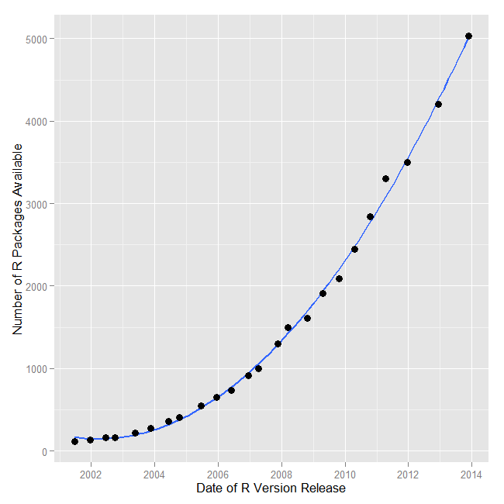
R Growth
Put this astonishing growth in perspective:
SAS.V 9.3S contains ~ 1,200 commands that are roughly equivalent to R functions
R packages contain a median of 5 functions
Therefore R has ~ 36,820 functions
During 2013 alone, R added more functions than SAS Institute has written in its entire history!
Bob Muenchen

Slide 11
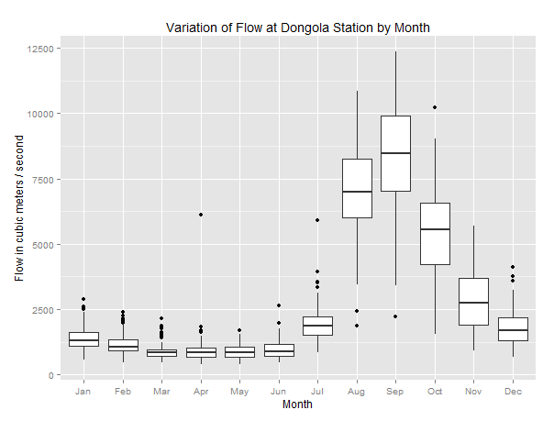

Why R for Data Science?
Visualizations

Slide 12
Why R for Data Science?
Programming
Scripting
Functional programming
Parallel programming
Data structures
Objects
Data Types
Regular expressions
Data connections
Interfaces to other languages

Slide 13
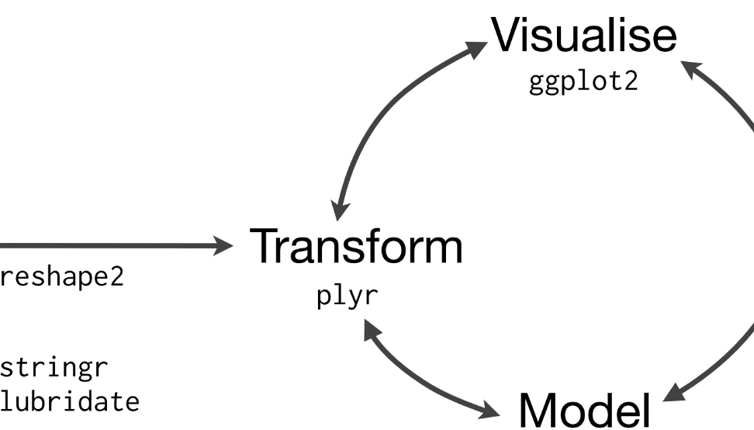
Why R for Data Science?
Data Manipulation
“It's often said that 80% of the effort of analysis is spent just getting the data ready to analyse, the process of data cleaning. Data cleaning is not only a vital first step, but it is often repeated multiple times over the course of an analysis as new problems come to light.” Hadley Wickham Tidy Data

Slide 14
Why R for Data Science?
Web applications
Internet graphics
D3
Potly
Other Languages
C, C++
Java
BI Tools
Data bases
SQL
MongoDB
R Integrates

Slide 15
Poll Question #2
What are the data platforms that you are connecting to regularly? (choose all that apply)
A) Hadoop
B) Spark
C) Cloud-based (Azure/AWS/Google)
D) Data Warehouses
E) Servers (Grid or Cluster)

Slide 16












Why R for Data Science
R Scales
Hadoop
Servers & Clusters
Data Warehouses

Slide 17
Poll Question #3
What are the types of models that you are working with most? (choose all that apply)
A) Linear models / Regression / GLM
B) Decision Trees / Random Forests
C) Survival Models
D) GBM
E) Time Series models

Slide 18
Let’s look at some code.
www.revolutionanalytics.com
1.855.GET.REVO
Twitter: @RevolutionR

Slide 19
Why is R Right for Data Science?
R is open source
R is a powerful language
Data Manipulation
Computational Statistics
Machine Learning
R is an innovation engine
R has a rich and expanding ecosystem

Slide 20

Q&A / Resources
R Code and Markdown Files https://github.com/joseph-rickert/DataScienceRWebinar
What is R? revolutionanalytics.com/what-is-r
Companies using R revolutionanalytics.com/companies-using-r
AcademyR training revolutionanalytics.com/AcademyR
AcademyR Certification revolutionanalytics.com/AcademyR-certification
Contact Revolution Analytics revolutionanalytics.com/contact-us

Slide 21
Thank you
Revolution Analytics is the leading commercial provider of software and support for the popular open source R statistics language.
www.revolutionanalytics.com, 1.855.GET.REVO, Twitter: @RevolutionR

