Slide 1


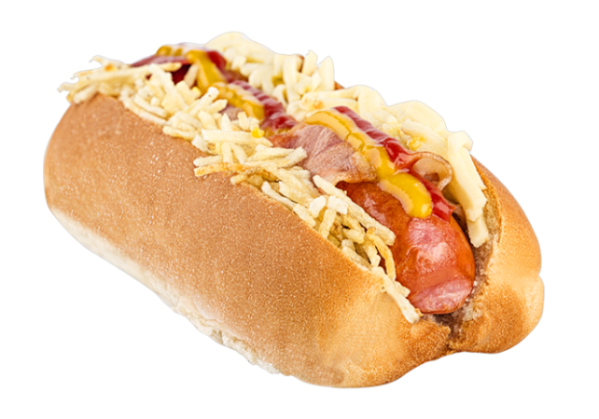
Dog Maru
Puro Sabor

