Slide 1


Alzheimer’s Disease Onset Recognition by Handwriting:
A Deep and Machine Learning Approach
Cartaya A.
Gonzalez J.
Hartmann F.
Rivas M.
Machine and Deep Learning 2022-2023

Slide 2
Introduction

Slide 3
Alzheimer's disease is a neurodegenerative disorder characterized by cognitive impairments that progressively affect motor skills and cognitive abilities.
Early diagnosis is crucial for slowing down brain damage and improving the quality of life for affected individuals.
This study employs machine learning and deep learning approaches to analyze data from Alzheimer's patients, focusing on pen gesture dynamics and task-related images.

Slide 4
Dataset and Feature Selection

Slide 5
Dataset
Original dataset includes 25 tasks distributed among three different types: tasks including memory stimulation, tasks that draw a graphic figure and tasks that requires copying text. Data consists of 166 samples (images and offline handwriting) divided into 88 patients and 78 healthy controls.

Slide 6
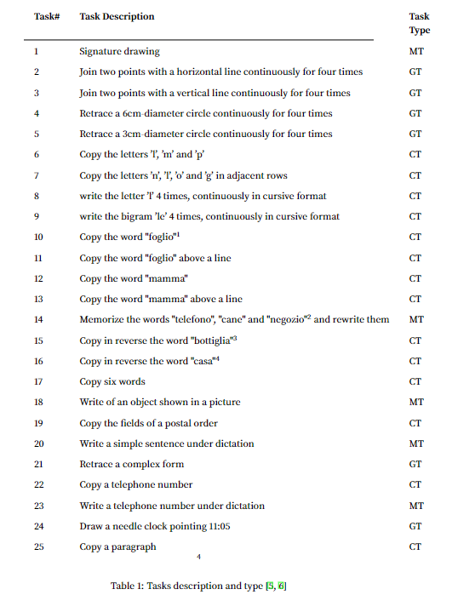

Slide 7
Feature Selection
Recursive Feature elimination was used. This uses a backward stepwise approach. The “importance” of the features is given by using a Random Forest Classifier with 10 or 400 estimators.

Slide 8
Feature Selection
RFE with RF10 est
Original Dataset
RFE with RF400 est
varies with task
88 features
varies with task
On-air features
On paper features
43 OA + 4 dem.
43 OP + 4 dem.
RFE with RF10 est
RFE with RF400 est
RFE with RF10 est
RFE with RF400 est
varies with task
varies with task
varies with task
varies with task

Slide 9
Machine Learning Approach

Slide 10
Things to Consider
A pipeline was considered in order to do data preprocessing, selection of best classifier and hyperparameter tuning. All handled by a reliable subset selection method: k-fold cross validation.

Slide 11
ML considerations
Preprocessing
Classifier Selection
Hyperparameters
Raw data, in most cases, is not enough to guarantee the success of a classifier. Instead a tidy version of each dataset improve the results. This includes encoding categorical features, scaling and handling outliers.
For the scope of this project, we selected:
Decision Tree
Gradient Boosting
LDA
Random Forest
SVC
Extreme Gradient boosting
Use of Gridsearch to find the best parameters for each classifier. All within a frame of cross validation.

Slide 12
Exploratory Analysis
Encoding categorical features
Standard
Robust
Minmax
Maxabs
Best performance is given by best combination of previous steps
Preprocessing
Outliers
Scaling
Hyperparameter Tuning
Final Result
Z-score
Modified Z-score
quantile-based imputation
criterion
max depth
solver
etc

Slide 13
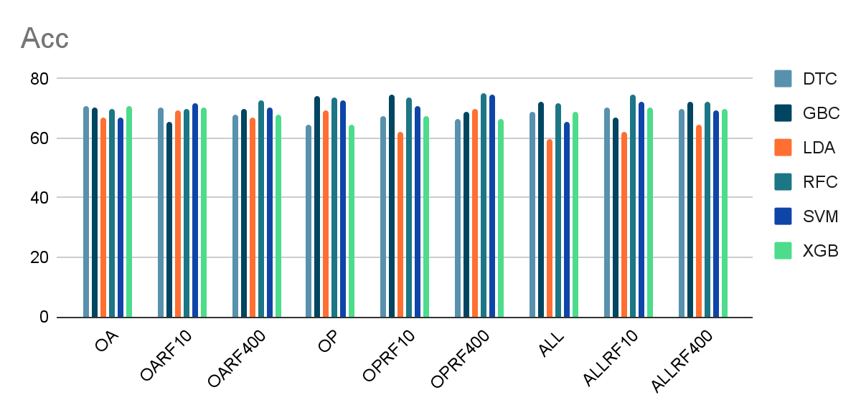
Pipeline Results - Task 1

Slide 14
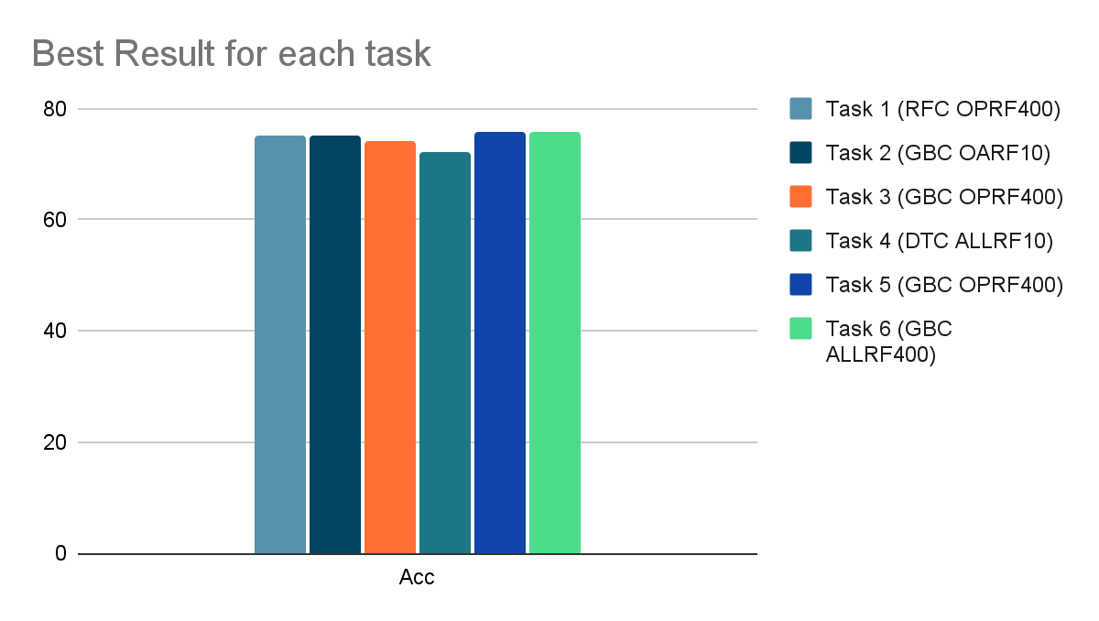
Pipeline Results - Best Result for each task

Slide 15
Deep Learning Approach

Slide 16
Things to Consider
Training a neural network requires the design of a structure and a lot of computational power. Even if used an existing architecture. A transfer learning approach was used considering our computational resources and the small dataset.

Slide 17
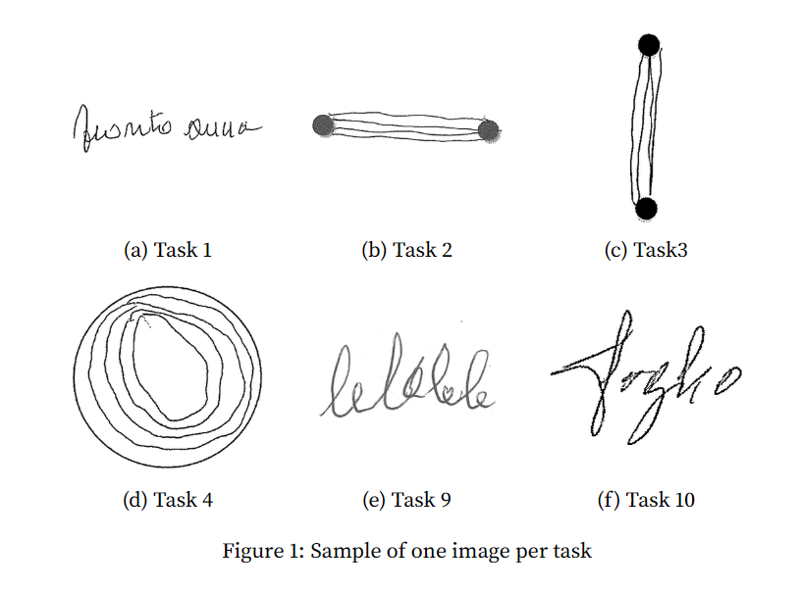

Slide 18
DL considerations
Backbone base model
Optimizer
Constraints
Among all possible architectures the following ones were selected:
VGG19
Inceptionv3
Resnet50
InceptionResnetv2
Stochastic Gradient Descent tend to perform better when transfer learning, but Adam converge faster-
Dataset images are 299x299 pixels and not all backbone base models have the same input. Consider fine tuning since our problem has few data and is different from the OG data: ImageNet.

Slide 19

DL considerations
Custom classifier
Frozen Layers
Selecting the Best
Different architectures would be tested, on top of the base model.
How many layers would be unfrozen to trade-off between learning from the new data and the already achieved generalization capacity.
The best Model would be retrained, changing parameters inherent to ANN like the epochs. After that, having an ensemble of models may improve performance.

Slide 20
Grid search between base model, unfrozen # of layers and optimizer
Top 2 of previous top 4 are selected to optimize and fine tune.
Best performance is given by either retrain, initial train or ensemble method
Initial Training
Top 4
Top 2
Ensemble Method
Final Result
Top 4 of the 32 possible models are chosen.
Combining two models to see if model improves

Slide 21
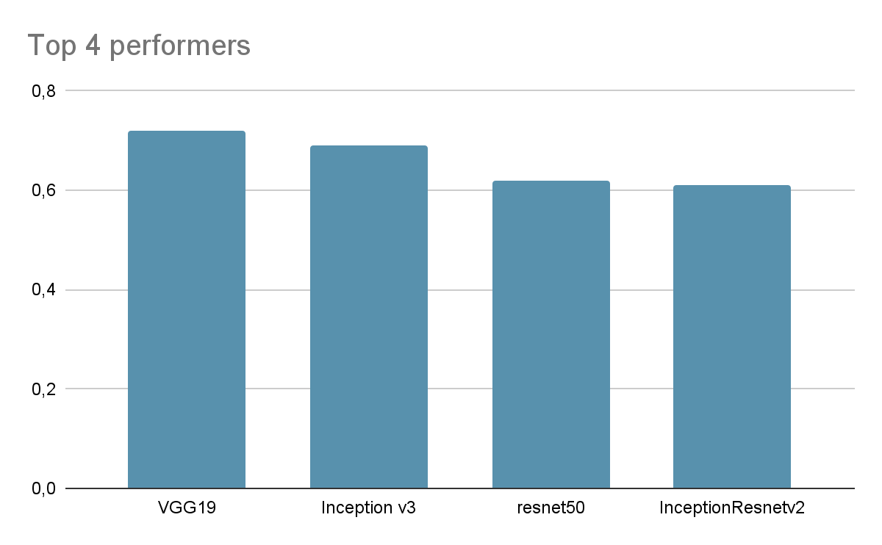
Pipeline Results - Best Result task 1

Slide 22
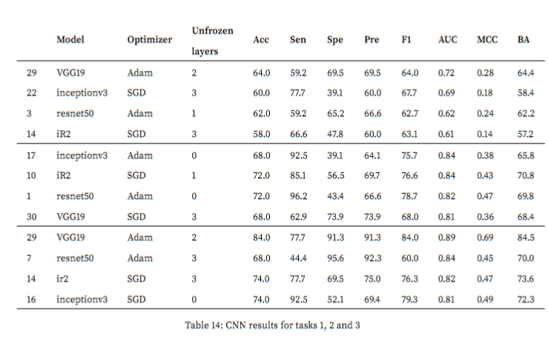

Slide 23
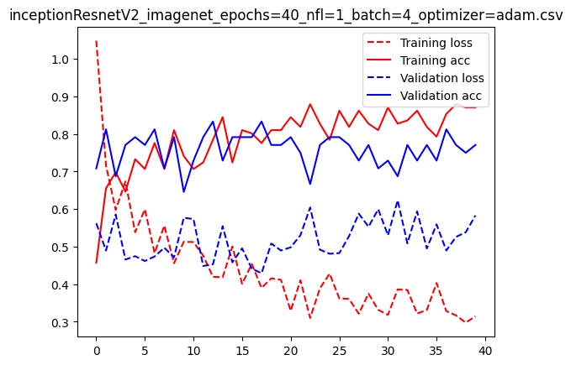

Slide 24
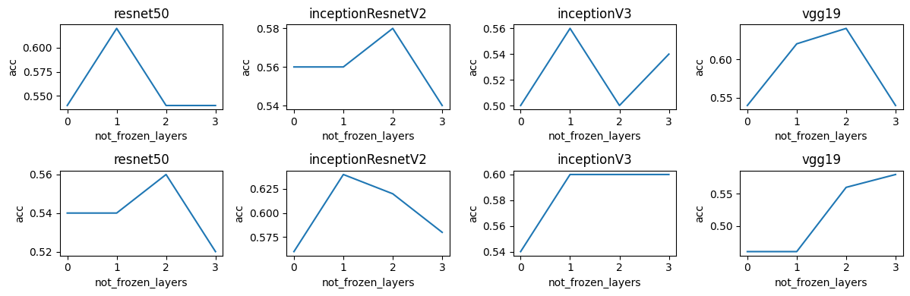

Slide 25
Final results
Task 1: Phase 3 Ensemble of VGG19 + inceptionv3 for an AUC of 0.73.
Task 2: Phase 3 Ensemble of inceptionV3 + inceptionResnetV2 with an AUC of 0.85.
Task 3: Phase 2 VGG19 with an AUC of 0.90.
Task 4: Phase 1 resnet50 with an AUC of 0.90.
Task 9: Phase 1.5 inceptionResnetV2 with an AUC of 0.89.
Task 10: Phase 1 inceptionResnetV2.

Slide 26
Deep Learning Features Approach

Slide 27
Things to Consider
Transfer learning not only serves as a learning model for new data, but also as a feature extraction tool. Using the convolutional layers, we extracted features from the images of the task and then used the same ML approach explained before.

Slide 28
DL features considerations
Number of features
Analysis Approach
Classifiers
100 features were extracted, taking advantage of feature extraction layers of each of the base models used before.
In this phase of the project, the same ML approach was used before in order to curate data, and select the best classifier with its own best parameters.
As we are working with ANNs, we used a Multi Layer Perceptron classifier, tuning hyperparameters like hidden layers, optimizer, solver and activation function.

Slide 29
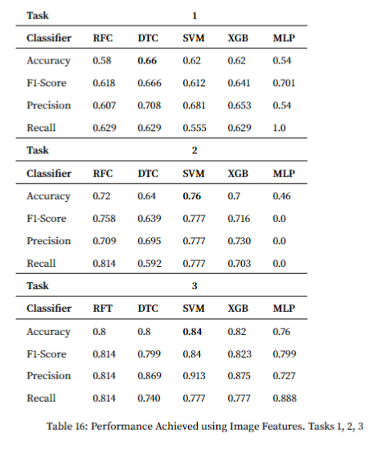

Slide 30
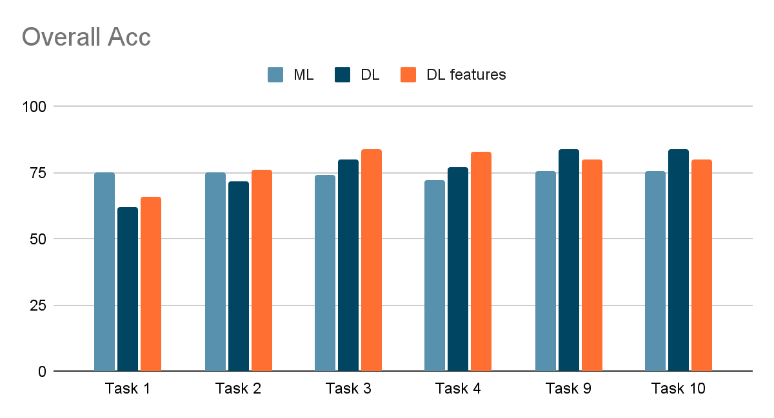
Overall Results

Slide 31
Key takeaways: ML
4 out of 6 tasks performed better using RF400 feature elimination method.
4 out of 6 tasks performed better with GBC classifier.
Just one task performed better with just on-air features. Meaning on-paper features are really descriptive when discriminating between classes.
Is the best approach when dealing with such irregular task as #1

Slide 32
Key takeaways: DL
Tasks 9 and 10 top performance.
Except from task 1, copy tasks appear to have better performance using this approach.
There are more “image” features than in graphic tasks.
Data augmentation was not done. After tests, general performance improved without it.

Slide 33
Key takeaways: DL features
Task 3 and 4 top performance.
Task 2. If a simpler model were required, then ML is better.
Graphic tasks benefit more of the features extracted by a DL approach.
WRT tasks 9 and 10, there may be almost the same dynamics but less shapes.

