Slide 1
Preliminary results conventional rotation E26 (2018-2022)
03/10/2024

Slide 2
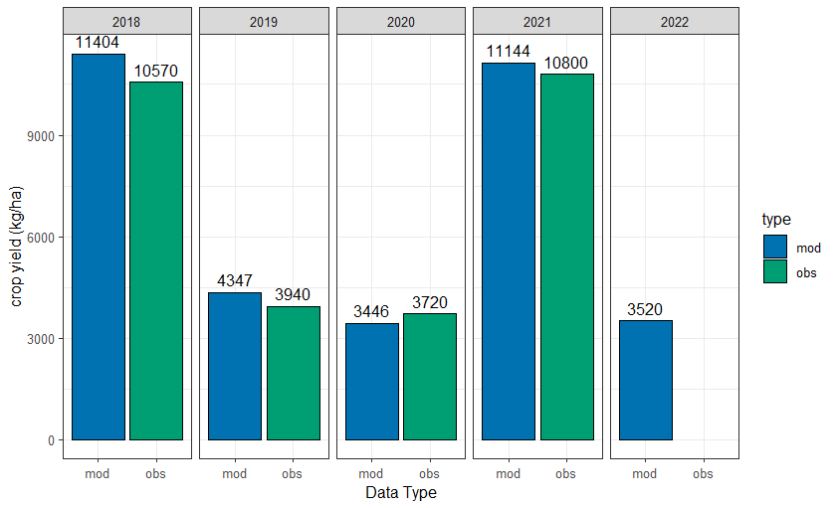

Slide 3
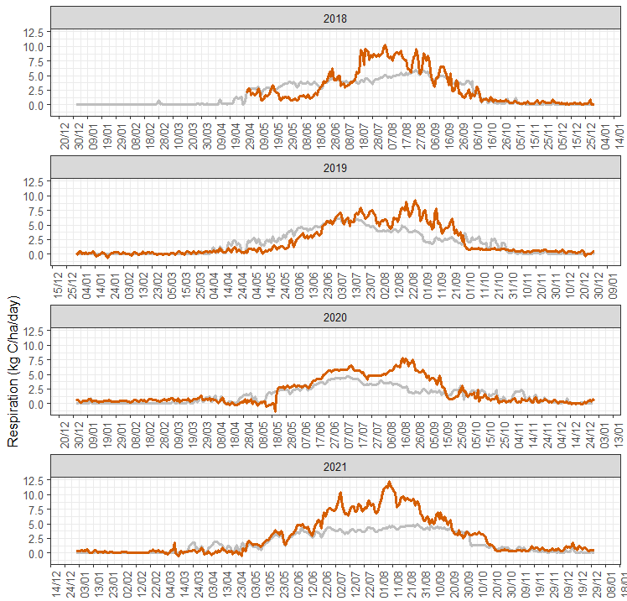
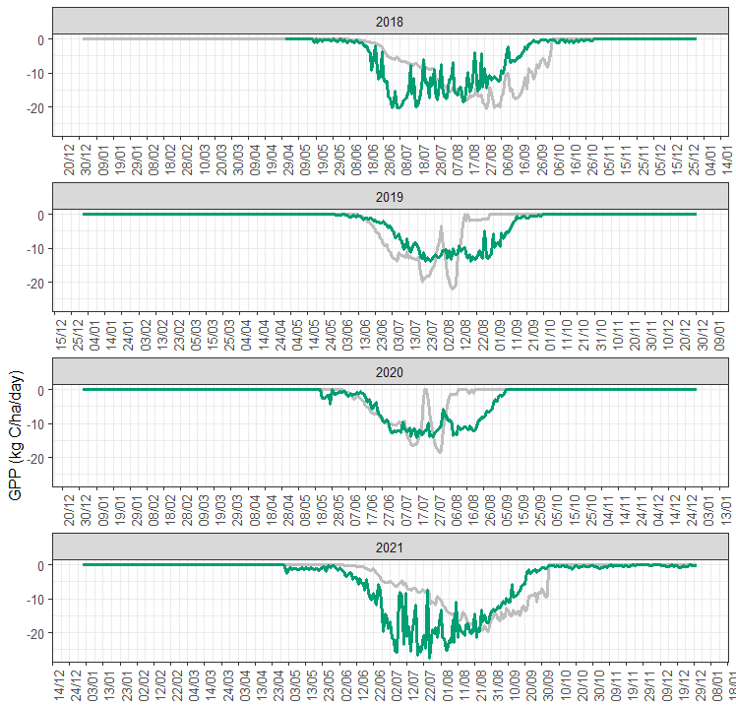
Observed (color)
Modeled (grey)

Slide 4
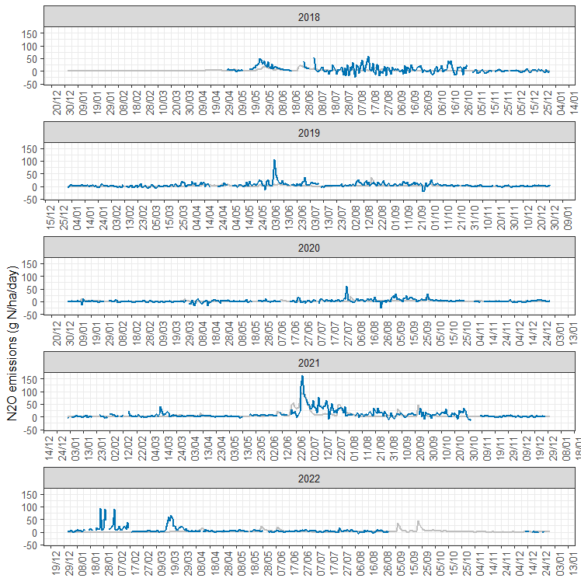
Observed (color)
Modeled (grey)

