Slide 1

Food Order System
CISC 3003 Web Programming
AgustinYan DC125714
Team 02

Slide 2

行业PPT模板http://www.1ppt.com/hangye/
CONTENTS
02
Function Design
04
Conclusion
01
Introduction
03
Project Walkthrough

Slide 3

PART 01
Introduction
Team 02

Slide 4
Why we want to design a
Food Order System ?
1
Convenience for customers
A food order system allows customers to conveniently browse menus, place orders, and make payments from the comfort of their own homes or on-the-go. It provides a user-friendly interface, making it easy for customers to explore available food options and customize their orders according to their preferences.
2
Increased efficiency
Automating the food ordering process improves operational efficiency for restaurants and food establishments. Instead of relying solely on phone orders or walk-in customers, a digital order system streamlines the process, reduces manual errors, and enables faster order processing and delivery.
3
Order accuracy
An online food order system minimizes order miscommunication between customers and restaurant staff. Customers can accurately specify their food choices, dietary preferences, and any special instructions, reducing the chances of errors in order preparation.
Here are some reasons to design a food order system
4
Order customization
A food order system allows customers to customize their orders, such as selecting toppings, specifying cooking preferences, or choosing portion sizes. This level of customization enhances the customer experience and satisfaction.

Slide 5
PART 02
Function Design
Team 02

Slide 6
Login System
Order System
We want to design food management system that admin could update new food
We want to design a admin management system that could manage the admin
We want to design a login system for admin
We want to design a order system that user could place order and admin could process order
Food Management System
Admin Management system
Notes:
模板来自于： 第一PPT https://www.1ppt.com/

Slide 7
LOGO HERE
PART 03
Project walkthrough
BUSINESS

Slide 8
PART 04
Conclusion
Team 02

Slide 9
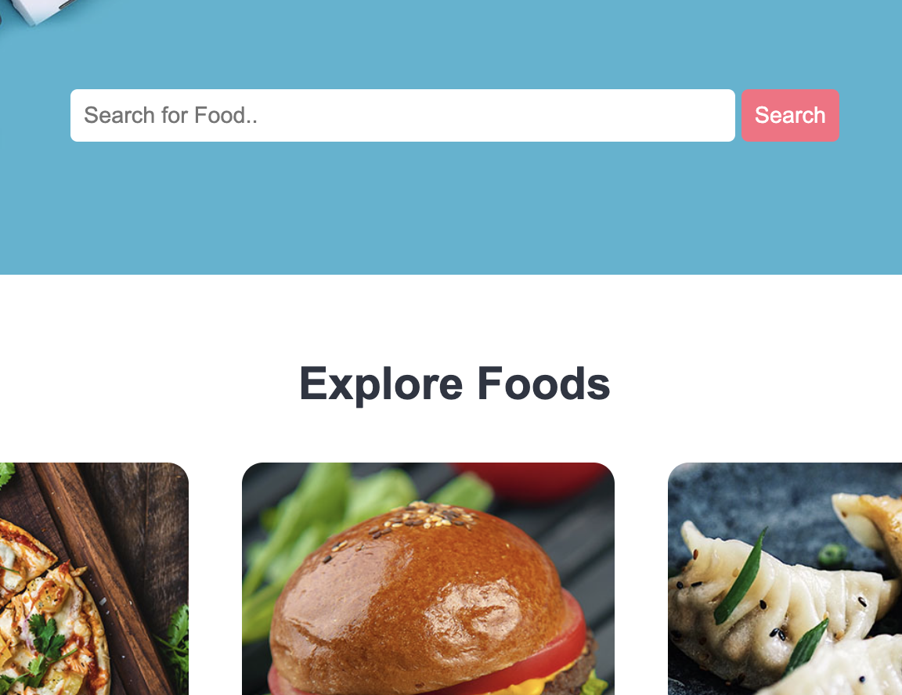
What we have done so far
We have completed the function we design above: including Login System, Food management system, Order System and Admin management system.
A food order system offers increased efficiency, improved customer communication, optimized resource utilization, and an enhanced ordering experience. It simplifies the ordering process, reduces errors, and provides valuable data for decision-making. Overall, it contributes to a streamlined and successful food ordering management process.
Notes:
模板来自于： 第一PPT https://www.1ppt.com/

Slide 10
THANK YOU
D-C1-2571-4 AGUSTINYAN
Notes:
模板来自于： 第一PPT https://www.1ppt.com/

