Slide 1
HARDHAQ2026
Surface Ion Trap Optimization
Geometry, stability and fabrication
Our attempt at create a single calcium-ion surface trap
153.643 meV • 49.82812 MHz • 100 V peak
Source: Final notebook: parameters and saved outputs
01
Notes:
Title slide. Latest numerical result is read directly from the final annotated notebook. No cloud solver is run by this presentation script.
Sources:
References:
Final notebook: parameters and saved outputs — file:///C:/Users/jacob/OneDrive/Documents/coding%20projects/HardHaq2026/hard_haq_working_dir/Ion%20trap%20-%20decisions%20and%20justification.ipynb

Slide 2
DESIGN OBJECTIVE
Objective: maximize depth within the constraints
Requirement
Allowed value
Ion height / radial frequency
50–100 µm / ≥1 MHz
Mathieu / peak voltage
q ≤0.4 / ≤100 V
RF width / gap
20–200 µm / 5–20 µm
RF drive
10–60 MHz
Expanded scope: center width and layer thicknesses are design variables.
Source: Starter notebook: constraints and RF model
Source: Final notebook: parameters and saved outputs
02
Notes:
The original starter fixes center width60 µm and metal2 µm. The final investigation relaxes those dimensions; passing the score does not establish compliance with unmodified fixed starter dimensions. RF voltage is peak amplitude, frequencyHz and lengthsµm.
Sources:
References:
Starter notebook: constraints and RF model — file:///C:/Users/jacob/OneDrive/Documents/coding%20projects/HardHaq2026/hard_haq_working_dir/starter_file_given.ipynb
Final notebook: parameters and saved outputs — file:///C:/Users/jacob/OneDrive/Documents/coding%20projects/HardHaq2026/hard_haq_working_dir/Ion%20trap%20-%20decisions%20and%20justification.ipynb

Slide 3
NOTEBOOK INVESTIGATION
Development: hypothesis, failure, correction
•
Initial hypothesis: lower ion height and RF frequency to strengthen trapping.
•
Failed trials showed that lowering frequency could violate the Mathieu limit.
•
Correct the electrode-separation ratio and tune frequency near q =0.4.
Recorded progress: ~150.5 meV milestone → latest saved result 153.643 meV.
Source: Final notebook: development notes and saved score
Source: Nizamani & Hensinger, 2012 • doi:10.1007/s00340-011-4803-x
03
Notes:
The original notes hypothesized lowerheight and lowerdrive for stronger depth. Initial39.423007/5 µm and20/12.5879626 µm geometries were recorded failing Mathieu. The3.68 ratio was initially confused with width/gap, then corrected to width/separation. Historical trials support the development path but do not isolate controlled improvements between the old and new scores.
Sources:
References:
Final notebook: development notes and saved score — file:///C:/Users/jacob/OneDrive/Documents/coding%20projects/HardHaq2026/hard_haq_working_dir/Ion%20trap%20-%20decisions%20and%20justification.ipynb
Nizamani & Hensinger, 2012 • doi:10.1007/s00340-011-4803-x — https://doi.org/10.1007/s00340-011-4803-x

Slide 4
GEOMETRY AND STABILITY
Why the selected effective ratio is about 6.46
Depth ∝ V²/f² q ∝ V G/f²
•
3.68 refers to RF width / RF separation—not the fabrication gap.
•
The constrained search varies height and frequency, changing the optimum.
•
(200 + 5)/(26.71361 + 5) ≈ 6.46 in the effective-width model.
Source: Nizamani & Hensinger, 2012 • doi:10.1007/s00340-011-4803-x
Source: Project constrained geometry model: optimize_trap.py
04
Notes:
The3.68 value maximizes a fixed-height depth factor for fixed RF drive. The later analytic constrained search permits height and frequency variation at fixed qmax. In the starter gap-sharing model a_eff=center+gap,b_eff=RFwidth+gap, giving205/31.71361≈6.46. This is an ideal-model optimum family, not a universal finite-thickness optimum. G is the local field gradient per volt.
Sources:
References:
Nizamani & Hensinger, 2012 • doi:10.1007/s00340-011-4803-x — https://doi.org/10.1007/s00340-011-4803-x
Project constrained geometry model: optimize_trap.py — file:///C:/Users/jacob/OneDrive/Documents/coding%20projects/HardHaq2026/hard_haq_working_dir/optimize_trap.py

Slide 5
SYMMETRY
Symmetric rails led the modeled depth search
Fixed 60 µm center
Predicted depth
Equal rails: 200 / 200 µm
144.29 meV
Independent widths: ≈200 / 200 µm
144.29 meV
Unequal example: 200 / 100 µm
134.20 meV
Asymmetry may help mode orientation; it did not improve this depth objective.
Source: Project analytic results: trap_optimization_results.json
Source: Allcock et al., 2010 • doi:10.1088/1367-2630/12/5/053026
05
Notes:
The fixed60 µmcenter comparison isgapless RF-only. Equal200/200 rails give144.290 meV at individually selected drive and q=.4. Independent-width optimization converges to equal widths; illustrative200/100 µmrails give134.202. Allcock demonstrates DC mode rotation with symmetric RF layout. This is not a full finite-gap asymmetry optimization.
Sources:
References:
Project analytic results: trap_optimization_results.json — file:///C:/Users/jacob/OneDrive/Documents/coding%20projects/HardHaq2026/hard_haq_working_dir/trap_optimization_results.json
Allcock et al., 2010 • doi:10.1088/1367-2630/12/5/053026 — https://arxiv.org/abs/0909.3272

Slide 6
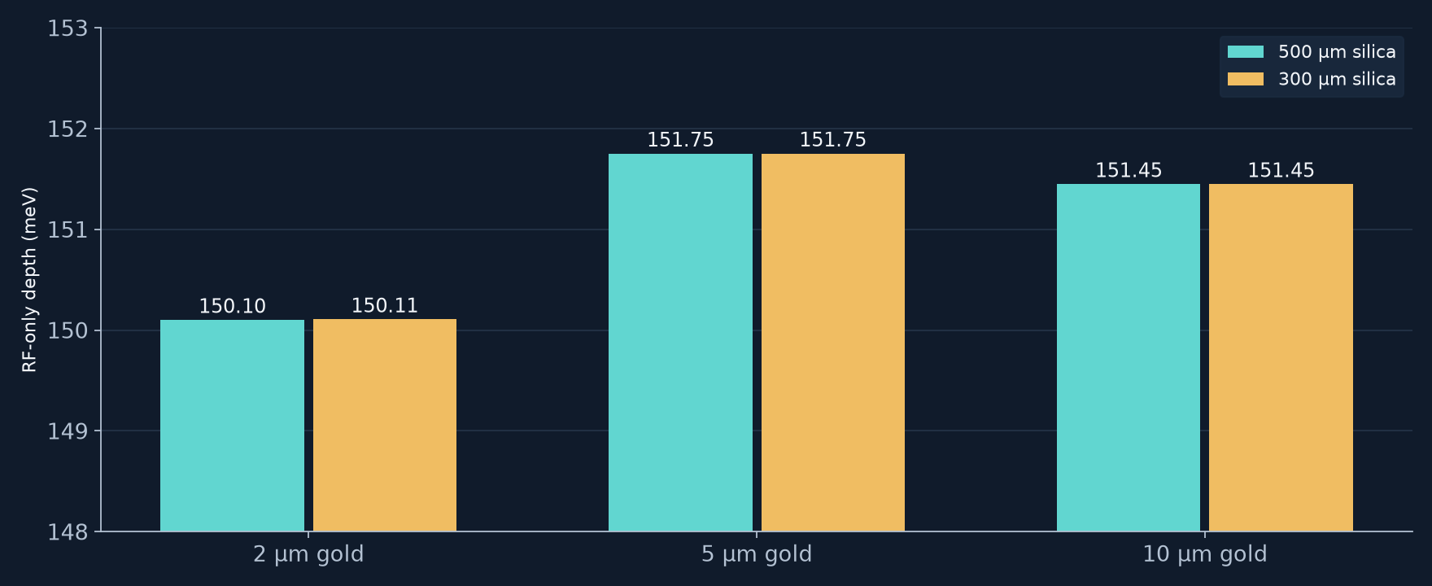
FABRICATION-AWARE SCREENING
Thickness selection: 5 µm gold, 500 µm silica
Retain the 500 µm wafer: thinning offered negligible modeled depth benefit.
Source: Project thickness screen: thickness_screen_results.json
Source: Britton, 2008 • plated-gold trap fabrication
06
Notes:
Six finite-gap field cases kept lateral geometryfixed and solved at50 MHz, then rescaled toq=.395. The5/500 combination gives151.752 meV at50.141MHz; it is not the final notebook run at q≈.4. Changing silica300 vs500µmhas negligible depth effect.5 vs10µmmetal differs≈.2%, so the screen selects a practical candidate without proving a precise continuous optimum. Britton quartz fabrication precedent is related but not an identical fusedsilica process.
Sources:
References:
Project thickness screen: thickness_screen_results.json — file:///C:/Users/jacob/OneDrive/Documents/coding%20projects/HardHaq2026/hard_haq_working_dir/thickness_screen_results.json
Britton, 2008 • plated-gold trap fabrication — https://www.nist.gov/system/files/documents/2017/05/09/Joe-Britton.pdf

Slide 7
FINAL RESULT
Final notebook: design and saved performance
Design
Value
RF width / gap / center
200 /5 /26.71361 µm
Gold / fused-silica thickness
5 /500 µm
Voltage / RF frequency
100 V peak /49.82812 MHz
Saved RF-only depth
Height above metal
Mathieu parameter
153.643 meV
58 µm
0.39999986
Source: Final notebook: parameters and saved outputs
08
Notes:
The final notebook currently saves depth153.643meV,height58.000µm,radial frequencies6.99/7.05MHz,q=0.39999986,at49.82812MHz. Code and outputs were inspected,not independently cloudrerun. All five coded scorechecks pass; parameter boundsalso pass in the expanded scope. qmargin is tiny,so this is a numerical result at currentresolution,not a precisionvalidated globaloptimum.
Sources:
References:
Final notebook: parameters and saved outputs — file:///C:/Users/jacob/OneDrive/Documents/coding%20projects/HardHaq2026/hard_haq_working_dir/Ion%20trap%20-%20decisions%20and%20justification.ipynb

Slide 8
FINDINGS
Conclusion
The design passes all coded constraints
at the current simulation resolution.
•
Symmetric RF rails and a constrained frequency search produced the selected design.
•
Several-micrometre gold is a practical fabrication candidate.
•
The result is an RF-only prediction; device performance remains to be validated.
Source: Final notebook: score and model assumptions
Source: Schmied, 2010 • finite-electrode modeling, doi:10.1088/1367-2630/12/2/023038
09
Notes:
At the current simulation resolution,all coded constraints pass for the expanded design. The current q is only1.4e−7below.4 and physical or numericaluncertainty is not qualified. Mesh/domain checks,full axial DC confinement,RF feednetwork,breakdown and thermalchecks remain relevant before physicalqualification. The concise slide states scope without repeating the full audit. The depth result is a model prediction,not a hardwaremeasurement or proof of globaloptimality.
Sources:
References:
Final notebook: score and model assumptions — file:///C:/Users/jacob/OneDrive/Documents/coding%20projects/HardHaq2026/hard_haq_working_dir/Ion%20trap%20-%20decisions%20and%20justification.ipynb
Schmied, 2010 • finite-electrode modeling, doi:10.1088/1367-2630/12/2/023038 — https://doi.org/10.1088/1367-2630/12/2/023038

