Slide 1
HARDHAQ2026
Surface ion trap: findings and recommendation
151.75 meV predicted RF-only depth
Symmetric 200 µm RF rails • 5 µm gaps
5 µm gold • 500 µm fused silica
100 V peak | 50.141 MHz | q = 0.395
Source: Project finite-gap thickness screen: thickness_screen_results.json
01
Notes:
Concise synthesis of notebook development, geometry screening, six finite-gap thickness cases and material calculations. The recommended center requires relaxing the starter fixed-center restriction.
Sources:
Project finite-gap thickness screen: thickness_screen_results.json — file:///C:/Users/jacob/OneDrive/Documents/coding%20projects/HardHaq2026/hard_haq_working_dir/thickness_screen_results.json

Slide 2
DESIGN SCOPE
Objective and constraints
Constraint
Limit
Height / radial frequency
50–100 µm / ≥1 MHz
Mathieu / voltage
q ≤0.4 / ≤100 V peak
RF width / gap
20–200 µm / 5–20 µm
Drive frequency
10–60 MHz
Extended design: center width and layer thicknesses may vary.
Source: starter_file_given.ipynb — parameter and score cells
Source: Working notebook — revised center and metal thickness
02
Notes:
The objective is maximum RF-only depth subject to the starter constraints. The later design permits a changed center, metal thickness and substrate thickness. The center is fixed at60 µm in the original starter, so scope must be explicit.
Sources:
starter_file_given.ipynb — parameter and score cells — file:///C:/Users/jacob/OneDrive/Documents/coding%20projects/HardHaq2026/hard_haq_working_dir/starter_file_given.ipynb
Working notebook — revised center and metal thickness — file:///C:/Users/jacob/OneDrive/Documents/coding%20projects/HardHaq2026/hard_haq_working_dir/Traped%20ion%20working%20file.ipynb

Slide 3
ORIGINAL INVESTIGATION
Notebook development: three key steps
•
Start: lower height and lower RF frequency to increase depth.
•
Failure: low-frequency trials exceeded the Mathieu limit.
•
Revision: correct the 3.68 ratio and retune frequency near q = 0.4.
Recorded milestone: ~150.5 meV → current saved output: 151.622 meV.
Source: Traped ion working file.ipynb — notes in cells 3–9; saved outputs 20 and 24
03
Notes:
The early notebook explored minimum height and lower drive, then recorded two failed geometry trials:39.423007 µmRF width with5 µm gap and20 µmRF width with12.5879626 µm gap. The notes attribute failure to q. The ratio was initially misread as width/gap before being corrected. The historical saved result150.543 meV was observed earlier in this session; the current saved output151.622 meV is distinct and was not independently rerun.
Sources:
Traped ion working file.ipynb — notes in cells 3–9; saved outputs 20 and 24 — file:///C:/Users/jacob/OneDrive/Documents/coding%20projects/HardHaq2026/hard_haq_working_dir/Traped%20ion%20working%20file.ipynb

Slide 4
GEOMETRY AND STABILITY
Why the final ratio differs from 3.68
Depth ∝ V²/f² q ∝ V G/f²
•
3.68 means RF width / RF separation—not fabrication gap.
•
The paper holds height and RF settings fixed; the constrained search varies them.
•
Selected effective ratio: (200 + 5)/(26.71361 + 5) ≈ 6.46.
Source: [1] Nizamani & Hensinger, Appl. Phys. B (2012), doi:10.1007/s00340-011-4803-x
Source: Project constrained analytic search: optimize_trap.py
04
Notes:
Nizamani and Hensinger optimize a geometry factor at fixed height, voltage and frequency. The later analytic search allows height and frequency to vary while constraining q. The starter gap-sharing approximation givesa_eff=center+gap andb_eff=RFwidth+gap.205/31.71361≈6.46. This ratio has not been jointly reoptimized for finite thickness.
Sources:
[1] Nizamani & Hensinger, Appl. Phys. B (2012), doi:10.1007/s00340-011-4803-x — https://doi.org/10.1007/s00340-011-4803-x
Project constrained analytic search: optimize_trap.py — file:///C:/Users/jacob/OneDrive/Documents/coding%20projects/HardHaq2026/hard_haq_working_dir/optimize_trap.py

Slide 5
SYMMETRY COMPARISON
Symmetric rails led the depth search
RF rails; center =60 µm
Predicted depth
Equal: 200 / 200 µm
144.29 meV
Independent-width search: ≈200 / 200 µm
144.29 meV
Illustrative unequal: 200 / 100 µm
134.20 meV
Asymmetry can aid mode orientation; it did not improve this modeled depth objective.
Source: Project gapless-plane results: trap_optimization_results.json
Source: [2] Allcock et al., New J. Phys. (2010), doi:10.1088/1367-2630/12/5/053026
05
Notes:
For fixed60 µm center, equal rails achieve144.290 meV; independently optimized unequal widths converge back to200/200 µm. The illustrative200/100 µm pair gives134.202 meV. Each uses100 V and its own drive atq=.4. These are gapless predictions, not a new finite-gap asymmetric sweep. DC quadrupoles can provide mode rotation in a symmetric RF layout.
Sources:
Project gapless-plane results: trap_optimization_results.json — file:///C:/Users/jacob/OneDrive/Documents/coding%20projects/HardHaq2026/hard_haq_working_dir/trap_optimization_results.json
[2] Allcock et al., New J. Phys. (2010), doi:10.1088/1367-2630/12/5/053026 — https://arxiv.org/abs/0909.3272

Slide 6
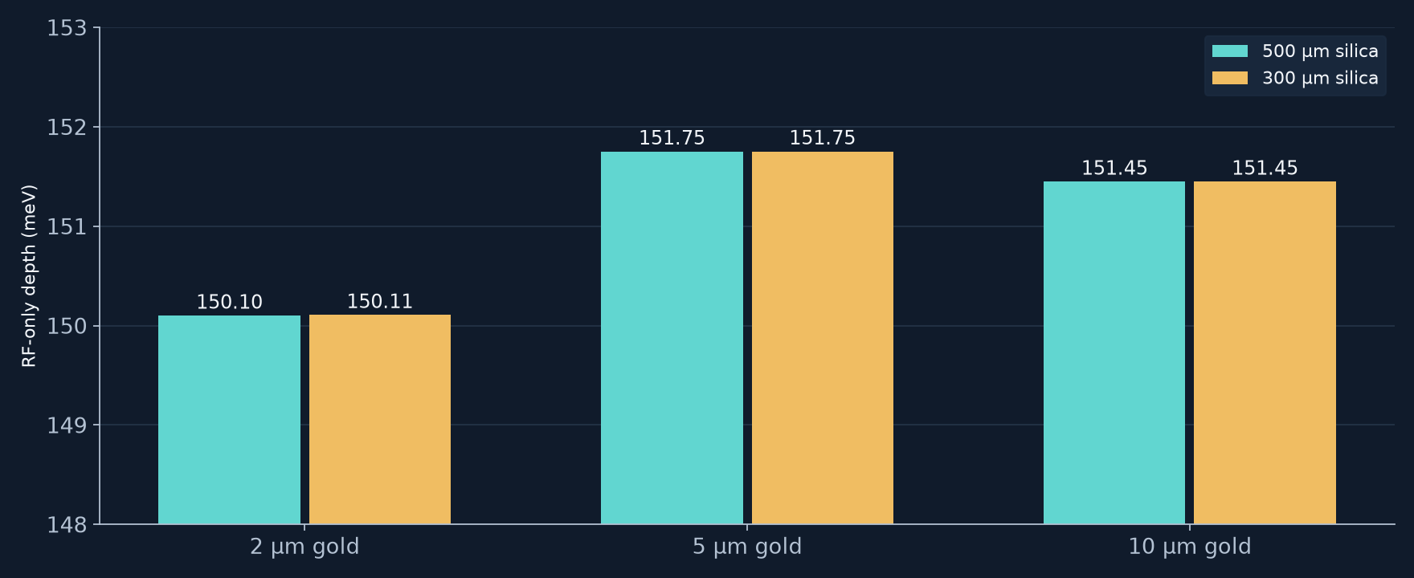
SIX FINITE-GAP FIELD SCREENS
Thickness: retain 5 µm gold on 500 µm silica
Wafer thinning offered negligible benefit; the 5 vs. 10 µm ranking needs a finer mesh.
Source: Project six-case finite-gap field results; retuned to q =0.395
Source: [3] Britton, microfabrication dissertation (2008) — plated-gold fabrication precedent
06
Notes:
The same200 µm rails,5 µm gap and26.71361 µm center are used throughout. Fields were solved at50 MHz with a fixed−4000 to+4000 µm domain including air below the wafer; frequency and depth were scaled toq=.395. The5 vs10 µm depth margin is about0.2%, below an established convergence guarantee. Quartz fabrication precedent is related to but not identical to fused silica.
Sources:
Project six-case finite-gap field results; retuned to q =0.395 — file:///C:/Users/jacob/OneDrive/Documents/coding%20projects/HardHaq2026/hard_haq_working_dir/thickness_screen_results.json
[3] Britton, microfabrication dissertation (2008) — plated-gold fabrication precedent — https://www.nist.gov/system/files/documents/2017/05/09/Joe-Britton.pdf

Slide 7
ELECTRODE MATERIALS
Cu/Au may reduce loss—not ideal trap depth
~23% lower estimated electrode resistance
•
Candidate: 4.8 µm copper + 0.2 µm gold; same 5 µm total thickness.
•
At the same 100 V electrode amplitude: no demonstrated depth gain.
•
Film quality, coating integrity and RF feed losses require validation.
Source: [6] Tao et al., working Cu/Au surface trap, arXiv:2002.11470 (2020)
Source: [7] Matula, J. Phys. Chem. Ref. Data (1979); resistance estimates in rf_material_comparison.json
07
Notes:
Compare5 µmAu with4.8 µmCu+.2 µmAu at equal total thickness. Bulk293 Kresistivities give a uniform-current sheet resistance ratio.7653, about23.5%less. This is not measured RF strip resistance. Skin depths are10.58 µmAu and9.21 µmCu. At fixed actual electrode voltage and shape PEC depth is unchanged. A complete network and measured films are needed for total savings. Surface charging,diffusion and ion motional heating are separate concerns.
Sources:
[6] Tao et al., working Cu/Au surface trap, arXiv:2002.11470 (2020) — https://arxiv.org/pdf/2002.11470
[7] Matula, J. Phys. Chem. Ref. Data (1979); resistance estimates in rf_material_comparison.json — https://srd.nist.gov/JPCRD/jpcrd155.pdf

Slide 8
OPERATING POINTS
Final candidate and saved notebook result
Parameter
Recommended screened candidate
RF width / gap / center
200 / 5 / 26.71361 µm
Gold / silica thickness
5 / 500 µm
Voltage / frequency / q
100 V / 50.141 MHz / 0.395
Depth / height / radial minimum
151.75 meV / 58 µm / 6.945 MHz
Notebook saves 151.622 meV at 49.4 MHz; domain and q differ, so compare cautiously.
Source: Fixed-window field screen + frequency scaling: recommended_thickness_candidate.json
Source: Current saved notebook outputs — inspected, not re-executed for this deck
08
Notes:
The recommended screen uses5 µmgold and500 µmsilica,100 V,26.71361 µmcenter,200 µmrails,5 µmgap. Predicted q=.395,depth151.752 meV,height58 µm,min radial6.945 MHz anddrive50.141 MHz come from fixed-window solved fields plus scaling. The current notebook saves151.622 meV at49.4 MHz,q=.39911176,height59 µm with original window conventions. These are not controlled head-to-head results; no improvement claim is made from their numerical difference.
Sources:
Fixed-window field screen + frequency scaling: recommended_thickness_candidate.json — file:///C:/Users/jacob/OneDrive/Documents/coding%20projects/HardHaq2026/hard_haq_working_dir/recommended_thickness_candidate.json
Current saved notebook outputs — inspected, not re-executed for this deck — file:///C:/Users/jacob/OneDrive/Documents/coding%20projects/HardHaq2026/hard_haq_working_dir/Traped%20ion%20working%20file.ipynb

Slide 9
VALIDATION
What remains before fabrication
•
Verify the final drive point with mesh and domain convergence.
•
Include axial DC confinement and the full escape barrier.
•
Check finished gaps, adhesion, post-bake coating and breakdown.
•
Measure the RF network, voltage balance, power loss and temperature.
Source: [5] Schmied, finite-electrode and dielectric corrections, New J. Phys. (2010)
Source: [11] Copper diffusion through gold coatings, Anal. Chim. Acta (2023)
09
Notes:
The model is RF-only and no hardware has been fabricated or measured during this investigation. The5 µmmetal choice is a screening recommendation. Mesh/domain convergence and final-drive solve remain. Axial DC confinement can lower the real escape barrier. Cu/Au estimates need measured films and bake qualification. The q margin does not qualify fabrication or RF tolerance.
Sources:
[5] Schmied, finite-electrode and dielectric corrections, New J. Phys. (2010) — https://doi.org/10.1088/1367-2630/12/2/023038
[11] Copper diffusion through gold coatings, Anal. Chim. Acta (2023) — https://www.sciencedirect.com/science/article/pii/S0003267023006499

