Slide 1

A PROJECT PRESENTATION ON
Agwis Messenger
MCA SEM 6th
^{Group No:01}
Internal Guide:
Dr. Idrish sandhi
External Guide:
Mr. Chetan Soni
Developed By:
Himani Prajapati.
(2016095900000614)
Gaurang Parmar
(2016095900000684)
Submitted To:
Department Of Computer Application(Sankalchand Patel College Of Engineering,Visnagar)
Sankalchand Patel University,Visnagar.

Slide 2
Project Profile
Project Title | Agwis messenger
Project Definition | To make a website which use to multi purpose social media.
Objective | The main objective of this site is to provide a platform through which people of different interest can communicate with each other and also can create page,Business profile and can add their product online.
External Project Guide | Mr. Chetan Soni
Internal Project Guide | Dr. Idrish sandhi
Team Size | TWO MEMBER
Team Member | 1)Himani prajapati 2)Gaurang parmar
Front End Tool | PHP (5.6.15)
Back End Tool | My SQL (5.6.17)
Report Generation Tools | MS Office 2019
Operating System | Window 10
Project Duration | 4 Months

Slide 3

Organization Profile
Name:- NIVAAN INFOTECH
Address:- F-33, Tirupati Metro Mall, Near Shahibaug Society, Visnagar-384315.
Website:- www.nivaaninfotech.com
E-Mail:- nivaaninfotech@nivaaninfotech.com
Owner:- Mr. Chetan Soni
About Company:- Nivaan Infotech Presently Based At Visnagar In North Gujarat Is Dedicated To Provide Quality Based.Satisfactory & Cost Effictive Services.We Believe In Implementing Innovation Ideas & Maintaining Quality Standards.

Slide 4
Problem Of Existing System
Existing system is time wasting.
User can not create his/her online business profile in single messenger app.
User can not get the notification online.
Admin can not verified the user.

Slide 5
Need For New System
For the better searching facility as per user convenient.
To include OTP facility in the system.
Create page and blog online business in single messenger app
To include the feedback and ratting.
Secure and perfect output.

Slide 6
Modules
Admin :
Login
Manage User
Manage User Call
Manage chat
View feedback
Manage page
Manage business profile and product.

Slide 7
User :
login
Send or receive message
video call or voice call
Create page
Edit page
Send feedback
Create business profile.
Add product.

Slide 8
TimeLine Chart

Slide 9
Month | January |  |  |  | February |  |  |  | March |  |  |  | April
Week | 1 | 2 | 3 | 4 | 1 | 2 | 3 | 4 | 1 | 2 | 3 | 4 | 1 | 2 | 3 | 4
Definition
System Analysis
Database Design
Page Design
Codding
Report
Testing
Documentation
Current progress

Slide 10
Hardware Specification(Recommended)
Processer i3 intel core
Server Side
RAM 4 GB
Hard disk 1TB
Processer i3 intel core or below
Client Side
RAM 4MB or below
Hard disk 1TB

Slide 11
Software Specification(Recommended)
Front End | PHP(5.6.20)
Back End | MySQL(5.6.17)
Application Server | Apache
Editor | Adobe Dreamweaver (21.0)
Operating System | Windows 10
Server Side
Operating System Window 10 or below
Client Side
Browser Mozilla Firefox, Google Chrome

Slide 12
DATA DICTIONARY
List Of Tables
users
contacts
chats
groups
group_memebers
statuses
admin
calls
pages
businesses
Product
feedback
page_posts
page_followers
page_likes
Page_comments

Slide 13
Table No:-1
Table Name:- users
Primary Key:-uid
Description:Using this table user can register to the system
Field Name | Type/Size | Constraints | Description
uid | bigint | Primary key | This field contains User id.
user_name | varchar (50) | not null | This field contains username name.
mobileno | varchar(10) | not null | This field contains Mobile number
Email_id | varchar (50) | not null | This field contains email_id of user
birth_date | datetime | not null | This field contains Birth date.
Profile img | varchar(50) | not null | This field contains profile image.
status | bit(1) | not null | This field contains status.
password | varchar(10) | not null | This field contains Password
createddate | Datetime | not null | This field contains created date.
Updated date | Datetime | not null | This field contains City.

Slide 14
Table No:- 2
Table Name:- admin
Primary Key:- aid
Description: Using this table admin can login to the system
Field Name | Type/Size | Constraints | Description
Aid | bigInt | Primary key | This field contains id of admin.
Admin_name | varchar (50) | not null | This field contains name of admin.
img | varchar (50) | not null | This field contains image of admin
email_id | varchar (50) | not null | This field contains Email id.
password | varchar (10) | not null | This field contains Password.

Slide 15
Table No:- 3
Table Name:- contacts
Primary Key:- cid
Foreign key:uid
Description: Using this table save customer contact.
Field Name | Type/Size | Constraints | Description
cid | bigInt | Primary key | This field contains contact id
uid | bigInt | Foreign key | This field contains Foreign key
contactNo | varchar(10) | not null | This field contains contact no

Slide 16
Table No:- 4
Table Name:- group
Primary Key:- gid
Foreign key:uid
Description: Using this table user can group chat .
Field Name | Type/Size | Constraints | Description
gid | bigint | Primary key | This field contains group id.
uid | bigint | Foreign key | This field contains reference key of users table
groupname | varchar(50) | not null | This field contains store group name
groupimg | varchar(50) | not null | This field contains image.
createdddate | datetime | not null | This field contains show group created date
updateddate | datetime | not null | This field contains show group updated

Slide 17
Table No:- 5
Table Name:- group_memeber
Primary Key:- groupmid
Foreign key:uid
Description: This Table store group member info.
Field Name | Type/Size | Constraints | Description
groupmid | bigint | Primary key | This field contains group_member id.
uid | bigint | Foreign key | This field contains user id

Slide 18
Table No:- 6
Table Name:- chat
Primary Key:- chatid
Foreign key:uid
Description: This Table is used to store contact details.
Field Name | Type/Size | Constraints | Description
chatid | bigint | primary key | This field contains chatid.
gid | bigint | Foreign key | This field contains reference key of group table.
view | Bit(1) | Not null | This field contains view of chat
date | datetime | Not null | This field contains date.
msg | Text | Not null | This field contains message.
media | Varchar(50) | Not null | This field contains store media image or video
uid | bigint | Foreign key | This field contains reference key of users table (sender)
rid | bigint | Foreign key | This field contains reference key of users table (receiver)

Slide 19
Table No:- 7
Table Name:- status
Primary Key:- sid
Foreign Key:- uid
Description: This Table is used to store status detail
Field Name | Type/Size | Constraints | Description
sid | bigint | primary key | This field contains sid.
text | Text | Not null | This field contains text.
media | Varchar(50) | Not null | This field contains store media image or video
view | bigint | Not null | This field contains view count of status.
uid | bigint | Not null | This filed contains reference key of users table
createddate | datetime | Not null | This field contains show group created date
updateddate | datetime | Not null | This field contains show group updated date

Slide 20
Table No: - 8
Table Name:- call
Primary Key:- callid
Foreign Key:- uid
Description: This Table is used to store call detail details
Field Name | Type/Size | Constraints | Description
callid | bigint | primary key | This field contains call id.
calltype | Varchar(50) | Not null | This field contains call type.
uid | bigint | Foreign Key | This field contains reference key of user table
rid | bigint | Foreign Key | This field contains reference key of user table
duration | Datetime | Not null | This field contains call duration.

Slide 21
Table No: - 9
Table Name:- page
Primary Key:- pageid
Foreign Key:- uid
Description: This Table is used to store page details
Field Name | Type/Size | Constraints | Description
pageid | bigint | primary key | This field contains page id.
uid | bigint | foreign key | This field contains user id.
pagename | varchar(50) | Not null | This field contains page name.
profileimg | varchar(50) | Not null | This field contains page profile image
bannerimg | varchar(50) | Not null | This field contains page banner image
description | varcahr(50) | Not null | This field contains page description
pageusername | varchar(50) | Not null | field contains page username
createddate | datetime | Not null | This field contains show group created date
updateddate | datetime | Not null | This field contains show group updated date

Slide 22
Table No: - 10
Table Name:- post
Primary Key:- pid
Foreign Key:- pageid
Description: This Table is used to store user page post details
Field Name | Type/Size | Constraints | Description
pid | bigint | primary key | This field contains page id.
pageid | bigint | foreign key | This field contains page id of user.
text | Text | Not null | This field contains text.
media | varchar(50) | Not null | This field contains store media image or video
date | datetime | Not null | This field contains store date
view | bigint | Not null | This field contains view count of status.
createddate | datetime | Not null | This field contains show group created date
updateddate | datetime | Not null | This field contains show group updated date

Slide 23
Table No: - 11
Table Name:- follow
Primary Key:- fid
Foreign Key:- pageid,uid
Description: This Table is used to store follower information
Field Name | Type/Size | Constraints | Description
fid | bigint | primary key | This field contains follow id.
pageid | bigint | Foreign key | This field contains reference key of page table
uid | bigint | Not null | This field contains reference key of users table.

Slide 24
Table No: - 12
Table Name:- like
Primary Key:-lid
Foreign Key:- uid,postid
Description: This Table is used to store like information
Field Name | Type/Size | Constraints | Description
lid | bigint | primary key | This field contains like id.
uid | bigint | Foreign key | This field reference key of users table
pid | bigint | Foreign key | This field reference key of post table
like | bit(1) | Not null | This field contains store like

Slide 25
Table No: - 13
Table Name:- comment
Primary Key:- commentid
Foreign Key:- postid,uid
Description: This Table is used to store comment information
Field Name | Type/Size | Constraints | Description
commentid | bigint | primary key | This field contains comment id.
postid | bigint | Foreign key | This field contains reference key of post table
uid | bigint | Not null | This field contains reference key of users table.
comment | varchar(50) | Not null | This field contains commenet

Slide 26
Table No:- 14
Table Name:- feedback
Primary Key:- feedbackid
Foreign key:uid
Description: Using this table save feedback.
Field Name | Type/Size | Constraints | Description
feedbackid | bigint | Primary key | This field contains feedback id
uid | bigint | Foreign key | This field contains Foreign key
message | varchar(50) | not null | This field contains store message

Slide 27
Table No: -15
Table Name:- business
Primary Key:- bid
Foreign Key:- uid
Description: This Table is used to store business details
Field Name | Type/Size | Constraints | Description
bid | bigint | primary key | This field contains business id.
uid | bigint | foreign key | This field contains user id.
name | varchar(50) | Not null | This field contains business name.
btype | varchar(50) | Not null | This field contains business type
address | varchar(50) | Not null | This field contains business address.
description | varcahr(50) | Not null | This field contains business description
createddate | datetime | Not null | This field contains show business created date
updateddate | datetime | Not null | This field contains show business updated date

Slide 28
Table No: -16
Table Name:- product
Primary Key:- proid
Foreign Key:- bid
Description: This Table is used to store product details
Field Name | Type/Size | Constraints | Description
proid | bigint | primary key | This field contains product id.
bid | bigint | foreign key | This field contains user id.
name | varchar(50) | Not null | This field contains product name.
img | Float() | Not null | This field contains product image
price | Float() | Not null | This field contains product price
discount | float | Not null | This field contains product discount
createddate | datetime | Not null | This field contains show product created date
updateddate | datetime | Not null | This field contains show product updated date

Slide 29
ER- Diagram

Slide 30
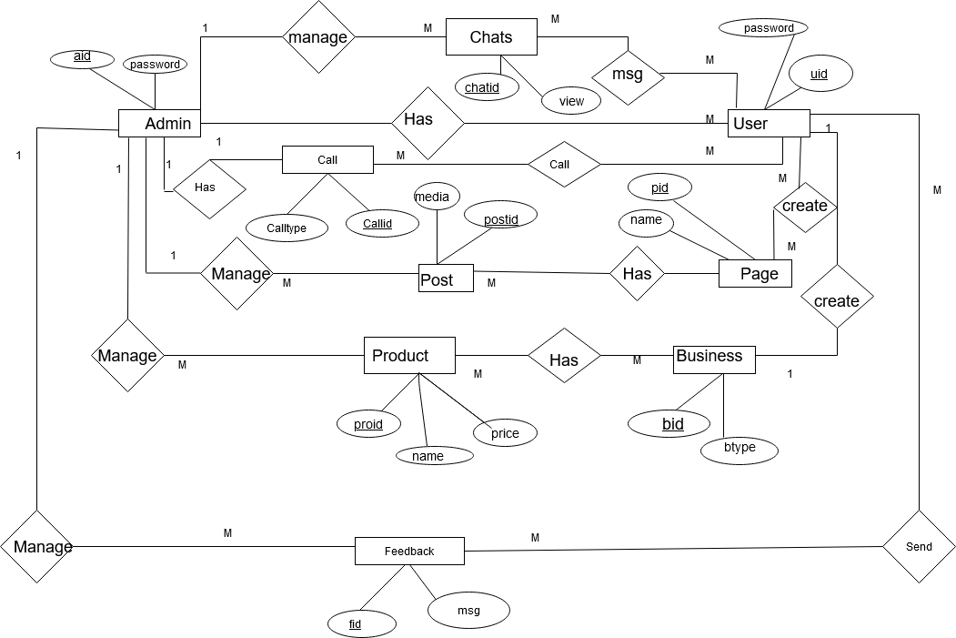

Slide 31
CLASS DIAGRAM

Slide 32
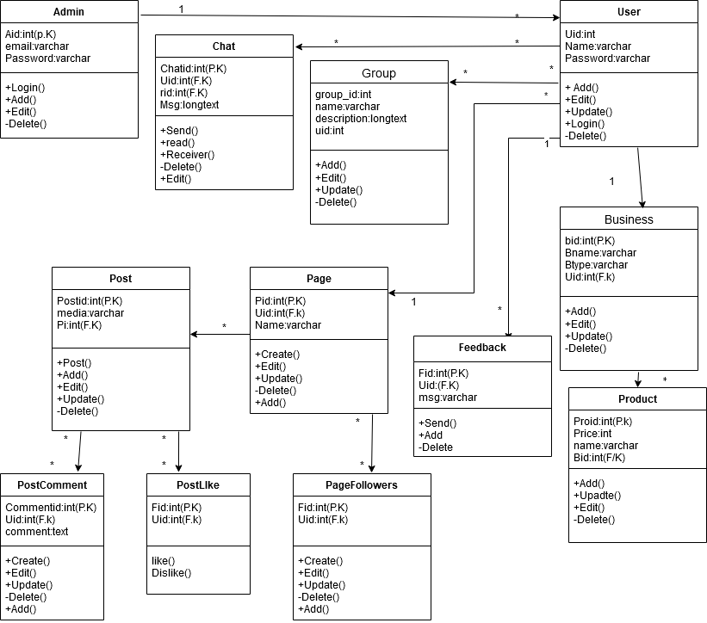

Slide 33
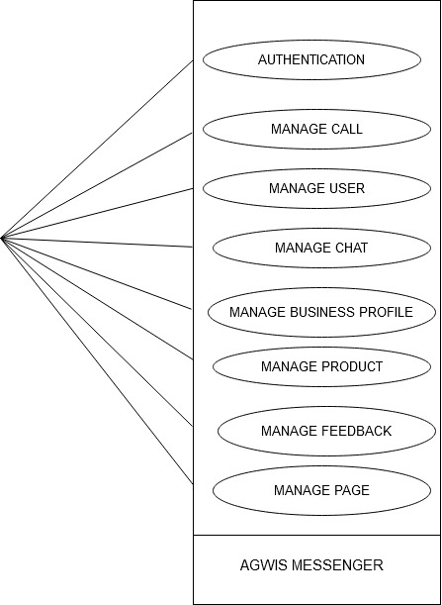
Admin

Slide 34
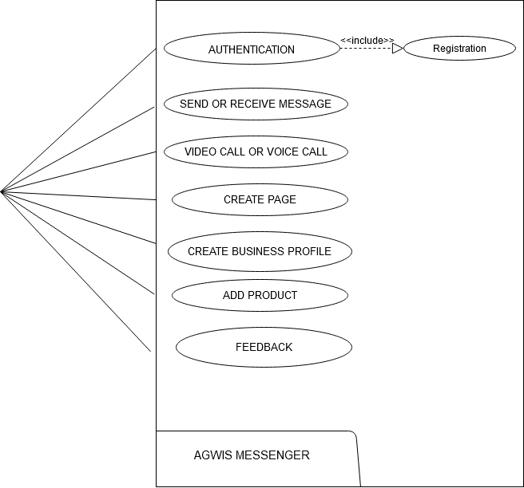
User

Slide 35
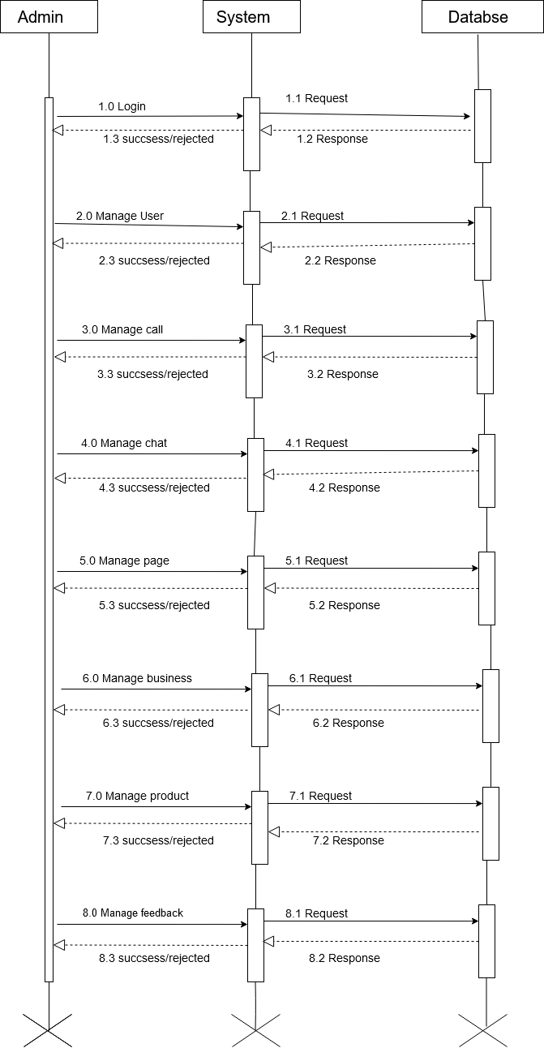
Sequence diagram of Admin

Slide 36
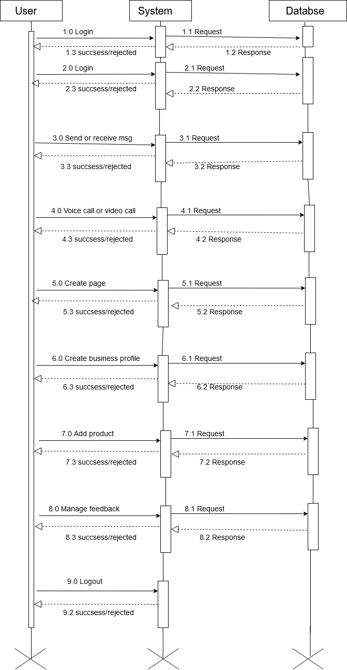
Sequence diagram of User

Slide 37
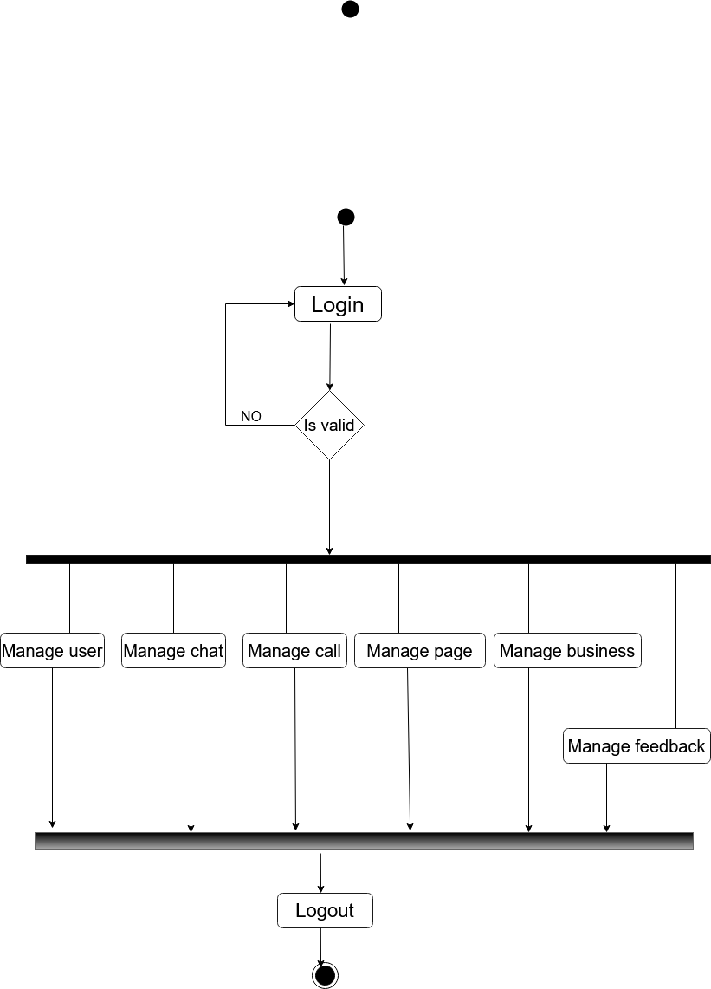
Activity diagram of Admin

Slide 38
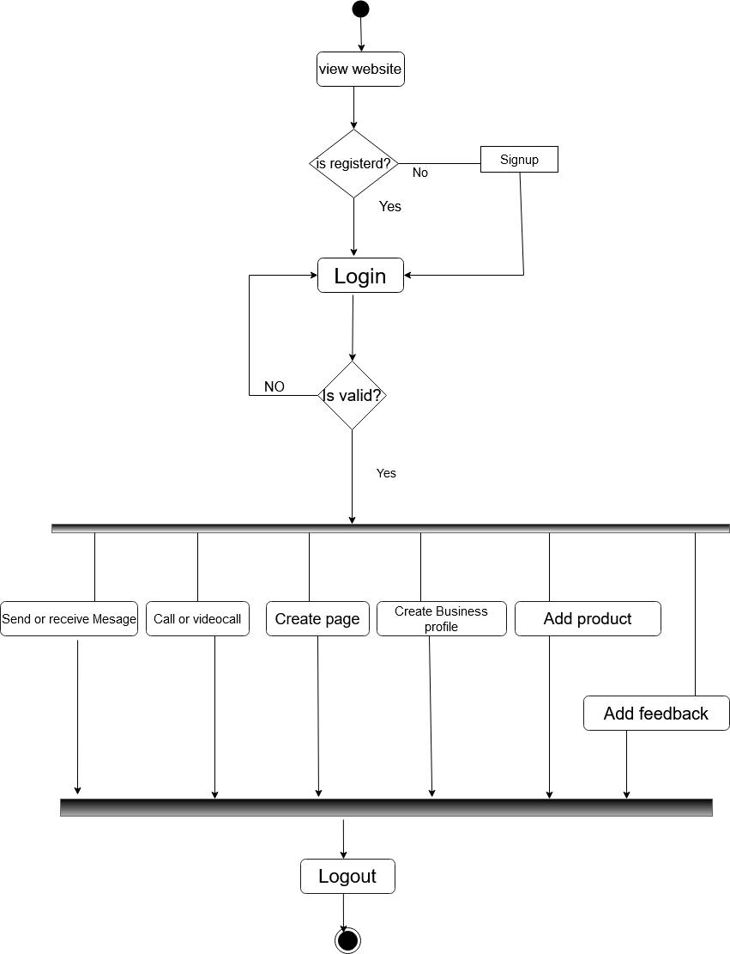
Activity diagram of User

Slide 39
Webform Design

Slide 40
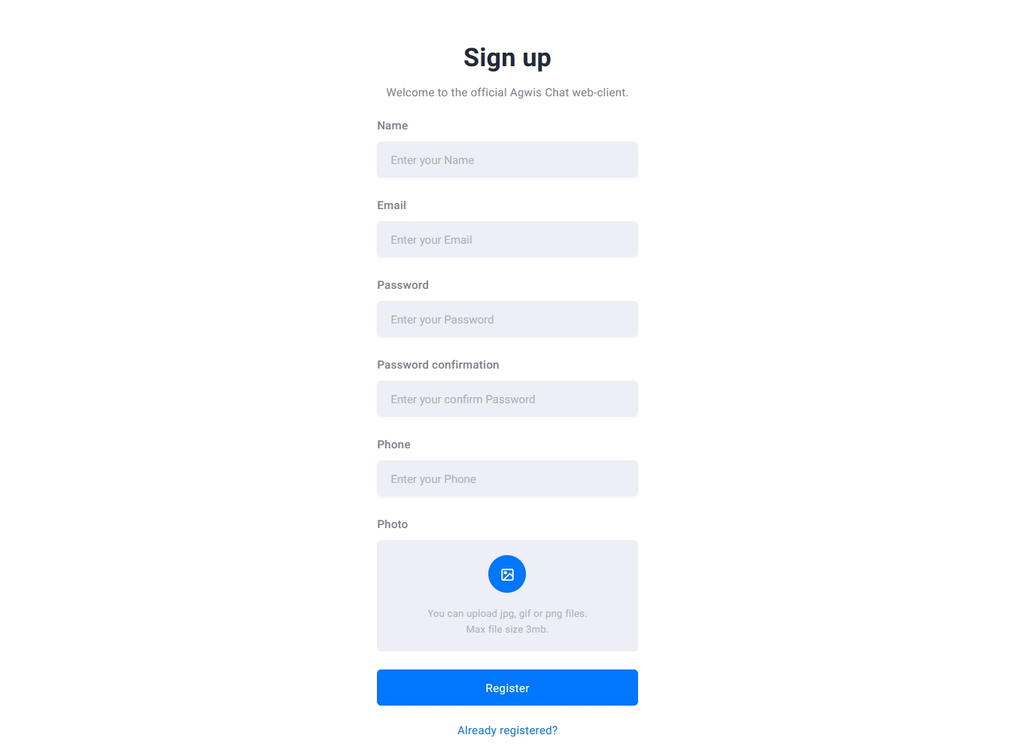
2.User registration form

Slide 41
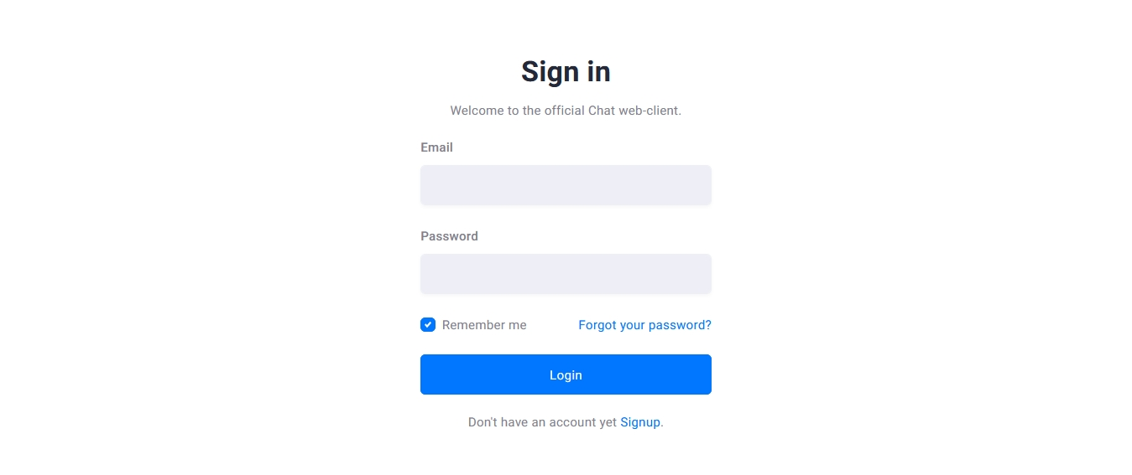
1.UserLogin form

Slide 42
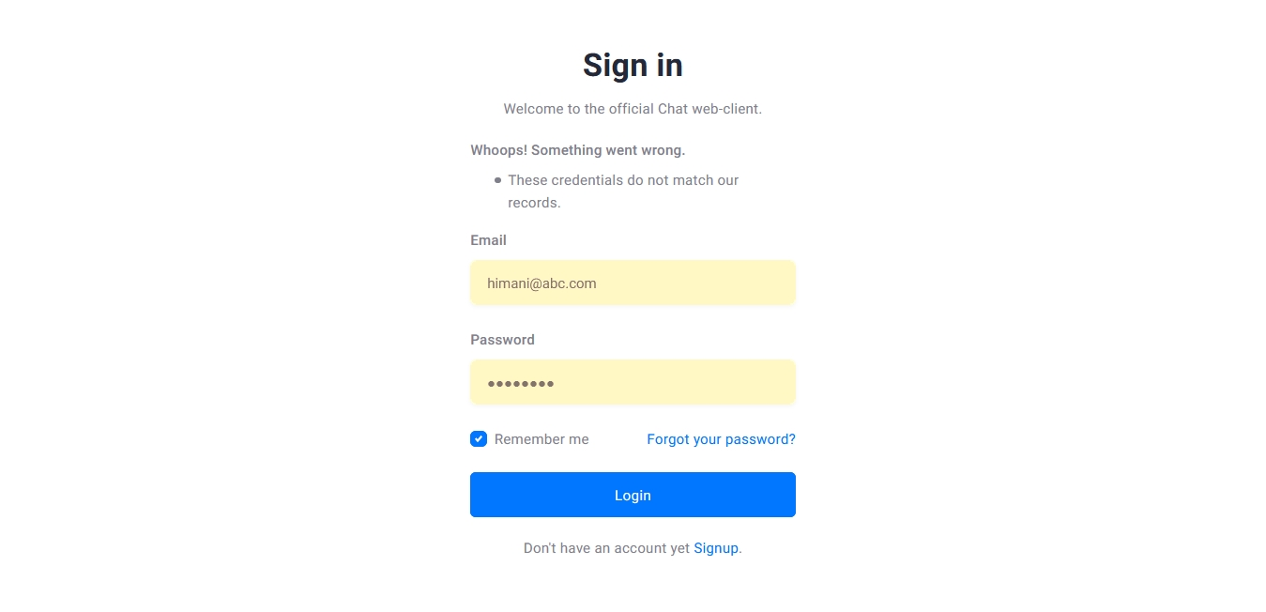
1.1UserLogin form
Description: this page show error in userlogin form

Slide 43
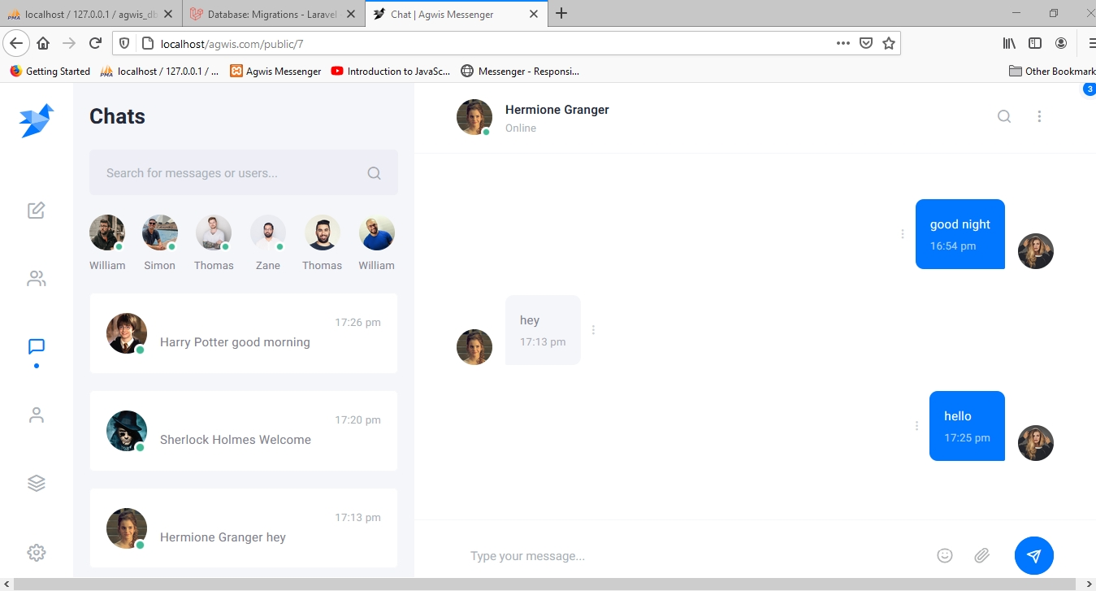
3.Chat form

Slide 44
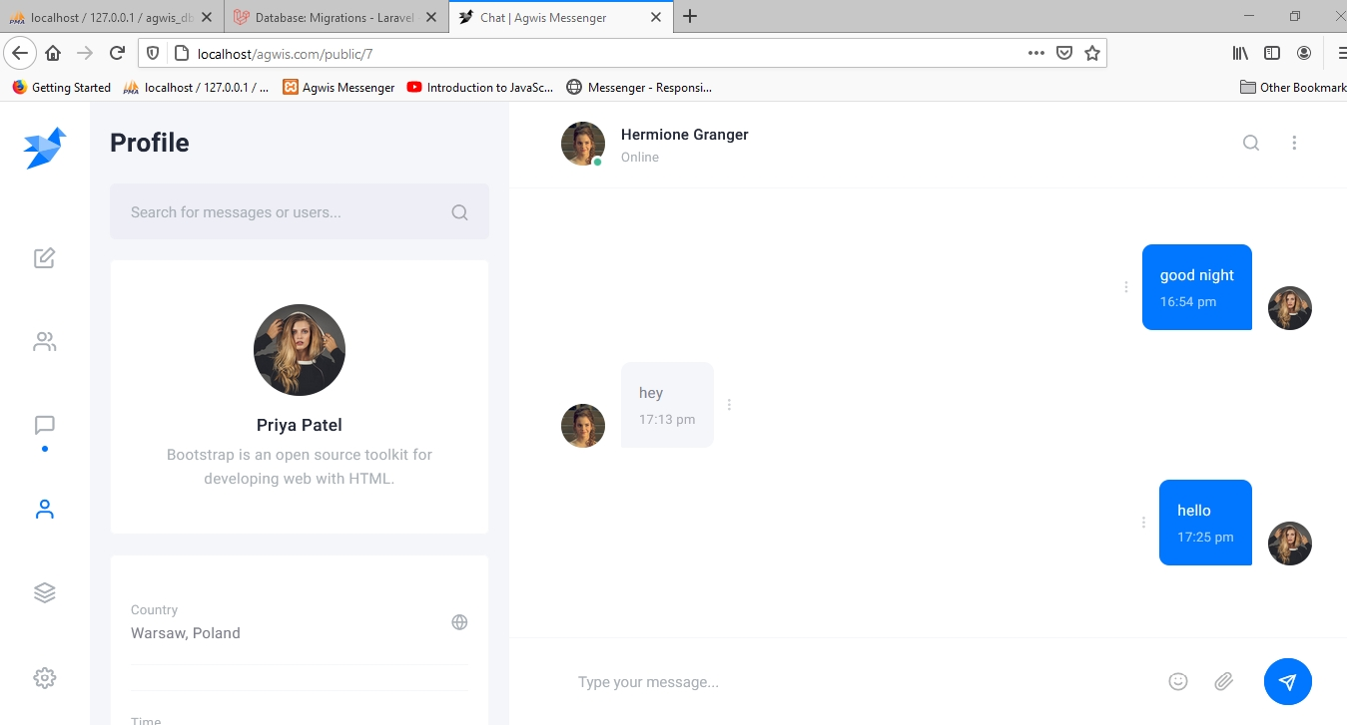
4.Userprofile form

Slide 45
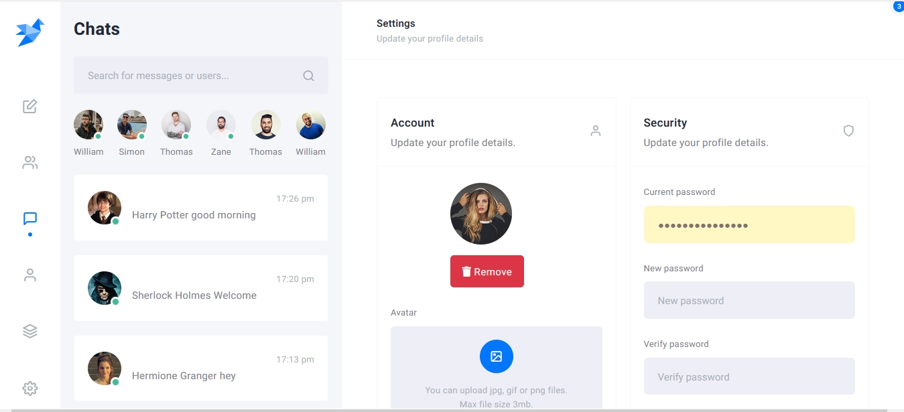
5.Editprofile

Slide 46
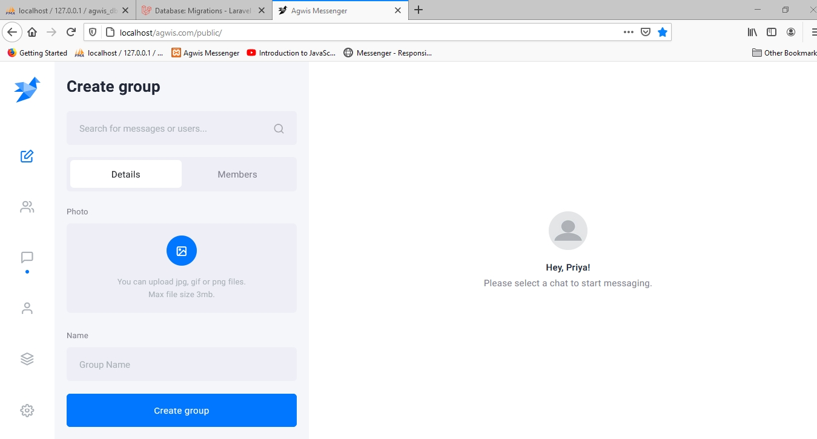
6.Create group

Slide 47
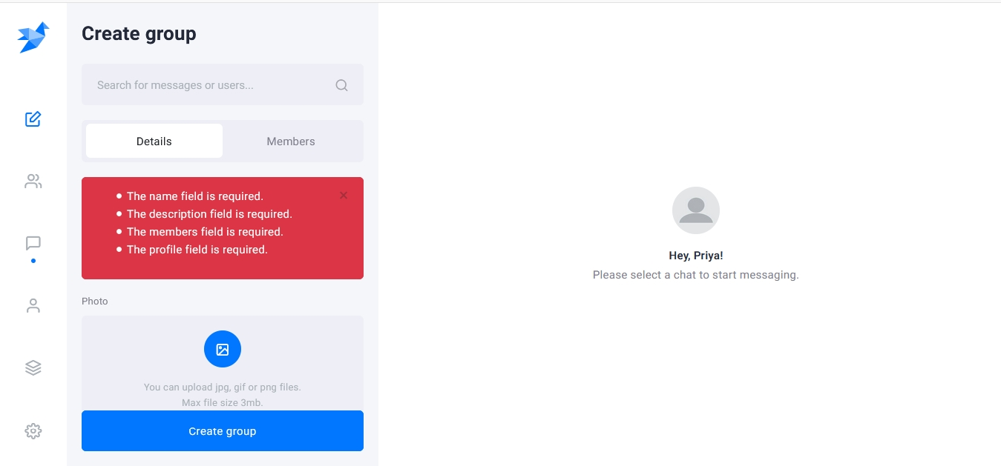
6.1 Create group

Slide 48
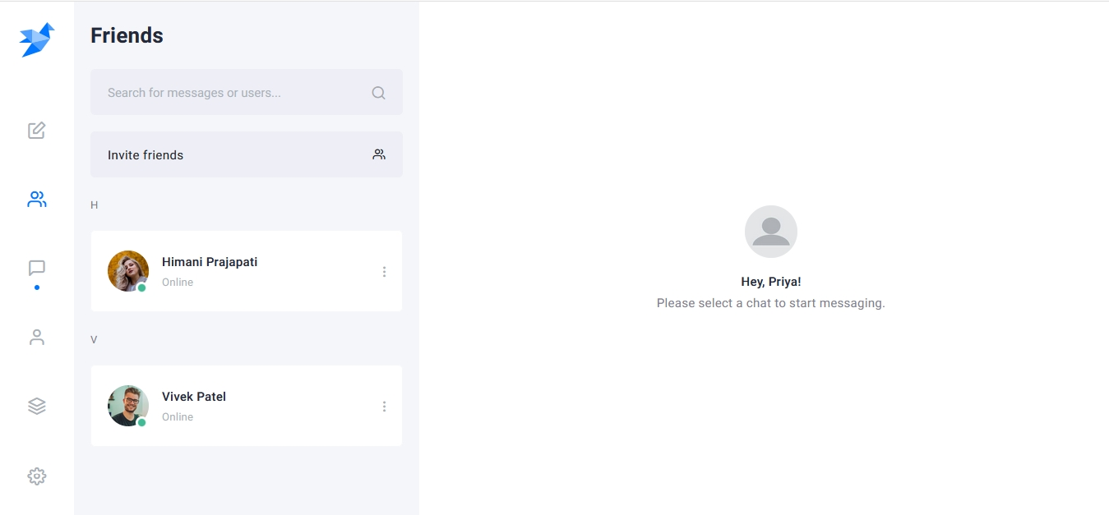
7.Friend form

Slide 49
REFERENCES
Facebook
WhatsApp
Telegram
Google.com
Instagram
Twitter

Slide 50
Thank You

