Slide 1


Halil İbrahim KALKAN
Designing Modularity on ASP.NET Core
Web: halilibrahimkalkan.com | Github: @hikalkan | Twitter: @hibrahimkalkan

Slide 2
Designing Modularity Introduction

Slide 3

Modular Architecture Goals
Reduce application complexity by creating separately developed, isolated and integrated application units.
Code reuse: Use same module by different applications.
Deploy only which modules are needed.
VS

Slide 4
Modular Architecture Problems
Lack of integration & communication of modules.
Complexity of the infrastructure – needs to a framework!
VS

Slide 5
Monolithic Application
VS
Services directly injects & use other services.
Developed and deployed as a single unit.

Slide 6
Monolithic Application Layered Architecture
Domain Driven Design (DDD) Layers
Infrastructure
Layer
Presentation Layer
Application Layer
VS
Domain Layer
A layer can only depend on the layers below.
Infrastructure layer supports other layers by implementing abstractions via Vendors.

Slide 7
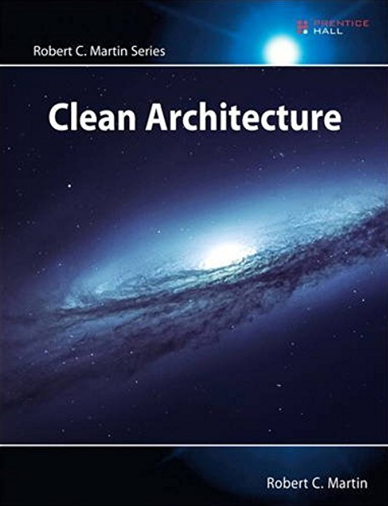
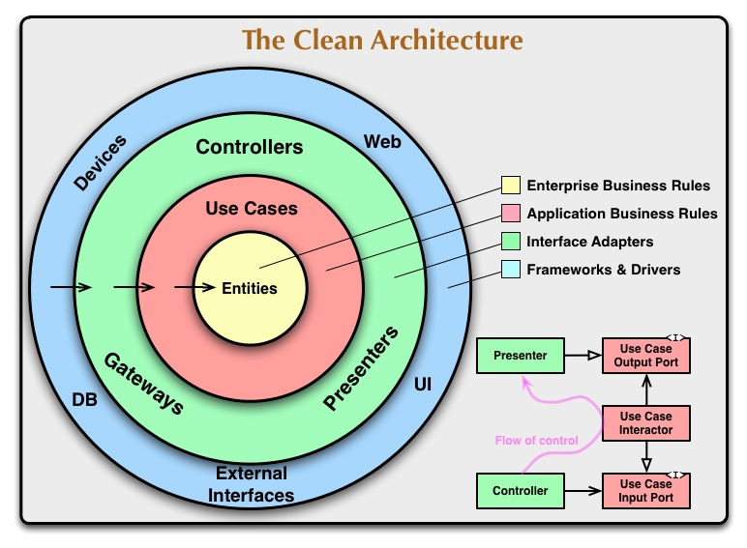
VS

Slide 8
Monolithic Application Modular Architecture
Monolithic Application
Module - 1
Module - 2
VS
Module - 3
Module - 4
Application functionalities are separated into multiple modules (bounded contexts).
Every module can be layered as multiple assemblies (projects).
A module can depend on another via project/DLL reference.
Still deployed as a single unit.
Module - 5
Module - 6

Slide 9
Microservices Architecture
Microservice - 1
Microservice - 2
Modules become services.
Every microservice can be layered as multiple assemblies (projects).
A module can depend on another via remote communication (REST, GraphQL, Messaging… etc).
A microservice is separately deployed, updated, versioned.
VS
Microservice - 3
Microservice - 4

Slide 10
What is a Module?
BUSINESS
MODULES
INFRASTRUCTURE
MODULES
VS

Slide 11
What is a Module?
Business Modules A unit of code base that implements some business functionalities. Consists of;
A database schema (and data)
Application/business code: Entities, Services, DTOs… etc.
Remote API: REST, GraphQL… etc.
UI Pages & Components

Slide 12
What is a Module?
Infrastructure (Framework) Modules A unit of code base that provides some common infrastructure services. Examples;
Authorization
Localization
Audit logging
Caching
Email sending
Integration modules (EF Core, MongoDB… etc.)

Slide 13
Why need to a Framework?

Slide 14
Why need to a Framework?
Application Startup
Runtime Services & Abstractions
Integration/Adapters
Conventions
Service Registration (for DI) Service Configuration Startup Actions Configure Module Dependencies

Slide 15
Why need to a Framework?
Application Startup
Runtime Services & Abstractions
Integration/Adapters
Conventions
Abstractions for Infrastructure: IRepository, IEmailSender, IBackgroundJobManager, INotificationSender… etc.
Common Functionality: Bundling & Minification, Logging, Caching, Authorization, Validation, Theming, Event Bus…

Slide 16
Why need to a Framework?
Application Startup
Runtime Services & Abstractions
Integration/Adapters
Conventions
Integration to ASP.NET Core Services: Localization, Razor Views, Static Files, Conventional APIs… etc.
Integration to database providers (like EF Core, MongoDB)
Adapters to 3rd-party libraries

Slide 17
Why need to a Framework?
Application Startup
Runtime Services & Abstractions
Integration/Adapters
Conventions
Reduce code duplication by defining useful conventions
Automate whatever possible

Slide 18
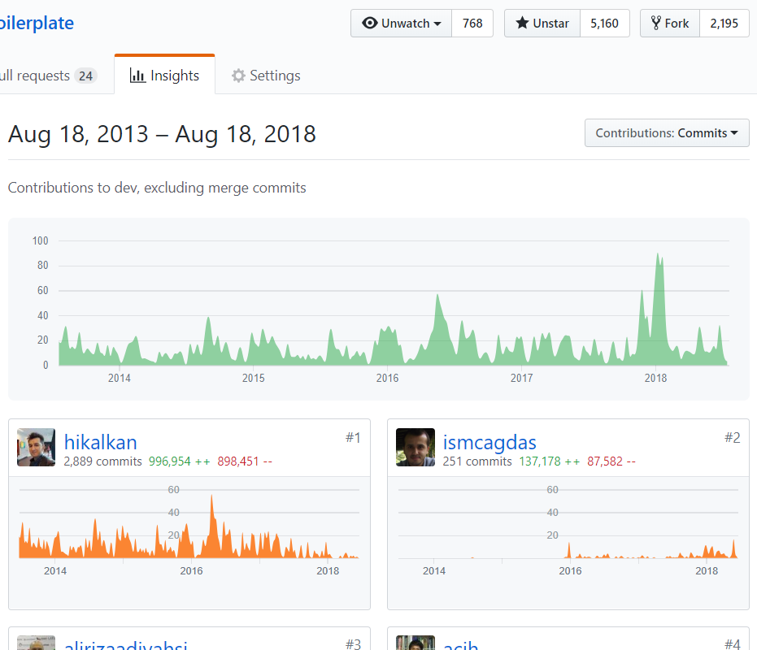
ASP.NET Boilerplate Open Source Web Application Framework
VS
5,200+ stars on Github 600,000+ downloads on Nuget 5+ years of continuos development
Web: aspnetboilerplate.com Github: github.com/aspnetboilerplate Twitter: @aspboilerplate

Slide 19
Implementation of the Infrastructure/Framework

Slide 20
Application Startup
Root Module
Investigate and sort modules using module dependencies starting from the ROOT MODULE.
Add PLUGIN modules.
CONFIGURE & INITIALIZE all modules.
Module A
Module B
VS
Module C
Module D
Module E
Module F

Slide 21
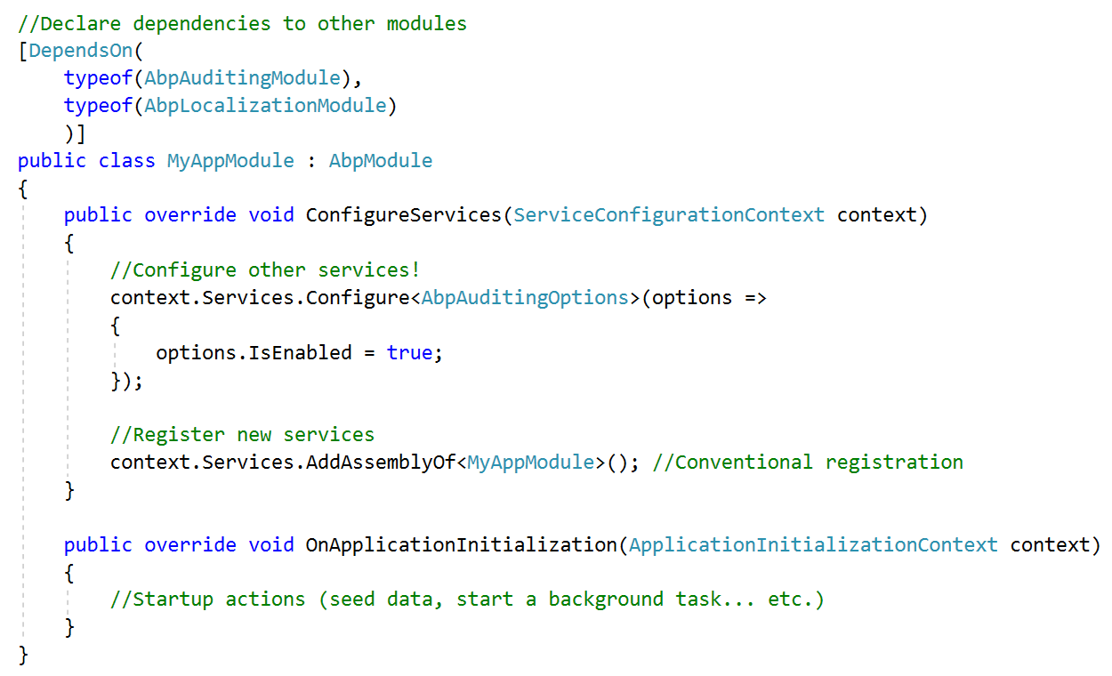
Application Startup
VS

Slide 22
Designing Modularity The Data Part

Slide 23
Database Best Practices
Every module owns its own isolated database schema (tables, views, stored procedures… etc.).
Avoid to establish cross-module foreign keys.
Avoid to depend on and manipulate (extend) other module’s schema.
Every module may use a different ORM or database provider (EF Core, Dapper, MongoDB… etc.) or even a module may support multiple providers.
VS

Slide 24
Schema/Database Sharing
A module can use & extend other module’s db schema only if it directly depends on that module as a project/dll reference.
If two modules share a common schema part, a 3rd module can be created that owns the common schema.
Every module may have its own physical database or a single physical database may contain more than one module schema.
VS

Slide 25
Database Abstractions
Repositories to abstract data access API.
Unit of work to manage database connection and transactions.
VS

Slide 26
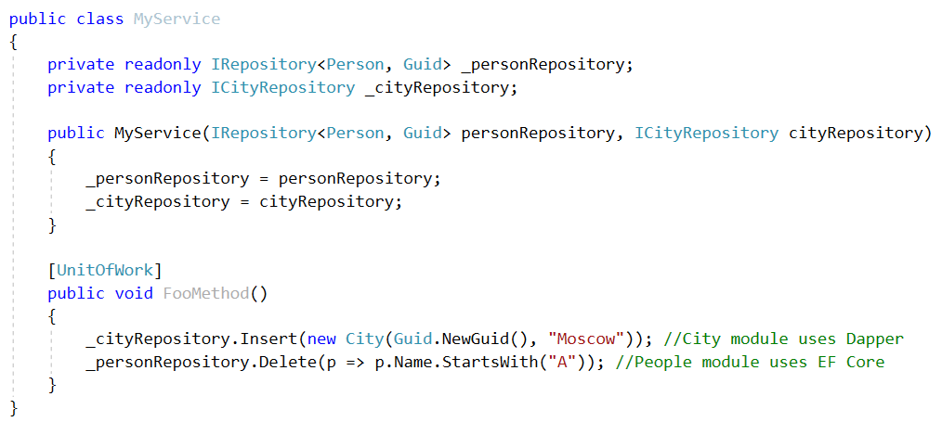
Database Abstractions
VS

Slide 27
Designing Modularity User Interface

Slide 28

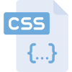

User Interface Components
User Interface
Static Resources
Dynamic Resources
VS
Razor Views
Razor Pages
View Components
Tag Helpers
/wwwroot
/ (root)
DLL files
StaticFiles Middleware
Razor View Engine
app.UseStaticFiles();

Slide 29
UI in a modular application
Embedded Files
Embedded Files
Embedded Files
@razor .cshtml
@razor .cshtml
@razor .cshtml
Module 1
Module 2
Module 3
Application
@razor .cshtml
Physical Files

Slide 30
Virtual File System
Static File Middleware (.css, .js, .png…)
Razor View Engine (.cshtml)
Pyhsical Files: Files under wwwroot folder.
Embedded Files: Static & dynamic resources in module DLLs.
Dynamic Files: Runtime generated files like CSS/JS bundles.
Overriding: Dynamic > Physical > Embedded
VS
Virtual File System
Physical Files (wwwroot)
Embedded Files (DLL)
Dynamic Files (Memory)

Slide 31
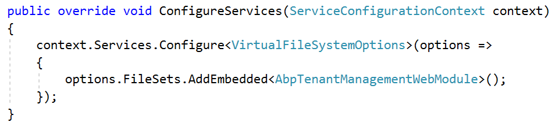
Virtual File System Contribution by Modules
VS

Slide 32
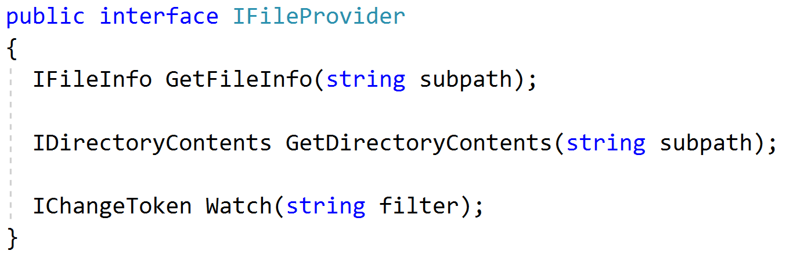
Virtual File System IFileProvider Interface
VS

Slide 33
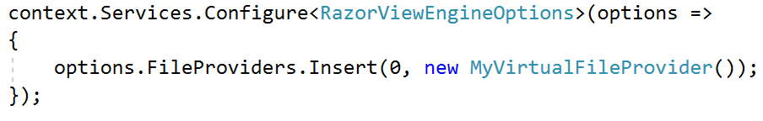
Virtual File System Configure Razor View Engine
VS

Slide 34

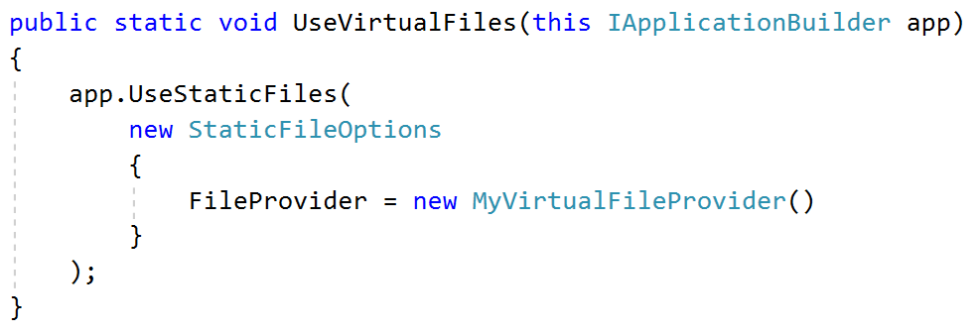
Virtual File System Replace Static File Middleware
VS

Slide 35
Depending on 3-rd Party JS/CSS Libraries
Font Awesome
JQuery
JQuery Validation
Bootstrap
Use NPM/Yarn as UI package manager.
Should depend on the same version of a library from all modules.
Determine a set of common libraries (jQuery, Bootstrap, Toastr, Datatables…).
Copy just needed files from node_modules to wwwroot/libs folder.
BS Datatables
VS
Module - 1
Module - 2

Slide 36
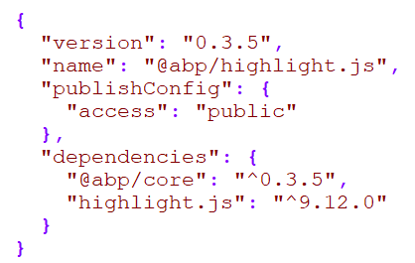
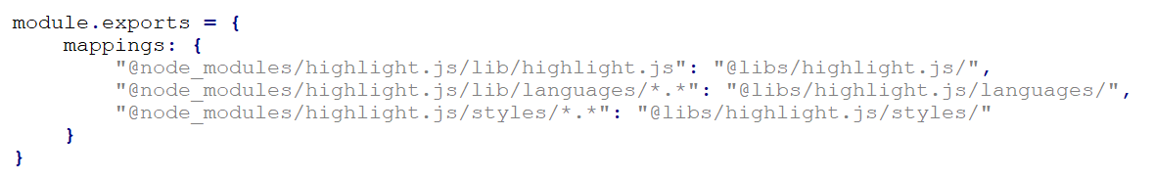
Standard Packages
package.json for @abp/highlight.js
Ensures that all modules use the same version of the library.
Contains configuration to copy files from node_modules to wwwroot/libs.
VS
abp.resourcemapping.js for @abp/highlight.js

Slide 37
Bundling & Minification
Should bundle & minify files distributed into DLLs as embedded resources.
Should be combined with the Virtual File System.
Should prevent duplication of css/js files in a bundle and in a page.
Should add dependencies to the bundle/page automatically.
VS

Slide 38
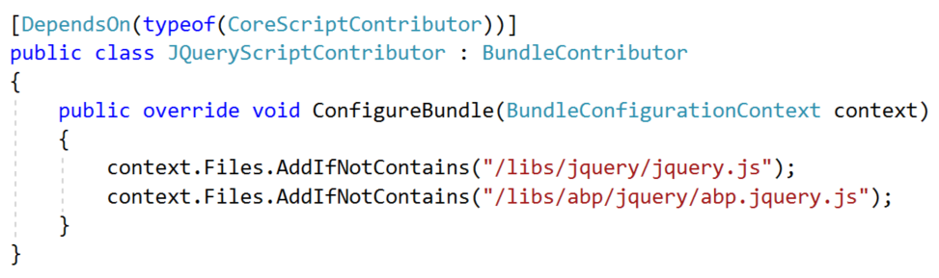
Bundle Contributors
VS

Slide 39
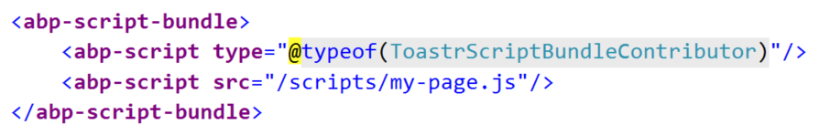
Create Bundle in views
Adding a single-file (and it’s dependencies) as a bundle:
VS
Creating a new bundle on the fly:

Slide 40
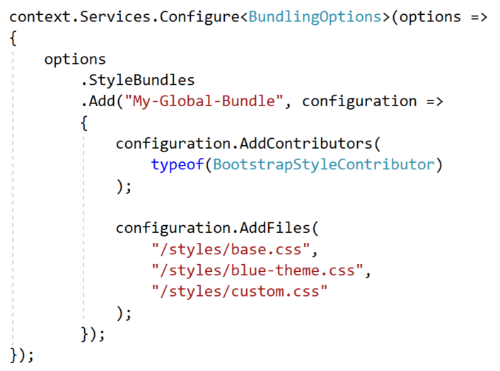
Create Bundle by code
VS

Slide 41
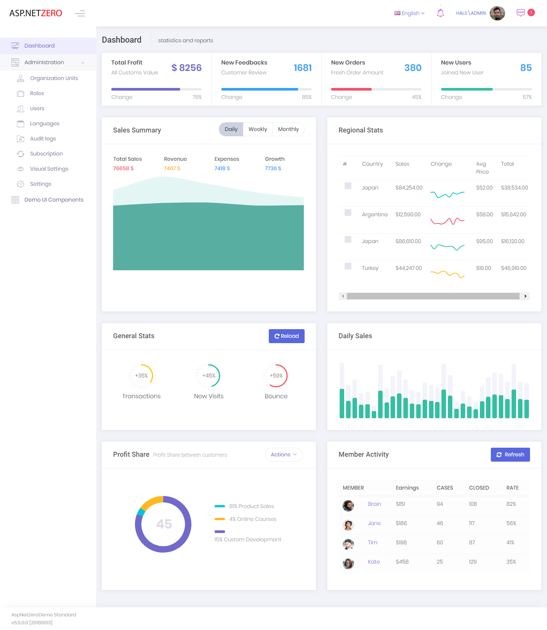
UI Layout
VS
The framework should provide toolbars, menus, header/footer areas, alert areas, sidebars, content areas and so on…

Slide 42
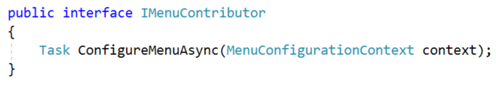
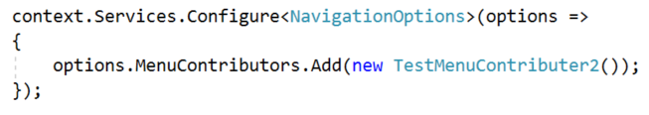
Menu Contributor
VS

Slide 43
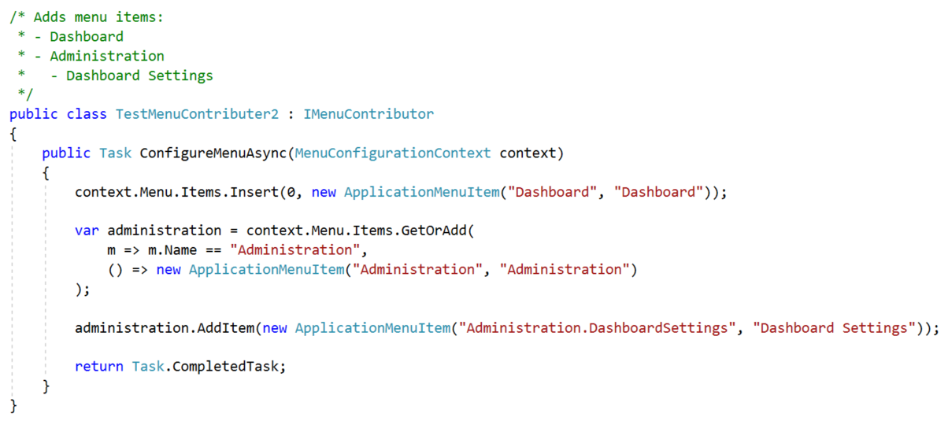
Menu Contributor
VS

Slide 44
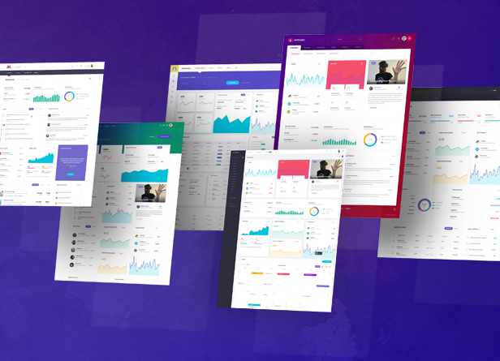
Theming
The framework may provide a theme system to allow applications;
Select one of the available themes (on the fly)
Configure the theme
Override the theme partially
Select a layout dynamically
Declare abstractions for themes (menu, toolbar, footer… etc.)
VS

Slide 45
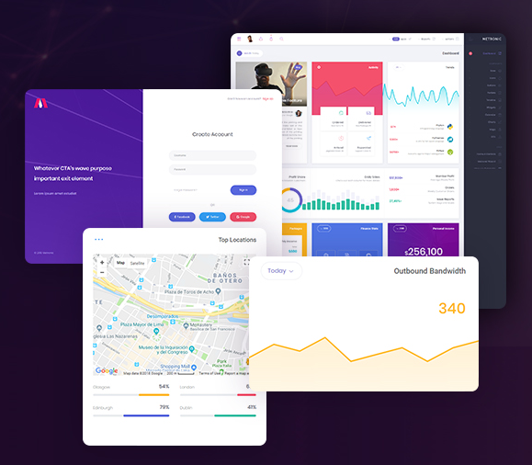
Theme Features
Multiple layouts
Account/Login page layout
Application layout
Public web site layout
Blank layout
Declare/manage css/js library dependencies and bundles
Implement theming abstractions
VS

Slide 46
Theme Base
Modules should be developed as theme-independent as much as possible.
All themes should share some common resources, libraries, functionalities and styles.
Bootstrap as the main HTML/CSS framework?
VS

Slide 47
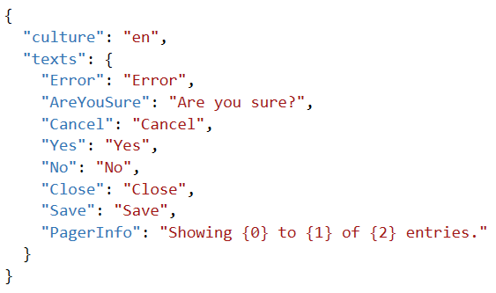
Flexible Localization
Every module should have an isolated localization resource.
A module may pre-define UI localization texts for several languages and can be translated later
May share some localization texts between modules (inheritance)
Override localization texts of a module (extend)
Integrated to the Virtual File System
Reuse same texts from JavaScript side
Dynamically override texts (by database)
VS

Slide 48
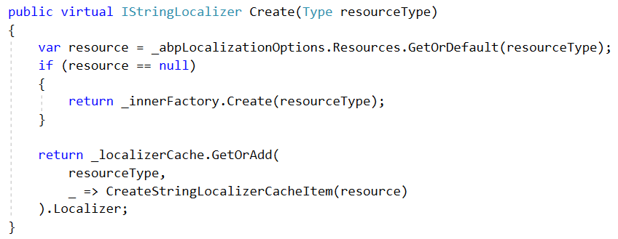
Replace IStringLocalizerFactory
VS

Slide 49
Using a Module as a Remote Service (Microservice?)

Slide 50
How to Use a module?
Embed a module into an application.
Use a module as a remote HTTP (REST) service via Client.
Embed UI into an application, but use the actual functionality (application layer) as a remote HTTP (REST) service via C# Client.
VS

Slide 51
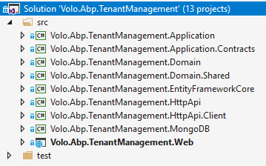
Module layers/projects
VS

Slide 52
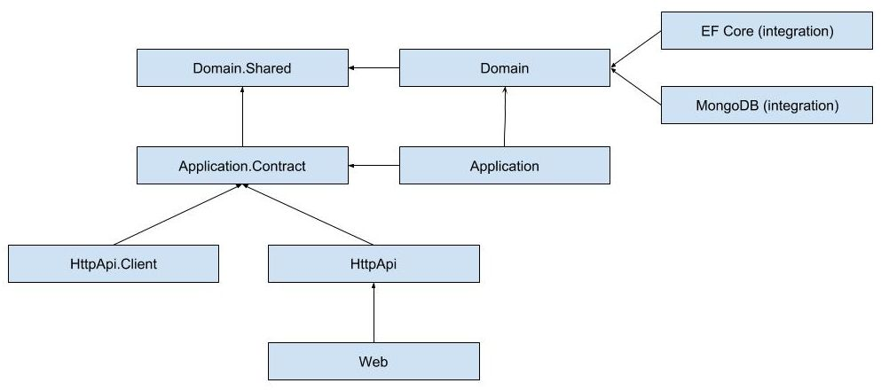
Module layers/projects
VS

Slide 53

Embed a module
VS
Application

Slide 54
Use as a Remote Service
VS
Application 1
(client)
Application 2 (remote service)

Slide 55
Embed UI, Use as a Remote Service
VS
Application 1
(UI + client)
Application 2 (remote service)

Slide 56
Designing Modularity Miscellaneous

Slide 57
In-Process Event Bus
Module 1
Module 2
VS
Domain/Business Events.
Pre-built events: Entity change events (created, updated, deleted).
One publisher, multiple subscriber.
Publish Events
Subscribe to Events
Event Bus

Slide 58
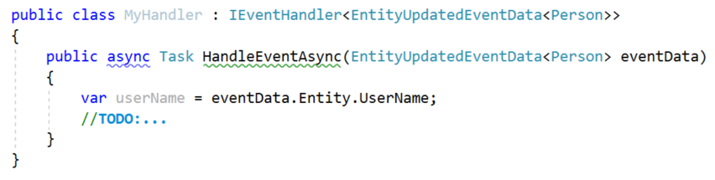
Sample Event Handler
VS

Slide 59
Trigger An Event
VS

Slide 60

Distributed Event Bus/Queue
Module 1
Module 2
Message Broker
VS
Used to communicate between distributed applications/services.
Message Brokers: RabbitMQ, MSMQ…
Domain/Business Events.
FIFO, Pub/sub model.
Module 3
Module 4

Slide 61
Common Infrastructure
The framework should provide module-independent common functionalities. Some examples:
Background job system
Sending email & SMS
Multi-tenancy
Audit logging
Object2Object mapping
Common utilities

Slide 62
Extensibility & Customization
The framework & modules should be easily configurable, customizable and extensible:
Replacing a service
Overriding methods
Extension points
Configuration options
Extending/Deriving entities

