Slide 1
Multi-Tenancy
Development, Challenges & Solutions.

Slide 2
Halil İbrahim Kalkan
Github: @hikalkan
Twitter: @hibrahimkalkan
http://halilibrahimkalkan.com

Slide 3
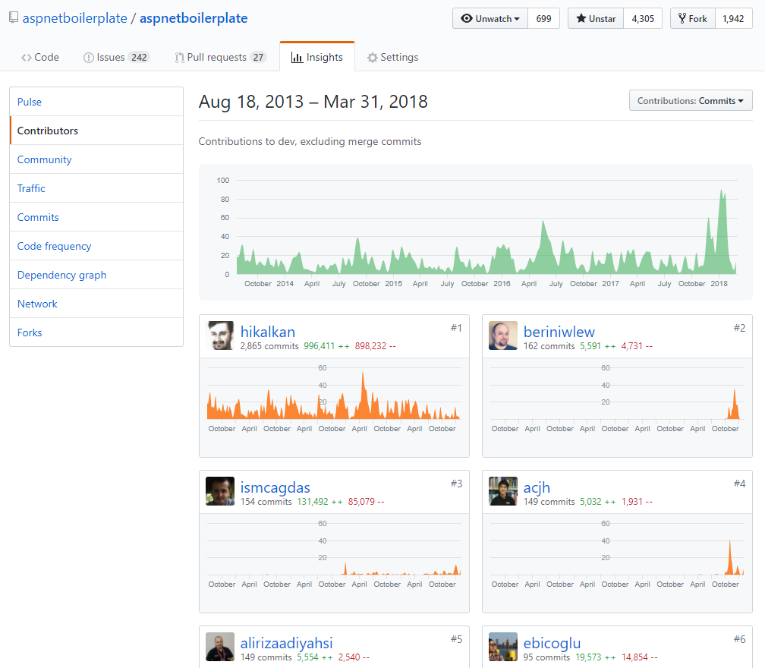
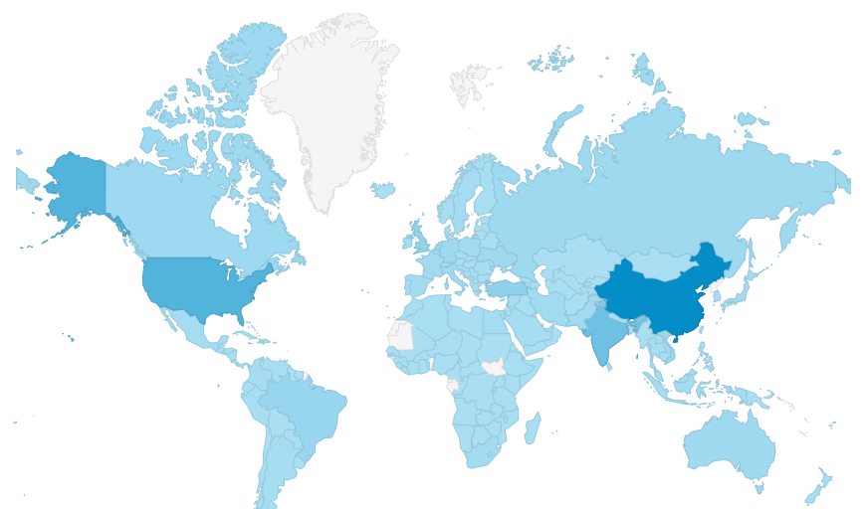
ASP.NET Boilerplate https://aspnetboilerplate.com
4.5+ years of continuous development.
4,300+ stars on Github.
470,000+ downloads on Nuget.

Slide 4
Two content layout with table
First bullet point here
Second bullet point here
Third bullet point here
Class | Group 1 | Group 2
Class 1 | 82 | 95
Class 2 | 76 | 88
Class 3 | 84 | 90

Slide 5
Title and content layout with SmartArt
Step 1 Title
Task description
Step 2 Title
Task description
Step 3 Title
Task description

Slide 6
Add a Slide Title - 1

Slide 7
Add a Slide Title - 2

Slide 8
Add a Slide Title - 3

Slide 10
Add a Slide Title - 4

Slide 11
Add a Slide Title - 5

