Slide 1


Halil İbrahim KALKAN Volosoft
Designing Modularity on ASP.NET Core
Web: halilibrahimkalkan.com | Github: @hikalkan | Twitter: @hibrahimkalkan

Slide 2
Designing Modularity Introduction

Slide 3

Modular Architecture Goals
Reduce application complexity by creating separately developed (probably by different teams), isolated and integrated application units.
Code reuse: Use same module by different applications.
Deploy only which modules are needed.
VS

Slide 4
Modular Architecture Problems
Lack of integration & communication of the modules.
Complexity of the infrastructure – needs to a framework!
VS

Slide 5
Monolithic Application
VS
Developed as a single code base and deployed as a single application.
Services directly injects & use other services.

Slide 6
Monolithic Application Layered/Clean Architecture
Domain Driven Design (DDD) Layers
Infrastructure
Layer
Presentation Layer
Application Layer
VS
Domain Layer
A layer can only depend on the layer below.
Infrastructure layer supports other layers by implementing abstractions.

Slide 7
Monolithic Application Modular Architecture
Monolithic Application
Module - 1
Module - 2
Application functionalities are separated into multiple modules (bounded contexts).
Every module can be layered as multiple assemblies (projects).
A module can depend on another via project/DLL reference.
Still deployed as a single unit.
VS
Module - 3
Module - 4
Module - 5
Module - 6

Slide 8
Microservices Architecture
Microservice - 1
Microservice - 2
Modules become services.
Every microservice can be layered as multiple assemblies (projects).
A module can depend on another via remote communication (REST, GraphQL, Messaging… etc).
A microservice is separately versioned, deployed and updated.
VS
Microservice - 3
Microservice - 4

Slide 9
What is a Module?
BUSINESS
MODULES
INFRASTRUCTURE
MODULES
VS

Slide 10
What is a Module?
Business Modules A unit of code base that implements some business functionality. Generally consists of;
A database schema (and data)
Application/business code: Entities, Services, DTOs… etc.
UI Pages & Components
Remote API: REST, GraphQL… etc.

Slide 11
What is a Module?
Infrastructure (Framework) Modules A unit of code base that provides some common infrastructure services. Examples;
Authorization
Localization
Audit logging
Caching
Email sending
Integration modules (EF Core, MongoDB… etc.)

Slide 12
Why need to a Framework?

Slide 13
Why need to a Framework?
Application Startup
Runtime Services & Abstractions
Integration/Adapters
Conventions
Service Registration (for DI) Service Configuration Startup Actions Manage Module Dependencies

Slide 14
Why need to a Framework?
Application Startup
Runtime Services & Abstractions
Integration/Adapters
Conventions
Abstractions for Infrastructure: IRepository, IEmailSender, IBackgroundJobManager, INotificationSender… etc.
Common Functionality: Bundling & Minification, Logging, Caching, Authorization, Validation, Theming, Event Bus…

Slide 15
Why need to a Framework?
Application Startup
Runtime Services & Abstractions
Integration/Adapters
Conventions
Integration to ASP.NET Core Services: Localization, Razor Views, Static Files, Conventional APIs… etc.
Integration to database providers (like EF Core, MongoDB)
Adapters to 3rd-party libraries

Slide 16
Why need to a Framework?
Application Startup
Runtime Services & Abstractions
Integration/Adapters
Conventions
Reduce code duplication by defining useful conventions
Automate whatever possible

Slide 17
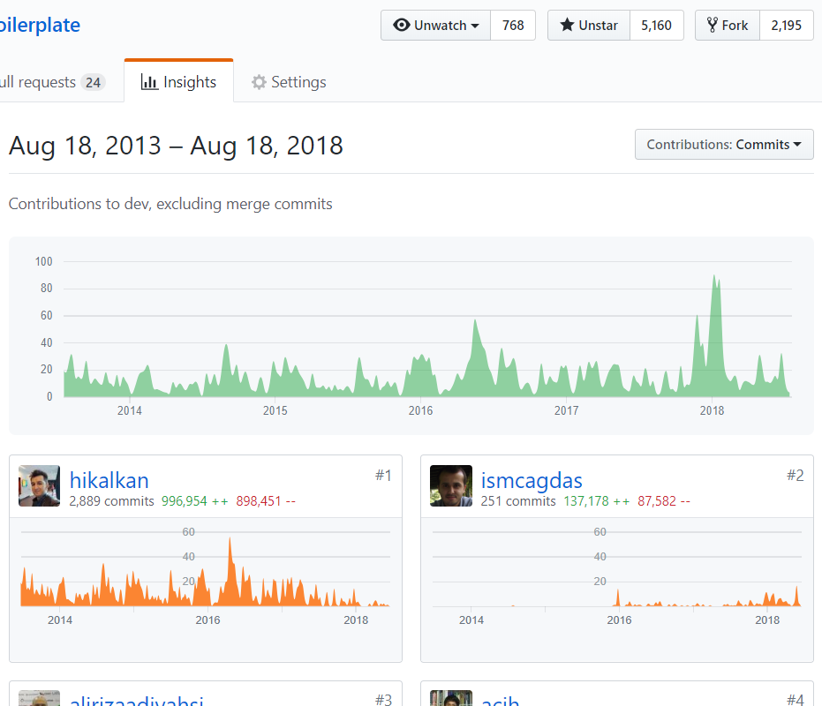
ASP.NET Boilerplate Open Source Web Application Framework
VS
5,200+ stars on Github 600,000+ downloads on Nuget 5+ years of continuous development
Web: aspnetboilerplate.com Github: github.com/aspnetboilerplate Twitter: @aspboilerplate

Slide 18
Implementation of the Infrastructure/Framework

Slide 19
Application Startup
Root Module
Investigate and sort modules using module dependencies starting from the ROOT MODULE.
Add PLUGIN modules.
CONFIGURE & INITIALIZE all modules.
Module A
Module B
VS
Module C
Module D
Module E
Module F

Slide 20
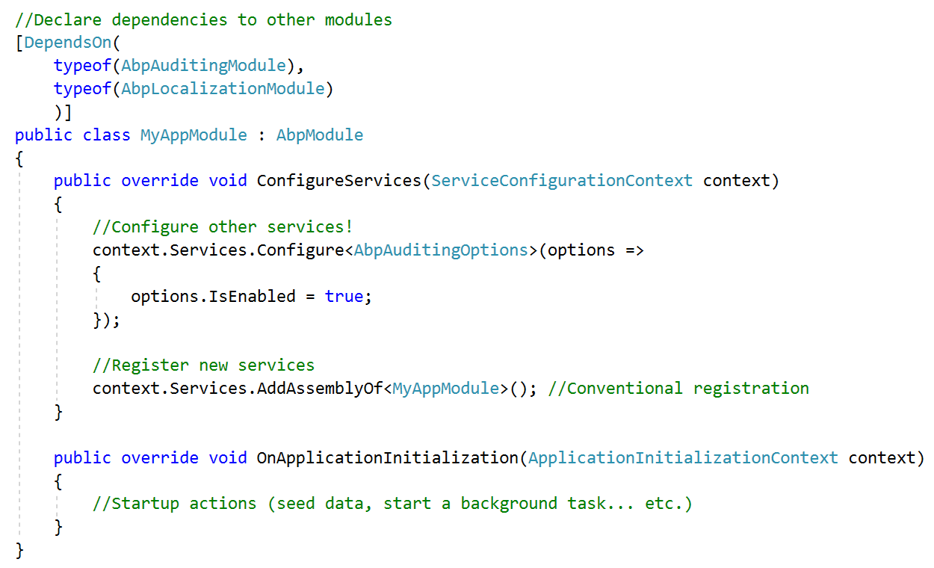
Application Startup
VS

Slide 21
Designing Modularity The Data Part

Slide 22
Database Practices Ideal Design
Every module owns its isolated database schema (tables, views, stored procedures… etc.) and data.
Every module may use a different ORM or database provider (EF Core, Dapper, MongoDB… etc.) or even a module may support multiple providers.
For EF Core, every module has its own DbContext.
Avoid to establish cross-module foreign keys.
Avoid to depend on and manipulate (extend) other module’s schema.
Multiple module may use the same physical database for simpler maintenance.
SQL Server
SQL Server
MongoDB
Module 1
Module 2
Module 3
VS
Application

Slide 23

Database Practices Schema Dependency
Requires DLL dependency.
Database Schema Migrations
PostCount should be nullable or should have a default value.
Blogging module should strictly follow Identity schema changes.
Shared schema can be extracted to a shared/common module.
Leads to tightly couple all modules.
Identity Module
Blogging Module
VS
Shared

Slide 24


Database Practices Loosely Coupling
Users Abstraction
Create an abstraction.
Depend on the abstraction
Define events in the abstraction (Create/Update/Delete…)
Register to events.
Trigger events.
Identity Module
events
Blogging Module
VS

Slide 25
Database Practices Adapter Libraries
DB
DB
Identity modules has no change and no info about the integration.
Blogging module defines abstractions for adapters.
Blogging.Identity (adapter) module makes Blogging module working with the Identity module.
Identity Module
Blogging Module
VS
Blogging.Identity Module (adapter)
Application

Slide 26
Database Abstractions
Repositories to abstract data access API (to be ORM idependent).
Unit of work to manage database connection and transactions.
VS

Slide 27
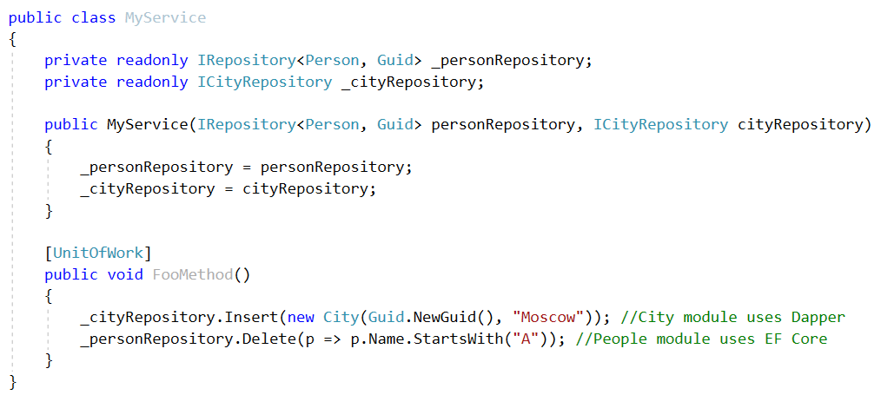
Database Abstractions
VS

Slide 28
Designing Modularity User Interface

Slide 29

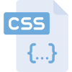

User Interface Components
User Interface
Static Resources
Dynamic Resources
VS
Razor Views
Razor Pages
View Components
Tag Helpers
/wwwroot
/ (root)
DLL files
StaticFiles Middleware
Razor View Engine
app.UseStaticFiles();

Slide 30
UI in a modular application
Embedded Files
Embedded Files
Embedded Files
@razor .cshtml
@razor .cshtml
@razor .cshtml
Module 1
Module 2
Module 3
Application
@razor .cshtml
Physical Files

Slide 31
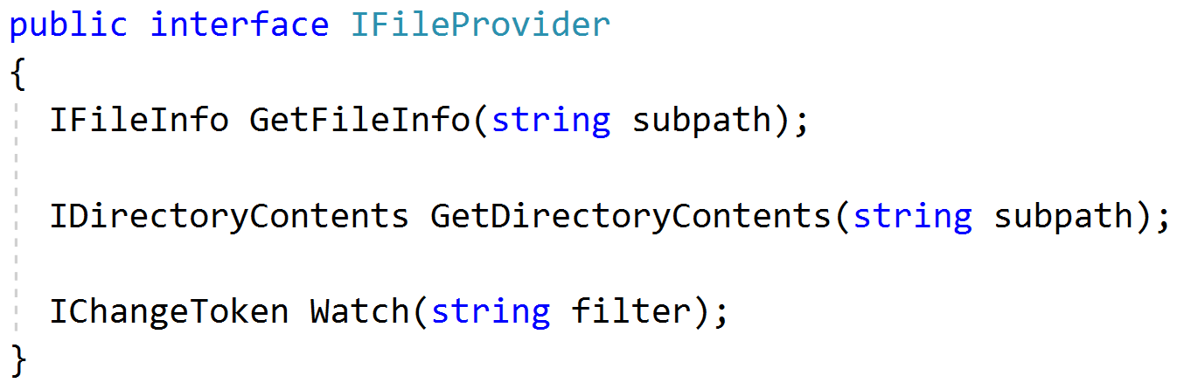
IFileProvider Interface
VS

Slide 32
Virtual File System
Static File Middleware (.css, .js, .png…)
Razor View Engine (.cshtml)
Pyhsical Files: Files under wwwroot folder.
Embedded Files: Static & dynamic resources in module DLLs.
Dynamic Files: Runtime generated files like CSS/JS bundles.
Overriding: Dynamic > Physical > Embedded
VS
Virtual File Provider (IFileProvider)
Physical Files (wwwroot)
Embedded Files (DLL)
Dynamic Files (Memory)

Slide 33
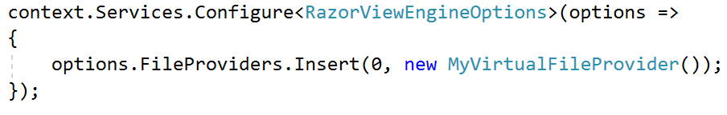
Virtual File System Configure Razor View Engine
VS

Slide 34

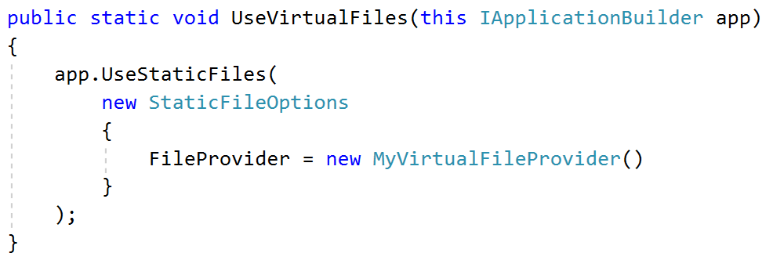
Virtual File System Replace Static File Middleware
VS

Slide 35
Depending on 3-rd Party JS/CSS Libraries
Font Awesome
JQuery
JQuery Validation
Bootstrap
Use NPM/Yarn as UI package manager.
Should depend on the same version of a library from all modules.
Determine a set of common libraries (jQuery, Bootstrap, Toastr, Datatables…).
Copy just needed files from node_modules to wwwroot/libs folder.
BS Datatables
VS
Module - 1
Module - 2

Slide 36
Bundling & Minification
Should bundle & minify files distributed into DLLs as embedded resources.
Should be combined with the Virtual File System.
Should prevent duplication of css/js files in a bundle and in a page.
Should add dependencies to the bundle/page automatically.
Should dynamically arrange and update bundles.
VS

Slide 37
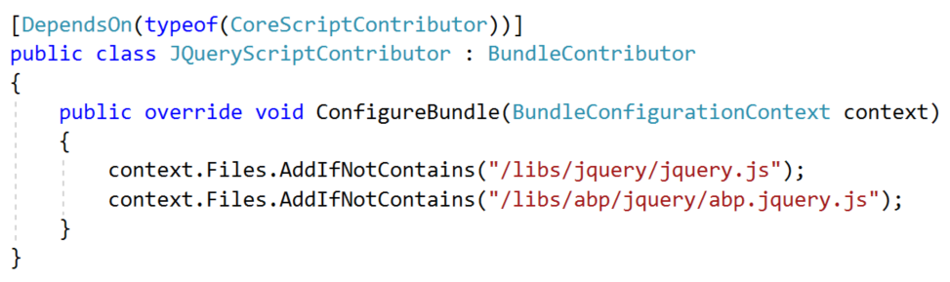
Bundle Contributors
VS

Slide 38
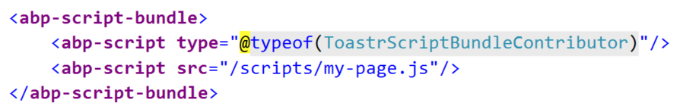
Create Bundle in views
Adding a single-file (and it’s dependencies) as a bundle:
VS
Creating a new bundle on the fly:

Slide 39
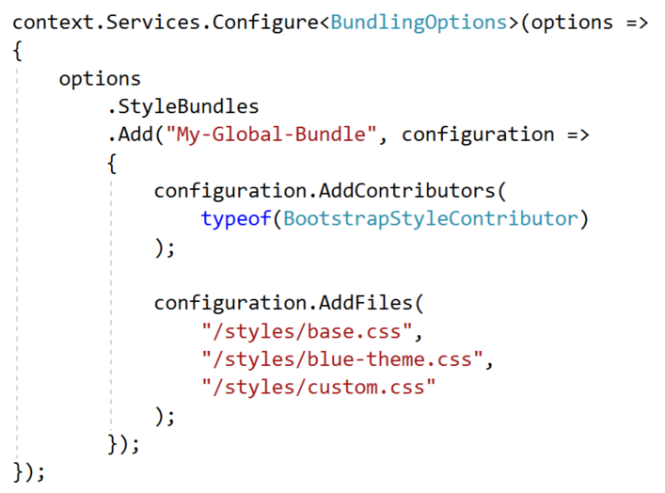
Create Bundle by code
VS

Slide 40
Create Bundle by code
VS

Slide 41
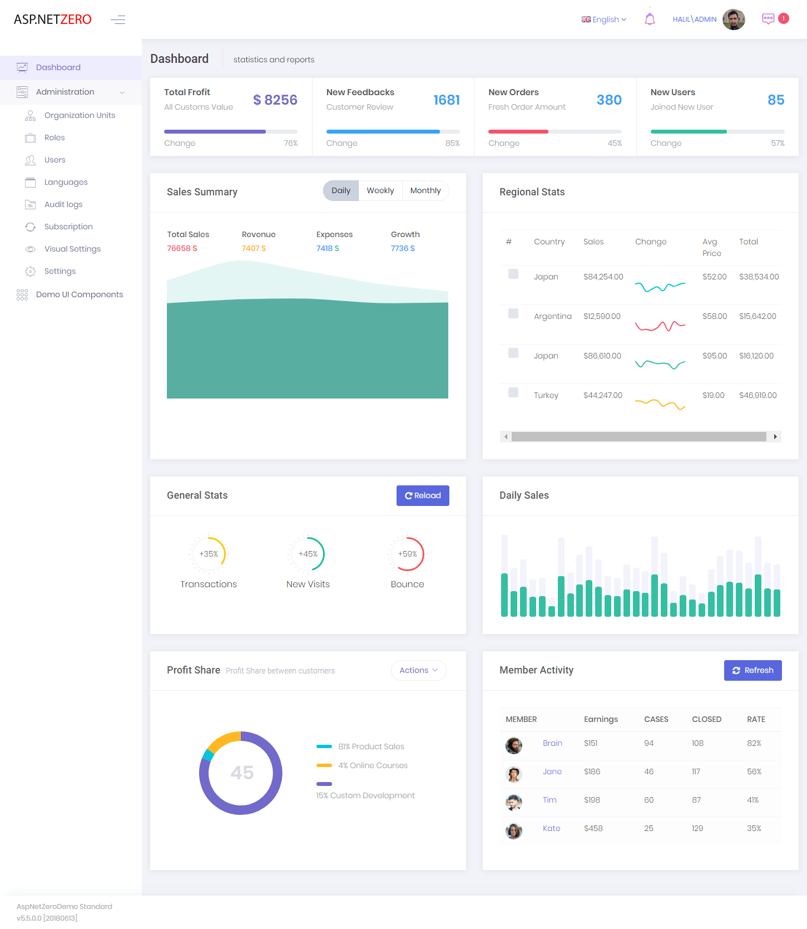
UI Layout
VS
The framework should provide toolbars, menus, header/footer areas, alert areas, sidebars, content areas and so on…

Slide 42
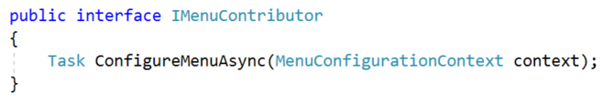
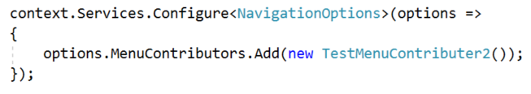
Menu Contributor
VS

Slide 43
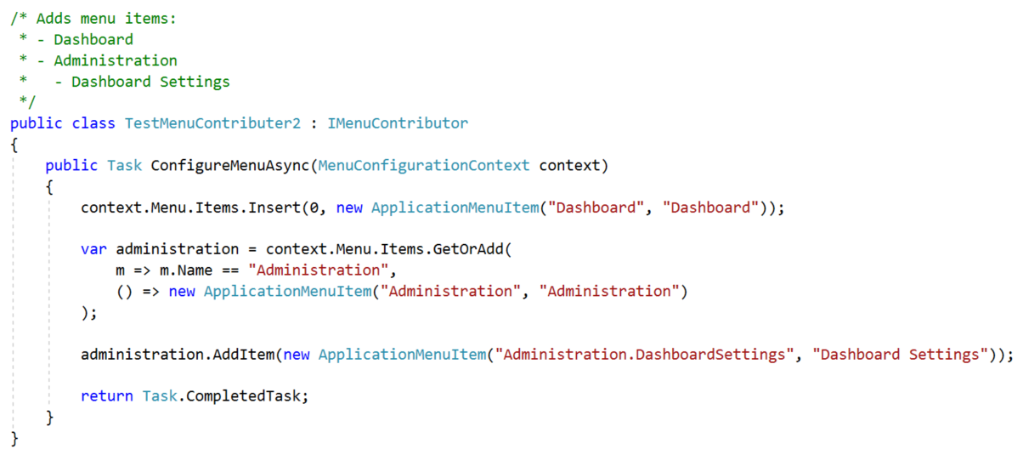
Menu Contributor
VS

Slide 44
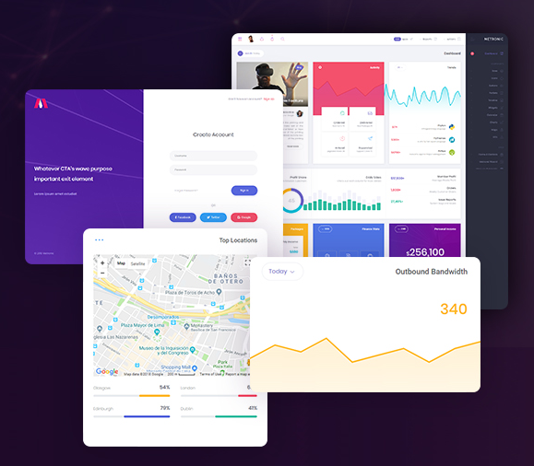
Theming
Multiple layouts
Account/Login page layout
Application layout
Public web site layout
Blank layout
Declare/manage css/js library dependencies and bundles
Render menus, toolbars… contributed by the modules
VS

Slide 45
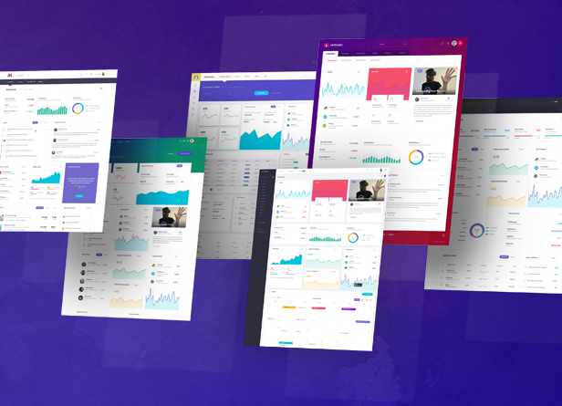
Theming
Select one of the available themes (on the fly)
Configure the theme
Select a layout dynamically (among multiple layouts)
Override the theme partially
VS

Slide 46
Theme Base
Modules should be developed as theme-independent as much as possible.
All themes should share some common resources, libraries, functionalities and styles.
Bootstrap as the main HTML/CSS framework?
VS

Slide 47
Using a Module as a Remote Service (Microservice?)

Slide 48
How to Use a module?
Embed a module into an application.
Use a module as a remote HTTP (REST) service via Client.
Embed UI into an application, but use the actual functionality (application layer) as a remote HTTP (REST) service via C# Client.
VS

Slide 49
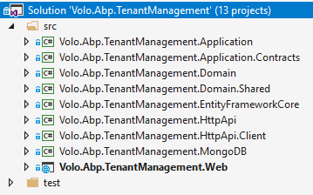
Module layers/projects
VS

Slide 50
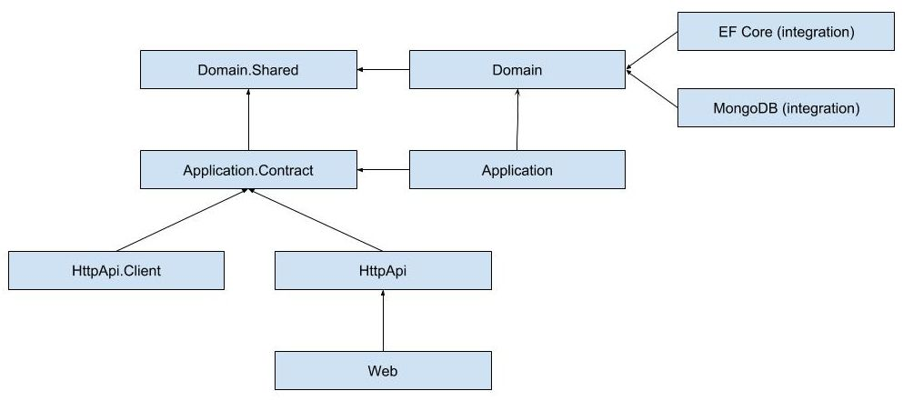
Module layers/projects
VS

Slide 51

Embed a module
VS
Application

Slide 52
Use as a Remote Service
VS
Application 1
(client)
Application 2 (remote service)

Slide 53
Embed UI, Use as a Remote Service
VS
Application 1
(UI + client)
Application 2 (remote service)

Slide 54
Designing Modularity Miscellaneous

Slide 55
In-Process Event Bus
Module 1
Module 2
VS
Domain/Business Events.
Pre-built events: Entity change events (created, updated, deleted).
One publisher, multiple subscriber.
Publish Events
Subscribe to Events
Event Bus

Slide 56
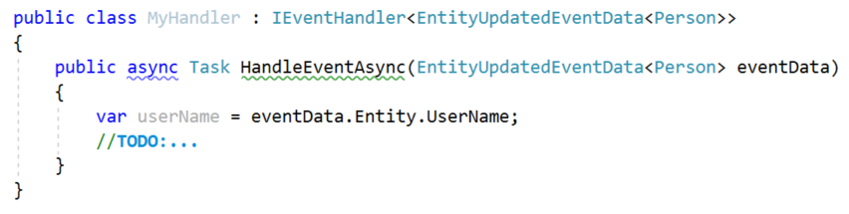
Sample Event Handler
VS

Slide 57
Trigger An Event
VS

Slide 58

Distributed Event Bus/Queue
Module 1
Module 2
Message Broker
VS
Used to communicate between distributed applications/services.
Message Brokers: RabbitMQ, MSMQ…
Domain/Business Events.
FIFO, Pub/sub model.
Module 3
Module 4

Slide 59
Common Infrastructure
The framework should provide module-independent common functionalities. Some examples:
Background job system
Sending email & SMS
Multi-tenancy
Audit logging
Object2Object mapping
Common utilities

Slide 60
Extensibility & Customization
The framework & modules should be easily configurable, customizable and extensible:
Replacing a service
Overriding methods
Extension points
Configuration options
Extending/Deriving entities

Slide 61
THANKS!
Web: halilibrahimkalkan.com
Github: @hikalkan
Twitter: @hibrahimkalkan
Halil İbrahim KALKAN Volosoft

