Slide 1
Multi-Tenancy
Development, Challenges & Solutions.

Slide 2
About Me
& My Company & My Projects

Slide 3
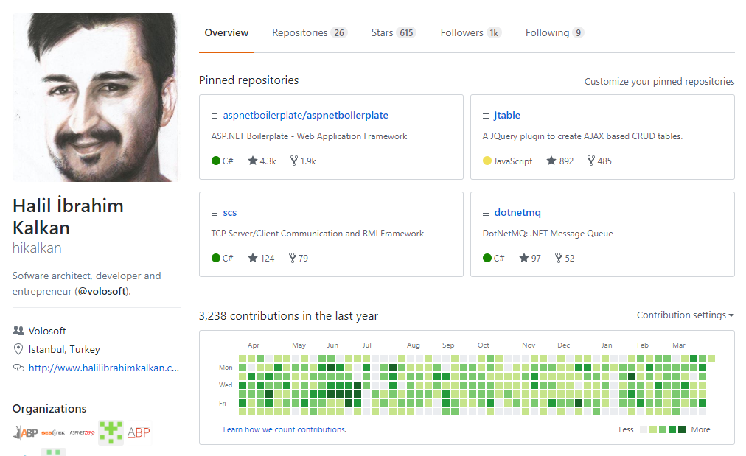
Halil İbrahim Kalkan
Github: @hikalkan
Twitter: @hibrahimkalkan
http://halilibrahimkalkan.com

Slide 4

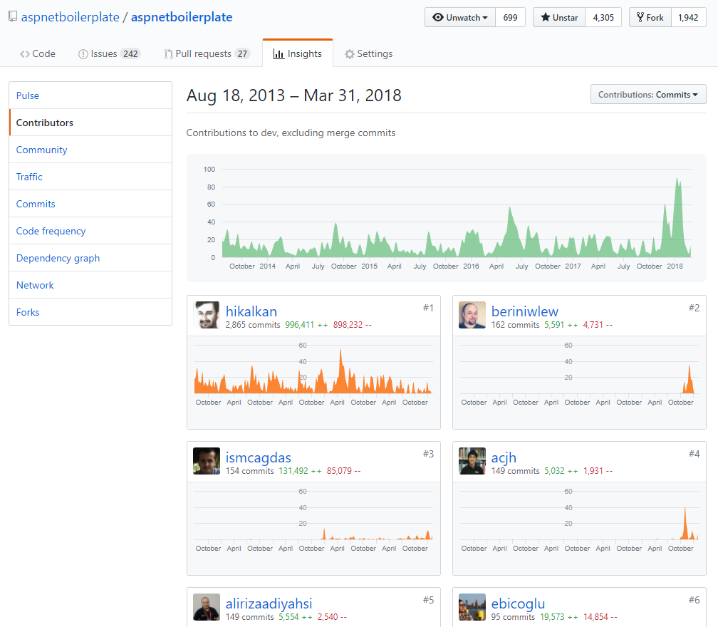
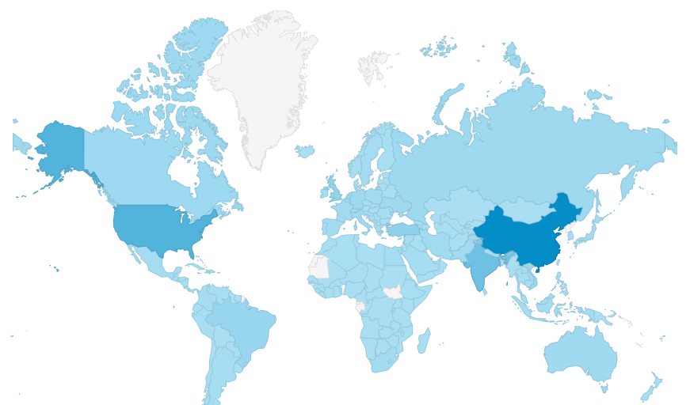
aspnetboilerplate.com
4.5 years of continuous development.
4,300+ stars on Github.
470,000+ downloads on Nuget.

Slide 5
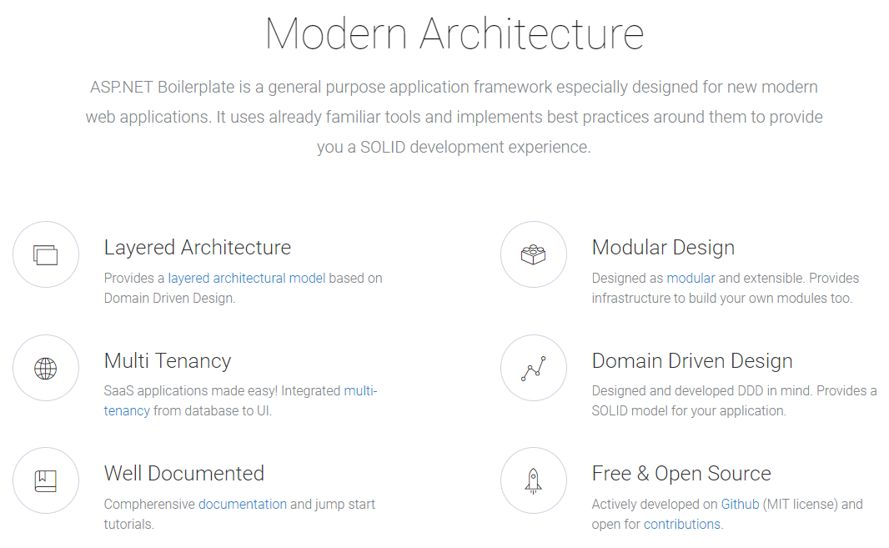

Slide 6
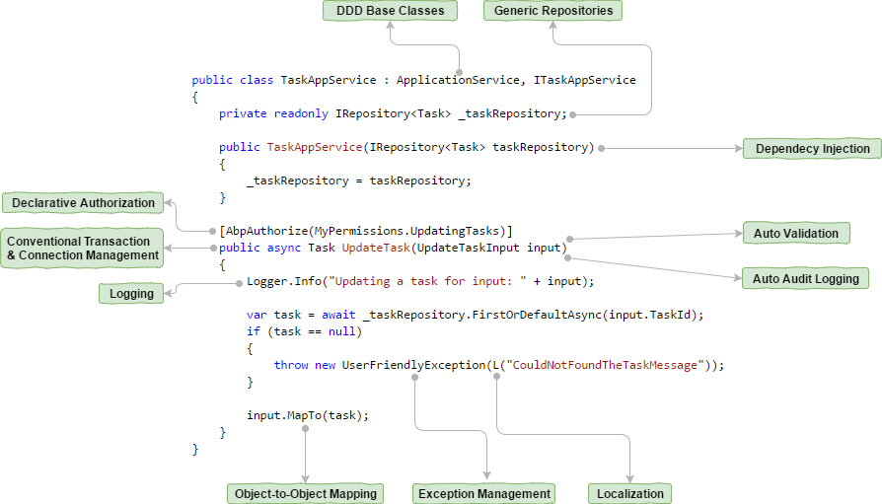

Slide 7
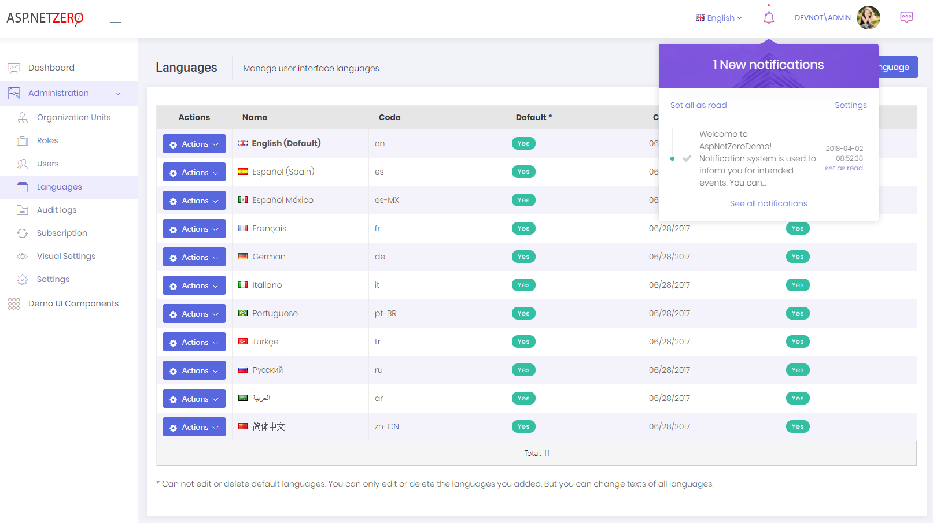
aspnetzero.com

Slide 8
SaaS
Software as a Service

Slide 9
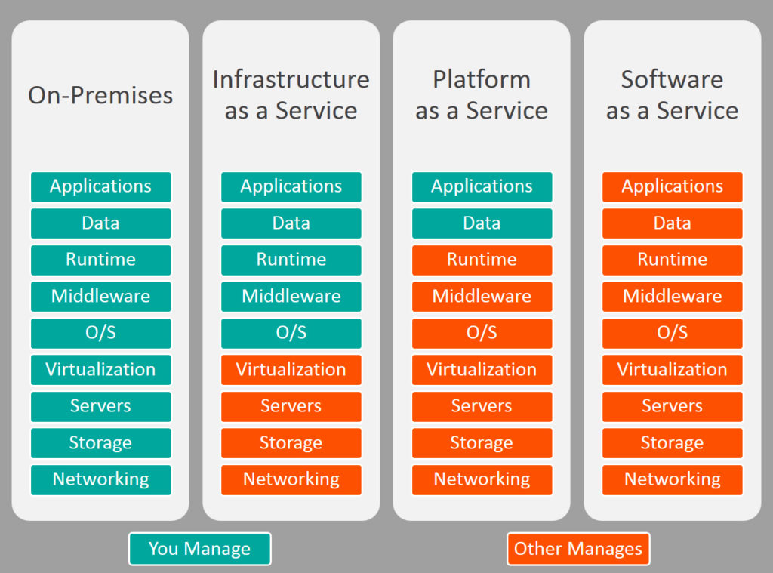

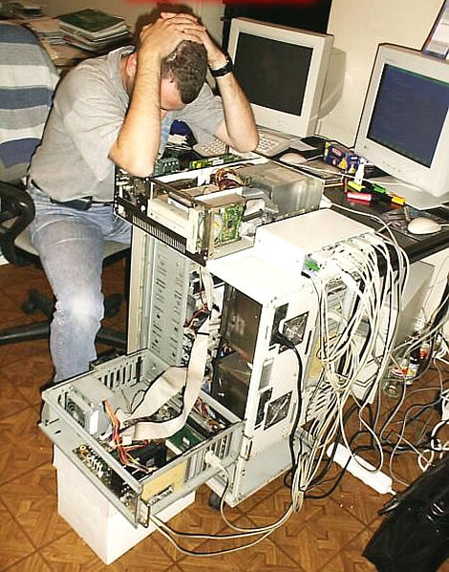
On-Premise / IaaS / PaaS / SaaS

Slide 10
SaaS Concepts
Tenant: An organization uses the application (and pay for it).
Host: The organization manages all the tenants.

Slide 11
SaaS Concepts
Edition/Package: A set of application features.
Subscription: Assigning a package to a tenant for a period of time.
Payment: A subscription has a price: Monthly, Yearly, User based and so on..

Slide 12
Multi-Tenancy
High-Level Architecture

Slide 13
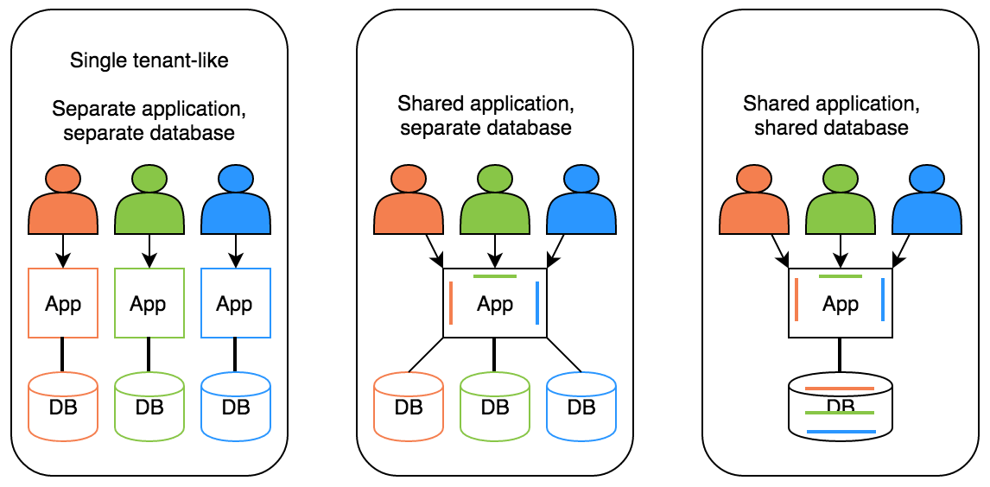
Deployment / Database Options
Hybrid

Slide 14
Ideal Multi-Tenant Application
Works exactly like on-premise: Separated users, permissions, data…
Should be able to work as on-premise too.
Should be developed independent from multi-tenancy. Multi-tenancy should be implemented in the infrastructure/framework.

Slide 15
Stateless Application Design
Application should be stateless!
Main state origins:
Http Request: Cookie, header, querystring, payload…
Authentication Ticket
Database: Relational, non-relational, file system…
Cache: Distributed caches like Redis, Memcached.

Slide 16
Multi-Tenancy
Determine the Current Tenant

Slide 17
Determine the Current Tenant
Sources
Current Claims (if user has been authenticated)
Subdomain (or domain): https://tenancy-name.mydomain.com
Http Header: _tenant = “acme” (for API clients & SPAs)
Http Cookie: _tenant = “acme” (for MVC applications)
ASP.NET Core
On-demand
Middleware (after app.UseAuthentication())

Slide 18
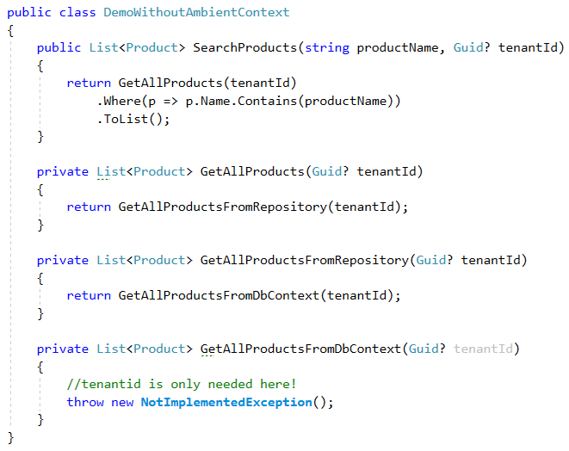
Ambient Context Pattern (without it)

Slide 19
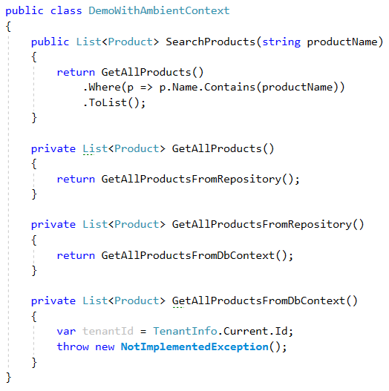
Ambient Context Pattern

Slide 20
Ambient Context Examples
HttpContext (IHttpContextAccessor)
CultureInfo.CurrentUICulture / Thread.CurrentThread.CurrentUICulture
Thread.CurrentPrincipal

Slide 21
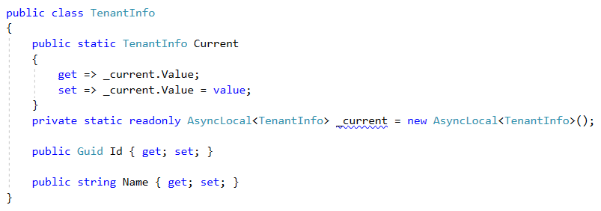
Implementation using AsyncLocal<T>

Slide 22
AsyncLocal<T> Alternatives
Public static … Multi-threading problem!
HttpContext: Web-depended!
ThreadStatic / ThreadLocal<T>: Not async/await friendly!

Slide 23
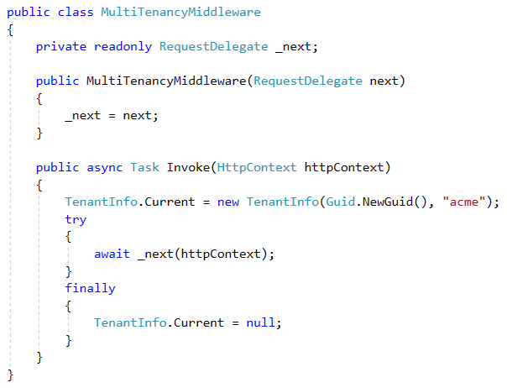
ASP.NET Core Multi-Tenancy Middleware

Slide 24
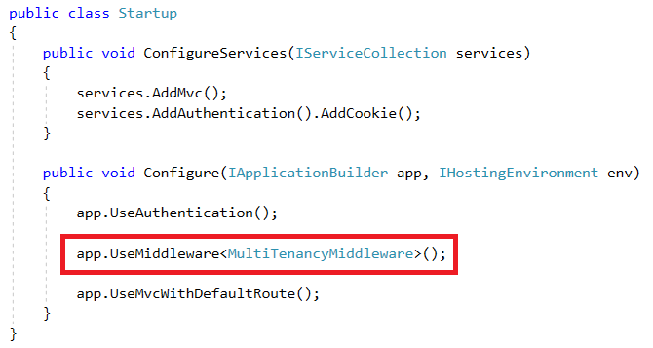
ASP.NET Core Multi-Tenancy Middleware

Slide 25
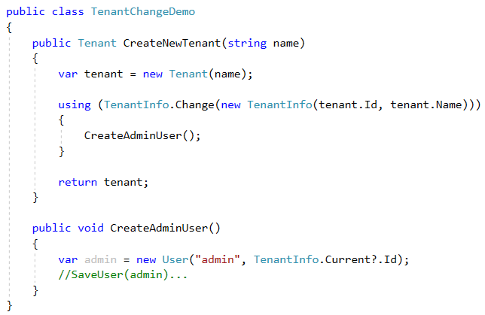
Change Current Tenant

Slide 26
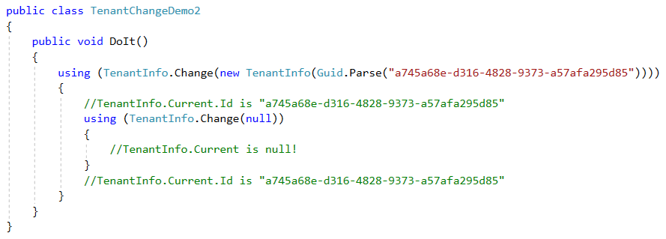
Change Current Tenant (Nested)

Slide 27
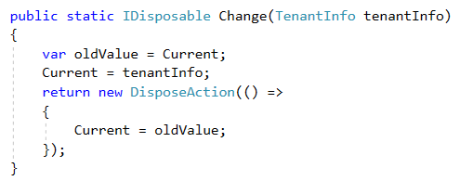
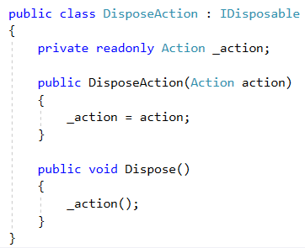
Change Current Tenant

Slide 28
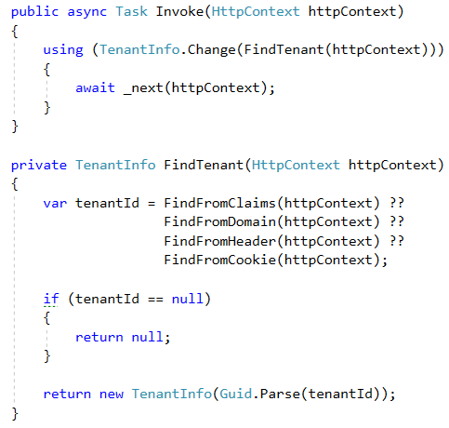
Multi-Tenancy Middleware Implementation

Slide 29
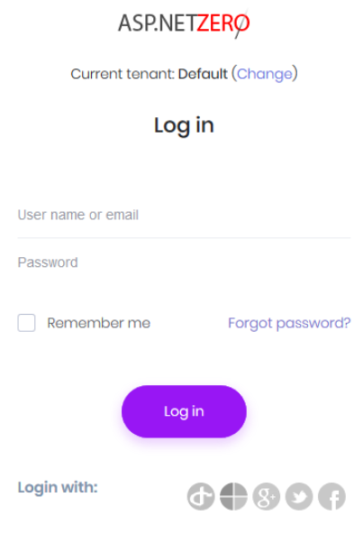
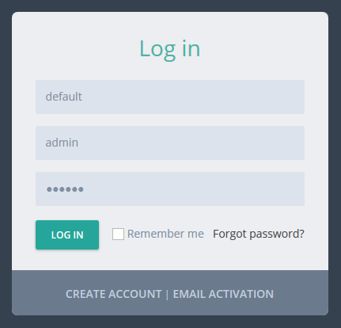
UI Design to Select the Tenant

Slide 30
Multi-Tenancy
Database / Data Isolation

Slide 31
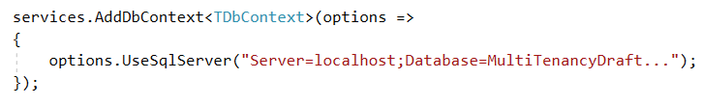

Dynamically Select the Connection String

Slide 32
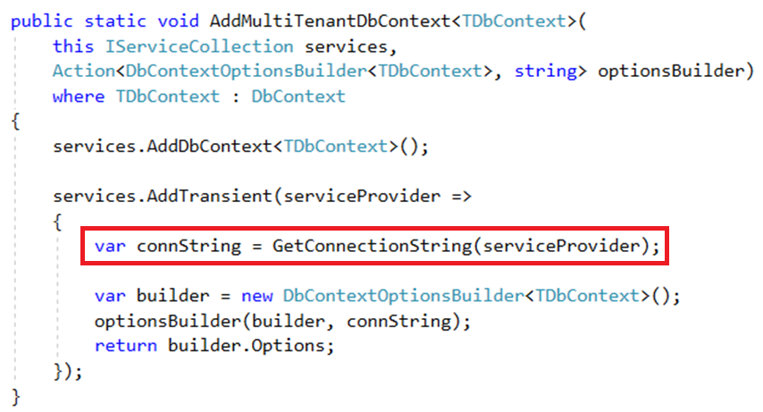
Dynamically Select the Connection String

Slide 33
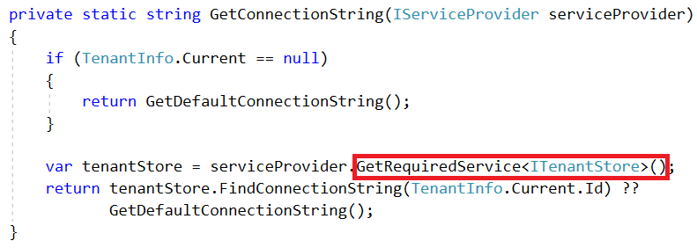
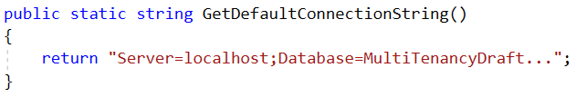
Dynamically Select the Connection String

Slide 34
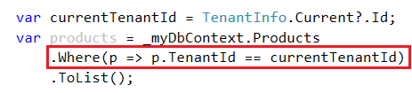
Data Filtering: Manual Way

Slide 35
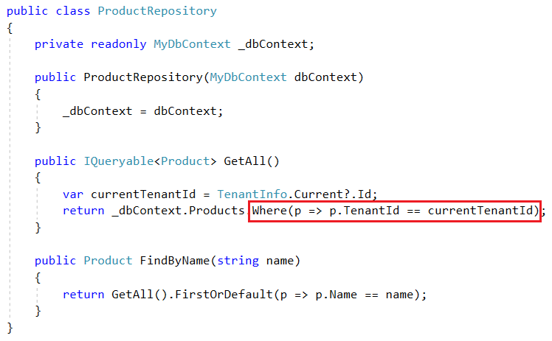
Automatic Data Filtering: Repository Pattern

Slide 36
Automatic Data Filtering: Repository Pattern
Pros
Easy to implement (especially using generic repository pattern - IRepository<TEntity>).
ORM Independent (can be implemented for any ORM that supports IQueryable).
Central data-access
Cons
Limited – Can be bypassed by directly using DbContext.
Limited – Does not work for navigation properties.
Open to leak (Repository developer may forget it).

Slide 37
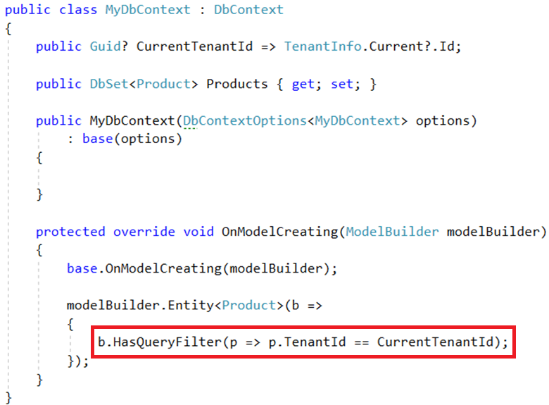
Automatic Data Filtering: EF Core Global Filters

Slide 38
Automatic Data Filtering: EF Core Global Filters
Pros
Natively works with EF Core.
Supports navigation properties as well.
Cons
Limited – does not support multiple filters and enable/disable individually (possible via workarounds – may be directly supported in the future).
Limited – Does not work if you directly work with SQL, stored procedures… etc.
Not available for all ORMs and data access APIs (but available for EF Core, NHibernate and even for EF 6.x)

Slide 39
Automatic Data Filtering: Other Options
Row Level Security – Available for SQL Server and Azure SQL Database.
Pros: Completely integrated to DBMS. Works for everything.
Cons: Relatively complex to implement. Specific to DBMS.
Azure Elastic Database Pool
Pros: Dynamically create databases per tenant. Easily scale.
Cons: Only for db per tenant scenario. Has it’s own API. Has limitations.

Slide 40
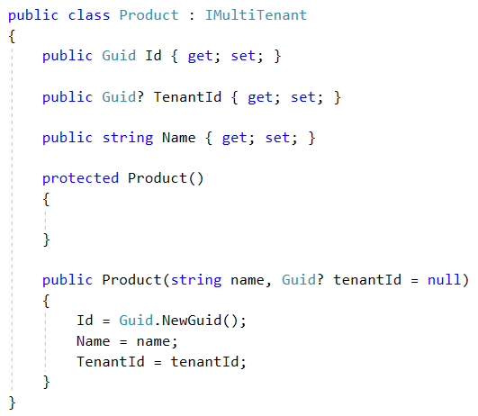
Setting Tenant Id for New Entities
In DbContext.SaveChanges()
Get new entities for change tracker, find IMultiTenant entities, set current TenantId.
In it’s constructor.
Why..?

Slide 41
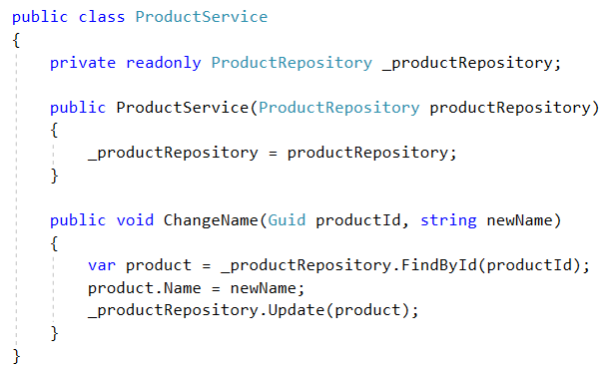
Safe Way to Manipulate Data

Slide 42
Multi-Tenancy
Cache Isolation

Slide 43
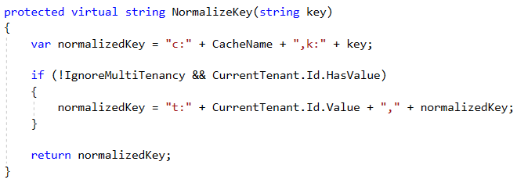
Cache Isolation
Key/Value Caches may share same data space for all tenants.
Tenants may want to cache same type of data with same id (unique per tenant).

Slide 44
Multi-Tenancy
Enable/Disable

Slide 45
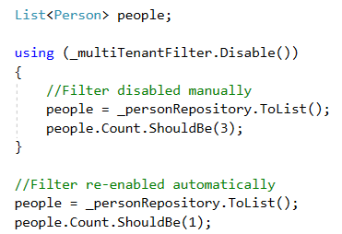
Disable/Enable By Scope
May need to query on all tenants.
Can be implemented using ambient context pattern.
Problem: Not easy for multi-database scenario.

Slide 46
Globally Disable
May want to run the application as on-premise.
Every table still has the TenantId column (with null values).

Slide 47
Multi-Tenancy
DB Transactions & Migrations

Slide 48
Distributed Transactions
Multi-tenant (or host + tenant) operations may require distributed transactions with database per tenant approach.
SQL Server can handle but requires to run MSDTC.
May not be possible for cloud platforms.
Avoid where possible, or use event queues or some other async mechanism.

Slide 49
Schema / Data Migration
Problem for multiple-databases.
Solution: Upgrade all in one with a custom tool.
Pros: Easy to implement. All tenants are in the same version.
Cons: May get too long time for big number of tenants and data. All tenants wait for all upgrade progress.
Solution: Upgrade the application servers immediately, upgrade databases individually on first access.
Pros: Upgrading is distributed to time. A tenant does not wait for another.
Cons: First accessing user may wait too much. Even we get timeout exception. Also, we don’t control the upgrade speed.

Slide 50
Schema / Data Migration
Solution: Multiple versions concurrently.
Split the application servers into two parts: Upgraded tenants use the new application, other tenants use the old application.
Pros:
Minimum waiting for every tenant.
Upgrading may be scheduled for every individual tenant and they can be informed.
Allows us to perform A/B tests and previews.
Cons
Requires multiple application servers – but reasonable for a big system.
Harder to implement, maintain and monitor.

Slide 51
Multi-Tenancy
Best Practices, Optimizations & Integrations

Slide 52
Separate Host & Tenant Application
Create two applications, deploy individually:
Tenant application: The actual business application.
Can be deployed as on-premise too.
Host application: The application used by the host users to manage tenants.
Do not include in an on-premise deployment.
Separate data schema & database from the tenant application.
Store tenancy-related data: Tenants, Subscriptions, Payments, Editions… etc.
Reduces tenant context switch by design.

Slide 53
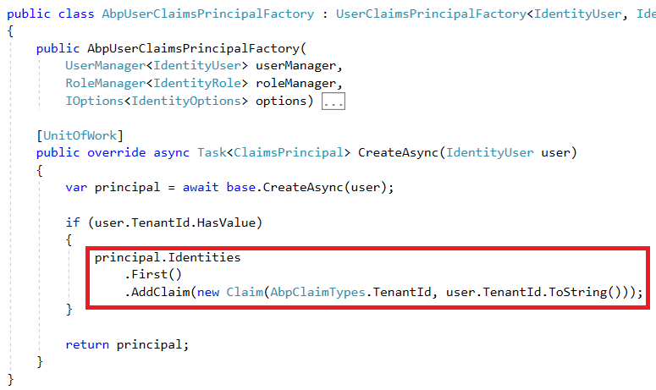
ASP.NET Core Identity Integration

Slide 54
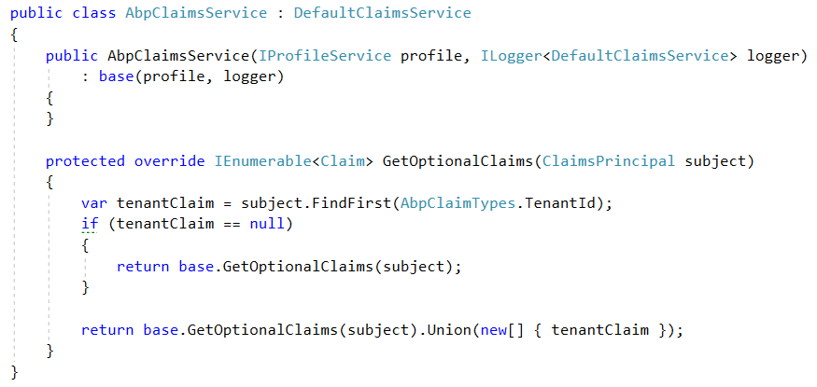
IdentityServer4 Integration

Slide 55
Partition Tables / Indexes by TenantId
Create partitions for all (or big) tables by TenantId.
Or Create TenantId indexes.

Slide 56
Multi-Tenancy
SaaS Features

Slide 57
Feature / Package / Subscription System
Define features of the application. Feature Types:
On/Off: Excel export, Replying by email (for a support app)…
Numeric:10 users, 20,000 emails/month…
Selection: one of the available options.
Group features into packages/editions.
Subscribe packages by tenants.
Check features: Declarative or by code

Slide 58

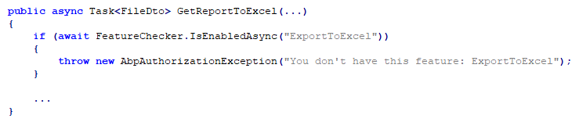
Feature Checking

Slide 59
Declarative Feature Check Implementation Options
MVC Action Filters
Easy to implement. Naturally works within ASP.NET Core.
Limited to Controller actions.
Method Interception using dynamic proxying.
Works everywhere.
Limited to virtual methods.
Weaving: Mono.Cecil, Fody, Postsharp… etc.

Slide 60
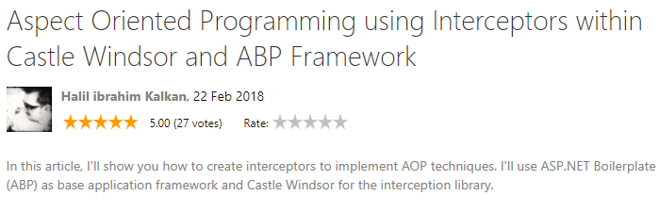
Method Interception

Slide 61
Multi-Tenancy
Miscellaneous

Slide 62
Primary Keys
GUID compared to auto increment (int/long)
Pros
Client can determine the value. No need to database roundtrip.
Allows us to use dbcontext.SaveChanges() only once.
Unique values even between tenants.
Easier to merge/split/replicate databases.
Cons
More data space (16 bytes to 4/8 bytes).
Gray Area
Not user/debug friendly Id values. But it’s more secure!
Notes
Should use sequential algorithms (important for clustered indexes).

Slide 63
Background Jobs / Workers / Services
No ambient tenant context!
Shared pool of threads between tenants?

Slide 64
Settings
Tenant based settings may override global settings (Ex: password complexity).
Some settings may be invisible from tenants (Ex: SMTP password).
Setting fallback: User > Tenant > Global (host) > Hard-Coded (Ex: menu position)
Branding: Tenant logo, colors… etc.

Slide 65
Tenant Plug-ins/Services
How to use different/custom services for different tenants.
Tenant-aware dependency injection.
Application container per tenant?
Combined with Elastic database pool.
Possibility for multi-versioning.
Possibility of loading application with tenant-specific plug-ins.
Different tenants may have different database schemas.

