Slide 1
Microservice Solution: Tools, Patterns & Practices
Halil İbrahim Kalkan

Slide 2
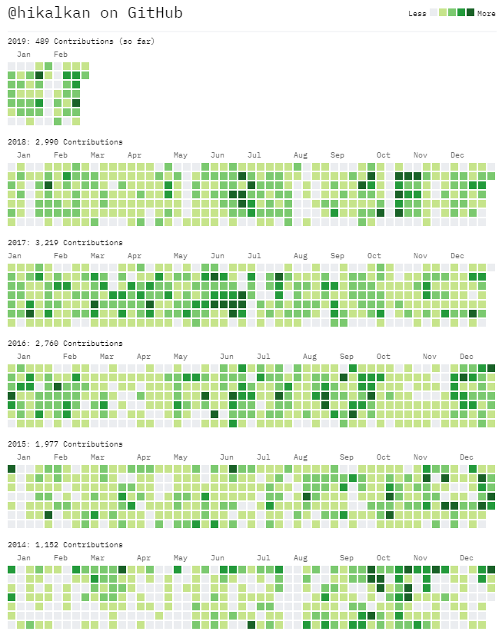

About Me
Halil İbrahim Kalkan
Web: halilibrahimkalkan.com
Github: @hikalkan
Twitter: @hibrahimkalkan

Slide 3
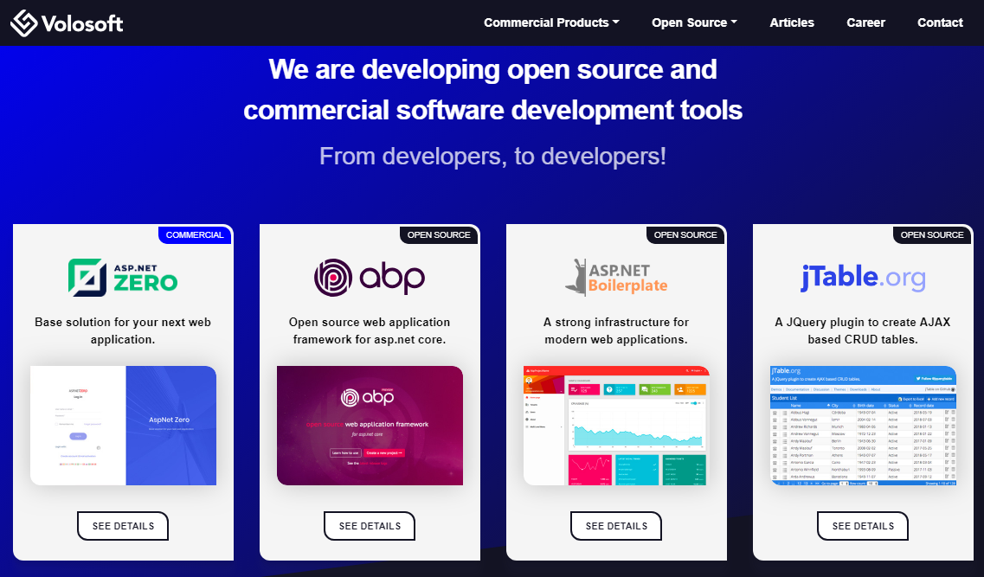

Slide 4
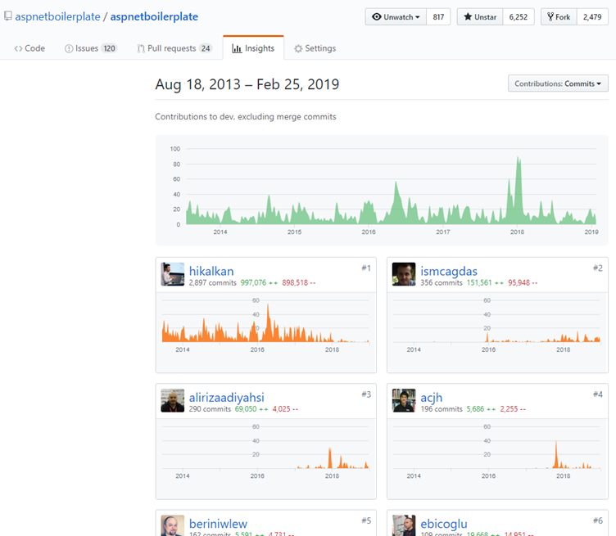
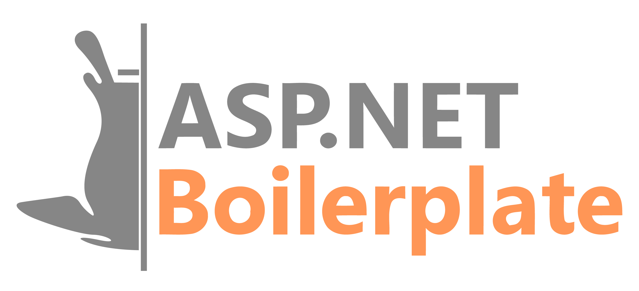
ASP.NET Boilerplate
6.000+ stars on GitHub
1.000.000+ downloads on Nuget
Visit https://aspnetboilerplate.com

Slide 5
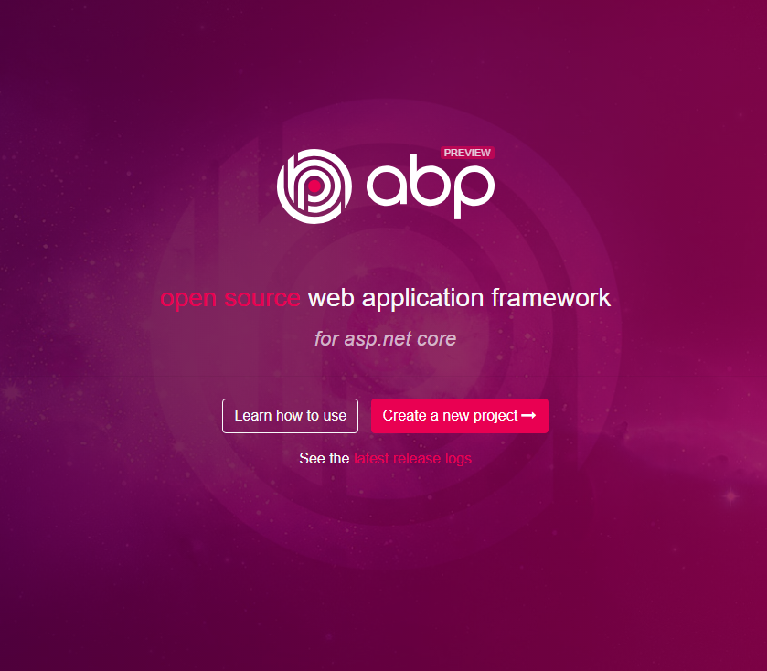
ABP vNext
Visit https://abp.io
Modular architecture
Microservice focused
Domain Driven Design
Multi-Tenancy
Virtual File System
Dynamic Forms & Tag Helpers
Theming
Background jobs
Dynamic HTTP Client Proxies
Database Agnostic
…

Slide 6
Agenda
Part-I: From Monolithic to Microservice: Challenges of the Distributed Architecture
Part II: The Implementation
Part III: Microservice compatible, layered module development model
Part IV: Running on docker containers

Slide 7
Part-I: From Monolithic to Microservice Simple Monolithic Application
Single programming language/platform
Services uses each other via Dependency Injection & simple method calls.
Easy to create database transaction scopes.
In-process & transactional messaging / event bus.
Monolithic Application
(UI, APIs, Services, DTOs, Entities, Repositories…)
Single Database

Slide 8
Part-I: From Monolithic to Microservice Layered Monolithic Application
Organize codebase better by layering
Domain Driven Design (DDD) offers four fundamental layers:
Domain Layer
Application Layer
Presentation Layer
Infrastructure Layer
Infrastructure
Layer
Presentation Layer
Application Layer
Domain Layer
Single Database

Slide 9
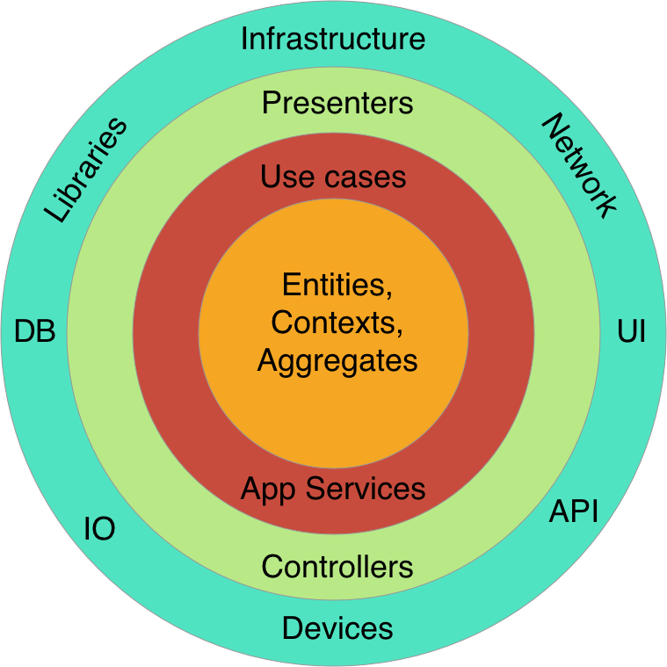
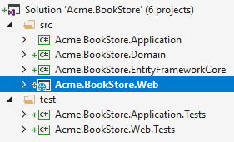
Part-I: From Monolithic to Microservice Layered Monolithic Application
Clean Architecture / Onion Architecture
Each layer can only depend on the layer directly inside it
More organized, maintainable, reusable & testable code base.
Each layer can be a separated project (csproj file)

Slide 10
Part-I: From Monolithic to Microservice Modular Application
Monolithic Application
Each module corresponds to a bounded context in DDD.
Modules can have a separated VS solutions
Modules can cross-reference to each other
Modular in development, but still monolithic on runtime.
A module can be layered inside it.
All modules uses the same database.
Module - 1
Module - 2
Module - 3
Module - 4
Module - 5
Module - 6
Single Database

Slide 11
Part-I: From Monolithic to Microservice Modular Application / Separated Databases
Monolithic Application
Database 1
Module - 1
Module - 2
Database 2
Database 1
Module - 3
Module - 4
Database 5
Database 1
Module - 5
Module - 6

Slide 12
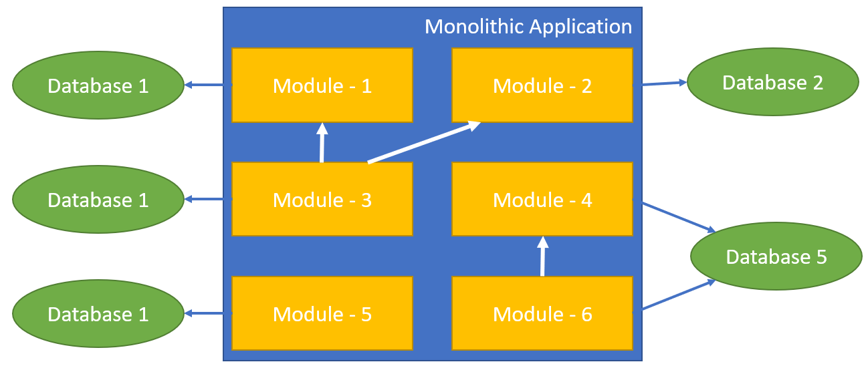
Part-I: From Monolithic to Microservice Modular Application / Separated Databases
Benefits
Better Scalability
Each database gets less load
Each database can be scaled independently
Schema Changes only affects the related module
Challenges
Cross-database joins can be hard or impossible
Inter-module method calls
Data duplication
Summary tables.
Requires distributed transactions
May not be supported by all database systems.

Slide 13
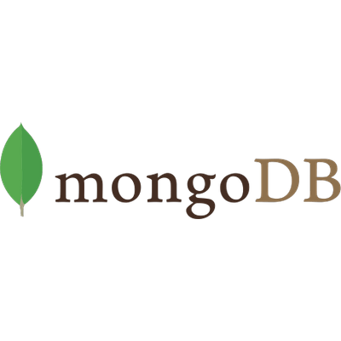

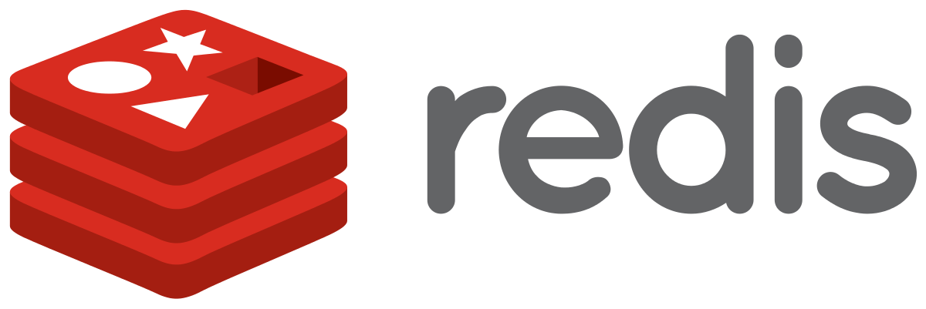
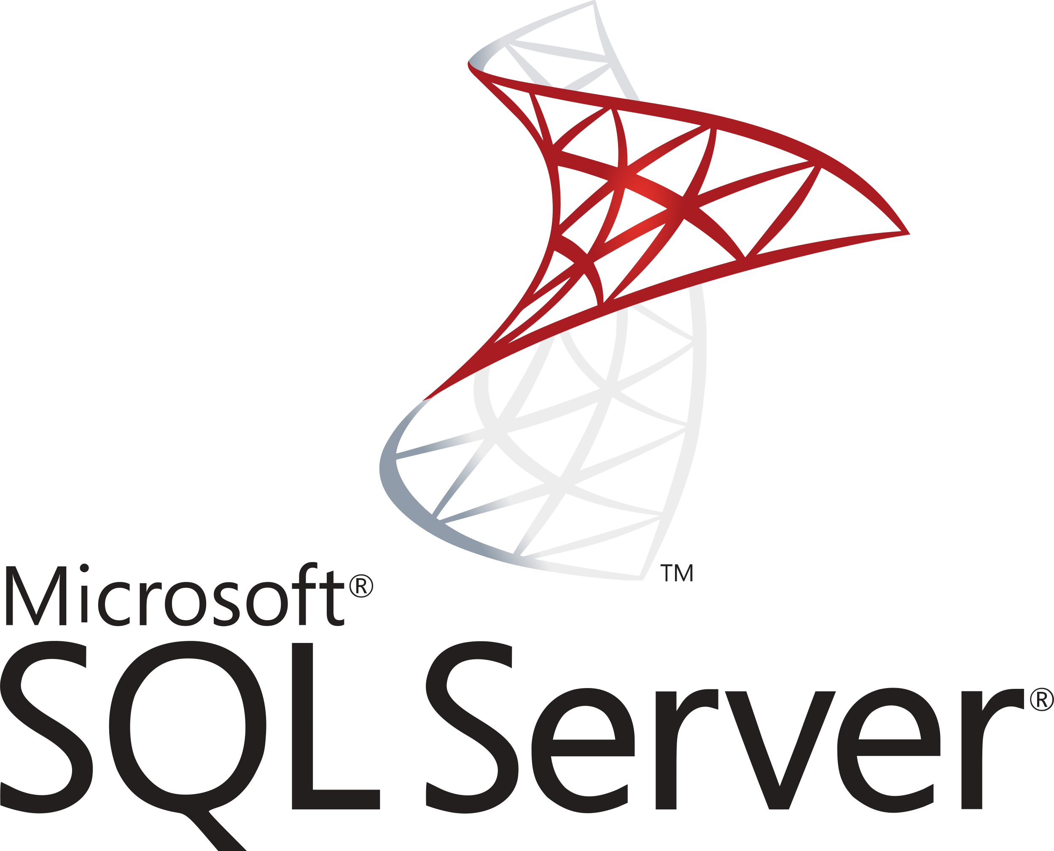
Part-I: From Monolithic to Microservice Modular Application / Polyglot Persistence
Monolithic Application
Module - 1
Module - 2
Module - 3
Module - 4
Module - 5
Module - 6

Slide 14
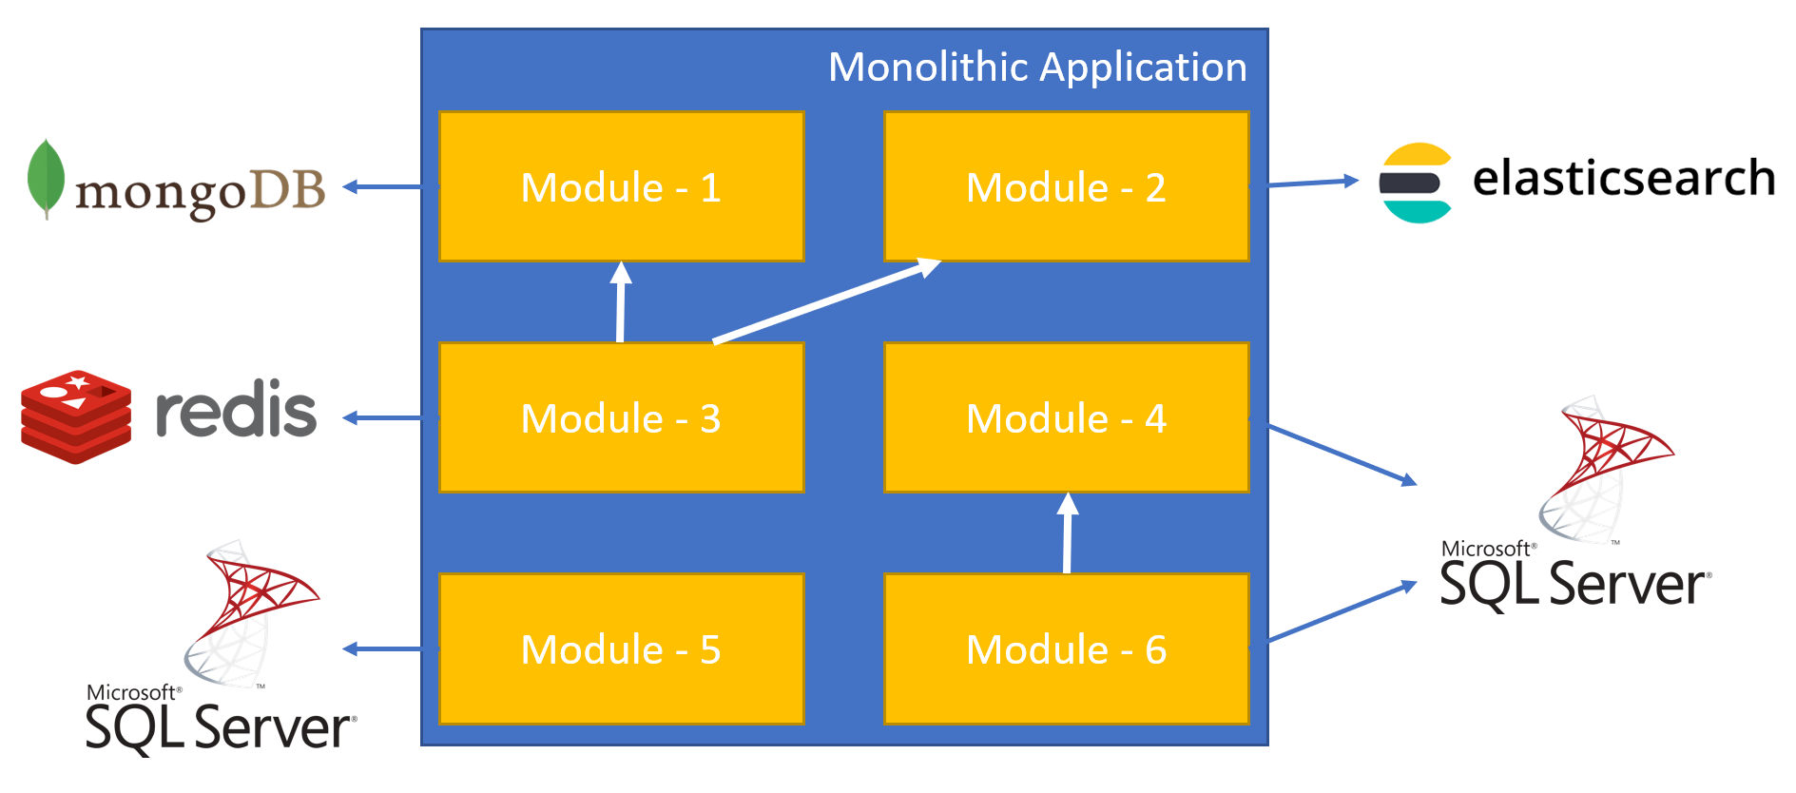
Part-I: From Monolithic to Microservice Modular Application / Separated Databases
Benefits
A module can use the best DBMS for it.
Challenges
Impossible to have cross-database joins and transactions

Slide 15
Part-I: From Monolithic to Microservice Distributed Services (SOA)
Web Application
3rd-Party Clients
server/container
server/container
Service - 1
Service - 3
server/container
Service - 2

Slide 16
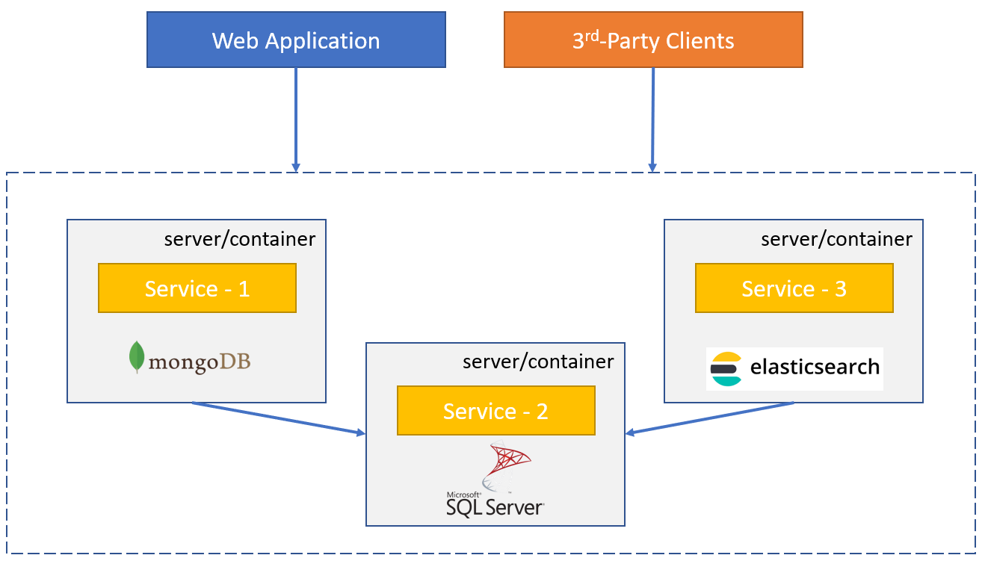
Part-I: From Monolithic to Microservice Modular Application / Separated Databases
Benefits
Better Scalability
Each service gets less load
Each service can be scaled independently
A service can be separately developed, versioned and deployed.
Every service can be developed using a different technology/platform/language as long as they use standard communication protocols (like TCP sockets, REST or GraphQL).

Slide 17
Part-I: From Monolithic to Microservice Modular Application / Separated Databases
Challenges
Complexity of service-to-service communication
Network delays
Security
Service downs
Bottlenecks
Multiple endpoints for clients?
Centralized logging
Code share may not be possible if you use different platforms

