Slide 1
Microservice Solution: Tools, Patterns & Practices
Halil İbrahim Kalkan

Slide 2
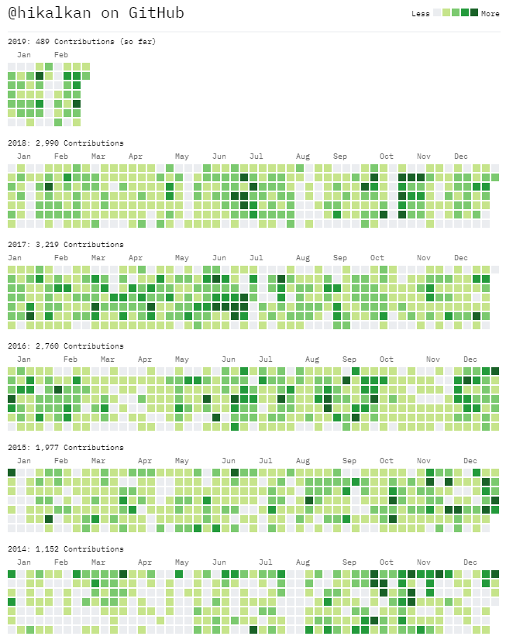

About Me
Halil İbrahim Kalkan
Web: halilibrahimkalkan.com
Github: @hikalkan
Twitter: @hibrahimkalkan

Slide 3
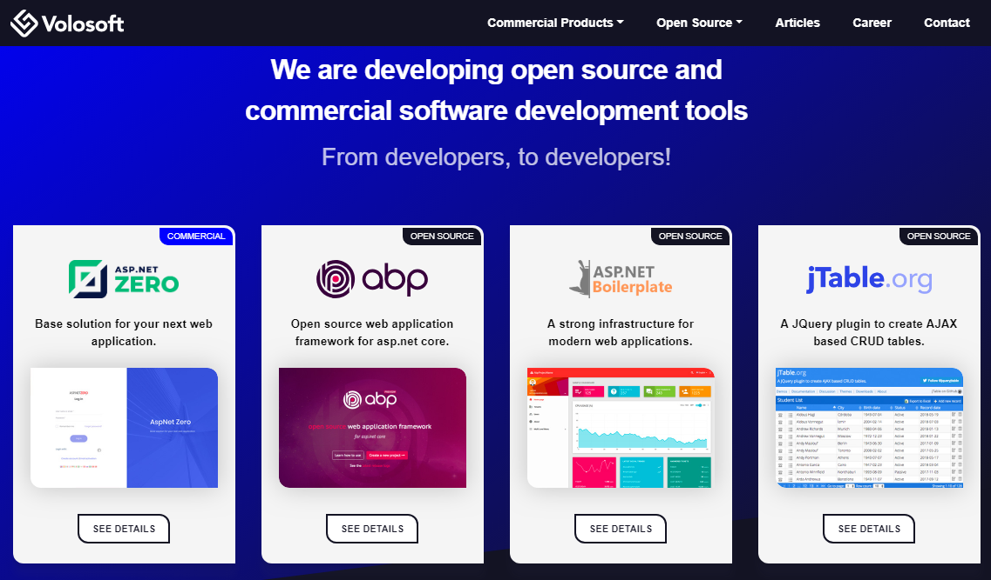

Slide 4
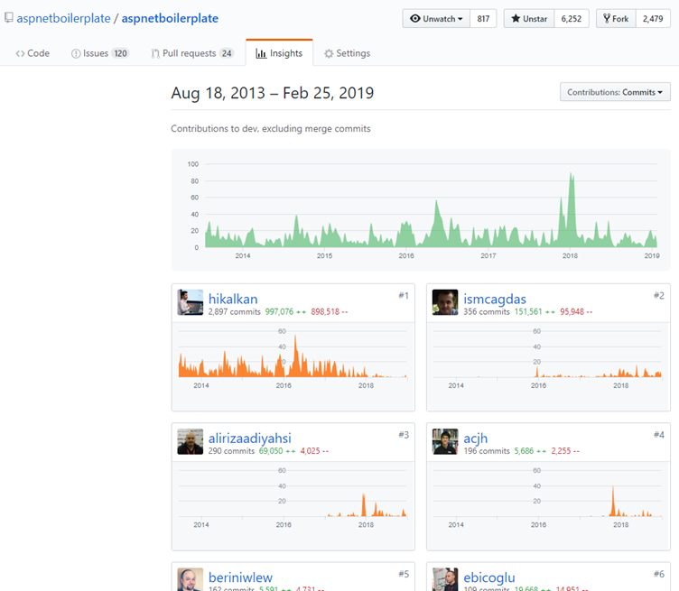

ASP.NET Boilerplate
6.000+ stars on GitHub
1.000.000+ downloads on Nuget
Visit https://aspnetboilerplate.com

Slide 5
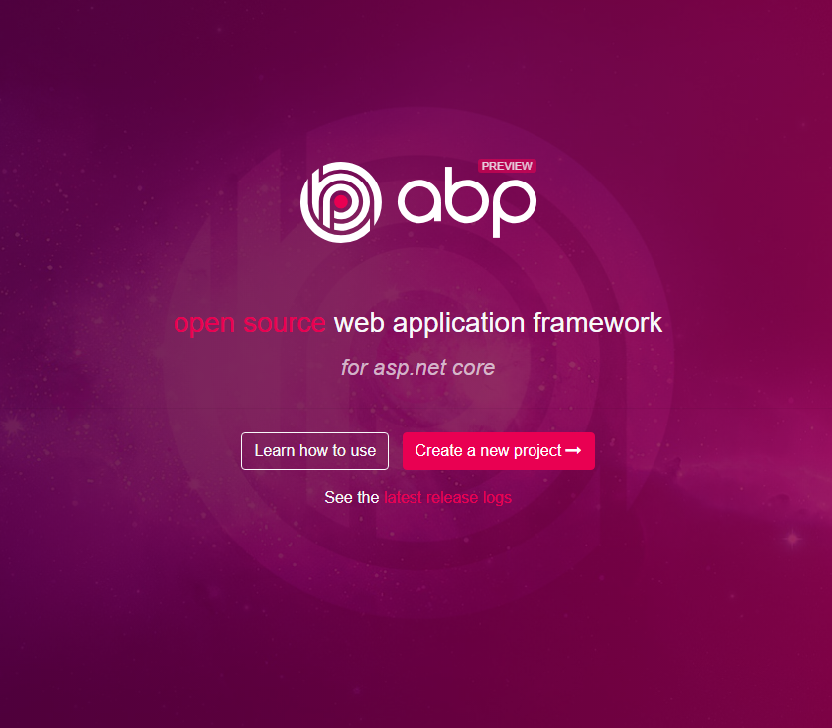
ABP vNext
Visit https://abp.io

