Slide 1
Multi-Tenancy
Development, Challenges & Solutions.

Slide 2
About Me
& My Company & My Projects

Slide 3
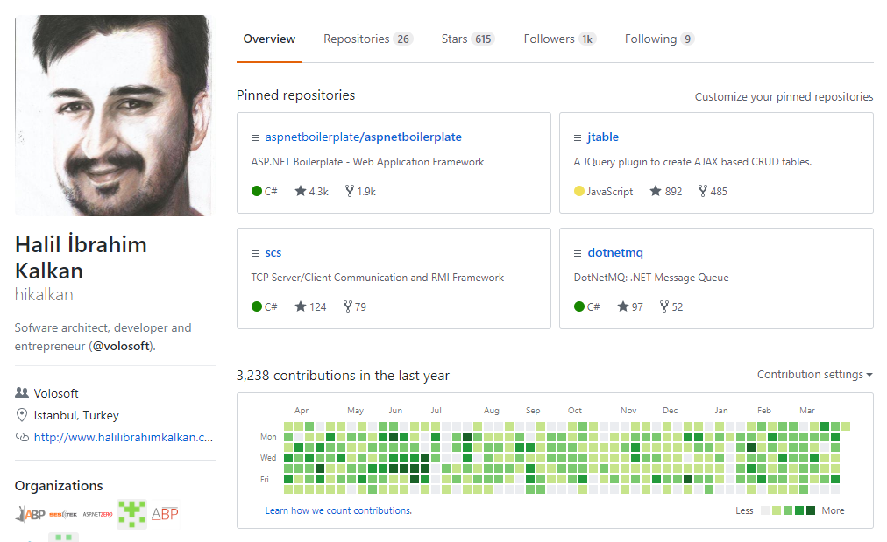
Halil İbrahim Kalkan
@hikalkan (github)
@hibrahimkalkan
http://halilibrahimkalkan.com

Slide 4

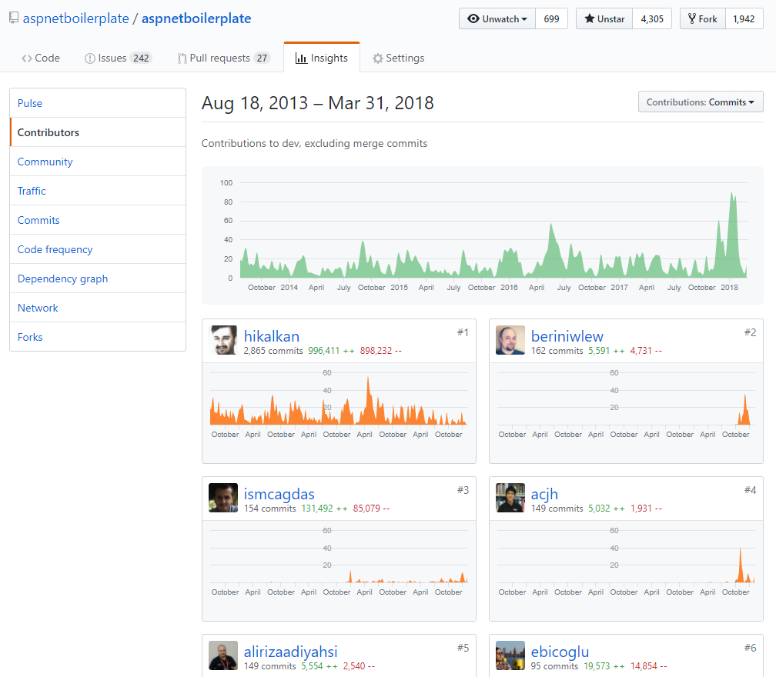

aspnetboilerplate.com
4.5 years of continuous development.
4,300+ stars on Github.
470,000+ downloads on Nuget.

Slide 5
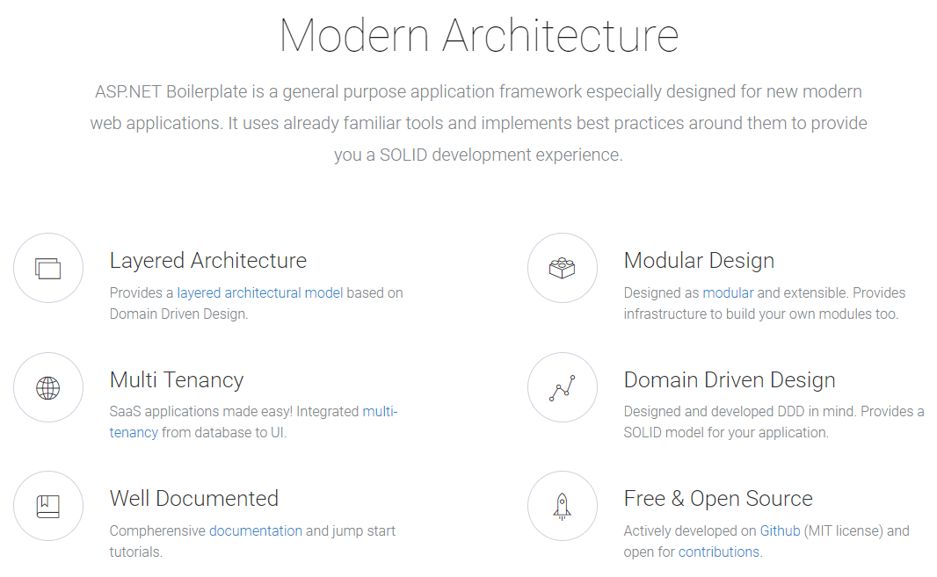

Slide 6
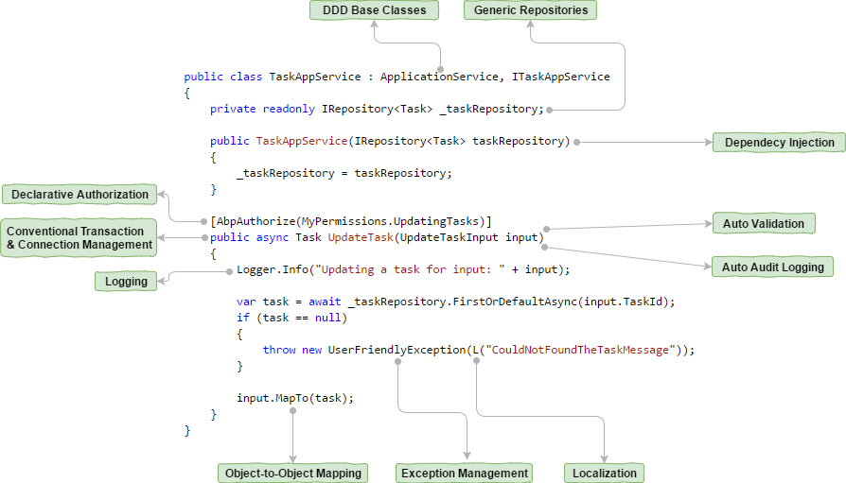

Slide 7
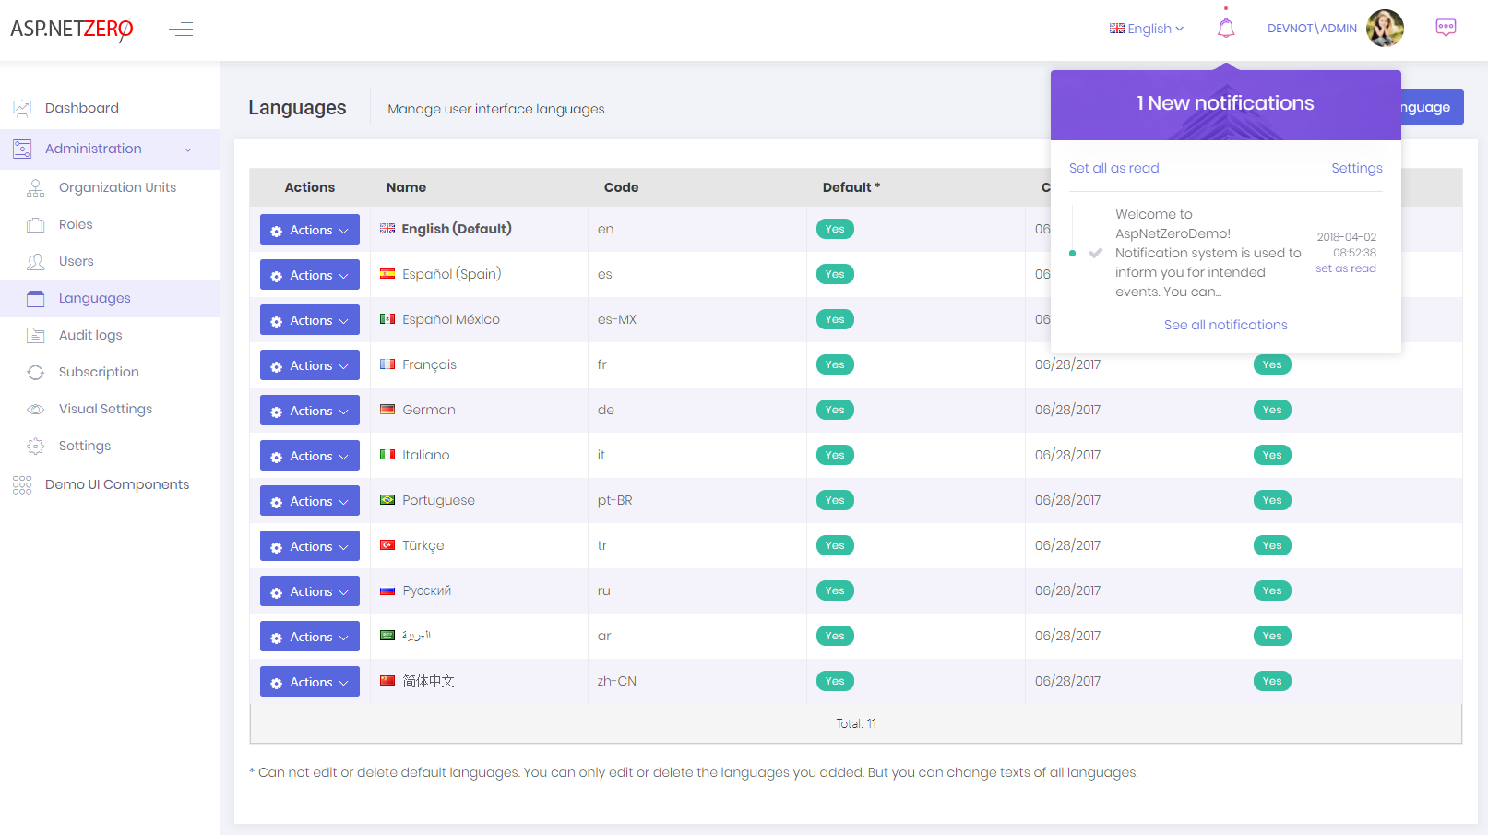
aspnetzero.com

Slide 8
SaaS
Software as a Service

Slide 9
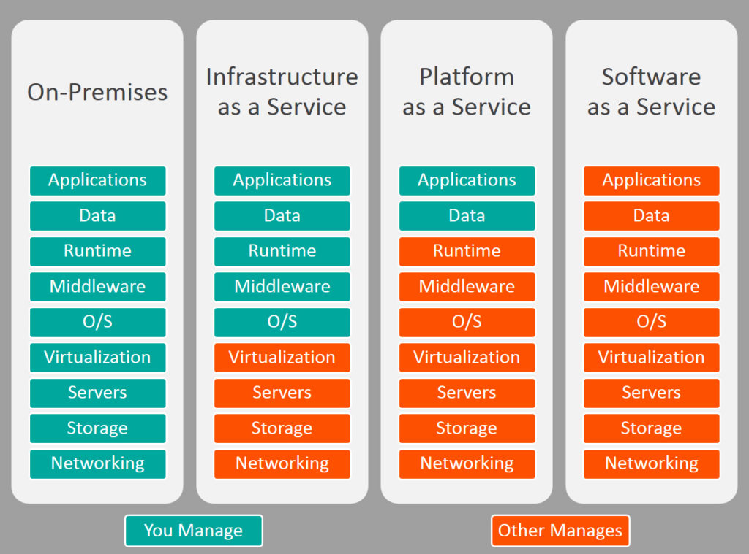


On-Premise / IaaS / PaaS / SaaS

Slide 10
SaaS Concepts
Tenant: An organization uses the application (and pay for it).
Host: The organization manages all the tenants.

Slide 11
SaaS Concepts
Edition/Package: A set of application features.
Subscription: Assigning a package to a tenant for a period of time.
Payment: A subscription has a price: Monthly, Yearly, User based and so on..

Slide 12
Multi-Tenancy
High-Level Architecture

Slide 13
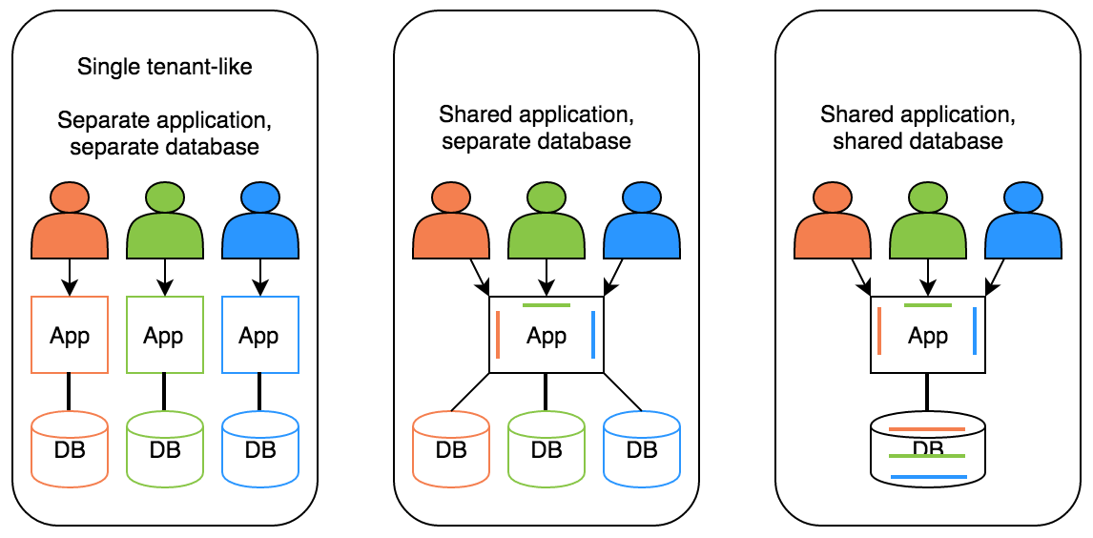
Deployment / Database Options
Hybrid

Slide 14
Ideal Multi-Tenant Application
Works exactly like on-premise: Separated users, permissions, data…
Should be able to work as on-premise too.
Should be developed independent from multi-tenancy. Multi-tenancy should be implemented in the infrastructure/framework.

Slide 15
Stateless Application Design
Application should be stateless!
Main state origins:
Http Request: Cookie, header, querystring, payload…
Authentication Ticket
Database: Relational, non-relational, file system…
Cache: Distributed caches like Redis, Memcached.

Slide 16
Multi-Tenancy
Determine the Current Tenant

Slide 17
Determine the Current Tenant
Sources
Current Claims (if user has been authenticated)
Subdomain (or domain): https://tenancy-name.mydomain.com
Http Header: _tenant = “acme” (for API clients & SPAs)
Http Cookie: _tenant = “acme” (for MVC applications)
ASP.NET Core
On-demand
Middleware (after app.UseAuthentication())

Slide 18
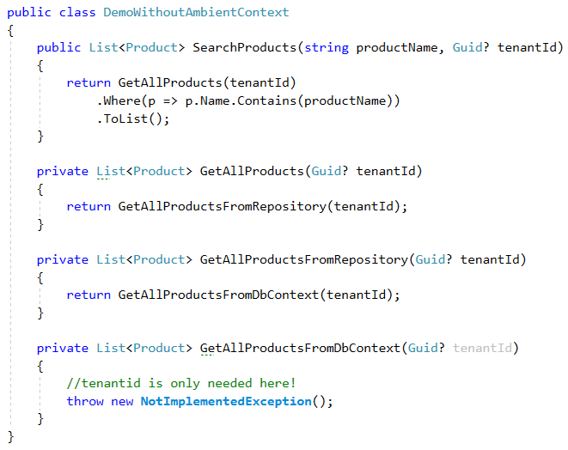
Ambient Context Pattern (without it)

Slide 19
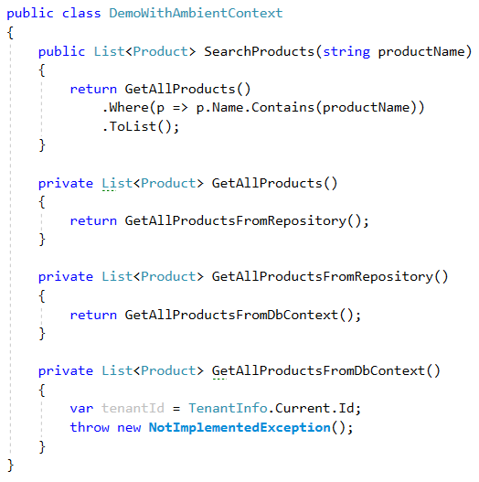
Ambient Context Pattern

Slide 20
Ambient Context Examples
HttpContext (IHttpContextAccessor)
CultureInfo.CurrentUICulture / Thread.CurrentThread.CurrentUICulture
Thread.CurrentPrincipal

Slide 21
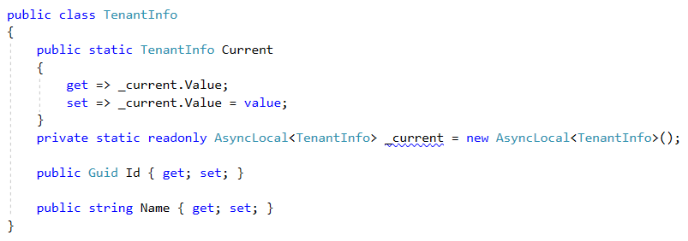
Implementation using AsyncLocal<T>

Slide 22
AsyncLocal<T> Alternatives
Public static … Multi-threading problem!
HttpContext: Web-depended!
ThreadStatic / ThreadLocal<T>: Not async/await friendly!

Slide 23
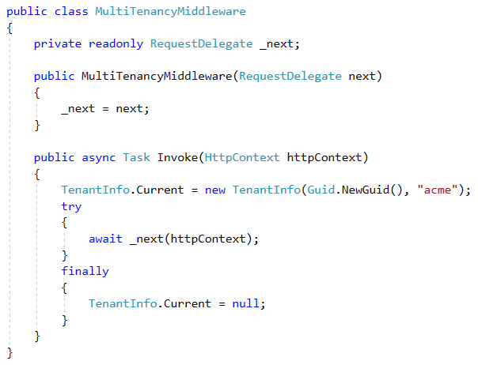
ASP.NET Core Multi-Tenancy Middleware

Slide 24
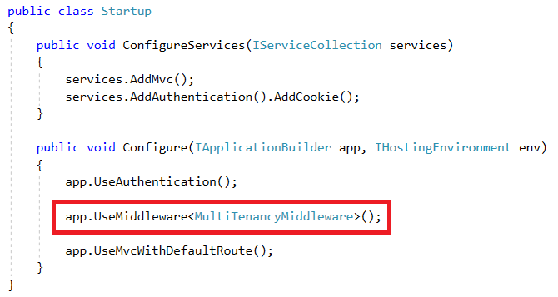
ASP.NET Core Multi-Tenancy Middleware

Slide 25
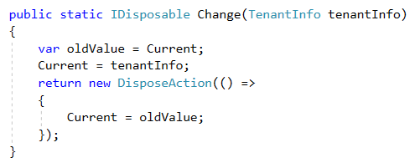
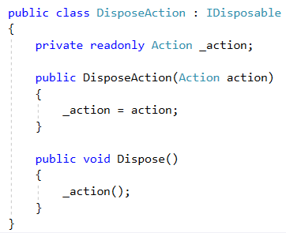
Change Current Tenant

Slide 26
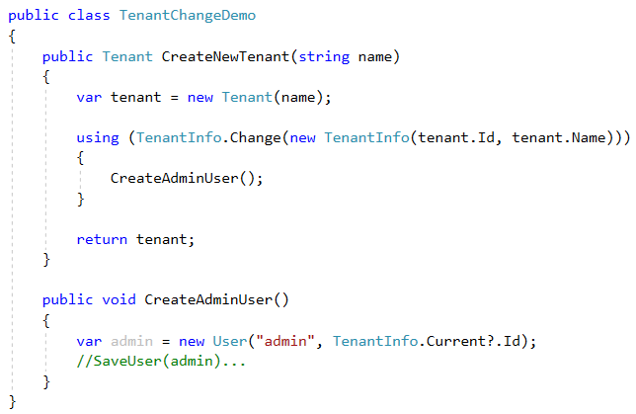
Change Current Tenant

Slide 27
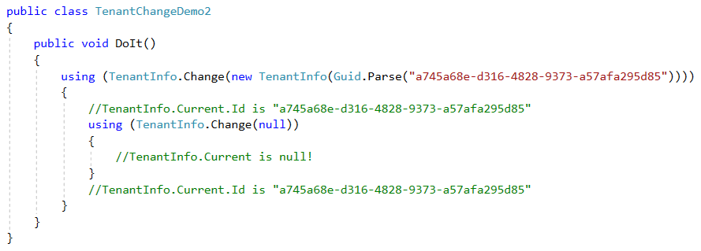
Change Current Tenant (Nested)

Slide 28
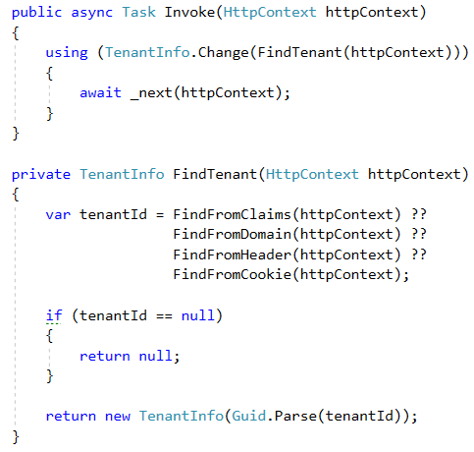
Multi-Tenancy Middleware Implementation

Slide 29
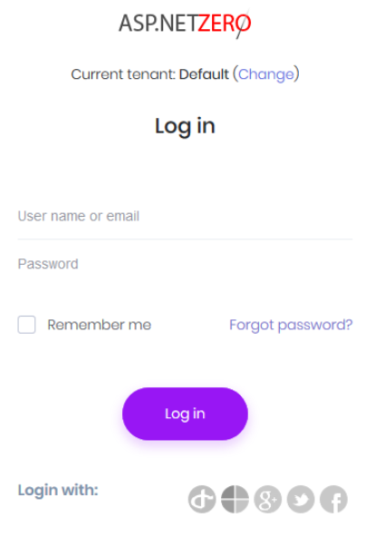
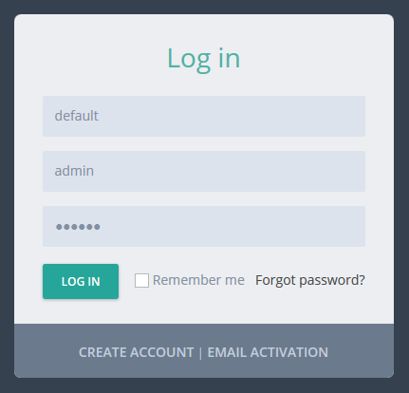
UI Design to Select the Tenant

Slide 30
Authentication Cookie/Token
Add TenantId to the authentication cookie on login.

Slide 31
Multi-Tenancy
Database / Data Isolation

Slide 32

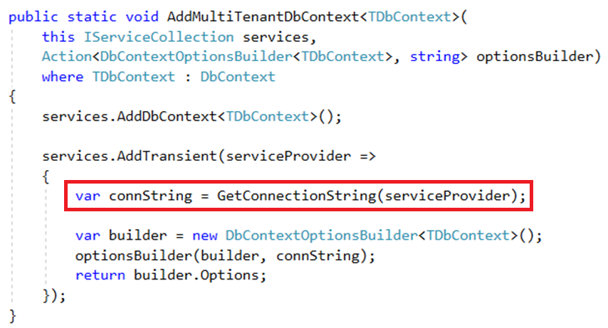
Dynamically Select the Connection String

Slide 33
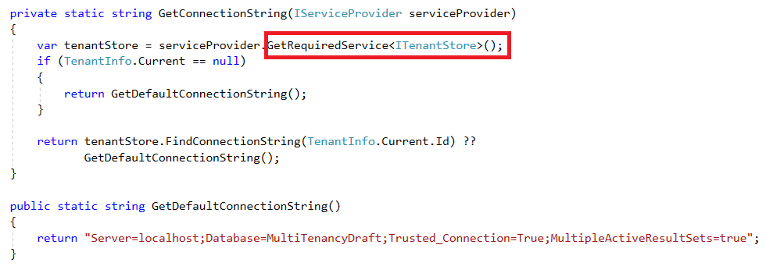
Dynamically Select the Connection String

Slide 40
Add a Slide Title - 4

Slide 41
Add a Slide Title - 5

