Slide 1


Slide 2
Team
Contribution | Name
Code | Ahmed Abdelfattah
Documentation | Ahmed Fawzy
 | Ahmed Morsy
Welding | Ahmed Hendawy
Simulation | Adham Eid
PCB Design & Printing | Eslam Khaled
Hardware | Abdullah Hashem

Slide 3
Features
Timer circuit
No. of present
List
Reset
(Buttons)

Slide 4
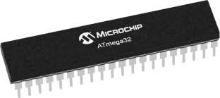
components

Slide 5
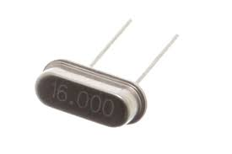
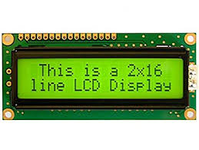
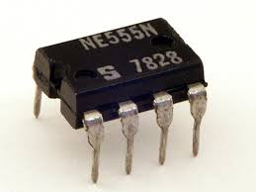
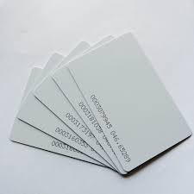
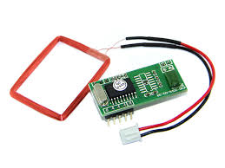

Slide 6
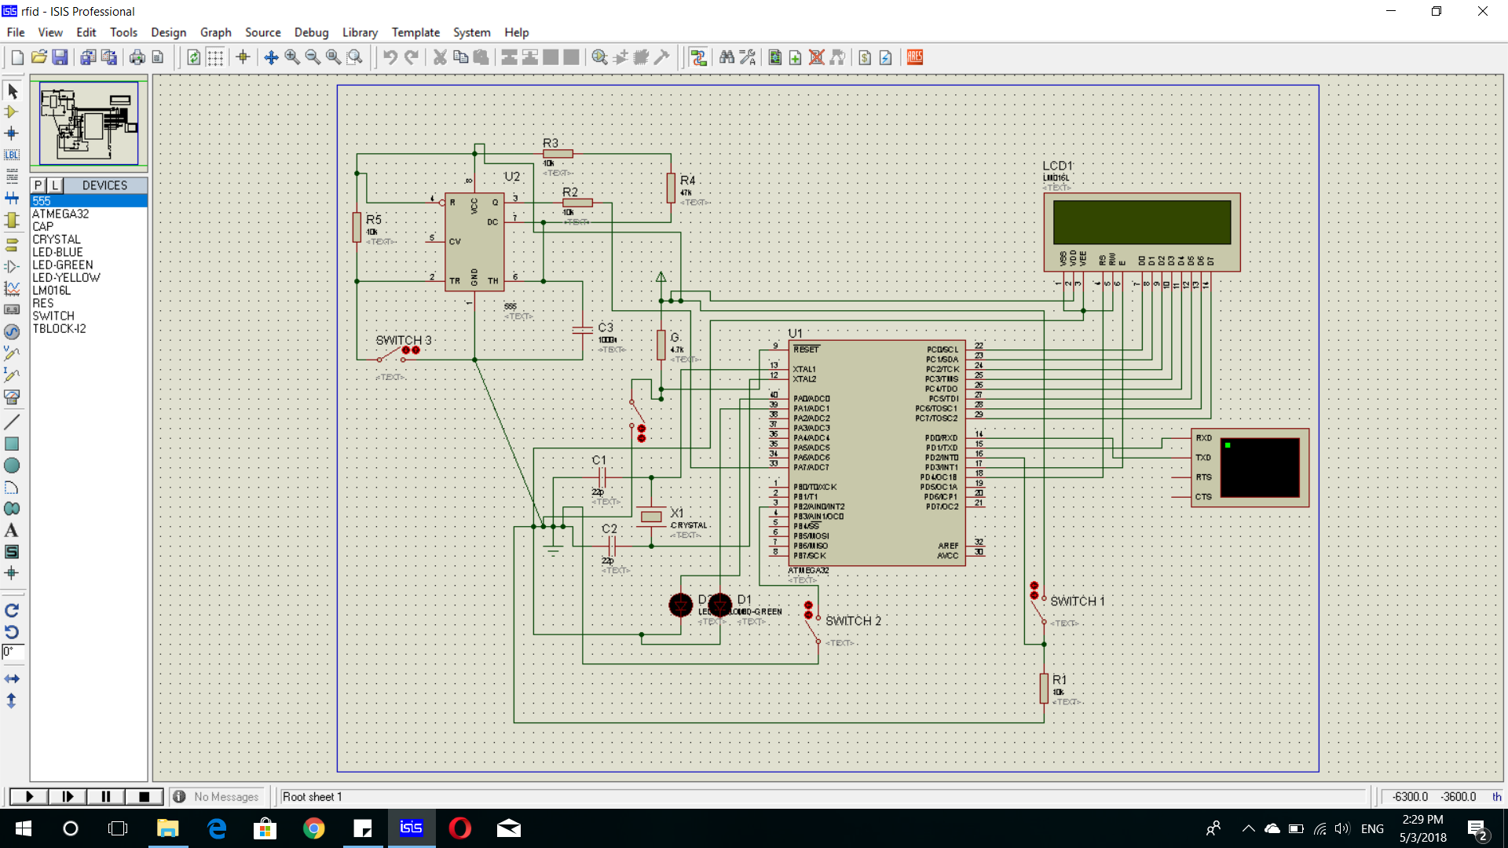
SIMULATION

Slide 7
Video
Bread board

Slide 8
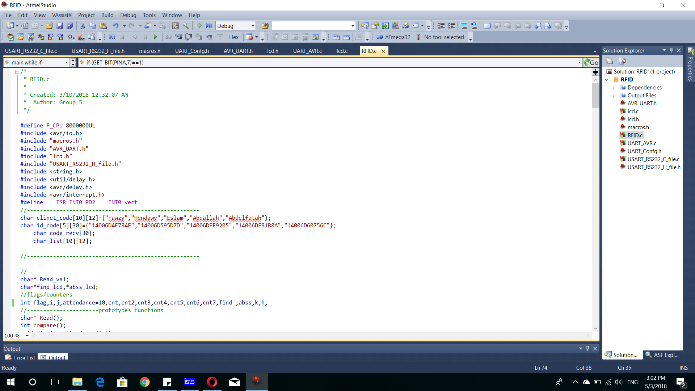
CODE

Slide 9
OTHER POSSIBILITIES

