Slide 1
Car Market Analysis Report
Student Name: Ahmed Tawfeeq P S Course 4 : Python for Data Science
Batch Code: DA464S46
Project Guide: Komilla Bhatia

Slide 2
Problem Statement
The automotive industry faces constant pressure to meet evolving customer expectations for performance, fuel efficiency, and safety. This analysis uses detailed car specifications to uncover trends, identify gaps, and guide strategic product decisions.

Slide 3
Dataset Overview
Datasource: Car Data
Key Metrics: Make, Model, Body Type, Fuel Type, Power, Torque, Mileage, Safety Features.

Slide 4
Data Preparation
Steps Taken: missing value handling, data cleaning
Tools used : Pandas, Numpy, Seaborn, Matplotlib, Scipy.

Slide 5
Objective
Understand market trends in fuel type, performance, and safety features.
Identify gaps and opportunities in product offerings.
Provide recommendations for improving competitiveness.

Slide 6
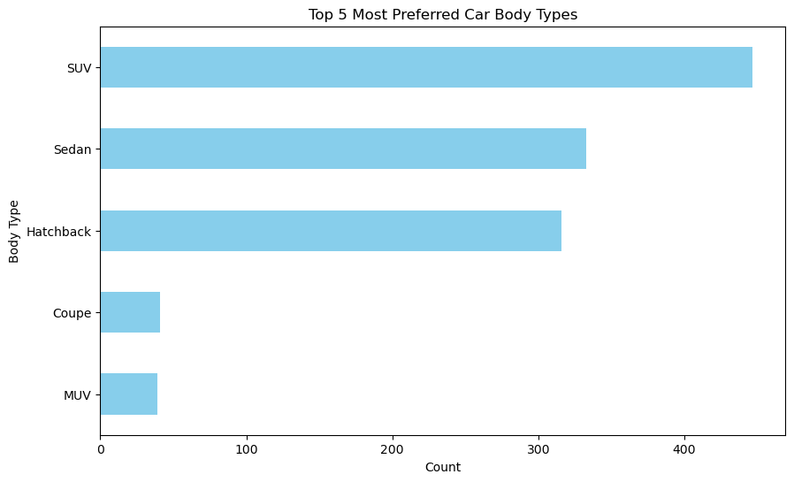
Top Five Car body Types

Slide 7
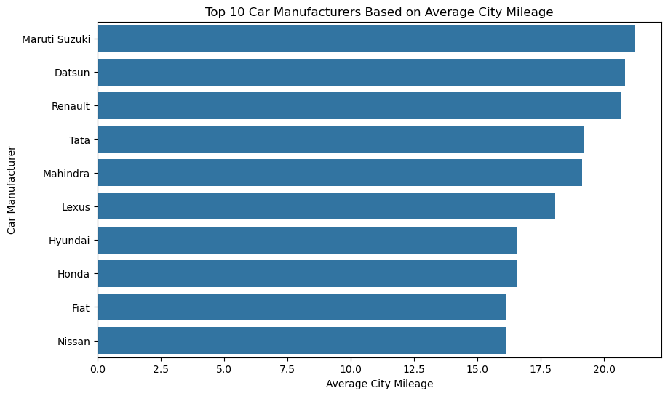
Top ten Manufacturers based on Mileage

Slide 8
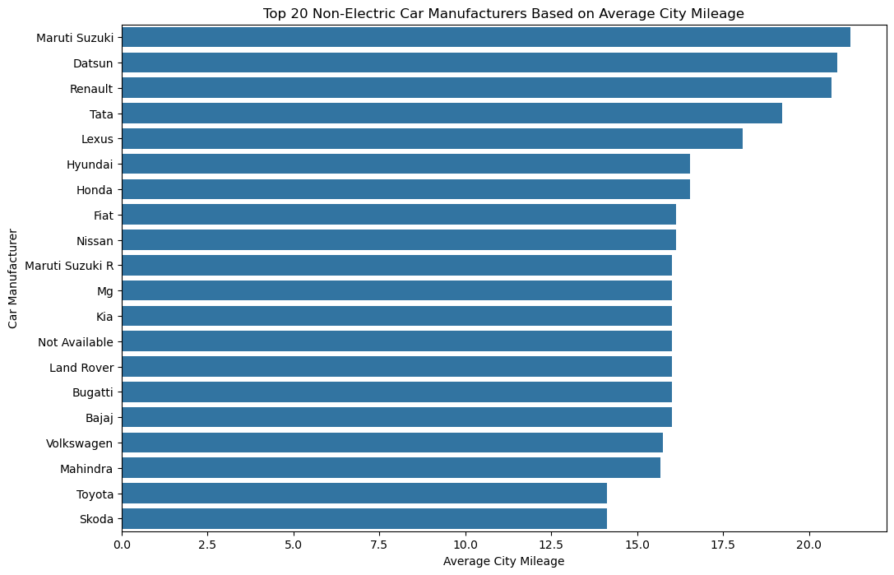
Top twenty Non electric Manufacturers based on Mileage

Slide 9
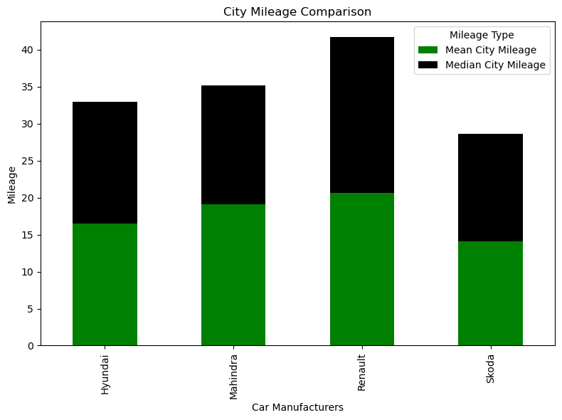
Mileage across Manufacturers

Slide 10
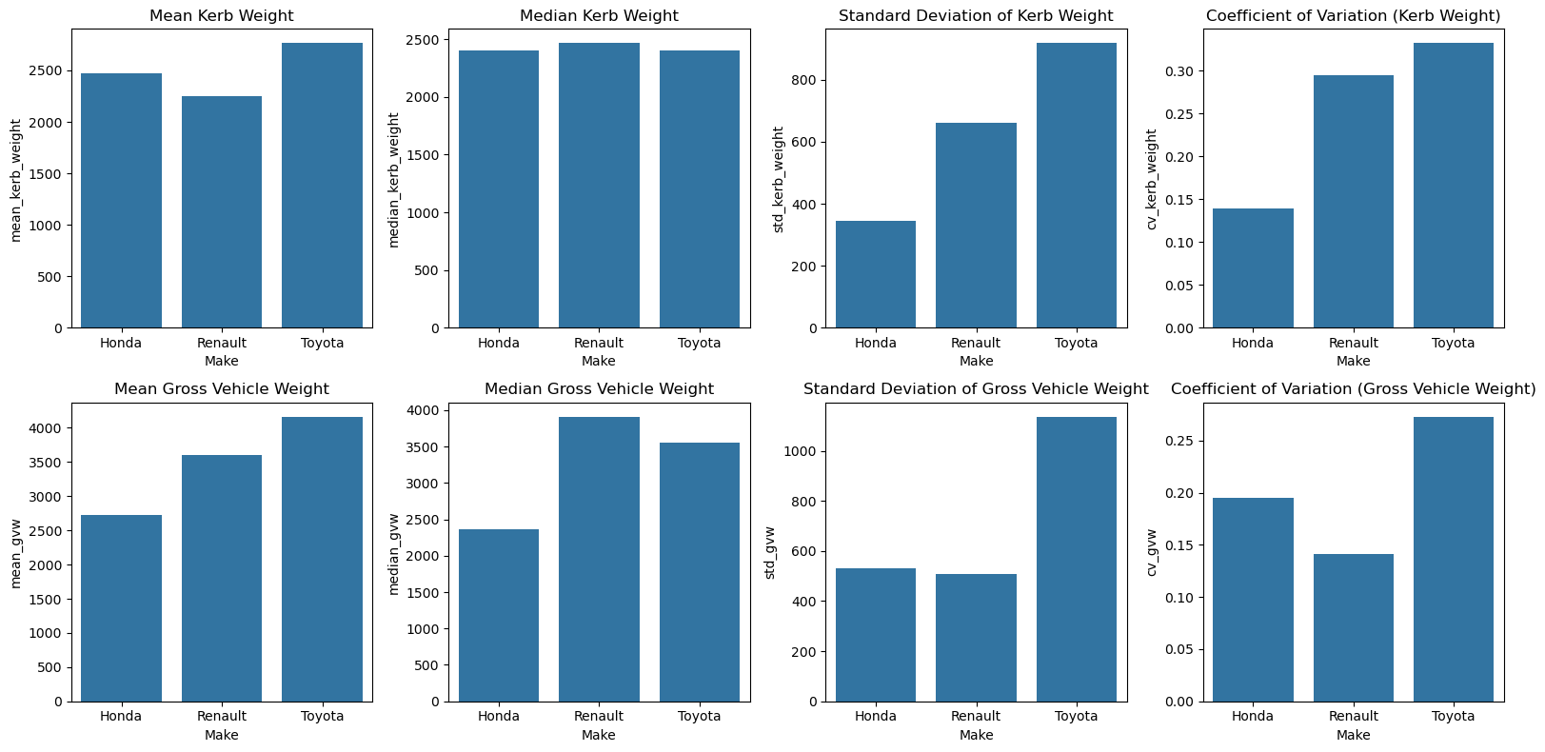
Weight Distribution Study

Slide 11
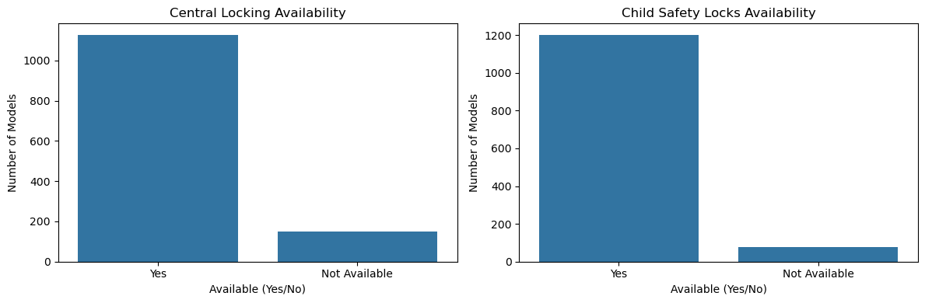
User Comfort Exploration

Slide 12
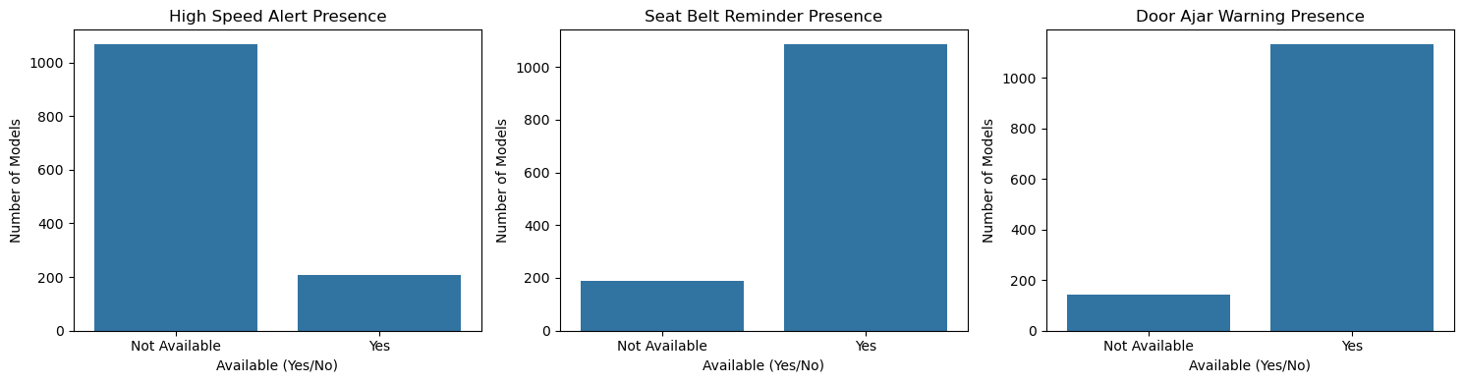
Alert System Analysis

Slide 13
Alert System Analysis

Slide 14
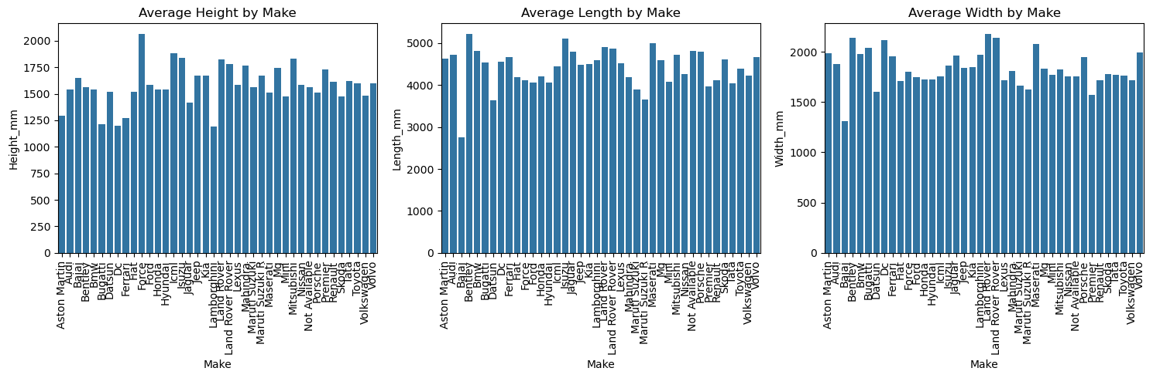
Dimensional Analysis

Slide 15
Key Business Findings
Petrol dominates but CNG is rising in mileage-conscious segments.
Safety features are inconsistent across models.
SUVs are a major growth segment.
Electric adoption is still small.

Slide 16
Summary
Size: 1,276 car entries covering multiple manufacturers and body types
Attributes: 30 columns, including specifications, performance metrics, safety features, and dimensions
Scope: Both mainstream and niche vehicle categories are represented

Slide 17
Summary
Performance metrics: displacement, cylinders, valves, power, torque, city mileage, highway mileage
Design and dimensions: length, width, height, seating capacity, fuel tank size
Safety and comfort: ABS, airbags, central locking, child safety locks, hill assist, drive modes

Slide 18
Summary
Missing values in mileage (highway more than city), safety features, and weight attributes
Some numerical values stored as text due to formatting
Opportunity: Standardizing data will improve accuracy of market analysis and feature comparison

Slide 19
Conclusion
Petrol-powered SUVs and hatchbacks dominate the current market landscape
CNG vehicles are gaining popularity among mileage-conscious customers
Safety features like ABS and airbags are not standard across all models

Slide 20
Conclusion
Significant missing data suggests the need for standardized specification reporting
Addressing feature gaps and expanding alternative fuel options can boost competitiveness
Enhancing safety features can improve brand perception and customer trust

