Slide 1
Sales Analysis Report
Student Name: Ahmed Tawfeeq P S Course 1 : Excel
Batch Code: DA464S46
Project Guide: Komilla Bhatia

Slide 2
Problem Statement
Analysis needed to be done in the Car manufacturers dataset and insights needed to be driven from that dataset, so that from a customer point of view it helps them to choose a car from all the options and category satisfying their needs accordingly.
Objective
Top Body Type and its Manufacturer
Best Car for different categories
Segmentation of Brands
Top Two Manufacturers
Fuel Efficiency

Slide 3
Observations about Data and Pre-Processing techniques
From the data, it was a semi structured and thus cleaning and imputation needed to done.
Columns such Highway_Mileage, Displacement and such were treated by using median, forward fill and backward fill.
In some cases data which were not necessary for the task and had missing values more than 30% thus they were not considered.
And in a Task, Combined Average Fuel Efficiency were required so City_Mileage and Highway_Mileage were added and their average had been taken for calculation, also to find the distance the average combined Fuel efficiency was multiplied with Fuel Tank capacity in order to calculate the distance for a task

Slide 4
Insights from the analysis
1: Top 10 cars with highest miles per
gallon
2: Top 10 cars with highest miles per
gallon based on displacement
Interpretation: Based on displacement Mahindra brand is the highest among others
Interpretation: Suzuki has the highest miles per gallon among other brands.

Slide 5
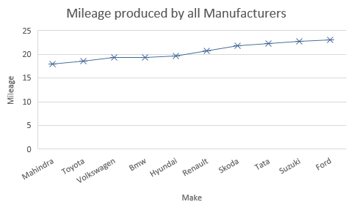
Insights from the analysis (continued)
3: Top 3 manufactures with highest
numbers of hatchback cars
4: Compare mileage of the cars.
Interpretation: Suzuki produces the most amount of hatchbacks compared to others
Interpretation: Ford manufacturer has the highest mileage compared to all other manufacturers.

Slide 6
Insights from the analysis (continued)
5: Relationship between
displacement and mileage
6: Relationship between mileage
and fuel tank capacity
Interpretation: When displacement increases, Mileage also increases, resulting with a positive correlation.
Interpretation: In city the mileage is less compared to that of Highway mileage and also positively correlated with fuel tank capacity.

Slide 7
Insights from the analysis (continued)
6: Best cars for the adventurous
drives
7: Best family cars
Interpretation: From various factors we can interpret that from Hyundai Creta.
Interpretation: From various factors we can determine that Suzuki Swift is best suitable option.

Slide 8
Insights from the analysis (continued)
8(i):Car manufactures for compact
city
8(ii): Car manufactures for family
car
Interpretation: For family preferences, Toyota Land Cruiser would be a suitable option.
Interpretation: For compact city, Suzuki Swift is the best suitable option

Slide 9
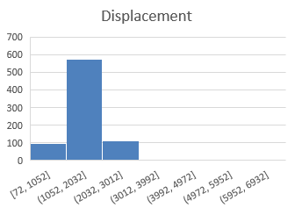
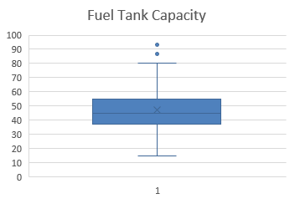
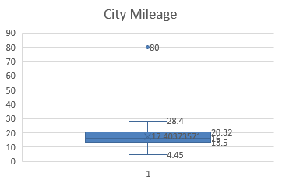
Insights from the analysis (continued)
9 : Outlier Analysis
Displacement Histogram
City Mileage Histogram
Fuel Tank Capacity Histogram
Interpretation: Outliers in displacement is 575
Interpretation: Outliers in city mileage is 80.
Interpretation: Outliers in fuel tank capacity is 93.

Slide 10
Insights from the analysis (continued)
10 : Top 3 manufactures
Hatchback Category
Sedan Category
SUV Category
Interpretation: Swift in first place, Hyundai in Second and Mahindra in Third.
Interpretation: Hyundai In first, Mahindra in second and Tata in third.
Interpretation: Mahindra in first, Hyundai in second and Tata in third.

Slide 11
Insights from the analysis (continued)
11 : most popular car body type by count
Hatchback Category
Sedan Category
SUV Category
Interpretation: Swift in first place, Hyundai in Second and Mahindra in Third.
Interpretation: Hyundai In first, Mahindra in second and Tata in third.
Interpretation: Mahindra in first, Hyundai in second and Tata in third.

Slide 12
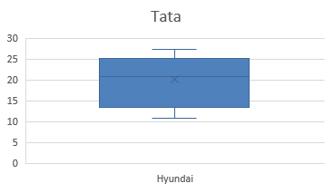


Insights from the analysis (continued)
The manufacturer who offers the widest variation of city mileage
Tata
Maruti Suzuki
Hyundai
Interpretation: Tata offers a variation of 27.39 making it in the second place.
Interpretation: Suzuki also offers a variation of 27.39 thus also making it second.
Interpretation: Hyundai offers a variation of 28.4 making it first in the city mileage.

Slide 13
Insights from the analysis (continued)
Does Fuel_Tank_Capacity have any impact on City_Mileage
Is there any association between Fuel_Tank_Capacity and Displacement
Interpretation: The graph has a correlation of 0.261193 making it a positive correlation.
Interpretation: The graph has a correlation of 0.75214 thus also making it a positive correlation.

Slide 14
Insights from the analysis (continued)
top two manufacturers with the
widest range of cars variants
Fuel efficiency Distribution
Interpretation: In the moderate efficiency, Suzuki is the first, in low Renault has the first place and in High efficiency its Mahindra in the first place.
Interpretation: Suzuki in the first and followed by Hyundai are the top two manufacturers, has the widest range of car variants.

Slide 15
Insights from the analysis (continued)
Association between average speed
and fuel efficiency
Correlation between distance
driven and fuel efficiency
Interpretation: As average speed maintained will produce good efficiency, thus giving a linear relation with positive correlation.
Interpretation: As distance increases, fuel efficiency decreases, thus negative correlation.

Slide 16
Insights from the analysis (continued)
FUEL EFFICIENCY DASHBOARD
Petrol
Electric
Diesel
Interpretation: Suzuki in Petrol
Interpretation: Tata in Electric
Interpretation: Mahindra in Diesel
CNG
CNG + Petrol
Hybrid
Interpretation: Suzuki in CNG category
Interpretation: Hyundai and Suzuki in the same place
Interpretation: Toyota in First place

Slide 17
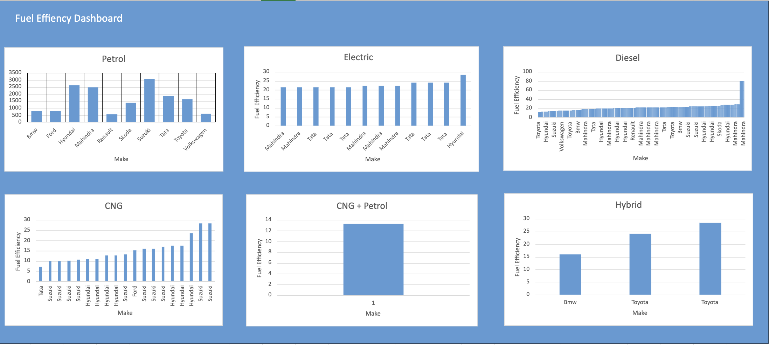
Insights from the analysis (continued)
FUEL EFFICIENCY DASHBOARD
Petrol
Electric
Diesel
Interpretation: Suzuki in Petrol
Interpretation: Tata in Electric
Interpretation: Mahindra in Diesel
CNG
CNG + Petrol
Hybrid
Interpretation: Suzuki in CNG category
Interpretation: Hyundai and Suzuki in the same place
Interpretation: Toyota in First place

Slide 18
Summary
Suzuki has the highest miles per gallon among other brands.
Based on displacement Mahindra brand is the highest among others.
Suzuki produces the most amount of hatchbacks compared to others

Slide 19
Summary
Ford manufacturer has the highest mileage compared to all other manufacturers.
When displacement increases, Mileage also increases, resulting with a positive correlation.
In city the mileage is less compared to that of Highway mileage and also positively correlated with fuel tank capacity.
Toyota Land Cruiser is the best car suitable for adventurous drives.

Slide 20
Summary
From various factors we can determine that Suzuki Swift is best suitable option.
For compact city, Suzuki Swift is the best suitable option.
For family preferences, Toyota Land Cruiser would be a suitable option.
Suzuki in the first and followed by Hyundai are the top two manufacturers, has the widest range of car variants.

Slide 21
Summary
Suzuki has the highest miles per gallon among the other manufacturers.
Average speed and fuel efficiency follows a non linear relationship, efficiency increases after certain speed and then starts to decline.
Found the correlation between Fuel Efficiency and the distance and found out how it impacts the car.

Slide 22
Conclusion
For best body type in various categories, we took the make, variant, and body type and found the best one in each category
In order to treat semi structured data, cleaning and data imputation was done.
For the segmentation of the brands, we have taken the required data in a pivot and took required fields to display the segmentation of brands.

Slide 23
Conclusion
For displaying top two manufacturers, we further segment the data in pivot, sort the values from largest to smallest and select to display top two manufacturers.
For the task involving fuel efficiency, we took city mileage and highway mileage, treated them with missing values and added them into a separate combined mileage and with conditional formatting we separated them into Low, Moderate and High fuel efficiency and plotted a graph with them.

Slide 24
THANK YOU

