Slide 1
Optimizing Hotel Performance through Booking and Customer Behaviour Analytics
Student Name: Ahmed Tawfeeq P S
Course 5 : Exploratory Data Analysis
Batch Code: DA464S46​
Project Guide: Komilla Bhatia​

Slide 2
Problem Statement
The hotel is experiencing a high rate of booking cancellations and inconsistent customer preferences. There is a need to analyze patterns in bookings, cancellations, customer behavior, and pricing to understand the driving factors and improve hotel performance metrics like occupancy, revenue, and customer retention.

Slide 3
Objectives
Identify trends in bookings (daily, weekly, monthly).
Analyze cancellation behavior based on lead time, customer type, deposit type, etc.
Explore the impact of customer behavior (repeated bookings, special requests).
Determine the relationship between pricing (ADR) and customer preferences.
Evaluate the performance of distribution channels and market segments.

Slide 4
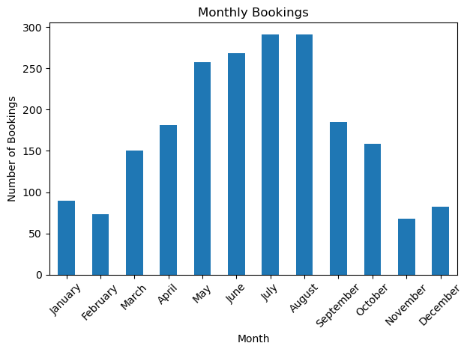
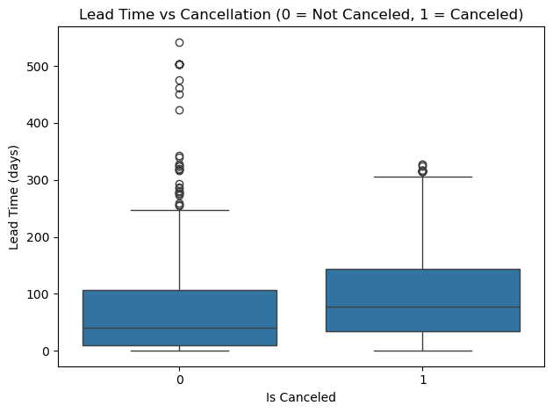
Monthly Bookings Lead Time vs Cancellation
Interpretation: Higher lead time strongly correlates with more cancellations, indicating people booking far in advance are more likely to cancel.
Interpretation: Bookings peak in July and August, suggesting high demand during summer. Lowest activity is seen in December and January.

Slide 5
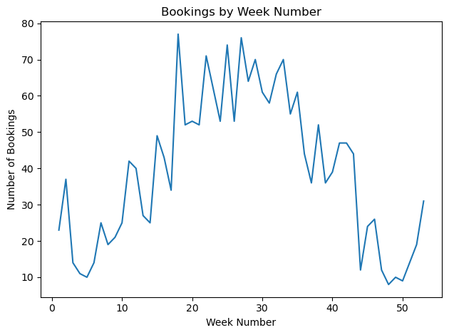
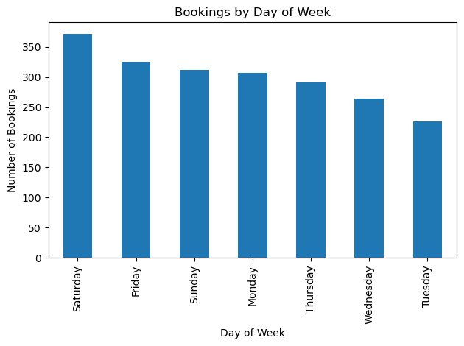
Bookings by Week Number Bookings by Day of Week
Interpretation: Weeks 28 to 34 (mid-year) see maximum bookings. A clear seasonal trend with activity dropping near year-end.
Interpretation: Weekends (Friday to Sunday) have more bookings, with a sharp drop during midweek (Tuesday and Wednesday).

Slide 6
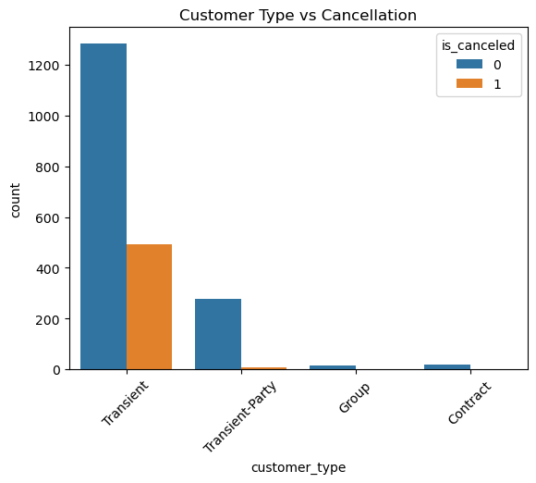
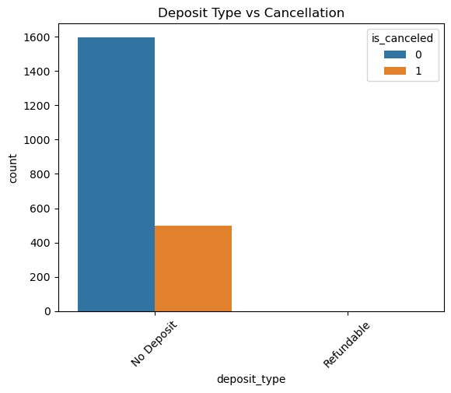
Customer Type vs Cancellation Deposit Type vs Cancellation
Interpretation: Transient customers have the highest cancellation rate. Contract customers rarely cancel.
Interpretation: No deposit bookings show very high cancellation rates. Non-refundable deposits have minimal cancellations.

Slide 7
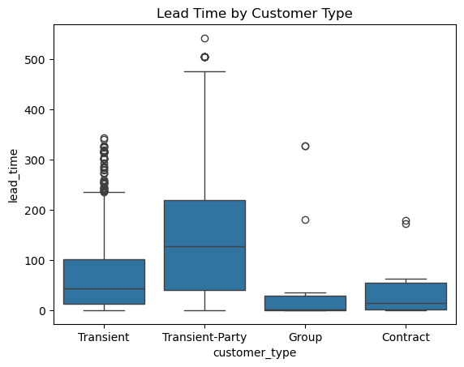
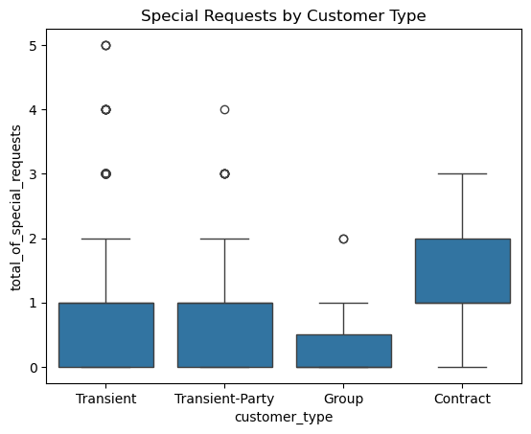
Lead Time by Customer Type Special Requests by Customer Type
Interpretation: Contract customers tend to book with short notice. Transient and group customers book with longer lead times.
Interpretation: Transient guests make the most special requests. Contract guests rarely request extras.

Slide 8
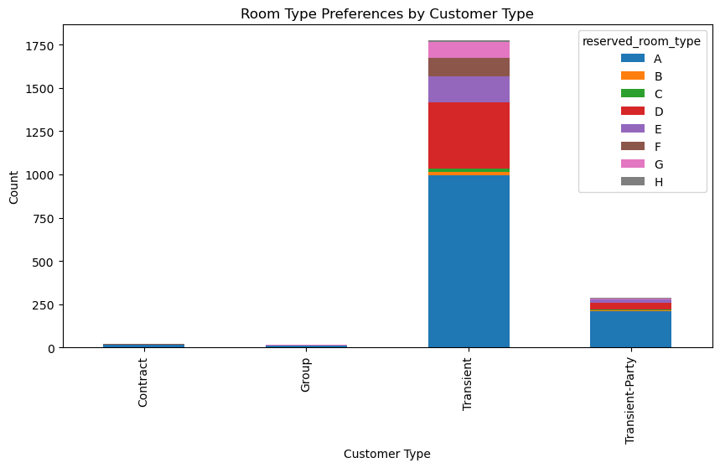
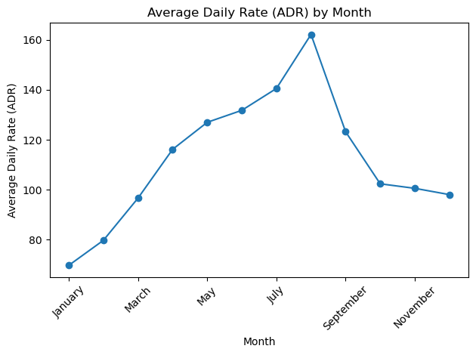
Room Type Preferences by Customer Type Average Daily Rate (ADR) by Month
Interpretation: ADR peaks in summer (July–August) and is lowest in January and November.
Interpretation: Transient guests prefer room type A. Groups prefer types C and D.

Slide 9
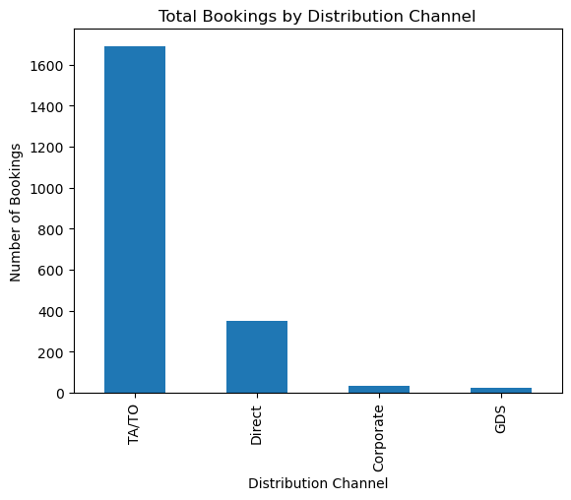
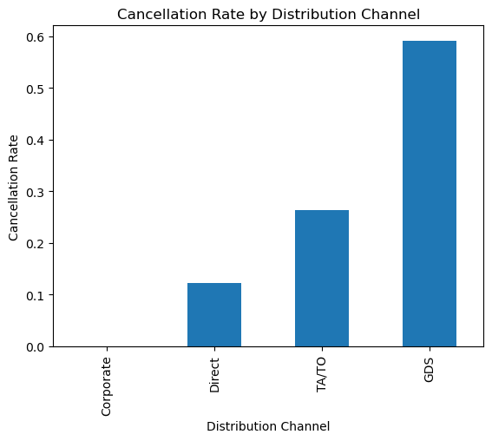
Total Bookings by Distribution Channel Cancellation Rate by Distribution Channel
Interpretation: Online TA (Travel Agents) dominate bookings, followed by Direct and Corporate channels.
Interpretation: Online TA has the highest cancellation rate. Corporate and Direct channels are more stable.

Slide 10
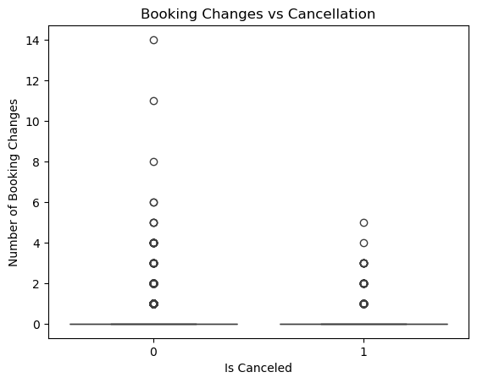
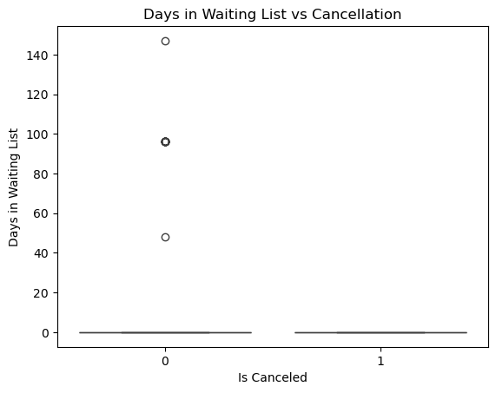
Booking Changes vs Cancellation Days in Waiting List vs Cancellation
Interpretation: More booking changes increase the likelihood of cancellation.
Interpretation: Bookings that wait longer are more likely to cancel.

Slide 11
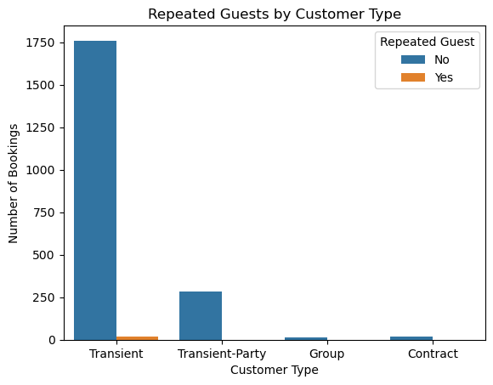
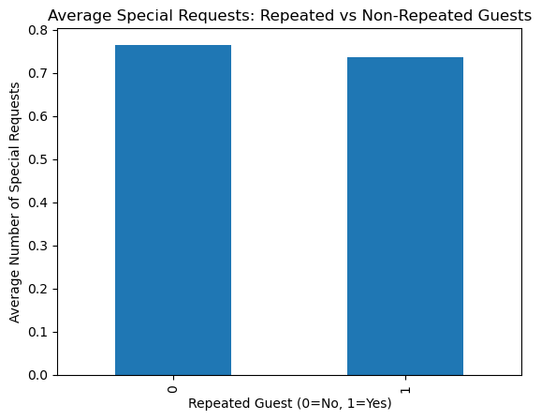
Repeated Guests by Customer Type Avg Spl Rqst: Repeated vs Non-Repeated Guests
Interpretation: Repeated guests are more common among transient customer type.
Interpretation: Repeated guests make slightly more special requests on average.

Slide 12
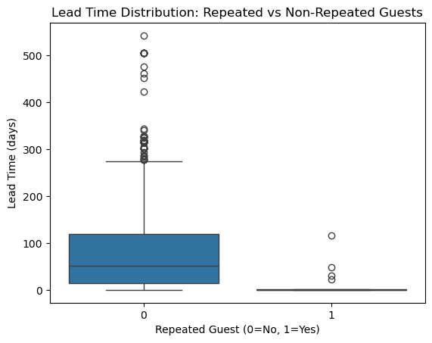
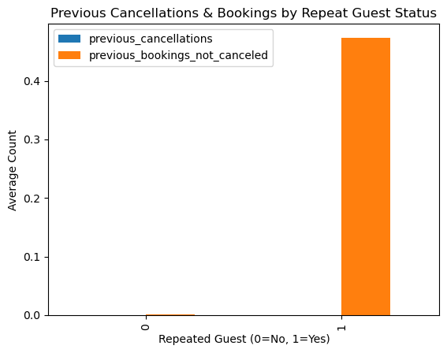
Lead Time Distribution Previous Cancellations &
Repeated vs Non-Repeated Guests Bookings by Repeat Guest Status
Interpretation: Majority of bookings have lead time under 20 days; long lead times are rare.
Interpretation: Guests with past cancellations are less likely to be repeated guests.

Slide 13
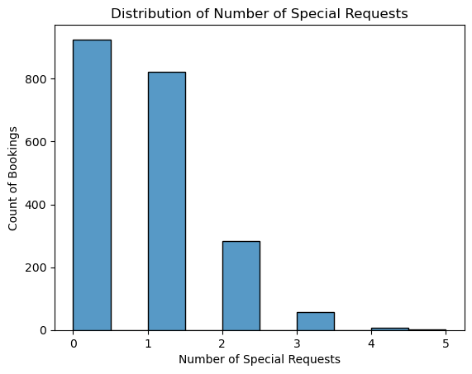
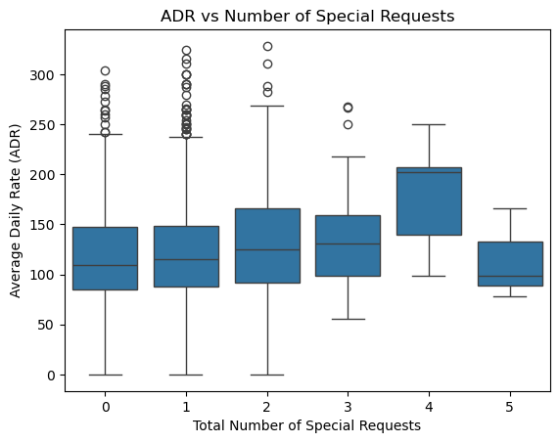
Distribution of Number of Special Requests ADR vs Number of Special Requests
Interpretation: Higher ADR is associated with more special requests, suggesting high-paying guests expect more.
Interpretation: Most bookings have 0 to 2 special requests; 3 or more are uncommon.

Slide 14
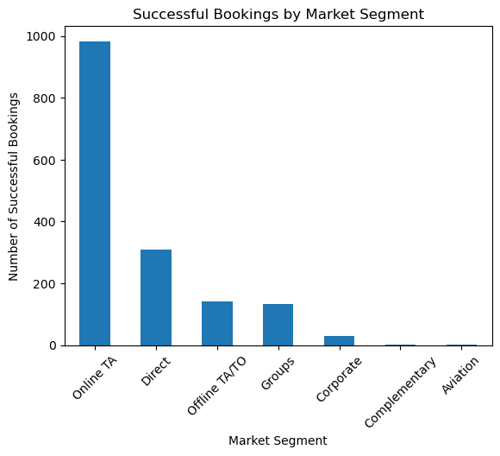
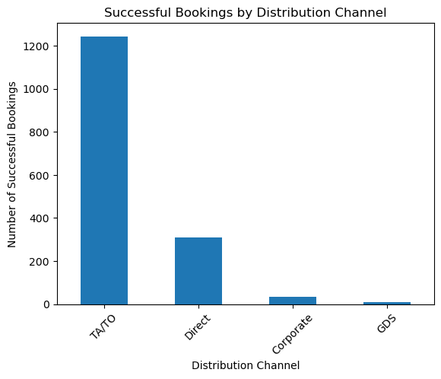
Successful Bookings by Market Segment Successful Bookings by Distribution Channel
Interpretation: Online TA and offline segments contribute the most to successful bookings.
Interpretation: Direct and Corporate channels have the highest success rates.

Slide 15
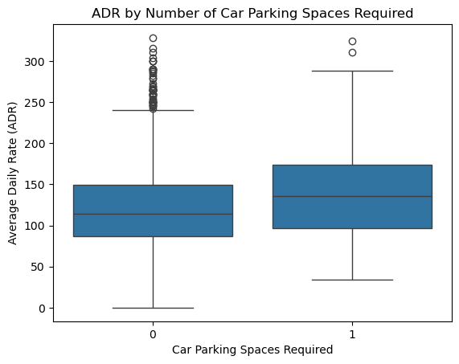

ADR by Number of Car Parking Total Bookings by Distribution Spaces Required Channel
Interpretation: Again shows Online TA leading in volume; includes the context of car parking usage.
Interpretation: Bookings with more car parking spaces tend to have higher ADR.

Slide 16
Summary:
Cancellations are influenced heavily by lead time, deposit type, and customer type.
Repeated guests tend to cancel less and have different behavior compared to new guests.
Distribution channels show varied performance in terms of bookings and cancellation rates.
Special requests, car parking, and room types are closely related to customer segmentation.
Pricing (ADR) fluctuates across months and customer types, influencing booking success.

Slide 17
Conclusion:
The analysis highlights that high cancellation rates and inconsistent customer preferences are significantly impacting occupancy and revenue.
By identifying booking patterns, customer behaviour trends, and pricing sensitivities, the hotel can adopt data-driven strategies to reduce cancellations, enhance customer satisfaction, and improve retention.
Implementing flexible pricing models, targeted promotions, and personalized service offerings can help stabilize occupancy rates, maximize revenue, and build long-term customer loyalty.

