Slide 1
Optimizing Order & Sales Data with SQL
Student Name: Ahmed Tawfeeq P S Course 2 : Analytics Using SQL
Batch Code: DA464S46
Project Guide: Komilla Bhatia

Slide 2
Problem Statement
Analysis of customer, sales, and employee data to identify key trends, optimize business performance, and provide strategic recommendations.

Slide 3
Dataset Overview
Database: modelcarsdb
Tables: Customers, Orders, OrderDetails, Employees
Key Metrics: Sales revenue, customer segmentation, employee performance

Slide 4
Data Preprocessing & Cleaning
Removed duplicate records
Handled missing values
Standardized column formats
Merged related tables for better insights

Slide 5
Top Customers by Credit Limit
Identified high-value customers
Helps in customer retention and targeted marketing

Slide 6
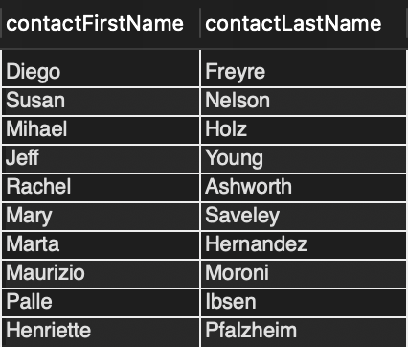
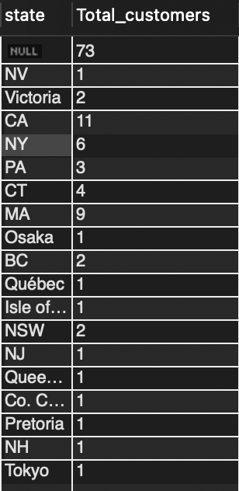
Customer Data Analysis
Top 10 customers by credit limit
Customers by State

Slide 7
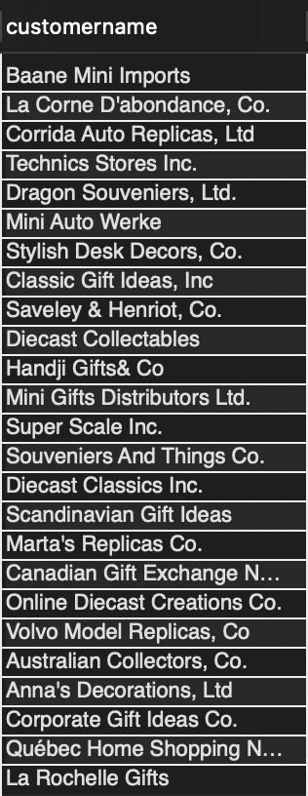
Customer Data Analysis
Customers with the most expensive purchases

Slide 8
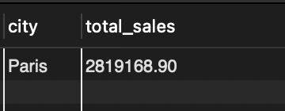
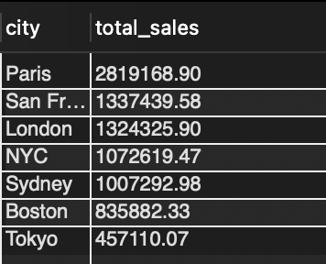
Office Data Analysis
Profitable offices based on Sales
City wise total sales

Slide 9
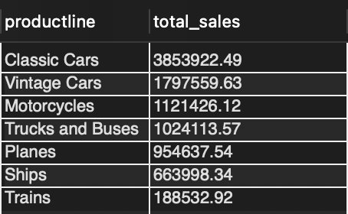
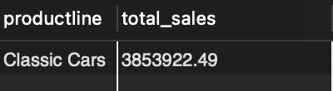
Product Data Analysis
Total Sales on Each product line
Top Performing product Line

Slide 10
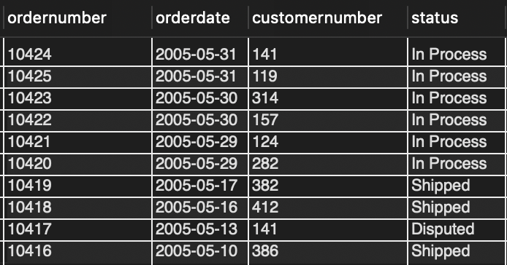
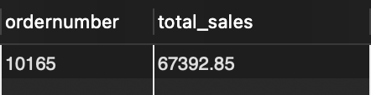
Order Analysis
Most recent orders
Highest value order based on Total Sales

Slide 11
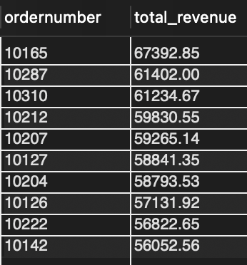
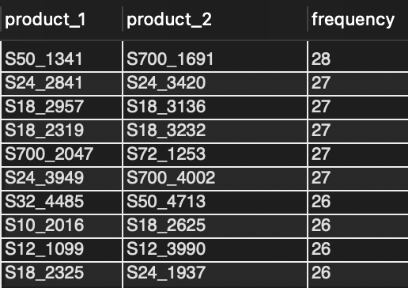
Order Analysis
Most profitable orders based on total revenue
Popular combinations within orders

Slide 12
Inactive Customers
Identified customers who haven't placed orders
Opportunity for re-engagement and targeted campaigns

Slide 13
Revenue by Product Line
Analyzed sales performance across different product categories
Identified best-selling and underperforming products

Slide 14
Sales Representative Performance
Ranked sales reps based on revenue generated
Helps optimize sales team strategies and incentives

Slide 15
Employee Role Distribution
Identified most common job roles
Helps in workforce planning and resource allocation

Slide 16
Summary
High-value customers identified
Expansion opportunities based on geographic analysis
Sales rep performance optimization
Product line sales trends

Slide 17
Summary
Prioritize customer retention strategies
Expand sales efforts in high-credit-limit countries
Optimize sales rep structure based on performance
Re-engage inactive customers with targeted marketing

Slide 18
Summary
Short-term: Improve customer engagement
Mid-term: Optimize sales team strategy
Long-term: Expand into high-potential markets

Slide 19
Conclusion
Data-driven decisions can improve business performance
SQL analysis provides key insights for growth strategies
Implementation of recommendations will drive success

