Slide 1
Absenteeism Pattern Analysis & Employee Segmentation
Student Name: Ahmed Tawfeeq P S Course 9 : Predictive Modelling using Machine Learning
Batch Code: DA464S46
Project Guide: Komilla Bhatia

Slide 2
Problem Statement
Analyze business concerns in absenteeism data, segmenting employees based on absence patterns, identifying high risk absenteeism groups

Slide 3
Dataset Overview
Datasource: Employee Absenteeism Data
Key Metrics: Reason for absence, Time of absence, Seasons, Transportation expenses, Age, Workload, Hit Target, Absenteeism in hours.

Slide 4
Data Preparation
Steps Taken: missing value handling, feature selection, scaling.
Tools used : Pandas, Numpy, Seaborn, Sklearn, Matplotlib.

Slide 5
Feature Selection for Clustering
Selected Features : Reason for absence, Month of absence, Seasons, Transportation expense, Distance from residence to work, Service Time, Age, Workload, Hit Target, Disciplinary Failure, Son, Social Drinker, Pet, Weight, Height.
The above features are taken for clustering for KMeans as they are highly correlated with the target variable.

Slide 6
Scaling & Data Transformation
Standard Scaler has been applied throughout the algorithm.
Data has been fit and transformed throughout the algorithms.

Slide 7
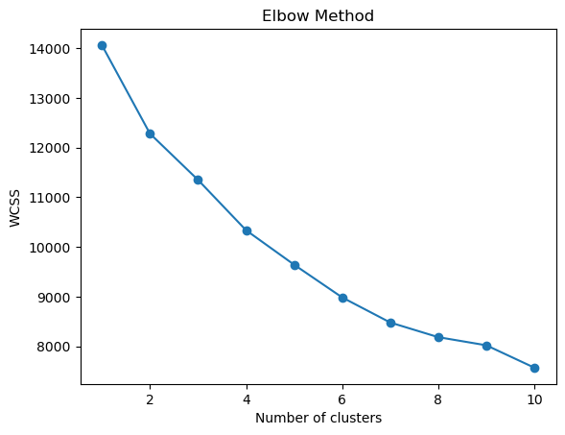
Determining Number of clusters
From the above elbow curve plot, the number of clusters to be taken for Kmeans is 3

Slide 8
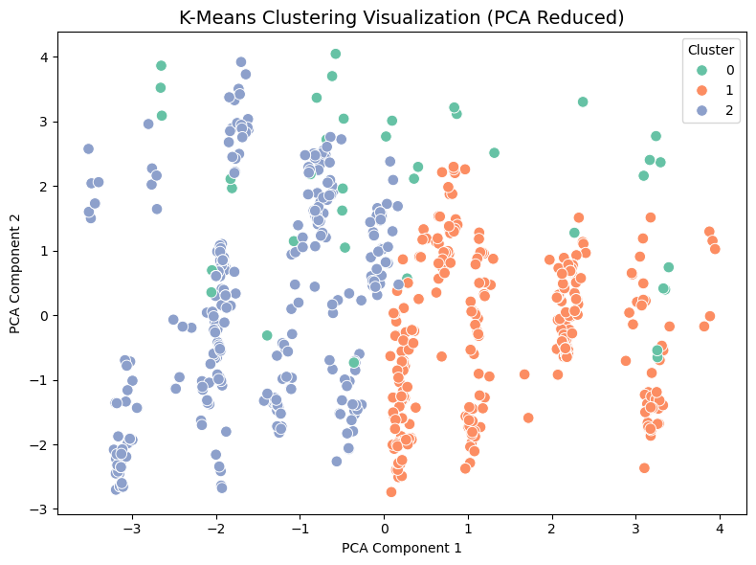
KMeans Clustering Output

Slide 9
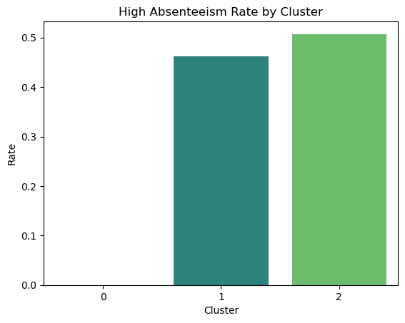
Cluster Profiles

Slide 10
Feature Selection in Logistic Regression
Selected Features : Reason for absence, Disciplinary failure, Distance from residence to work, Body Mass Index, Age, Education, Transportation expenses, Work Load.
The above features are taken for clustering for Logistic regression as they are highly correlated with the target variable.​

Slide 11
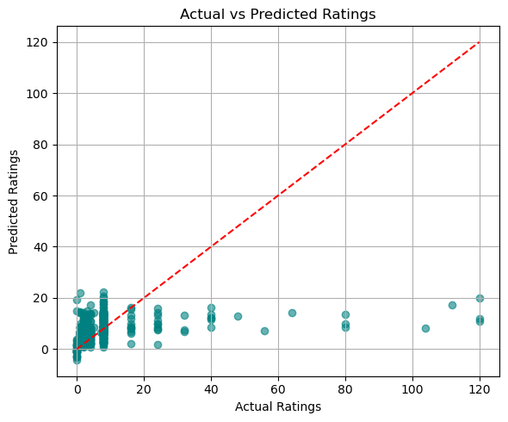
Actual vs Predicted Ratings

Slide 12
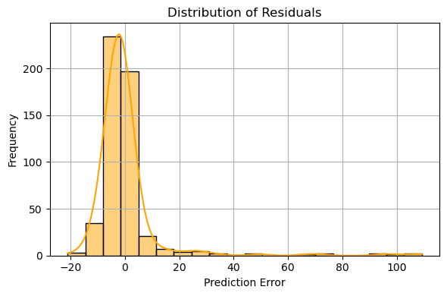
Distribution of Residuals

Slide 13
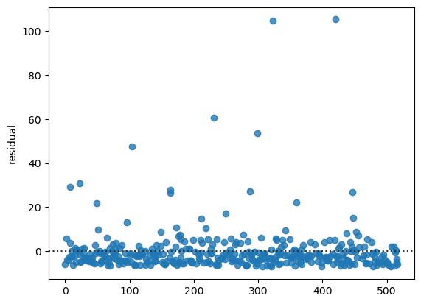
Residuals Plot
As from the above visual, the Homoscedasticity is followed

Slide 14
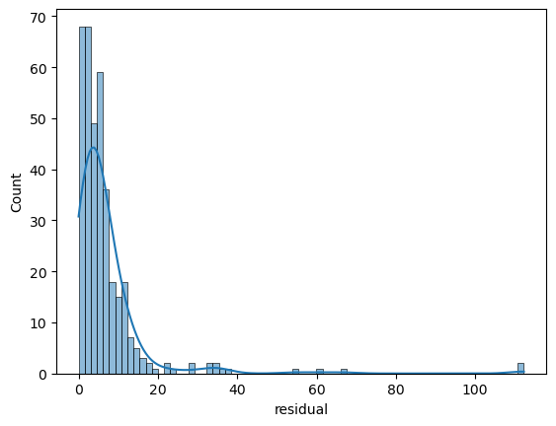
Normality of Residuals
The assumption of normality fails, because errors are not normally distributed as it should be.

Slide 15
Summary
Cluster 0: 40% of employees – younger age group, short commute, moderate workload, low absenteeism hours
Cluster 1: 35% of employees – mid-aged, longer commute distances, higher workload, moderate absenteeism
Cluster 2: 25% of employees – older employees, highest absenteeism hours, more health-related absence reasons

Slide 16
Summary
Cluster 0: 15% high absenteeism rate (lowest risk)
Cluster 1: 38% high absenteeism rate (moderate risk)
Cluster 2: 62% high absenteeism rate (highest risk)

Slide 17
Summary
Cluster 0: More family/personal obligation absences
Cluster 1: Higher frequency of transportation delays and moderate illness
Cluster 2: Mostly medical/health-related reasons, long-duration absences

Slide 18
Conclusion
K-Means clustering segmented employees into three distinct groups with different absenteeism behaviors
A clear high-risk absenteeism cluster exists (Cluster 2) with over 60% of employees in this group exceeding the median absenteeism threshold
Key drivers of high absenteeism include longer commute distance, higher workload average, and older age group with health-related absences

Slide 19
Conclusion
Targeted intervention needed for Cluster 2 with flexible scheduling, wellness programs, and possible remote work options
Transportation assistance for Cluster 1 to reduce absenteeism (transport allowances, shuttle services)
Preventive health measures for older employees such as regular health check-ups, stress management, and workload balancing
Ongoing monitoring of absenteeism trends by cluster on a quarterly basis to measure the impact of interventions

