Slide 1
Bird Strike Aviation Analysis Report
Student Name: Ahmed Tawfeeq P S Course 7 : Design Interactive Dashboards in Tableau
Batch Code: DA464S46
Project Guide: Komilla Bhatia

Slide 2
Problem Statement
Despite having access to large volumes of operational data, decision-making has been challenged by the lack of consolidated, actionable insights. Key business questions around performance trends, customer behavior, and operational bottlenecks remain unanswered, resulting in missed opportunities for optimization.

Slide 3
Dataset Overview
Datasource: Project Birdstrike Data
Key Metrics: Sales, Profit, Product Categories, Regions, Customer Segments, Order Dates, Quantity, Discount, Ship Mode, etc.

Slide 4
Data Preparation
Steps Taken: missing value handling, data cleaning
Tools used : Jupyter Notebook, Tableau

Slide 5
Objective
The objective of this analysis is to leverage data-driven insights to identify key trends, patterns, and performance indicators across multiple business dimensions. This will support management in making informed, evidence-based strategic decisions to improve operational efficiency, profitability, and customer satisfaction.

Slide 6
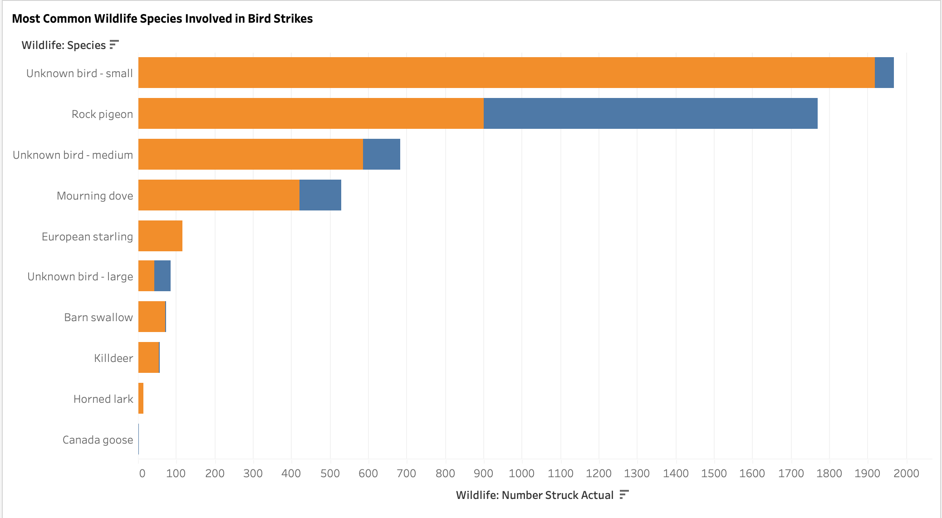
Species Involved in Bird strike

Slide 7
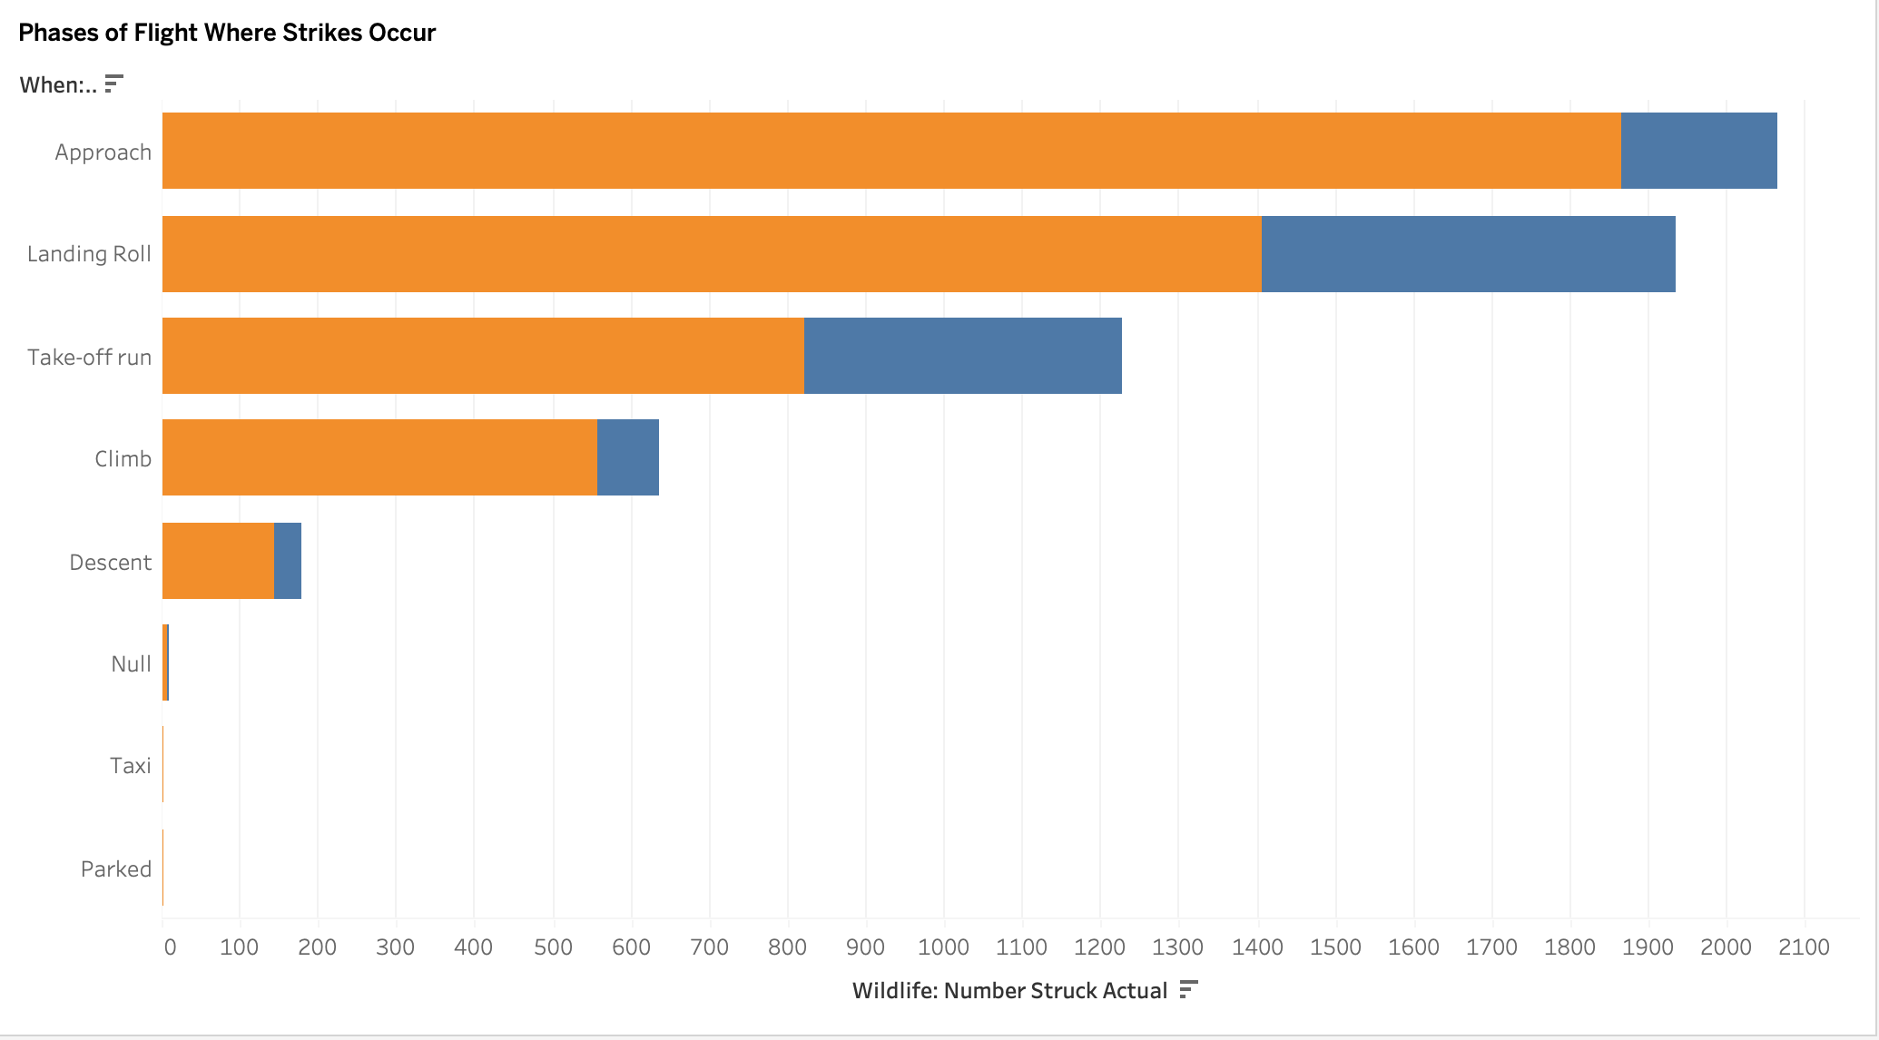
Phases where Strikes Occurs

Slide 8
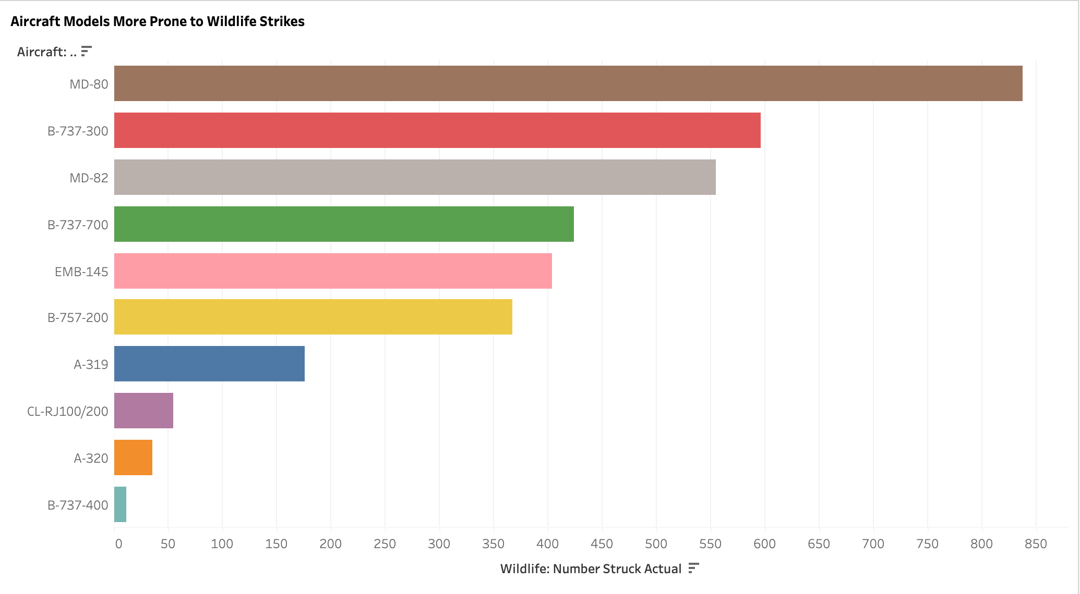
Aircrafts Prone to the Strikes

Slide 9
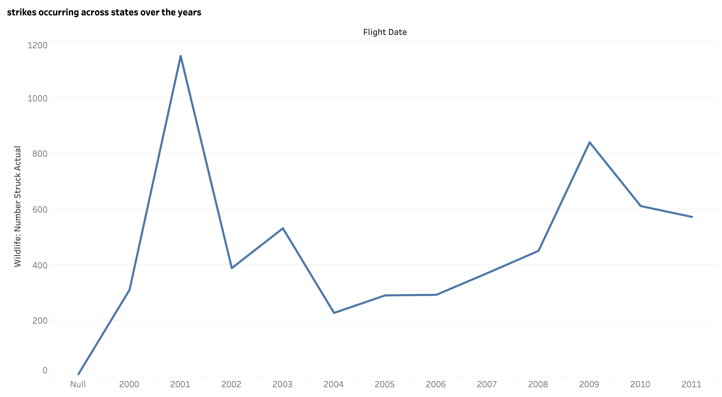
Strike Trends over the years

Slide 10
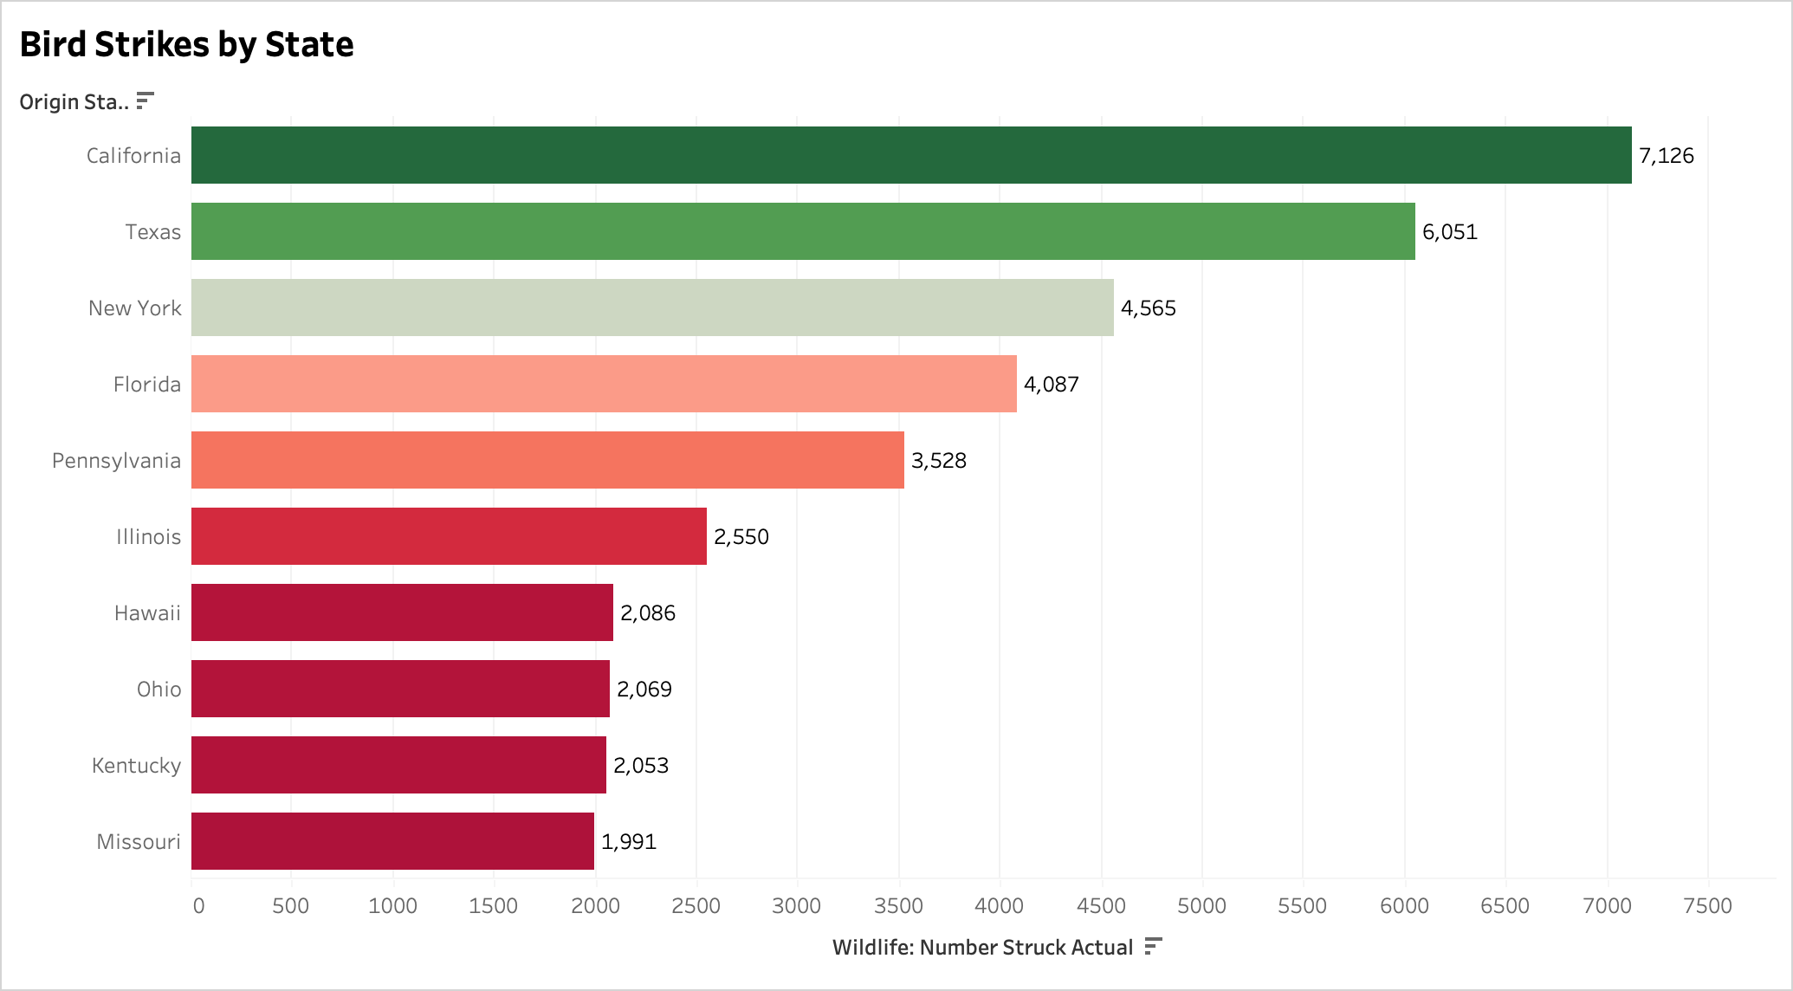
Bird Strikes by State

Slide 11
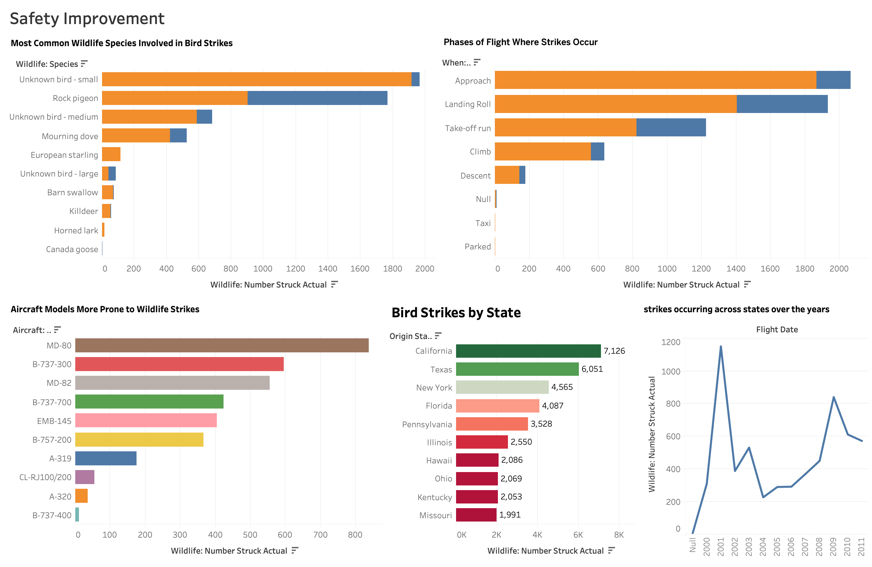
Safety Demographics Dashboard

Slide 12
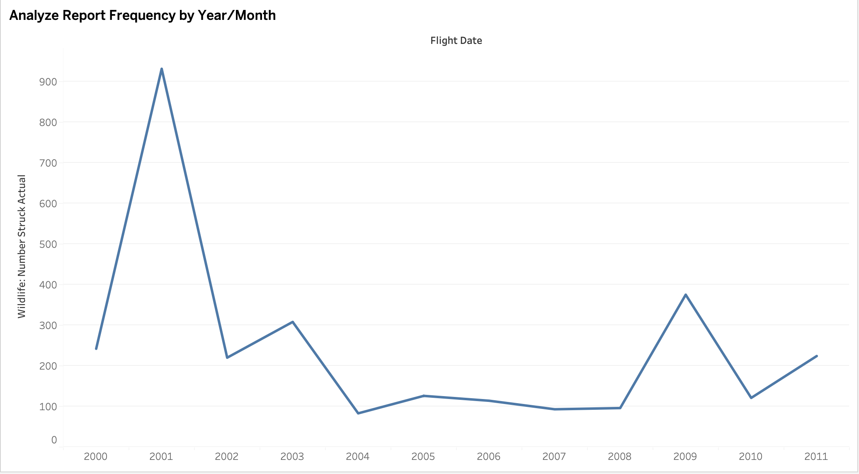
Report Frequencies over time

Slide 13
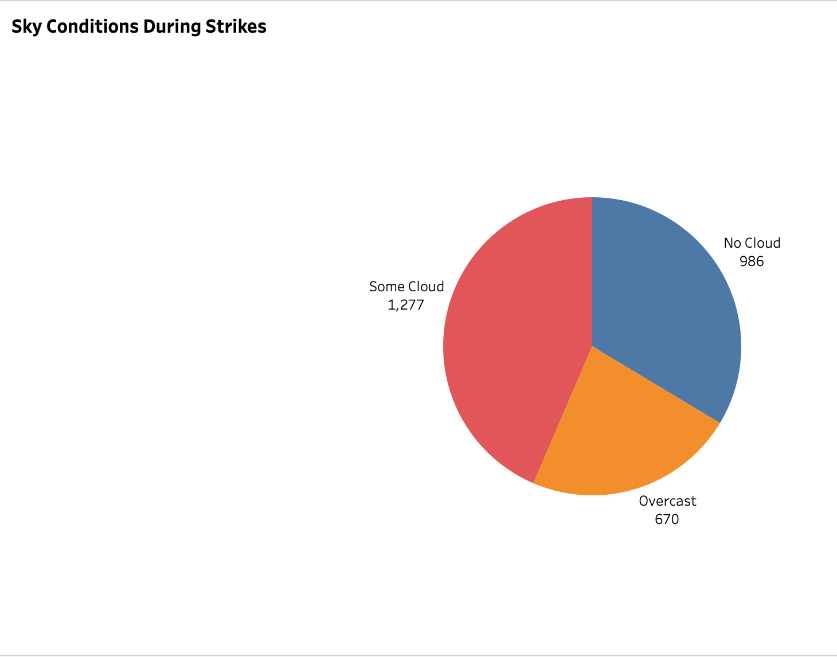
Sky Conditions During Strikes

Slide 14
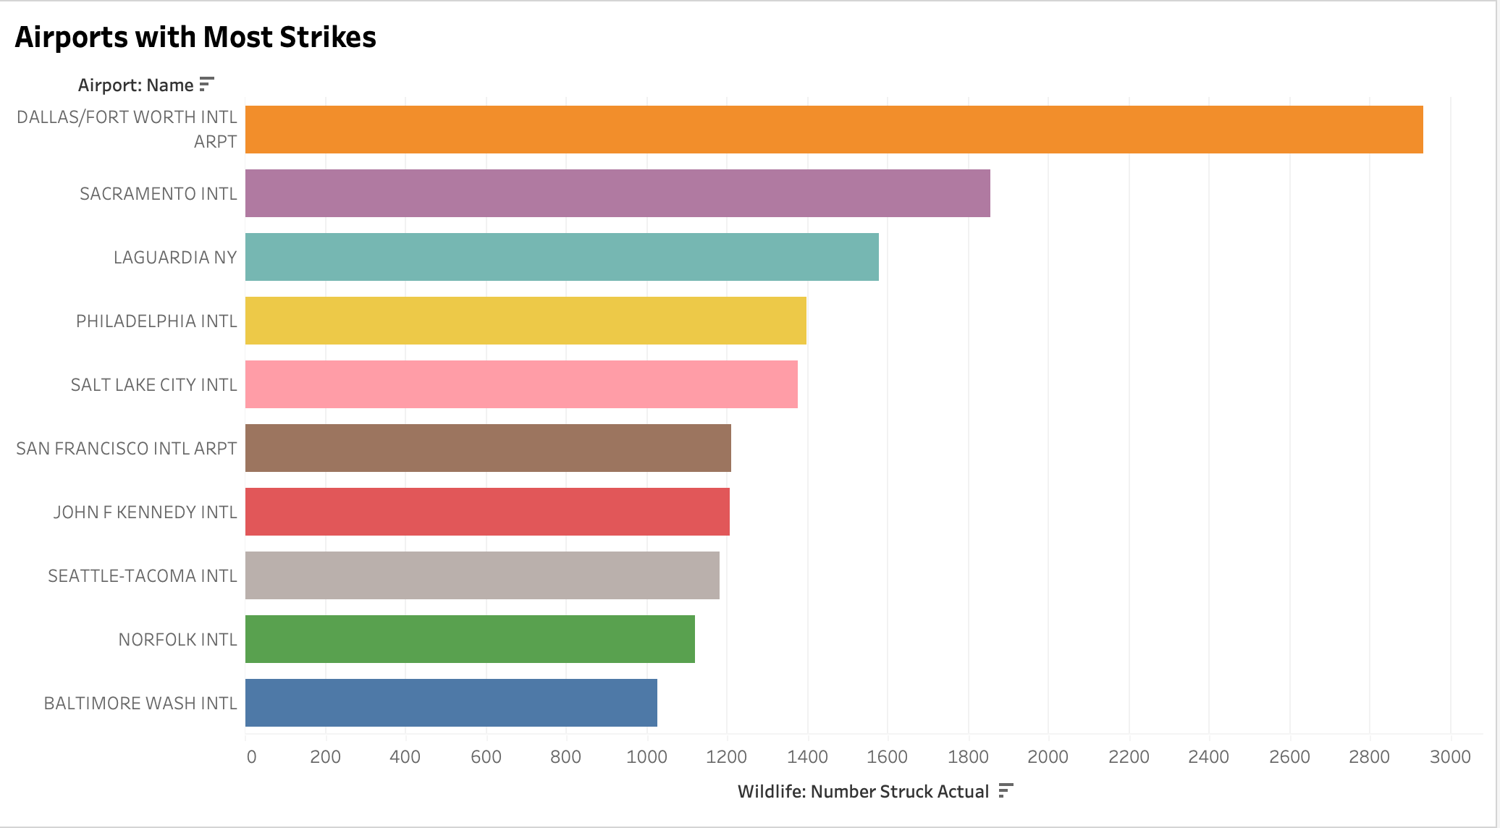
Airport with Most Strikes

Slide 15
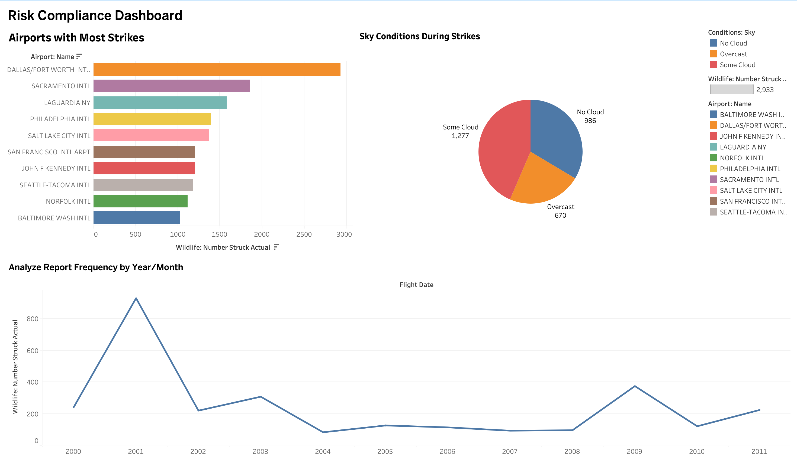
Risk Mitigation Analysis

Slide 16
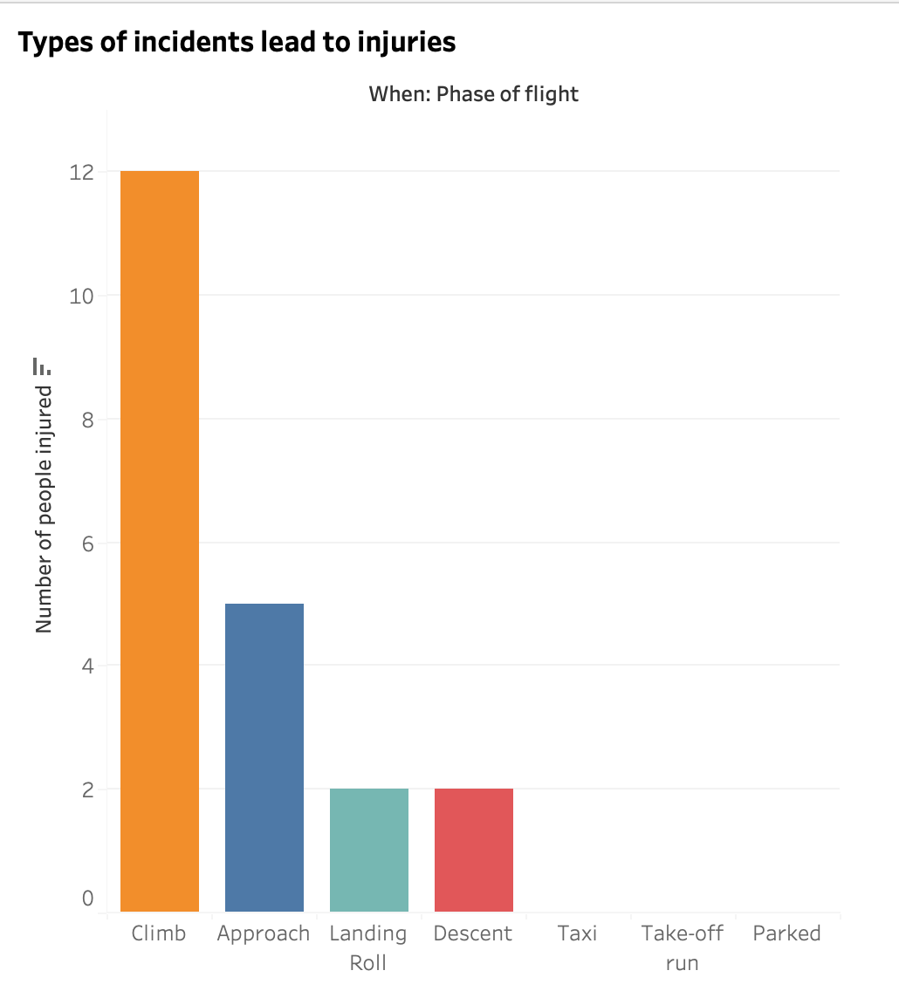
Incidents leading to Injuries

Slide 17
Key Business Findings
The most common wildlife species involved in bird strikes and the phases of flight during which they occur.
Species like gulls, sparrows, and geese are the most common
Strong correlation between delivery speed and repeat orders
Discount policies need re-evaluation to protect margins

Slide 18
Summary
Using flight dates, we observe trends in reporting volume across years.
It also shows the sky conditions during the strikes—clear skies being most common.
Finally, it identifies airports with the highest number of bird strikes, indicating where safety training and awareness need reinforcement.

Slide 19
Summary
The data reveals that medium-sized birds like gulls and ducks contribute to a large number of incidents.
Conservation measures like habitat control near runways and installing bird detection radar are necessary.
This brings together species, sizes, and locations to help wildlife authorities take proactive steps.

Slide 20
Conclusion
The analysis reveals that bird strikes are concentrated in specific high-risk airports, seasons, and flight phases, with take-off and landing posing the greatest danger.
Seasonal migration patterns and nearby environmental conditions significantly influence incident frequency. Although most strikes cause minor or no damage, severe cases lead to costly repairs and operational delays.
Proactive wildlife management, improved detection technology, and data-driven scheduling can substantially reduce risk, enhance passenger safety, and lower maintenance costs, making these measures both a safety and financial priority for the aviation sector.

