Slide 1

Linear Regression: What do these numbers mean?

Slide 3
y

Slide 4
Ordinary
Least Squares

Slide 5
m

Slide 6
Residual
degrees
of
freedom
=
number of observations
- number of parameters -- (including intercept)

Slide 7
Model
degrees
of
freedom
=
number of parameters – 1
(or # of features not including intercept)

Slide 8

$$\text{R}\text{²}$$

Slide 9
Best model minimizes
Sum of Squared Error SSE
Variance of observed points (times m) is
Total Sum of Squares SST

Slide 10
Randomness
left in the model
Variation in the data

Slide 11
Randomness
left in the model
Variation in the data
SSE/SST is the portion of variation left unexplained by the model (handled by ε)

Slide 12
Randomness
left in the model
Variation in the data
R² is the portion of variation explained by the model (R² is between 0 and 1)
(as long as the model has smaller residuals than the mean-only model)

Slide 13
F-test
Null hypothesis:
This data can be modeled by setting all β values to zero
(and the linear relationship we’ve found is purely due to chance)
Prob (F-statistic):
Is the p-value for this test. ie: it is the probability of finding the observed ( or more extreme) results when the above null hypothesis (Ho) is true.
If p-value <0.05, we can reject the null hypothesis. (Data is too extreme to fit this model just by chance.) It doesn’t mean the model is “true”

Slide 14
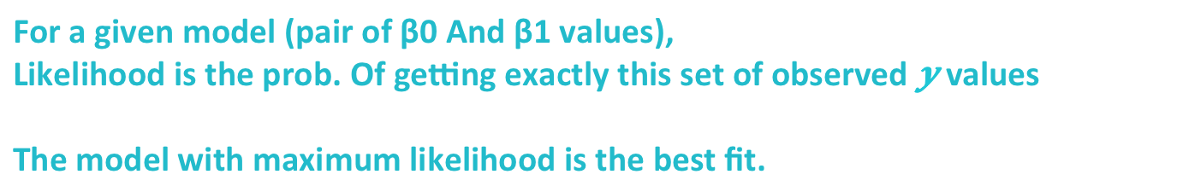
Log L
Likelihood is just a different cost function
For a given model (pair of β0 And β1 values),
Likelihood is the prob. Of getting exactly this set of observed values
The model with maximum likelihood is the best fit.

Slide 15
t-test

Slide 16
t-test
Null hypothesis:
This specific β value is zero
(and the data can be created by such a model (with the other β values intact)
P >|t|:
P-value for this test. Again if p-value < 0.05, we can reject the null hypothesis:
This variable does contribute to this model ( DOES or DOESN’T. Not how much)

Slide 17
Normality test
Null hypothesis:
ε is normally distributed. (no skew, no excess kurtosis)
Prob(Omnibus):
The p-value for this test. If p-value < 0.05, we reject the null hypothesis:
ε does not exactly follow the normal distribution that we assumed.

Slide 18
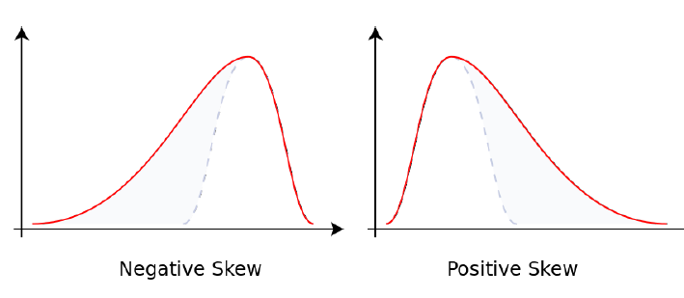
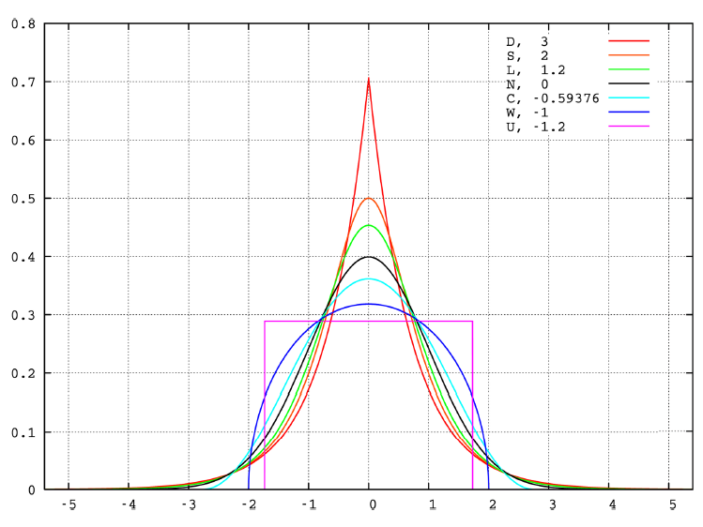
Skew &
Kurtosis
Skew
(asymmetry)
Kurtosis
(peakness)

Slide 19
Another normality test
Null hypothesis:
Again, ε is normally distributed. Idea is : we are looking for a skewness
coeff. ~ 0, and Kurtosis ~ 3. JB tests if those conditions are held against alternatives.
Prob(JB):
The p-value for this test.

Slide 20
Autocorrelation test
Null hypothesis:
Errors are uncorrelated
The Durbin Watson test reports a test statistic, with a value from 0 to 4, where:
2 is no autocorrelation.
0 to <2 is positive autocorrelation (common in time series data).
>2 to 4 is negative autocorrelation (less common in time series data).
Notes:
http://www.statisticshowto.com/durbin-watson-test-coefficient/

Slide 21
Sensitivity of prediction to small errors in input
Condition Number:
Given Mx=b, we can calculate the condition number :
CN = |λmax(M)|
|λmin(M)|
Note that if the condition number becomes quite large, then this implies that the matrix is ill-posed (does not have a unique, well-defined solution). This may be due to multi-collinear relationships between independent variables.

Slide 22
Model Selection I

Slide 23
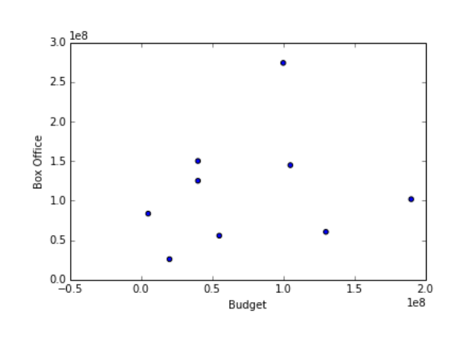
For models with the same amount of parameters, easy:

Slide 24
For models with the same amount of parameters, easy:
Take the one with the better cost function

Slide 25
For models of different complexity:
Beware under/overfitting

Slide 26
For models of different complexity:
Beware under/overfitting
Underfitting
Just Right
Overfitting

Slide 27
In machine learning, this is also called
Bias/variance tradeoff
High bias
Low varience
Low bias
High variance
Just Right

Slide 28
First training poor, predictions bad
First training strong, can’t generalize
Just Right
First and third will do poorly in the test set

Slide 29
Challenge: Fit a training set, calculate mean squared error on your test set (scikit learn)

Slide 30
There are a few metrics that try to measure this (without even looking at a test set yet)

Slide 31

$$Adjusted$$

Slide 32
Low R²
Higher R²
Highest R²

Slide 33
Low R²
Higher R²
Highest R²

Slide 34
m – k – 1
m= # points
k = # parameters
m – 1
Low R²
Higher R²
Highest R²

Slide 35
m – k – 1
m= # points
k = # parameters
m – 1
Low adj. R²
Max. adj R²
Low adj. R²

Slide 36
Akaike Information Criterion

Slide 37
# parameters
Log likelihood

Slide 38
# parameters
Log likelihood
Higher AIC
Min. AIC
Higher AIC

Slide 39
Bayesian Information Criterion

Slide 40
# parameters
# points
Log likelihood

Slide 41
# parameters
# points
Log likelihood
Higher BIC
Min. BIC
Higher BIC

Slide 42
My model is not
awesome
enough.
What do I do?

Slide 43
Try these and check test error
(and AIC,BIC,etc.) again:
Use a smaller set of features
Try adding polynomials
Check functional forms for each feature
Try including other features
Use more data (bigger training set)
Regularization (tomorrow)
Try some other model (later)

