Slide 1
Regularization

Slide 2
Notes:
These metrics tell us about our performance?
What kind? Out of sample.

Slide 3
# parameters
Log likelihood
While awarding goodness of fit, penalize model complexity

Slide 4
While awarding goodness of fit, penalize model complexity
Why not do that while we are fitting?

Slide 5
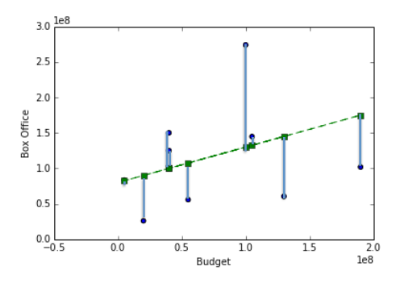
Cost function
Takes a model (specific parameter values), returns a score

Slide 6


Slide 7
Cost function
Lower for better fits

Slide 8
Cost function
Add a penalty for the size of each parameter!
Low: good fit
High: bad fit
Low: simple model
High: complex model
Notes:
Show examples of polynomials with different scalars, and how increasing parameters makes wider swings

Slide 9
Diagnostics to detect
under/overfitting
Underfitting
Just Right
Overfitting
J = V. High + Low
J = Low + Low
J = Low + V. High

Slide 10
Ridge Regression

Slide 11
Underfitting
Just Right
Overfitting
J = V. High + Low
J = Low + Low
J = Low + V. High
λ=1
Notes:
Lambda is a hyperparameter, can’t optimize automatically

Slide 12
Underfitting
Just Right
Overfitting
J = V. High + Low
J = Low + Low
J = Low + V. High
λ=1
≈0
≈0

Slide 13
Underfitting
Just Right
Overfitting
J = V. High + Medium
J = Low + V High
J = Low + VVVHigh
VERY LARGE
underfit
≈0
≈0
≈0
≈0

Slide 14
Underfitting
Just Right
Overfitting
J = V. High + Tiny
J = Low + Tiny
J = Low + Tiny
very small
possible overfit

Slide 15
Error vs. regularization λ
High λ
Low λ

Slide 16
Underfit
Overfit
High λ
Low λ

Slide 17
Ridge Regularization (L2)

Slide 18
Ridge Regularization (L2)
Lasso Regularization (L1)

Slide 19
Ridge Regularization (L2)
Lasso Regularization (L1)
Elastic Net (L1 + L2)

Slide 20
How can I use this?
We were doing:
from sklearn.linear_model import LinearRegression model = LinearRegression()
model.fit(X,Y)

Slide 21
How can I use this?
We were doing:
from sklearn.linear_model import LinearRegression model = LinearRegression()
model.fit(X,Y)
To use Lasso Regularization:
from sklearn.linear_model import Lasso
model = Lasso(1.0)
model.fit(X,Y)
λ (sklearn Calls It alpha)

Slide 22
How can I use this?
We were doing:
from sklearn.linear_model import LinearRegression model = LinearRegression()
model.fit(X,Y)
To use Ridge Regularization:
from sklearn.linear_model import Ridge
model = Ridge(1.0)
model.fit(X,Y)
λ (sklearn Calls It alpha)

Slide 23
How can I use this?
We were doing:
from sklearn.linear_model import LinearRegression model = LinearRegression()
model.fit(X,Y)
To use Elastic Net:
from sklearn.linear_model import ElasticNet
model = ElasticNet(1.0, l1_ratio = 0.5)
model.fit(X,Y)
total weight for the full penalty term
ratio of l1/l2 penalty

Slide 24
How can I use this?
We were doing:
import statsmodels.formula.api as sm model = sm.OLS.fit(Y, X)

Slide 25
How can I use this?
We were doing:
import statsmodels.formula.api as sm model = sm.OLS.fit(Y, X)
To use Lasso Regularization:
import statsmodels.formula.api as sm model = sm.OLS.fit_regularized(Y, X, alpha=1.0)

Slide 26
How can I use this?
We were doing:
import statsmodels.formula.api as sm model = sm.OLS.fit(Y, X)
To use Ridge Regularization:
import statsmodels.formula.api as sm model = sm.OLS.fit_regularized(Y, X,
alpha=1.0,
L1_wt = 0)

Slide 27
How can I use this?
We were doing:
import statsmodels.formula.api as sm model = sm.OLS.fit(Y, X)
To use Elastic Net:
import statsmodels.formula.api as sm model = sm.OLS.fit_regularized(Y, X,
alpha=1.0,
L1_wt = 0.5)

Slide 28
My model is not
awesome
enough.
What do I do?

Slide 29
Try these and check test error again:
Use a smaller set of features
Try adding polynomials
Check functional forms for each feature
Try including other features
Use more data (bigger training set)
Regularization

Slide 30
Try these and check test error again:
Use a smaller set of features
Try adding polynomials
Check functional forms for each feature
Try including other features
Use more data (bigger training set)
Regularization: Increase/decrease λ

