Slide 1

Stochastic Gradient Descent

Slide 2
Gradient Descent
Start with a cost function J( ):

Slide 3
Gradient Descent

Slide 4
Gradient Descent
Then gradually move to the minimum.

Slide 5
Gradient Descent with Linear Regression
How can we do this?

Slide 6
Gradient Descent with Linear Regression
How can we do this?
(without seeing the graph of J( )!)
Start with the function J( ):

Slide 7
Gradient Descent with Linear Regression
How can we do this?
(without seeing the graph of J( )!)
Start with the function J( ):

Slide 8
Gradient Descent with Linear Regression
How can we do this?
(without seeing the graph of J( )!)
Start with the function J( ):
and compute its
gradient vector .

Slide 9
Gradient Descent with Linear Regression
How can we do this?
(without seeing the graph of J( )!)
Start with the function J( ):
and compute its
gradient vector .
The gradient points
in the “direction of
maximum increase” of J.

Slide 10
Gradient Descent with Linear Regression

Slide 11
Gradient Descent with Linear Regression

Slide 12
Gradient Descent with Linear Regression

Slide 13
Gradient Descent with Linear Regression

Slide 14
Gradient Descent with Linear Regression

Slide 15
Gradient Descent with Linear Regression

Slide 16
Gradient Descent with Linear Regression

Slide 17
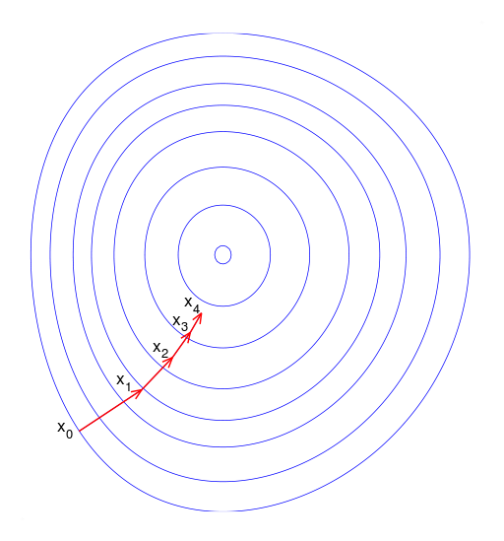
Gradient Descent

Slide 18
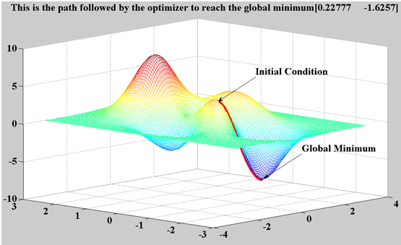
Gradient Descent

Slide 19
Gradient Descent

Slide 20
Stochastic Gradient Descent

Slide 21
Stochastic Gradient Descent
Instead of using all points to find the gradient,
Only use a SINGLE point each time

Slide 22
Stochastic Gradient Descent
Instead of using all points to find the gradient,
Only use a SINGLE point each time

Slide 23
Stochastic Gradient Descent
Instead of using all points to find the gradient,
Only use a SINGLE point each time

Slide 24
Stochastic Gradient Descent
Instead of using all points to find the gradient,
Only use a SINGLE point each time

Slide 25
Stochastic Gradient Descent
Instead of using all points to find the gradient,
Only use a SINGLE point each time

Slide 26
Faster
Derivative of single point at each step (instead of 100K)
Online Training
Only need to keep single point in memory
No need to store 100K rows, large data no problem
Covers Many Algorithms
Gradient Descent is the bottleneck for linear algorithms
Can do Linear Regression, Logistic Regression, SVMs

Slide 27
Some Implementations

Slide 28
Some Implementations
from sklearn.linear_model import SGDRegressor
from sklearn.linear_model import SGDClassiﬁer

Slide 29
from sklearn.linear_model import SGDRegressor

Slide 30
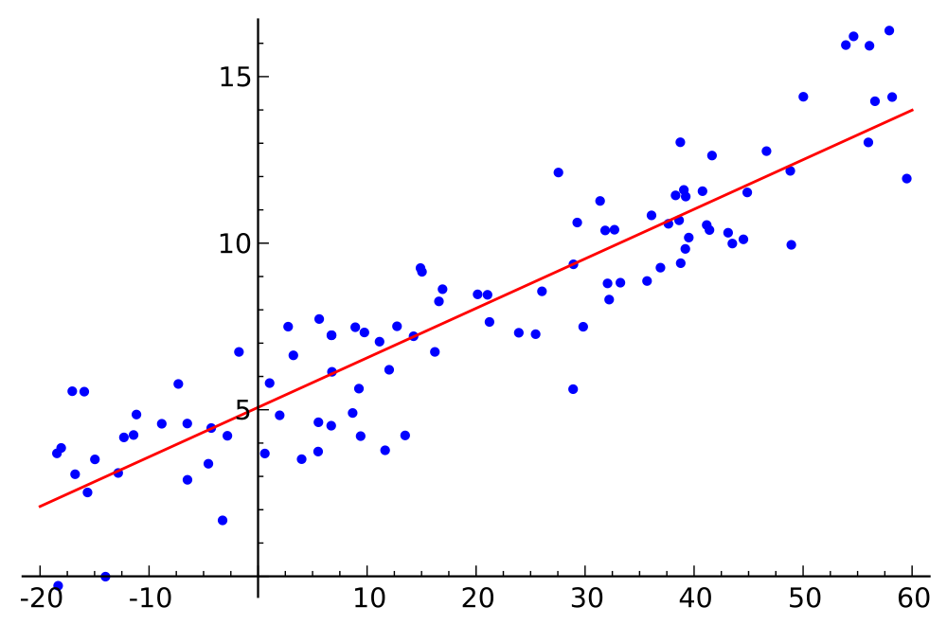
from sklearn.linear_model import SGDRegressor
SGDRegressor(loss=‘squared_loss’)
Sum of squared errors
squared loss ==
Linear Regression
Optimization Function:

Slide 31
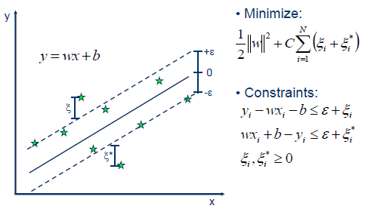
from sklearn.linear_model import SGDRegressor
SGDRegressor(loss=‘epsilon_insensitive’)
Source: http://kernelsvm.tripod.com

Slide 32
from sklearn.linear_model import SGDClassiﬁer

Slide 33
from sklearn.linear_model import SGDClassiﬁer
SGDClassifier(loss=‘hinge’)

Slide 34
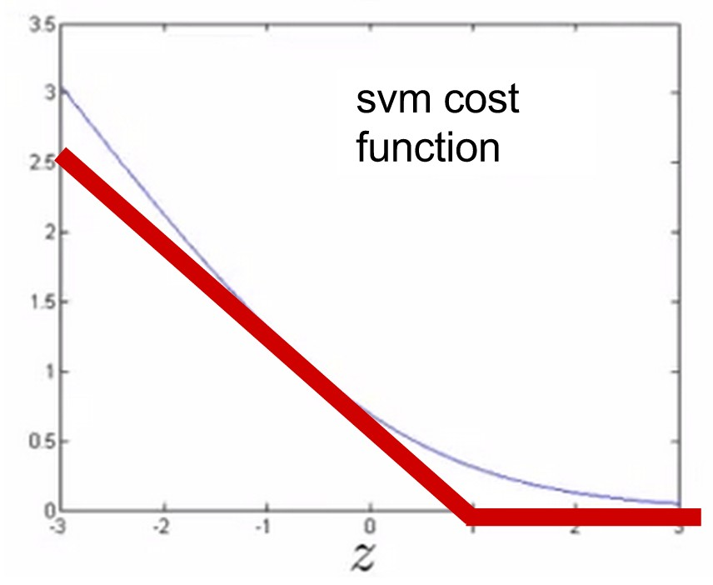
from sklearn.linear_model import SGDClassiﬁer
SGDClassifier(loss=‘hinge’)
Looks like a hinge.
hinge loss == SVM
Optimization Function:
What is Δ ? Just like with λ within our regularization term, Δ it affects the trade-off between our data loss and our regularization loss within our objective function.

Slide 35
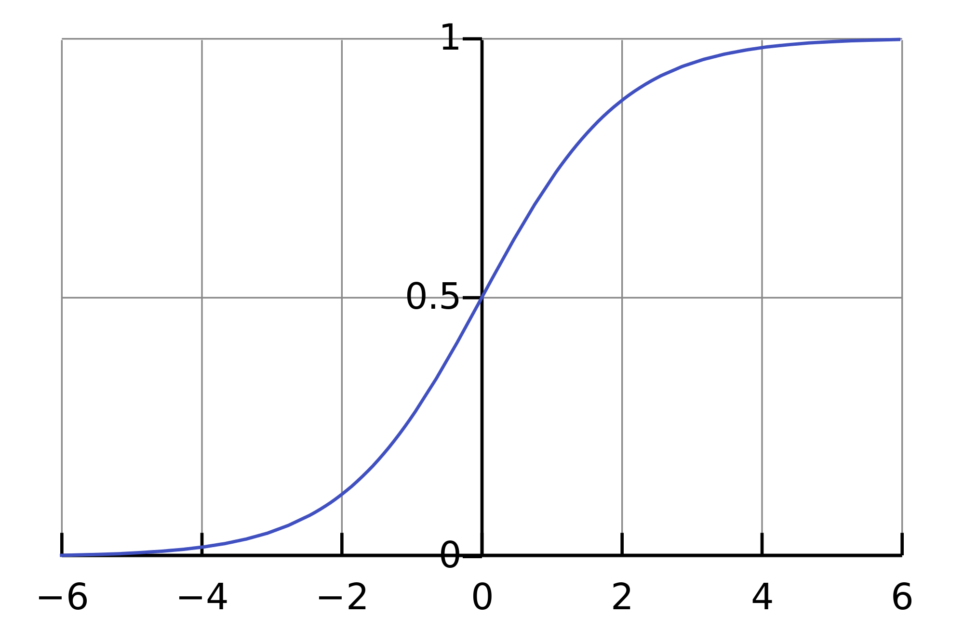
from sklearn.linear_model import SGDClassiﬁer
SGDClassifier(loss=‘log’)
This one’s kind of clear
log loss == Logistic Regression
where
Optimization Function:

Slide 36
from sklearn.linear_model import SGDClassifier
SGDClassifier(alpha=0.0001,
penalty=‘l2’,
l1_ratio=0.15)
Regularization parameters
Penalty values: ‘l1’, ‘l2’, ‘elasticnet’
L1 optimiz.
Function:
L2 optimiz.
Function:

Slide 37
Mini Batch Gradient Descent
Combines of the best of both worlds (‘Vanilla’ Gradient Descent & Stochastic Gradient Descent): performs an update for every n training examples.

Slide 38
Mini Batch Gradient Descent
Combines of the best of both worlds (‘Vanilla’ Gradient Descent & Stochastic Gradient Descent): performs an update for every n training examples.

Slide 39
Mini Batch Gradient Descent
Combines of the best of both worlds (‘Vanilla’ Gradient Descent & Stochastic Gradient Descent): performs an update for every n training examples.

Slide 40
Mini Batch Gradient Descent
Combines of the best of both worlds (‘Vanilla’ Gradient Descent & Stochastic Gradient Descent): performs an update for every n training examples.

Slide 41
Mini Batch Gradient Descent
Mini Batch implementation is typically used for neural nets
Mini Batch sizes typically range from 50 to 256.
There is a trade off between MB size and the learning rate (α): we can reduce learning rate for larger mini batch sizes (vice versa)
We can tailor a learning rate schedule (i.e.): we can reduce the learning rate as go further along within our training epoch.
We can implement with SGDClassifier (using ‘partial fit’) ex:
SGDClassifier(loss=‘log’).partial_fit()

