Slide 1

Kernels

Slide 2
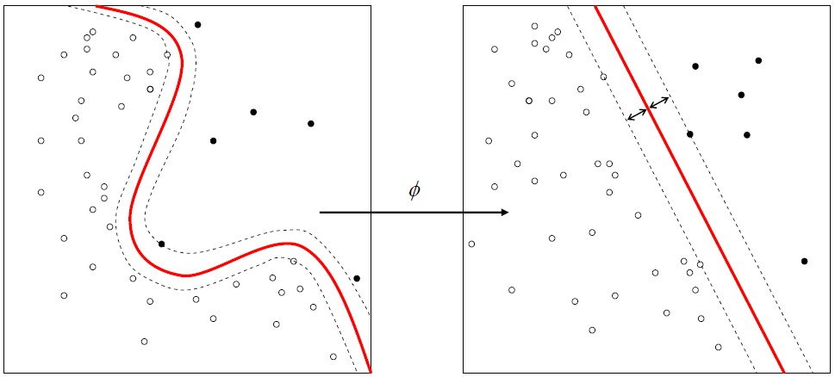
Nonlinear SVMs
Nonlinear data is linear in higher dimensions

Slide 3
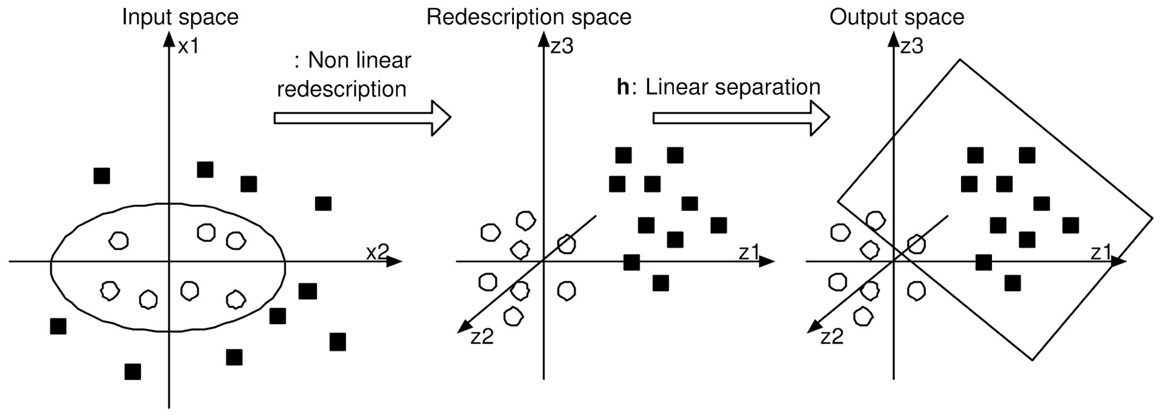
Kernel Trick
Transform data so it is linearly separable

Slide 4
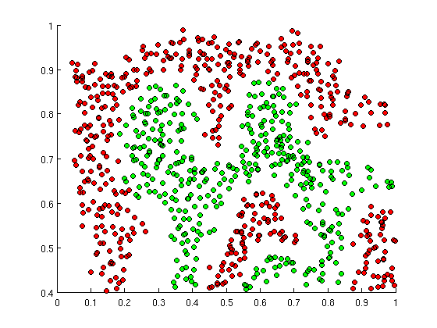
SVMs can ﬁt intricate boundaries with the Gaussian (RBF) kernel

Slide 5
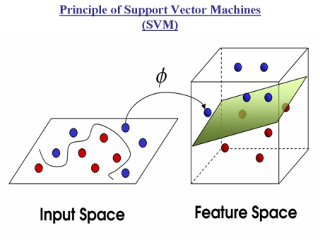
Gaussian Kernel
How does it work?

Slide 6



































Palme d’Or Winners at Cannes
Pretty intricate boundary
Budget
IMDb User Rating

Slide 7
Palme d’Or Winners at Cannes
Pretty intricate boundary
I need to use higher order features to get the curved boundary
Budget²
Rating²
Budget*Rating
Budget³
Rating³
etc.
Budget
IMDb User Rating

Slide 8
Palme d’Or Winners at Cannes
Different Approach: Transform the space
Budget
Two features describe this space
Can I describe it differently?
IMDb User Rating

Slide 9
Palme d’Or Winners at Cannes
Different Approach: Transform the space
Budget
Two features describe this space
Can I describe it differently?
IMDb User Rating

Slide 10
Palme d’Or Winners at Cannes
Different Approach: Transform the space
Budget
Transformers
IMDb User Rating

Slide 11
Palme d’Or Winners at Cannes
Different Approach: Transform the space
Budget
Transformers
Pulp Fiction
IMDb User Rating

Slide 12
Palme d’Or Winners at Cannes
Different Approach: Transform the space
Budget
Transformers
Pulp Fiction
Black Swan
IMDb User Rating

Slide 13
Define feature a₁: “Pulp Fiction”ness
Are you close to Pulp Fiction?
T
Budget
PF
BS
IMDb User Rating

Slide 14
Define feature a₁: “Pulp Fiction”ness
Are you close to Pulp Fiction?
T
Budget
PF
BS
IMDb User Rating

Slide 15
Define feature a₁: “Pulp Fiction”ness
Are you close to Pulp Fiction?
T
Budget
PF
BS
a₁=0
IMDb User Rating

Slide 16
Define feature a₁: “Pulp Fiction”ness
Are you close to Pulp Fiction?
T
Budget
a₁=0
PF
BS
IMDb User Rating

Slide 17
Define feature a₁: “Pulp Fiction”ness
Are you close to Pulp Fiction?
T
Budget
PF
BS
a₁=0
IMDb User Rating

Slide 18
Define feature a₁: “Pulp Fiction”ness
Are you close to Pulp Fiction?
T
Budget
PF
BS
a₁=0.05
IMDb User Rating

Slide 19
Define feature a₁: “Pulp Fiction”ness
Are you close to Pulp Fiction?
T
Budget
PF
BS
a₁=0.2
IMDb User Rating

Slide 20
Define feature a₁: “Pulp Fiction”ness
Are you close to Pulp Fiction?
T
Budget
PF
BS
a₁=0.7
IMDb User Rating

Slide 21
Define feature a₁: “Pulp Fiction”ness
Are you close to Pulp Fiction?
T
Budget
PF
a₁=0.9
BS
IMDb User Rating

Slide 22
Define feature a₁: “Pulp Fiction”ness
Are you close to Pulp Fiction?
T
Budget
a₁=0.62
PF
BS
IMDb User Rating

Slide 23
Define feature a₁: “Pulp Fiction”ness
Are you close to Pulp Fiction?
T
Budget
a₁=0.01
PF
BS
IMDb User Rating

Slide 24

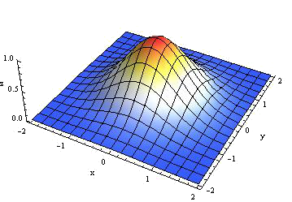
Define feature a₁: “Pulp Fiction”ness
Are you close to Pulp Fiction?
T
Budget
PF
BS
IMDb User Rating

Slide 25
Define feature a₂: “Black Swan”ness
Are you close to Black Swan?
T
Budget
PF
BS
IMDb User Rating

Slide 26
Define feature a₃: “Transformers”ness
Are you close to Black Swan?
T
Budget
PF
BS
IMDb User Rating

Slide 27
New features: a₁ , a₂ , a₃
T
Budget
PF
BS
IMDb User Rating

Slide 28
Transformation: [x₁, x₂] → [a₁ , a₂ , a₃]
T
Budget
PF
BS
a₁=0.09
a₂=0.00
a₃=0.00
IMDb User Rating

Slide 29
Transformation: [x₁, x₂] → [a₁ , a₂ , a₃]
T
Budget
PF
BS
a₁=0.16
a₂=0.42
a₃=0.00
IMDb User Rating

Slide 30
Transformation: [x₁, x₂] → [a₁ , a₂ , a₃]
T
Budget
a₁=0.00
a₂=0.00
a₃=0.96
PF
BS
IMDb User Rating

Slide 31
Transformation: [x₁, x₂] → [a₁ , a₂ , a₃]
T
Budget
PF
BS
a₁=0.00
a₂=0.00
a₃=0.00
IMDb User Rating

Slide 32
Transformation: [x₁, x₂] → [a₁ , a₂ , a₃]
x₁ (Budget)
x₂ (IMDb Rating)

Slide 33
Transformation: [x₁, x₂] → [a₁ , a₂ , a₃]
a₂ (BlackSw)
x₁ (Budget)
a₁ (PulpFic)
x₂ (IMDb Rating)
a₃ (Transf)

Slide 34
Classification in the new space
a₂ (BlackSw)
a₁ (PulpFic)
a₃ (Transf)

Slide 35
Classification in the new space
a₂ (BlackSw)
a₁ (PulpFic)
a₃ (Transf)

Slide 36
Palme d’Or Winners at Cannes
Budget
IMDb User Rating

Slide 37
Palme d’Or Winners at Cannes
Budget
Budget
IMDb User Rating

Slide 38
Palme d’Or Winners at Cannes
Budget
Budget
IMDb User Rating

Slide 39
Palme d’Or Winners at Cannes
Budget
Budget
IMDb User Rating

Slide 40
Budget
IMDb User Rating

Slide 41
Budget
IMDb User Rating

Slide 42
Budget
IMDb User Rating

Slide 43
Budget
IMDb User Rating

Slide 44
Budget
IMDb User Rating

Slide 45
Budget
IMDb User Rating

Slide 46
Budget
IMDb User Rating

Slide 47
Budget
IMDb User Rating

Slide 48
Budget
IMDb User Rating

Slide 49
Budget
IMDb User Rating

Slide 50
Budget
IMDb User Rating

Slide 51
Budget
IMDb User Rating

Slide 52
Palme d’Or Winners
at Cannes
Budget
IMDb User Rating

Slide 53
Palme d’Or Winners at Cannes
Fitting the intricate boundary with the kernel
Budget
IMDb User Rating

Slide 54
Palme d’Or Winners at Cannes
Fitting the intricate boundary with the kernel
Budget
IMDb User Rating

Slide 55
Ok, but how do I choose my feature movies?
What is my Pulp Fiction, Black Swan and Transformers?
T
Budget
PF
BS
IMDb User Rating

Slide 56
ALL OF THE TRAINING POINTS
Every movie I know is a feature itself
T
Budget
IMDb User Rating

Slide 57
Palme d’Or Winners at Cannes
SVM: Fitting the intricate boundary with RBF kernel
Budget
IMDb User Rating

Slide 58
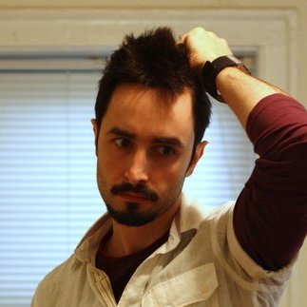
Oh no! Too many points! What do?
Approximate the feature map

Slide 59
from sklearn.kernel_approximation import Nystroem
Use a small random sample of points as new features

Slide 60
from sklearn.kernel_approximation import Nystroem
Use a small random sample of points as new features
from sklearn.kernel_approximation import RBFSampler
Try to mathematically approximate transformation
with Monte Carlo sampling (faster, less accurate)

