Slide 1

Support Vector Machines

Slide 2




1 feature (num. nodes), 2 labels (survived/not)
1
Patient status after 5 yr.
0.5
0
Number of positive nodes

Slide 3
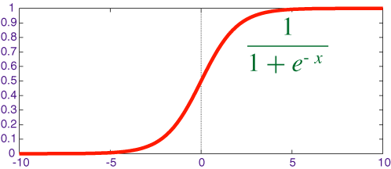
Logistic Regression
Patient status after 5 yr.
Number of positive nodes
1
y_{β} (x) =
_{1+ e}−(β₀ +β₁x+ε )

Slide 4
Support Vector Machine (SVM)
1
Patient status after 5 yr.
0.5
0
Number of positive nodes
Find the best boundary that separates two classes

Slide 5
Support Vector Machine (SVM)
?
1
Patient status after 5 yr.
0.5
0
Number of positive nodes
Bad: 3 misclassifications, accuracy 67%

Slide 6
Support Vector Machine (SVM)
?
1
Patient status after 5 yr.
0.5
0
Number of positive nodes
One misclassification, accuracy 89%

Slide 7
Support Vector Machine (SVM)
?
1
Patient status after 5 yr.
0.5
0
Number of positive nodes
Accuracy: 78%

Slide 8
Support Vector Machine (SVM)
?
1
Patient status after 5 yr.
0.5
0
Number of positive nodes
Accuracy: 100%

Slide 9
Support Vector Machine (SVM)
?
1
Patient status after 5 yr.
0.5
0
Number of positive nodes
Accuracy: 100%

Slide 10
Support Vector Machine (SVM)
?
1
Patient status after 5 yr.
0.5
0
Number of positive nodes
Accuracy: 100%

Slide 11
Support Vector Machine (SVM)
1
Patient status after 5 yr.
0.5
0
Number of positive nodes
The margin: No man’s land

Slide 12
Support Vector Machine (SVM)
1
Patient status after 5 yr.
0.5
0
Number of positive nodes
Extra error due to point in margin

Slide 13
Support Vector Machine (SVM)
1
Patient status after 5 yr.
0.5
0
Number of positive nodes
Extra error due to point in margin

Slide 14
Support Vector Machine (SVM)
1
Patient status after 5 yr.
0.5
0
Number of positive nodes
Best boundary

Slide 15
Support Vector Machine (SVM)
1
Patient status after 5 yr.
0.5
0
Number of positive nodes
An even better way of doing this:
Find the boundary with the largest margin

Slide 16
Support Vector Machine (SVM)
1
Patient status after 5 yr.
0.5
0
Number of positive nodes
Extra error due to point in margin

Slide 17
Support Vector Machine (SVM)
1
Patient status after 5 yr.
0.5
0
Number of positive nodes
Best boundary

Slide 18
Logistic Regression
Patient status after 5 yr.
Number of positive nodes
1
y_{β} (x) =
_{1+ e}−(β₀ +β₁x+ε )

Slide 19
Logistic Regression and SVM are not very diﬀerent
Patient status after 5 yr.
Number of positive nodes
Best boundary

Slide 20
















































2 Features: Number of + nodes, Age
2 Labels: Survived / Lost
Age
Number of positive nodes

Slide 21

Find the line that separates the classes best
Age
Number of positive nodes

Slide 22

Age
Number of positive nodes

Slide 23

Age
Number of positive nodes

Slide 24

Age
Number of positive nodes

Slide 25

Age
Number of positive nodes

Slide 26

Age
Number of positive nodes

Slide 27

Age
Number of positive nodes

Slide 28

Best boundary
Age
Number of positive nodes

Slide 29
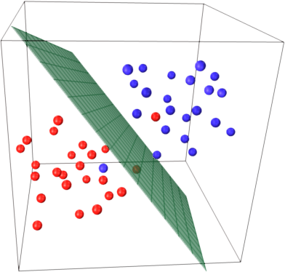
3 features: Find the best boundary plane
(More features: hyperplane)

Slide 30
Logistic Regression Cost Function
1 1
y_{pred} (x) =
=
_{1+ e}−(β₀ +β₁x+...+ε )
1+ e^{− z}

Slide 31
Logistic Regression Cost Function
1 1
y_{pred} (x) =
=
_{1+ e}−(β₀ +β₁x+...+ε )
1+ e^{− z}

Slide 32
Logistic Regression Cost Function
1 1
y_{pred} (x) =
=
_{1+ e}−(β₀ +β₁x+...+ε )
1+ e^{− z}
y_true = 1

Slide 33
Logistic Regression Cost Function
1 1
y_{pred} (x) =
=
_{1+ e}−(β₀ +β₁x+...+ε )
1+ e^{− z}
y_true = 1
y_pred= .75

Slide 34
Logistic Regression Cost Function
1 1
y_{pred} (x) =
=
_{1+ e}−(β₀ +β₁x+...+ε )
1+ e^{− z}
error =.25

Slide 35
Logistic Regression Cost Function
1 1
y_{pred} (x) =
=
_{1+ e}−(β₀ +β₁x+...+ε )
1+ e^{− z}
error =.75

Slide 36
Logistic Regression Cost Function
1 1
y_{pred} (x) =
=
_{1+ e}−(β₀ +β₁x+...+ε )
1+ e^{− z}
error =.93

Slide 37
Logistic Regression Cost Function
1 1
y_{pred} (x) =
=
_{1+ e}−(β₀ +β₁x+...+ε )
1+ e^{− z}
error =.02

Slide 38
Logistic Regression Cost Function
1 1
y_{pred} (x) =
=
_{1+ e}−(β₀ +β₁x+...+ε )
1+ e^{− z}
Cost(y_{pred} , y_{true} ) =
− log(y_{pred} )
if
^{y}true ⁼ ¹
^{y}true ⁼ ⁰
− log(1–y_{pred} )
if

Slide 39
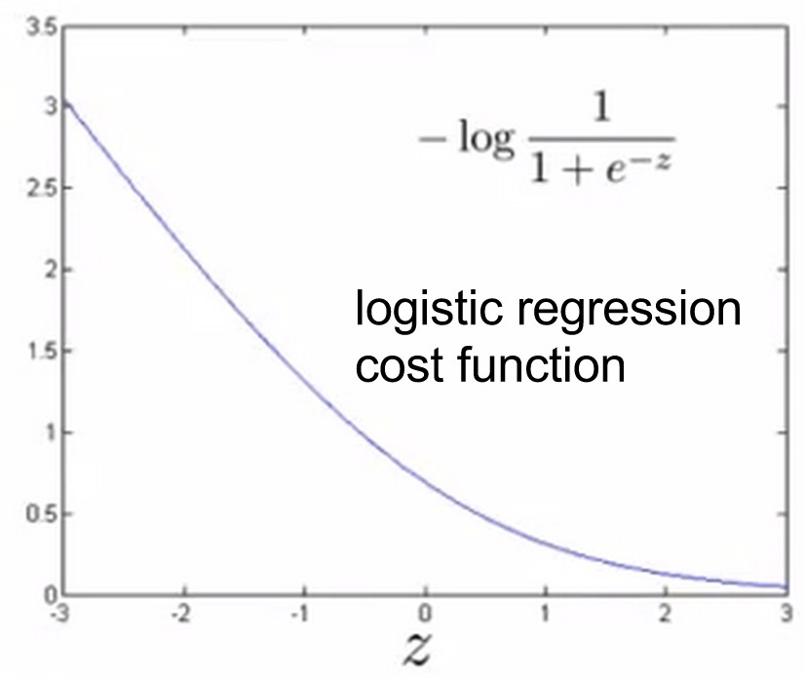
Logistic Regression Cost Function
Cost(y_{pred} , y_{true} ) =
− log(y_{pred} )
if
^{y}true ⁼ ¹
^{y}true ⁼ ⁰
− log(1–y_{pred} )
if

Slide 40
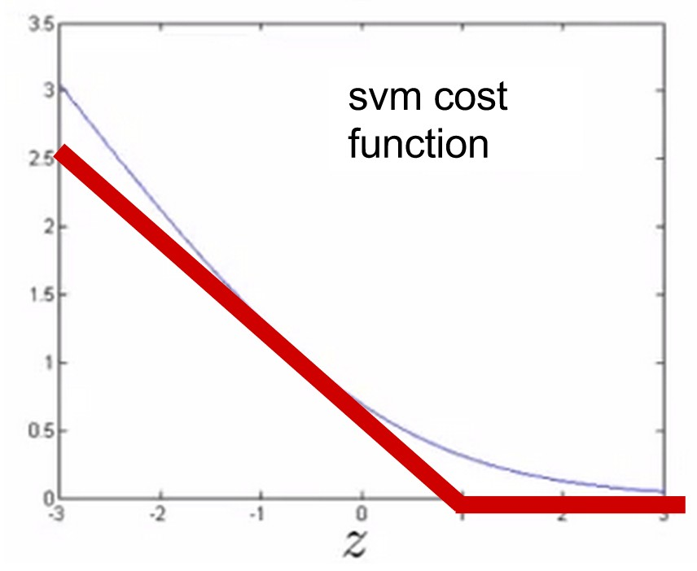
Logistic Regression Cost Function
Cost(y_{pred} , y_{true} ) =
− log(y_{pred} )
if
^{y}true ⁼ ¹
^{y}true ⁼ ⁰
− log(1–y_{pred} )
if

Slide 41
SVM Cost Function

Slide 42
SVM Cost Function

Slide 43
SVM Cost Function

Slide 44
SVM Cost Function

Slide 45
SVM Cost Function

Slide 46
SVM Cost Function

Slide 47
SVM Cost Function

Slide 48
SVM Cost Function

Slide 49
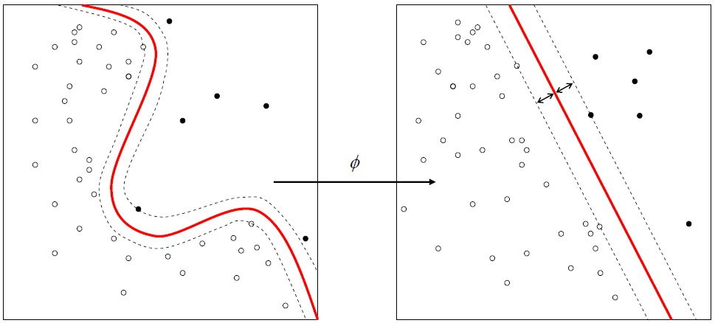
Nonlinear SVMs
Nonlinear data is linear in higher dimensions

Slide 50
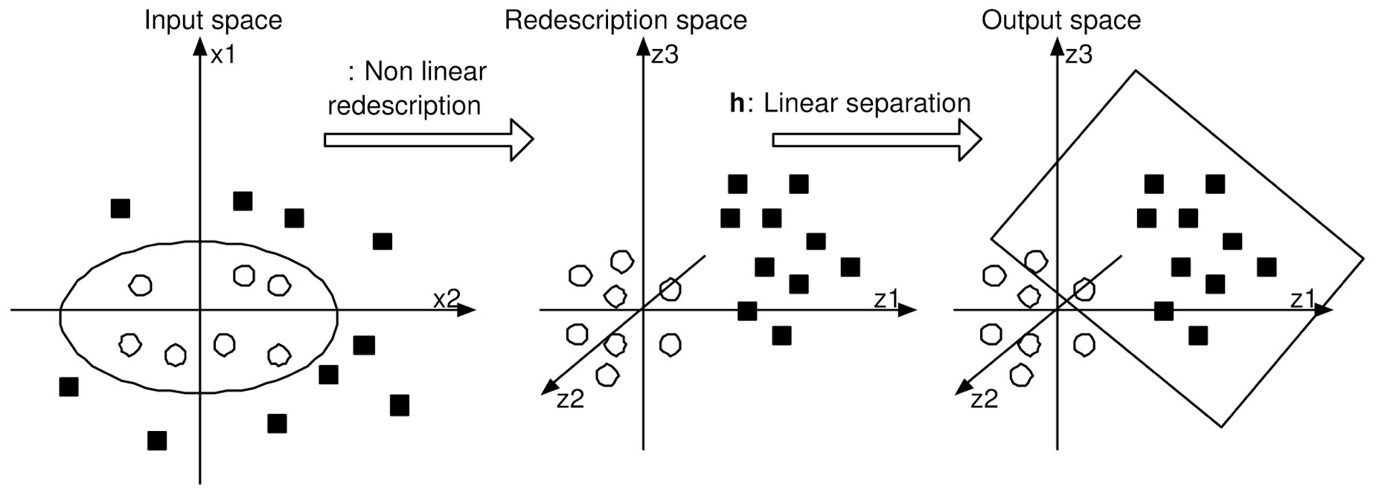
Kernel Trick
Transform data so it is linearly separable

Slide 51
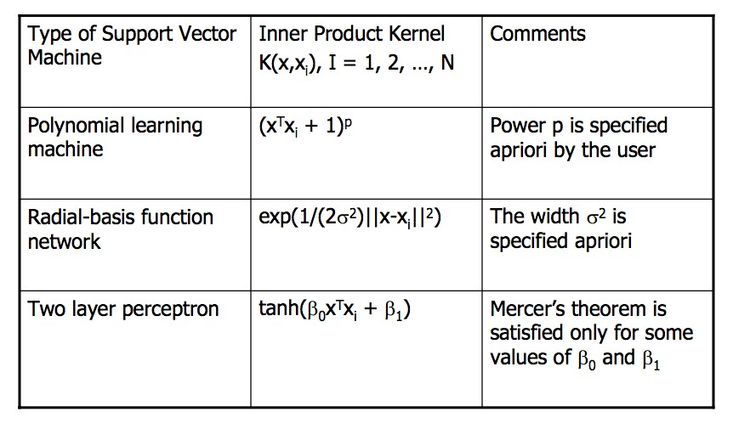
Diﬀerent Kernels
Linear kernel: No transformation

Slide 52


Diﬀerent Kernels

Slide 53
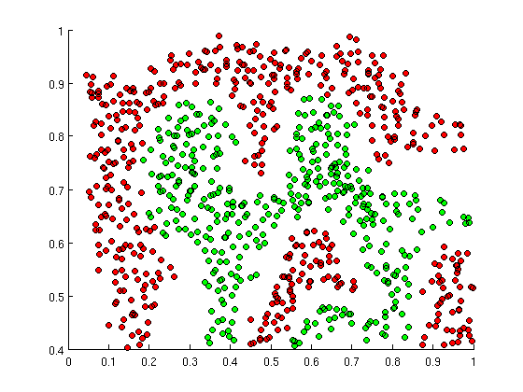
SVMs can ﬁt intricate boundaries with the Gaussian (RBF) kernel

Slide 54
from sklearn.svm import SVC
from sklearn.svm import LinearSVC

Slide 55



































Outlier problems
Age
Number of positive nodes

Slide 56
Outlier problems
Age
Number of positive nodes

Slide 57
Outlier problems
Age
Number of positive nodes

Slide 58

Outlier problems
Age
Number of positive nodes

Slide 59

Outlier problems
Age
Number of positive nodes

Slide 60
This is probably still the best boundary
Age
Number of positive nodes

Slide 61
Regularization in the Cost Function handles this
1
C
∑β_{i}
Cost(y_{pred} , y_{true} ) = SVMCost(β_{i} ) +
2
i
Age
Number of positive nodes

Slide 62
Regularization in the Cost Function handles this
1
C
∑β_{i}
Cost(y_{pred} , y_{true} ) = SVMCost(β_{i} ) +
2
i
But first, what do coefficients mean for SVMs?

Slide 63
Regularization in the Cost Function handles this
1
C
∑β_{i}
Cost(y_{pred} , y_{true} ) = SVMCost(β_{i} ) +
2
i
But first, what do coefficients mean for SVMs?

Slide 64
Regularization in the Cost Function handles this
1
C
∑β_{i}
Cost(y_{pred} , y_{true} ) = SVMCost(β_{i} ) +
2
i
But first, what do coefficients mean for SVMs?
x₂
x₃
x₁

Slide 65
Regularization in the Cost Function handles this
1
C
∑β_{i}
Cost(y_{pred} , y_{true} ) = SVMCost(β_{i} ) +
2
i
But first, what do coefficients mean for SVMs?
Vector
orthogonal to the separating hyperplane
x₂
x₃
x₁

Slide 66
1
C
∑β_{i}
Cost(y_{pred} , y_{true} ) = SVMCost(β_{i} ) +
2
i
Age
Number of positive nodes

Slide 67
1
C
∑β_{i}
Cost(y_{pred} , y_{true} ) = SVMCost(β_{i} ) +
2
i
Model 1
Age
Number of positive nodes

Slide 68
1
C
∑β_{i}
Cost(y_{pred} , y_{true} ) = SVMCost(β_{i} ) +
2
i
Model 1
vector:
(1,-1.5)
ß_{nodes} = 1
ß_{age} = -1.5
Age
Number of positive nodes

Slide 69
1
C
∑β_{i}
Cost(y_{pred} , y_{true} ) = SVMCost(β_{i} ) +
2
i
optimal high
(best fit) (large beta vector)
Model 1
vector:
(1,-1.5)
ß_{nodes} = 1
ß_{age} = -1.5
Age
Number of positive nodes

Slide 70
1
C
∑β_{i}
Cost(y_{pred} , y_{true} ) = SVMCost(β_{i} ) +
2
i
Model 2
Age
Number of positive nodes

Slide 71
1
C
∑β_{i}
Cost(y_{pred} , y_{true} ) = SVMCost(β_{i} ) +
2
i
Model 2
vector:
(1,0)
ß_{nodes} = 1
ß_{age} = 0
Age
Number of positive nodes

Slide 72
1
C
∑β_{i}
Cost(y_{pred} , y_{true} ) = SVMCost(β_{i} ) +
2
i
slightly higher lower
(close but not (smaller beta vector,
best fit) simpler model)
Model 2
vector:
(1,0)
ß_{nodes} = 1
ß_{age} = 0
Age
Number of positive nodes

Slide 73
1
C
∑β_{i}
Cost(y_{pred} , y_{true} ) = SVMCost(β_{i} ) +
2
i
slightly higher lower
(close but not (smaller beta vector,
best fit) simpler model)
i
Total cost is lower for this simpler model.
The more complex model improved fit, but not as much to overcome the extra regularization cost from the added term.
That’s how regularization drives simpler models and avoids overfitting.

Slide 74
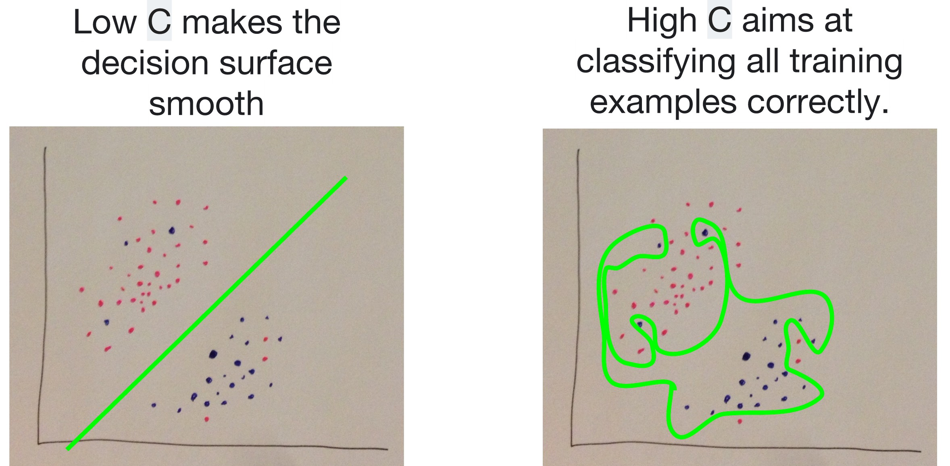
Tune regularization with C
1
C
∑β_{i} i
Cost(y_{pred} , y_{true} ) = SVMCost(β_{i} ) +
2

Slide 75
Tune regularization with C
1
C
∑β_{i} i
Cost(y_{pred} , y_{true} ) = SVMCost(β_{i} ) +
2
Low C
underﬁt
High C
overﬁt

Slide 76
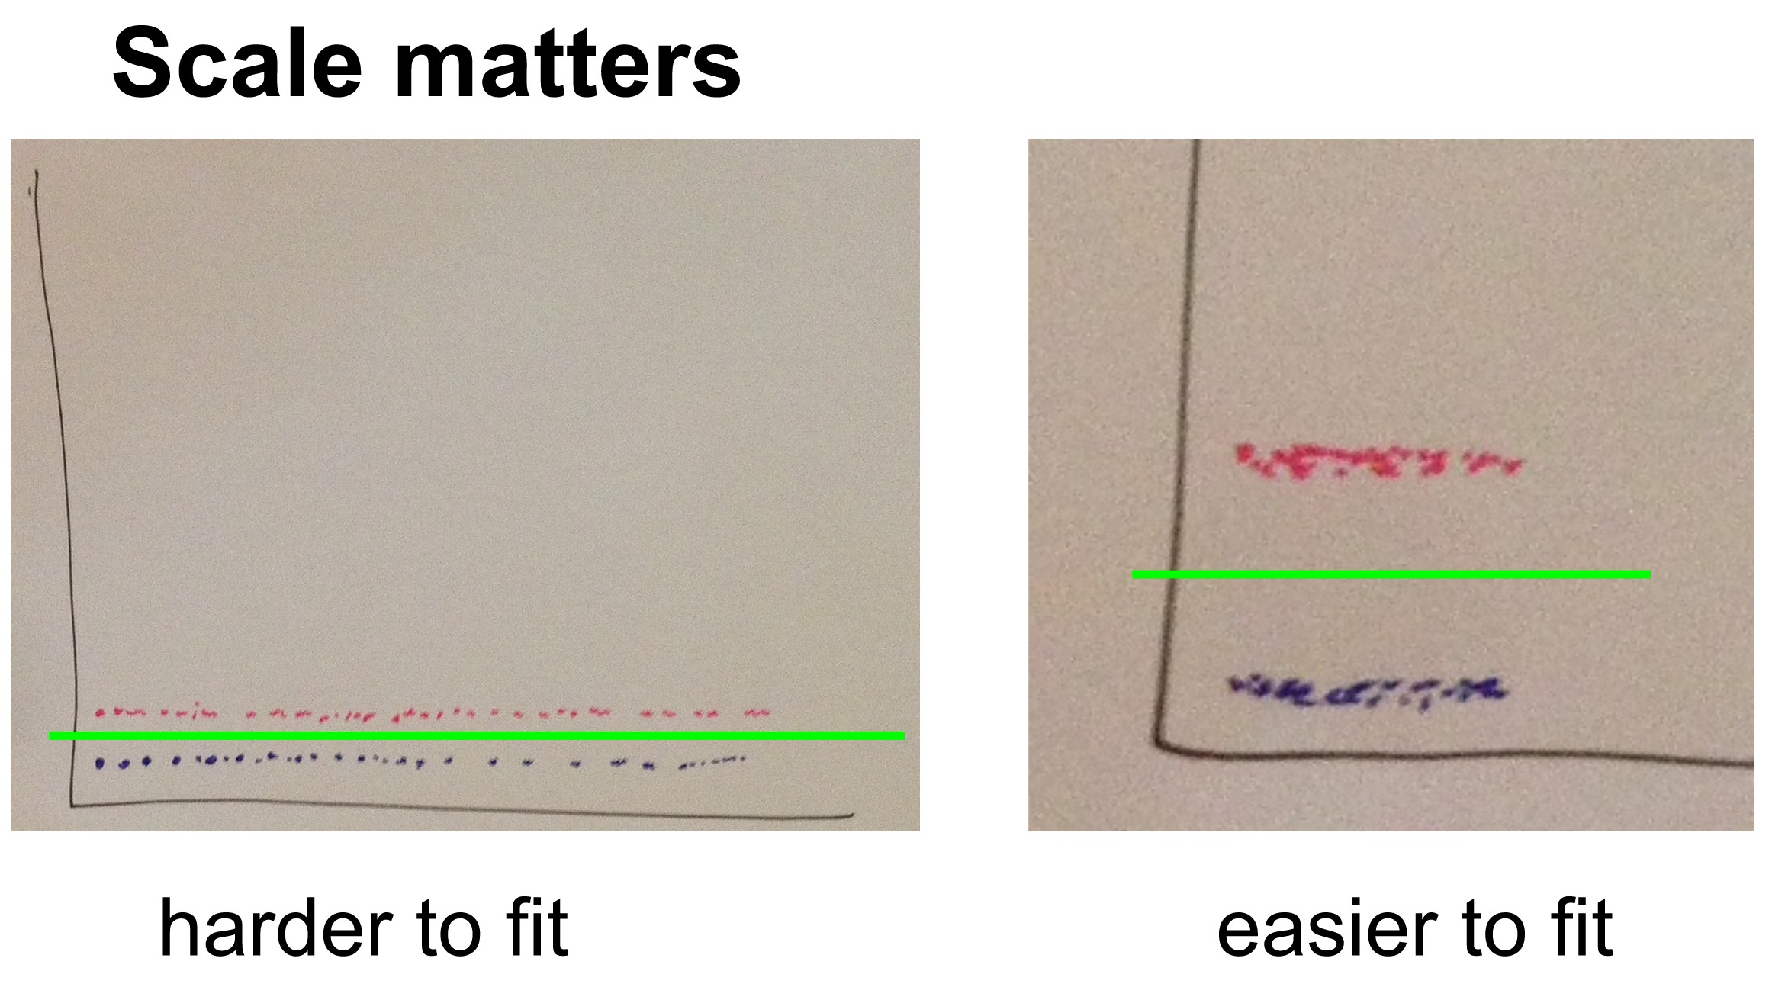
SVMs are not scale-invariant.

Slide 77
from sklearn import preprocessing
X_scaled = preprocessing.scale(X)

Slide 78
When to use SVM, Logistic Regression, etc.
A lot of features, but small data
(10K features, 1000 training examples)
Best you can do is a simple model, go for Logistic Regression or LinearSVC

Slide 79
When to use SVM, Logistic Regression, etc.
Few features, decent data
(5-100 features, 10K training examples)
Go for a Radial Basis Function Kernel SVC, rock the hell out of it.

Slide 80
When to use SVM, Logistic Regression, etc.
Few features, lots of data
(5-100 features, 100K training examples)
With that much data, you can extract more from weaker features. Add more features. Use Logistic Regression or LinearSVC.
(RBF kernel SVC is too slow with large data)

