Slide 1

Linear Regression

Slide 2
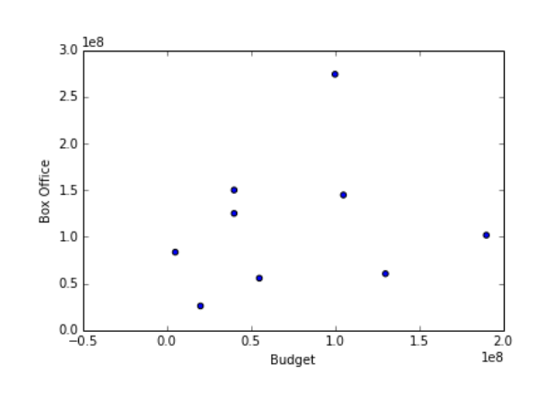

Slide 4
coef 0
coef 1
Gross
of
movie
Budget
of
movie

Slide 12
Predicted value by model – Observed value
β0 =80M, β1=0.5

Slide 13
Predicted value by model – Observed value
β0 =80M, β1=0.5

Slide 14
Predicted value by model – Observed value
β0 =80M, β1=0.5

Slide 15
Predicted value by model – Observed value
β0 =80M, β1=0.5

Slide 16
Predicted value by model – Observed value
β0 =80M, β1=0.5

Slide 17
Cost function
Takes a model (specific parameter values), returns score

Slide 21
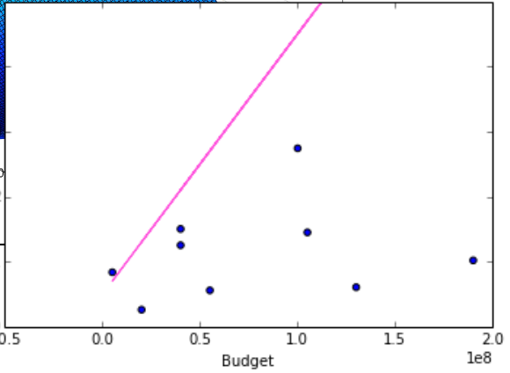

Slide 22
import statsmodels.formula.api as sm
linmodel = sm.OLS(Y, X).fit()

Slide 25
Models and Randomness
DATA SCIENCE BOOTCAMP

Slide 26
Random for
each movie

Slide 27
Random
Normal distribution
Mean=0
Stdev=
$67,762,000

Slide 28
Random
Normal distribution
Mean=0
Stdev=
$67,762,000

Slide 29
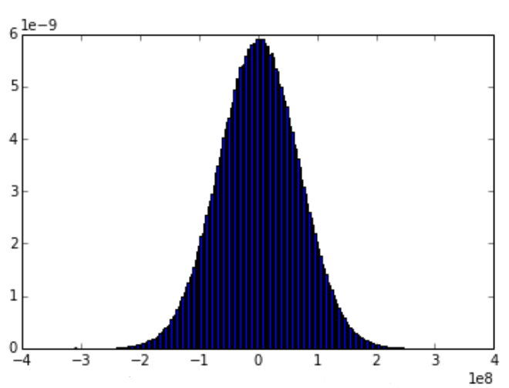
Random
Normal distribution
Mean=0
Stdev=
$67,762,000
pdf(ε)
ε
(Note axes!)

Slide 30
Random
Normal distribution
Mean=0
Stdev=
$67,762,000

Slide 31
Random
Normal distribution
Mean=0
Stdev=
$67,762,000

Slide 32
def underlying_gross_model(budget):
return 94.68e6 + 0.248*budget +random.gauss(0,67762000)

Slide 33
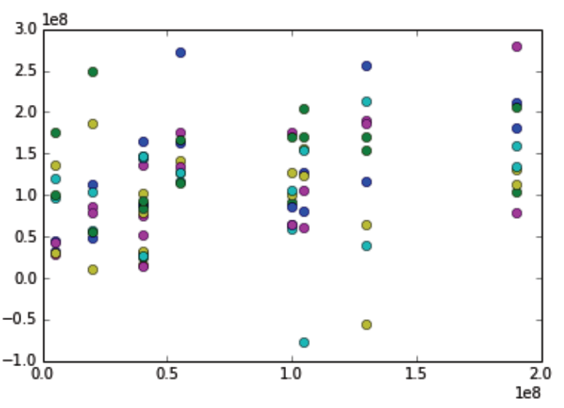
def underlying_gross_model(budget):
return 94.68e6 + 0.248*budget +random.gauss(0,67762000)
Possible Values in alternative universes

Slide 34
def underlying_gross_model(budget):
return 94.68e6 + 0.248*budget +random.gauss(0,67762000)
Expected value is β0+β1x (without ε)

Slide 35
def underlying_gross_model(budget):
return 94.68e6 + 0.248*budget +random.gauss(0,67762000)
95% prediction interval

Slide 36
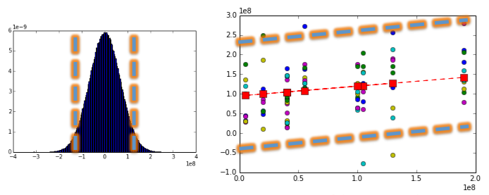
def underlying_gross_model(budget):
return 94.68e6 + 0.248*budget +random.gauss(0,67762000)
95% prediction interval

Slide 37
def underlying_gross_model(budget):
return random.gauss(94.68e6 + 0.248*budget, 67762000)
95% prediction interval

Slide 38
Multiple Linear Regression
DATA SCIENCE BOOTCAMP

Slide 40
to find the best fitting model

Slide 41
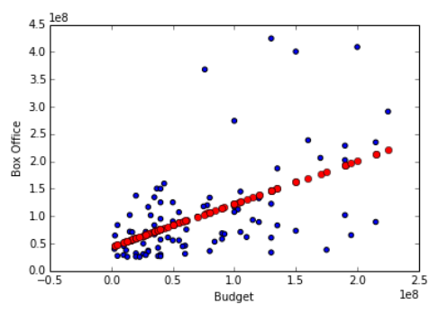
Polynomial regression

Slide 42
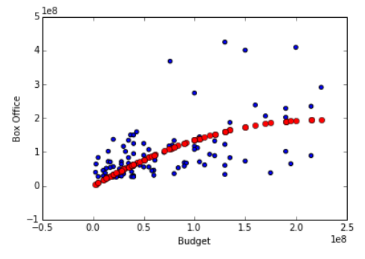
Polynomial regression

Slide 43
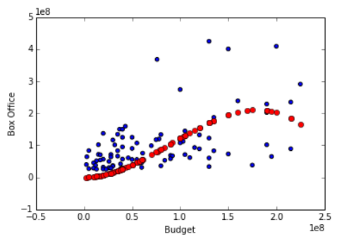
Polynomial regression

Slide 44
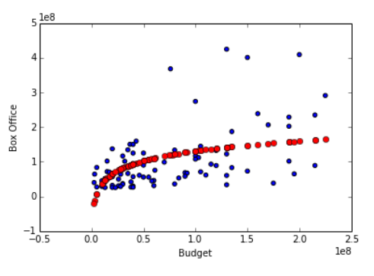
Other functional forms
log

Slide 45
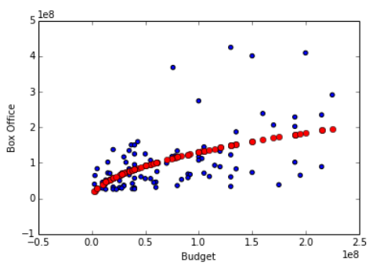
Other functional forms
square root

Slide 46
Possible to combine variables

Slide 47
Possible to combine variables
Interactions
(example: existence of both genres has an each extra effect, different than the sum of each)

Slide 48
Linear Regression is not “linear”
because we’re fitting “a line.”
We also fit many other forms.
It’s “linear” because the features are combined in a linear fashion ( Σβ_{i}f(x_{i}) ).

Slide 49
Linear
.
Nonlinear

Slide 50
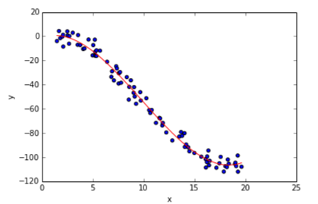
How to choose functional forms to try?
Check one on one relationship of variable with outcome

Slide 51
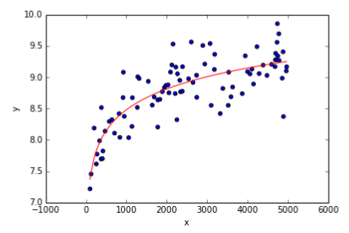
How to choose functional forms to try?
Check one on one relationship of variable with outcome

Slide 52
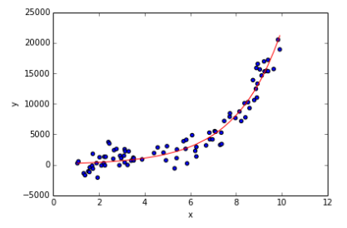
How to choose functional forms to try?
Check one on one relationship of variable with outcome

