Slide 1
Faculty of Engineering & Information Technology Al-AZHAR UNIVERSITY-GAZA Digital Signal Processing (DSP) (ITCC 4325)
Teacher Assistant: Eng. Dalia Tariq Alhindi Supervised by: Dr. Ali Awad

Slide 2
Objectives:
Samples
Basic operations on discreet signals
SAMPLING RATE CONVERSION.
up Sampling.
down sampling.
PROPERTIES OF DISCRETE TIME SYSTEM.
Linear Time Discrete Systems.
Time-invariant Discrete Systems.
Causal Discrete Time Systems.

Slide 3
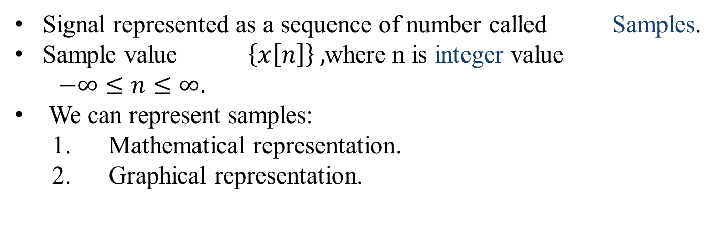
Samples:
Signal represented as a sequence of number called Samples.
Sample value $\left\{x\left[n\right]\right\} ,$where n is integer value
$−∞≤n≤∞.$
We can represent samples:
Mathematical representation.
Graphical representation.

Slide 4
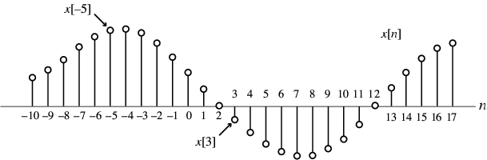
Mathematical representation:
Example:
$$\left\{x\left[n\right]\right\}=\{……,−0.2,2.2,1.1,0.2,3.7,2.9,………\}$$
NOTE:
The arrow is placed under the sample at time index n=0 .
Value of {x[n]} can be real values or complex values .
{x[n]} May be a finite or infinite length.
2. Graphical representation:

Slide 5
Basic operations on discreet signals:
Amplitude manipulation:
1.Amplitude scaling: y[n] =ax[n], where a is a constant:
If a > 1, then y[n] is amplified sequence.
If a < 1, then y[n] is attenuated sequence.
If a = - 1, then y[n] is amplitude reversal sequence.
2. Addition: Two signals x1[n] and x2[n] can also be added ,By adding the values y1[n]= x1[n] + x2[n] at each corresponding sample.
3. Multiplications: multiplying the values y2[n]= x1[n] X x2[n] at each corresponding sample.

Slide 6
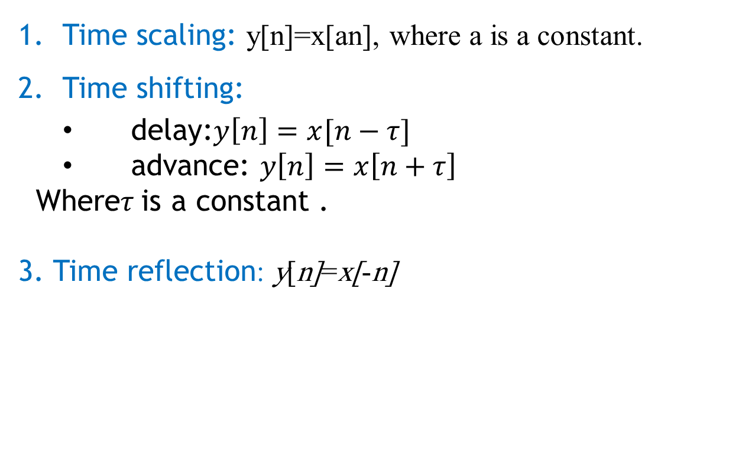
Time manipulation:
Time scaling: y[n]=x[an], where a is a constant.
Time shifting:
delay:$y\left[n\right]=x[n−τ]$
advance: $y\left[n\right]=x\left[n+τ\right]$
Where$τ$is a constant .
3. Time reflection: y[n]=x[-n]

Slide 7
Implementation 1 :
clc; clear all; close all;
%operations on the amplitude of signal
x=input('Enter input sequence:'); a=input('Enter amplification factor:'); b=input('Enter attenuation factor:'); c=input('Enter amplitude reversal factor:’);
y1=a*x; y2=b*x;
y3=c*x;
n=length(x); subplot(2,2,1); stem(0:n-1,x); xlabel('time'); ylabel('amplitude'); title('Input signal'); subplot(2,2,2); stem(0:n-1,y1); xlabel('time');
ylabel('Amplitude'); title('Amplified signal'); subplot(2,2,3); stem(0:n-1,y2); xlabel('time'); ylabel('Amplitude'); title('Attenuated signal'); subplot(2,2,4); stem(0:n-1,y3); xlabel('time'); ylabel('Amplitude'); title('Amplitude reversal signal'); %scalar addition d=input('Input the scalar to be added:'); y4=d+x; figure(2); stem(0:n-1,y4); xlabel('time'); ylabel('Amplitude'); title('Scalar addition signal');

Slide 8
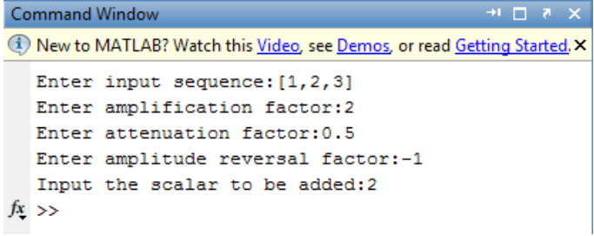
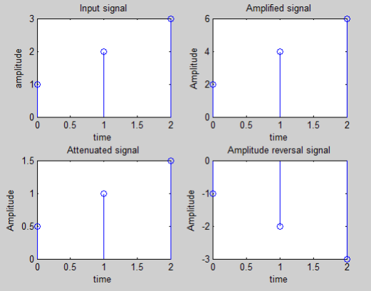
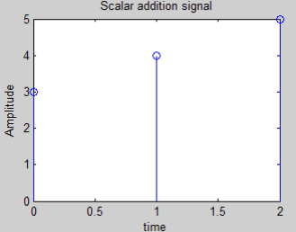
>> Solution:

Slide 9
Implementation :
clc; clear all; close all; %Operations on the independent variable %Time shifting of the independent variable x=input('Enter the input sequence:'); n0=input('Enter the +ve shift:’);
n1=input('Enter the -ve shift:'); l=length(x); subplot(2,2,1); stem(0:l-1,x); xlabel('time'); ylabel('Amplitude'); title('Input signal'); i=n0:l+n0-1; j=n1:l+n1-1; subplot(2,2,2);
stem(i,x); xlabel('time'); ylabel('Amplitude'); title('Positive shifted signal'); subplot(2,2,3); stem(j,x); xlabel('time'); ylabel('Amnplitude'); title('Negative shifted signal'); %Time reversal subplot(2,2,4); stem(-1*(0:l-1),x); xlabel('time'); ylabel('Amplitude'); title('Time reversal signal');

Slide 10

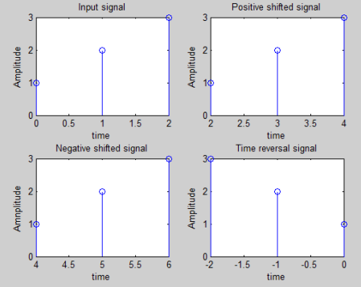
>> Solution:

Slide 11
Implementation 2:
clc; clear all; close all; %Arithmetic operations on signals %Addition and multiplication of two signals x1=input('Enter the sequence of first signal:'); x2=input('Enter the sequence of second signal:’);
subplot(2,2,1);
stem(0:l1-1,x1); xlabel('time'); ylabel('Amplitude'); title('Input sequence 1'); subplot(2,2,2); stem(0:l2-1,x2); xlabel('time'); ylabel('Amplitude'); title('Input sequence 2');
%Addition y1=x1+x2; subplot(2,2,3); stem(0:l1-1,y1); xlabel('time'); ylabel('Amplitude'); title('Addition of two signals’);
%multiplication
y2=x1.*x2; subplot(2,2,4); stem(0:l1-1,y2); xlabel('time'); ylabel('Amplitude'); title('Multiplication of two signals');

Slide 12
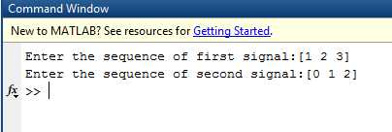
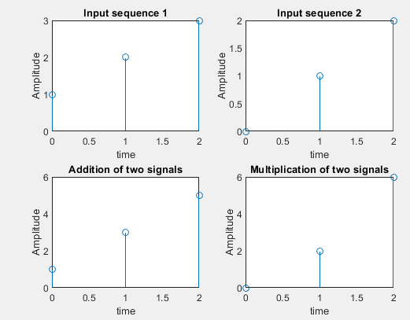
>> Solution:

Slide 13
Task:
Find the addition and multiplication of two signals:
X1[n]=[1,2,3,4]
X2[n]=[2,4,1]
Hint: don't forget using zero padding

Slide 14
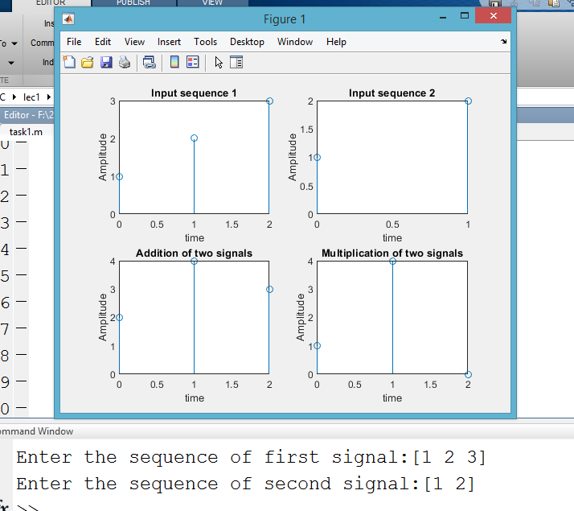
Solution:
Open task.m file

Slide 15
SAMPLING RATE CONVERSION
Sampling rate conversion is employed to generate a new sequence with a sampling rate higher or lower than that of a given sequence.
If x[n] is a sequence with a sampling rate of F Hz and it is used to generate another sequence y[n] with desired sampling rate F’ Hz, then the sampling rate alteration is given by : F’/F = R
If R > 1, the process is called interpolation and results in a sequence with higher sampling rate.
If R< 1, the process is called decimation and results in a sequence with lower sampling rate.

Slide 16
DOWNSAMPLE:
Down sampling operation by an integer factor M (M>1) on a sequence x[n] consists of keeping every Mth sample of x[n] and removing M-1 in between samples.
Example:
X[n]={1,2,3,4,5,6,7,8,9} and M=3 find Xd[n]:
Solution:
Xd[n]=X[nM]:
n=0 ,M=3 >> Xd[0]=5,
n=1 ,M=3>> Xd[n]=8,
n=2 ,M=3>>Xd[6]=Nan
n=-1, M=3>> Xd[-3]=2
N=-2 ,M=3>>Xd[-6]=nan
>>>Xd[nM]={2,5,8]

Slide 17
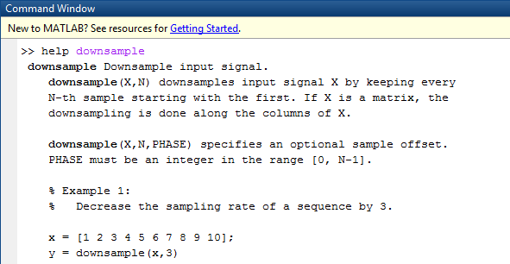
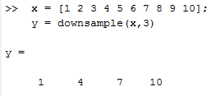

Slide 18
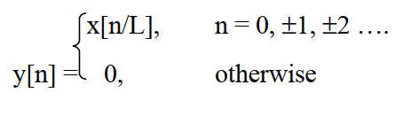
2. UPSAMPLE
Upsampling by an integer factor L (L > 1) on a sequence x[n] will insert (L–1) equidistant samples between an output sequence y[n] according to the relation:
The sampling rate of y[n] is L times that of x[n].
Example:
L=3 X[n]={1,2,3} find Xu[n]:
Solution:
L-1=2 then we will add 2 zeros after each sample :
Xu[n]={1,0,0,2,0,0,3}
Notes:
Down sample >> Decrease sampling rate
Up Sample >> Increase sampling rate .

Slide 19
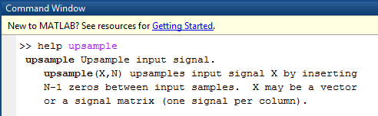
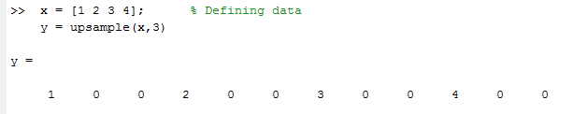

Slide 20
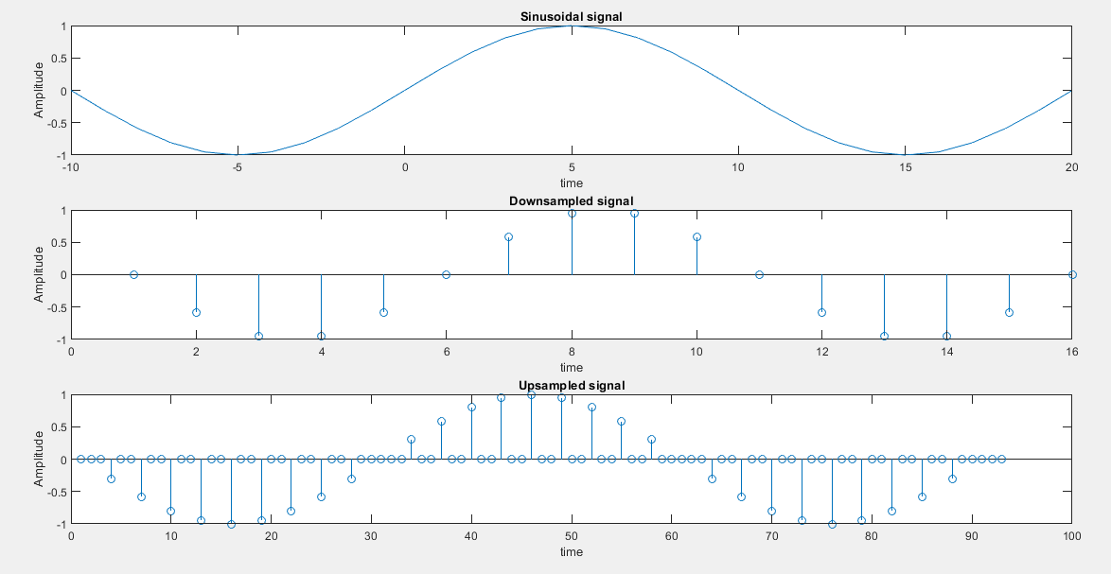
Implementation 1:
clc;
clear all;
close all;
%continuous sinusoidal signal
a=input('Enter the amplitude:');
f=input('Enter the Timeperiod:');
t=-10:1:20;
x=a*sin(2*pi*f*t);
subplot(3,1,1);
plot(t,x);
xlabel('time');
ylabel('Amplitude');
title('Sinusoidal signal’);
%downsampling the signal
y1=downsample(x,2);
subplot(3,1,2);
stem(y1);
xlabel('time');
ylabel('Amplitude');
title('Downsampled signal');
%upsampling the signal
y2=upsample(x,3);
subplot(3,1,3);
stem(y2);
xlabel('time');
ylabel('Amplitude');
title('Upsampled signal');

Slide 21
PROPERTIES OF DISCRETE TIME SYSTEM:
Linear Time Discrete Systems:
The response of the system to a weighted sum of signals is equal to the corresponding weighted sum of the responses (outputs) of the system to each of the individual input signals.
X1[n]
system
Y1[n]
X2[n]
system
Y2[n]
X1[n]+X2[n]
system
Y3[n]
IF Y1+Y2 =Y3 the system is linear

Slide 22
Implementation 1:
clc;
clear all;
close all;
%Properties of DT Systems(Linearity)
%y(n)=[x(n)]^2+B; (system)
x1=input('Enter first input sequence:');
n=length(x1);
x2=input('Enter second input sequence:');
a=input('Enter scaling constant(a):');
b=input('Enter scaling constant(b):');
B=input('Enter scaling constant(B):');
y1=power(x1,2)+B;
y2=power(x2,2)+B;
rhs=a*y1+b*y2;
x3=a*x1+b*x2;
lhs=power(x3,2)+B;
subplot(2,2,1);
stem(0:n-1,x1);
xlabel('Time');
ylabel('Amplitude');
title('First input sequence');
subplot(2,2,2);
stem(0:n-1,x2);
xlabel('Time');
ylabel('Amplitude');
title('Second input sequence');
subplot(2,2,3);
stem(0:n-1,lhs);
xlabel('Time');
ylabel('Amplitude');
title('LHS');
subplot(2,2,4);
stem(0:n-1,rhs);
xlabel('Time');
ylabel('Amplitude');
title('RHS');
if(lhs==rhs)
display('system is linear');
else
display('system is non-linear');
end;

Slide 23
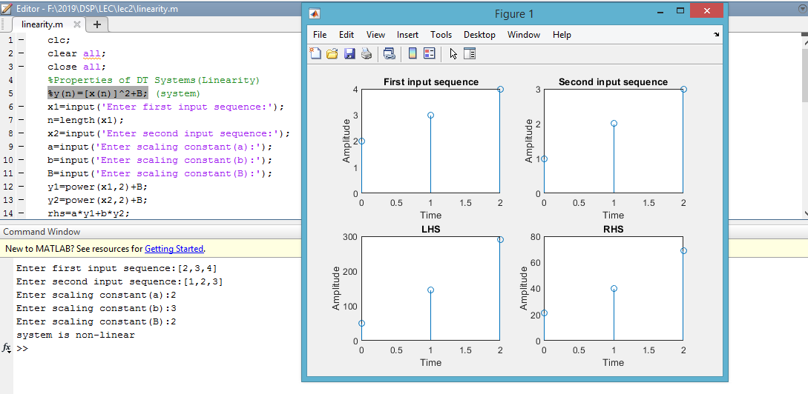

Slide 24

If the discrete time systems described by equation below:
To apply this equation in MATLAB, the command filter can be used.
There are several versions of this command. If we denote
num = [p0 p1 . . . pM], den = [d0 d1 . . . dN],
then y = filter(num,den,x) generates an output vector y of the same length as the specified input vector x with zero initial conditions, that is, y[-1]=y[-2] = ... =y[-N] = 0.
The output can also be computed using y = filter(num,den,x,ic) where ic = [y[-1], y[-2], ..., y[-N] is the vector of initial conditions. Access to final conditions is obtained using [y,fc].

Slide 25
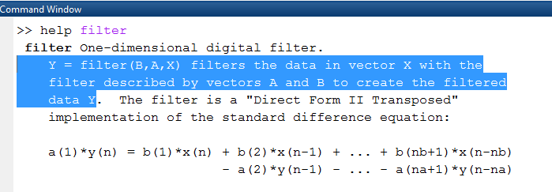
Filter command:

Slide 26
Implementation 2:
n = 0:40;
D = 10;
a = 3.0;
b = -2;
x1 = a*cos(2*pi*0.1*n) +
X2= b*cos(2*pi*0.4*n);
y[n]−0.4 y[n−1]+0.75 y[n−2] = 2.2403 x[n]+2.4908 x[n−1]+2.2403 x[n−2].
Check if the system above is linear or not.

Slide 27
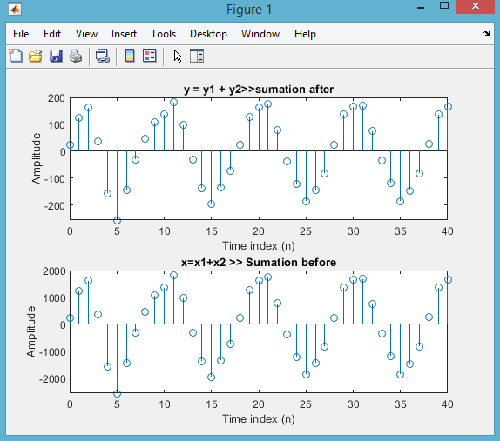
clf
clc
clear all
%% system define
num=[2.2403 2.4908 2.2403];
den=[1 -0.4 0.75];
n = 0:40;
D = 10;
a = 3.0;
b = -2;
x1 = D*a*cos(2*pi*0.1*n); %%Signal 1
x2 = D*b*cos(2*pi*0.4*n);%% signal 2
y1 = filter(num,den,x1);
y2 = filter(num,den,x2);
y = y1 + y2;
subplot(2,1,1);
stem(n,y);
title('y=y1+y2’);
xlabel('Time index (n)');
ylabel('Amplitude');
x = x1 + x2;
z = D*filter(num,den,x);
subplot(2,1,2);
stem(n,z);
title('x=x1+x2');
xlabel('Time index (n)');
ylabel('Amplitude');

Slide 28
Time-invariant Discrete Systems:

Slide 29
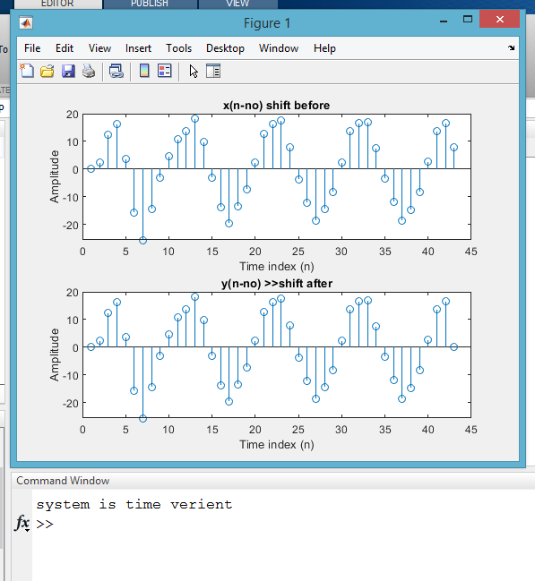
clf
clc
clear all
num=[2.2403 2.4908 2.2403];
den=[1 -0.4 0.75];
n = 0:40;
a = 3.0;
b = -2;
X1 = a*cos(2*pi*0.1*n) + b*cos(2*pi*0.4*n); %without shift
x1 = [0 X1 0]; %with shift
y1 = filter(num,den,x1);
subplot(2,1,1);
stem(y1);
title('x(n-no) shift before');
xlabel('Time index (n)');
ylabel('Amplitude');
z = filter(num,den,X1);
y2 = [0 z 0];%%shift after
subplot(2,1,2);
stem(y2);
title('y(n-no) >>shift after');
xlabel('Time index (n)');
ylabel('Amplitude');
if (y1-y2==0)
disp('system is time Inverient');
else
disp('system is time verient')
end

Slide 30
Causal Discrete Time Systems:
A system is said to be causal, if the output of the system at any time n (y(n)) depends only on the present and past inputs ,But does not depend on future inputs
Y[n] = X[n] >> Causal
Y[n] = X[n+1] >> Non Causal
Y[n] = X[n-1] >> Causal

Slide 31
Implementation 2:
clc;
clear all;
close all;
%Properties of DT Systems(Causality)
%y(n)=x(-n);
x1=input('Enter input sequence x1:');
n1=input('Enter lower limit n1:');
n2=input('Enter lower limit n2:');
flag=0;
for n=n1:n2
arg=-n;
if arg>n;
flag=1;
end;
end;
if(flag==1)
display('system is causal');
else
display('system is non-causal');
end;

Slide 32
