Slide 1
Faculty of Engineering & Information Technology Al-AZHAR UNIVERSITY-GAZA Digital Signal Processing (DSP) (ITCC 4325)
Teacher Assistant: Eng. Dalia Tariq Alhindi Supervised by: Dr. Ali Awad

Slide 2
Objectives:
Analog to Digital Conversion Process (ADC) .
Samples
Basic operations on discreet signals
SAMPLING RATE CONVERSION.
up Sampling.
down sampling.

Slide 3
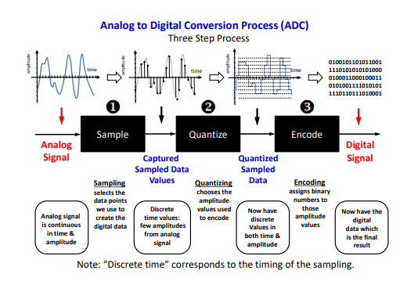
Analog to Digital Conversion Process (ADC):

Slide 4
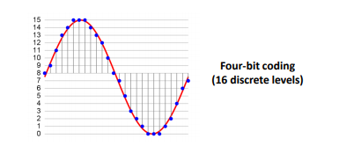
Pulse Code Modulation:
Pulse-code modulation (PCM) is used to digitally represent sampled analog signals. It is the standard form of digital audio in computers, CDs, digital telephony and other digital audio applications. The amplitude of the analog signal is sampled at uniform intervals and each sample is quantized to its nearest value within a predetermined range of digital levels.

Slide 5
Pulse Code Modulation step by step:
Sampling .
Quantization.
Coding.

Slide 6
Sampling :
Nyquist sampling theorem The Nyquist sampling theorem provides a prescription for the nominal sampling interval required to avoid aliasing.
It may be stated simply as follows:
The sampling frequency should be at least twice the highest frequency contained in the signal.
Or in mathematical terms: fs >=2 fm where fs is the sampling frequency (number of sample/sec) and fm is the highest frequency contained in the signal.

Slide 7
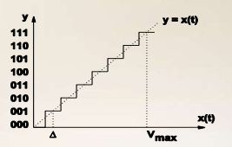
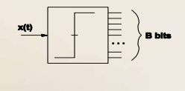
Quantizing:
The number of possible states that the converter can output is: N=2n (Where n is the number of bits in the AD converter) Analog quantization size: Q= (V max -V min)/N

Slide 8
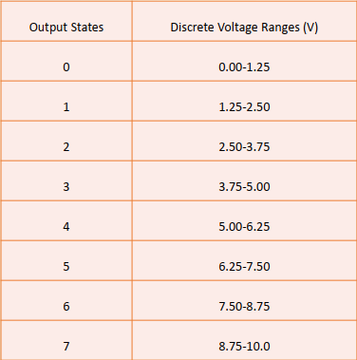
Example: For a 3 bit A/D converter, you have 0-10V signals. Separate them into a set of discrete states.
Sol: N=23=8 Q= (10V – 0V)/8 = 1.25V

Slide 9
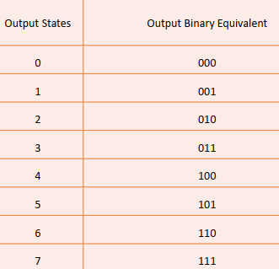
Encoding:
Here we assign the digital value (binary number) to each state for the computer to read .

Slide 10
Open pcm.m file and read the code ☺

Slide 11
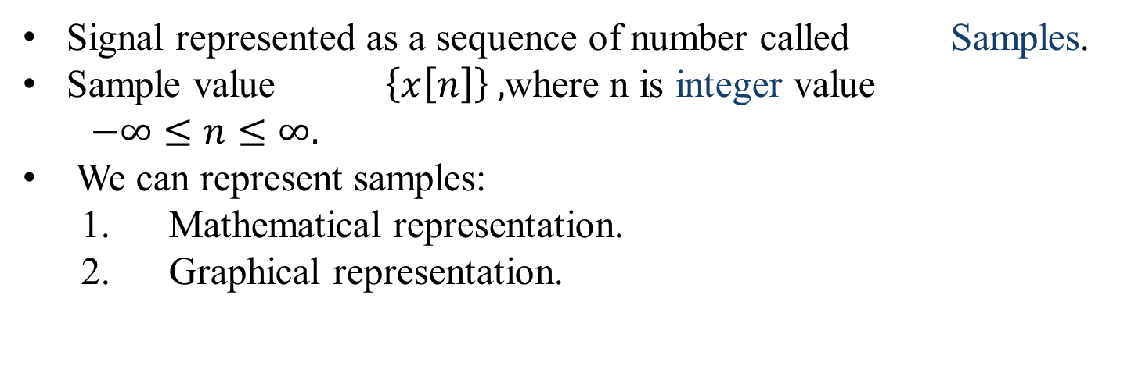
Samples:
Signal represented as a sequence of number called Samples.
Sample value $\left\{x\left[n\right]\right\} ,$where n is integer value
$−∞≤n≤∞.$
We can represent samples:
Mathematical representation.
Graphical representation.

Slide 12
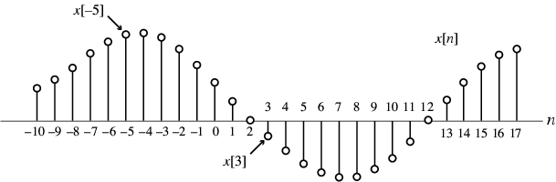
Mathematical representation:
Example:
$$\left\{x\left[n\right]\right\}=\{……,−0.2,2.2,1.1,0.2,3.7,2.9,………\}$$
NOTE:
The arrow is placed under the sample at time index n=0 .
Value of {x[n]} can be real values or complex values .
{x[n]} May be a finite or infinite length.
2. Graphical representation:

Slide 13
Basic operations on discreet signals:
Amplitude manipulation:
1.Amplitude scaling: y[n] =ax[n], where a is a constant:
If a > 1, then y[n] is amplified sequence.
If a < 1, then y[n] is attenuated sequence.
If a = - 1, then y[n] is amplitude reversal sequence.
2. Addition: Two signals x1[n] and x2[n] can also be added ,By adding the values y1[n]= x1[n] + x2[n] at each corresponding sample.
3. Multiplications: multiplying the values y2[n]= x1[n] X x2[n] at each corresponding sample.

Slide 14
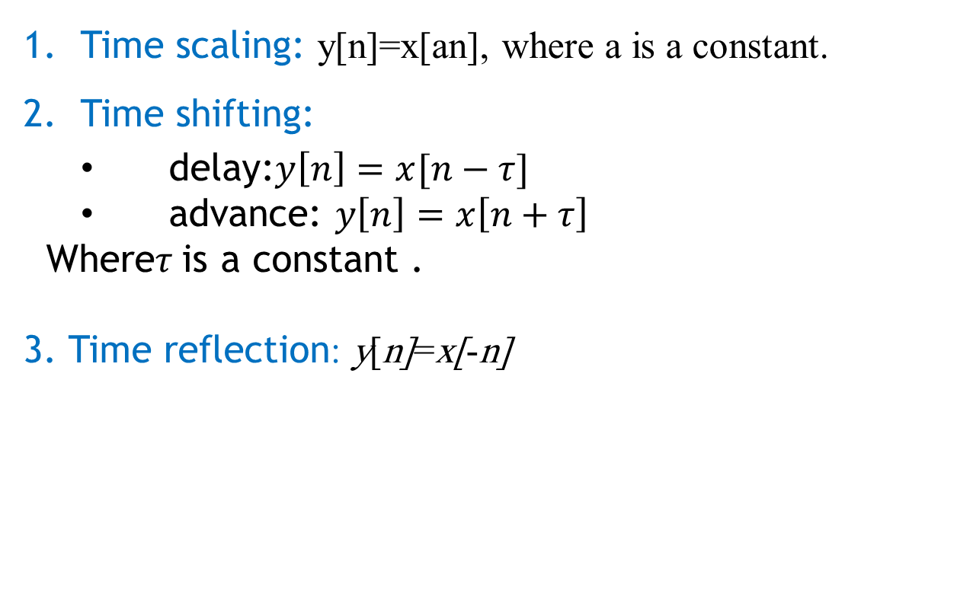
Time manipulation:
Time scaling: y[n]=x[an], where a is a constant.
Time shifting:
delay:$y\left[n\right]=x[n−τ]$
advance: $y\left[n\right]=x\left[n+τ\right]$
Where$τ$is a constant .
3. Time reflection: y[n]=x[-n]

Slide 15
Implementation 1 :
clc; clear all; close all;
%operations on the amplitude of signal
x=input('Enter input sequence:'); a=input('Enter amplification factor:'); b=input('Enter attenuation factor:'); c=input('Enter amplitude reversal factor:’);
y1=a*x; y2=b*x;
y3=c*x;
n=length(x); subplot(2,2,1); stem(0:n-1,x); xlabel('time'); ylabel('amplitude'); title('Input signal'); subplot(2,2,2); stem(0:n-1,y1); xlabel('time');
ylabel('Amplitude'); title('Amplified signal'); subplot(2,2,3); stem(0:n-1,y2); xlabel('time'); ylabel('Amplitude'); title('Attenuated signal'); subplot(2,2,4); stem(0:n-1,y3); xlabel('time'); ylabel('Amplitude'); title('Amplitude reversal signal'); %scalar addition d=input('Input the scalar to be added:'); y4=d+x; figure(2); stem(0:n-1,y4); xlabel('time'); ylabel('Amplitude'); title('Scalar addition signal');

Slide 16
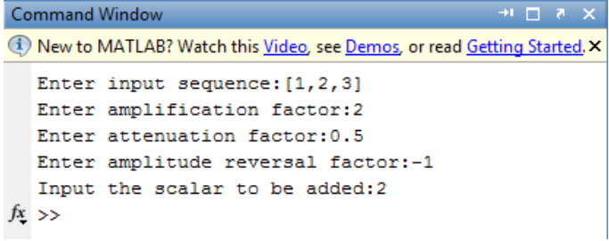
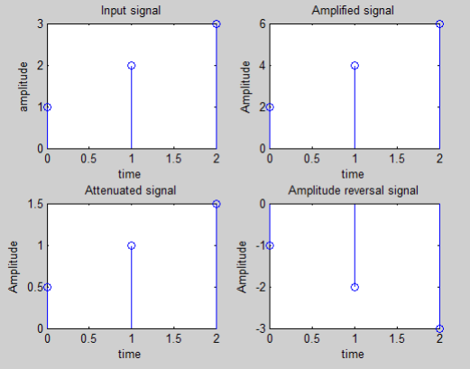
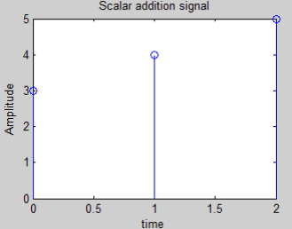
>> Solution:

Slide 17
Implementation 2:
clc; clear all; close all; %Operations on the independent variable %Time shifting of the independent variable x=input('Enter the input sequence:'); n0=input('Enter the +ve shift:’);
n1=input('Enter the -ve shift:'); l=length(x); subplot(2,2,1); stem(0:l-1,x); xlabel('time'); ylabel('Amplitude'); title('Input signal'); i=n0:l+n0-1; j=n1:l+n1-1; subplot(2,2,2);
stem(i,x); xlabel('time'); ylabel('Amplitude'); title('Positive shifted signal'); subplot(2,2,3); stem(j,x); xlabel('time'); ylabel('Amnplitude'); title('Negative shifted signal'); %Time reversal subplot(2,2,4); stem(-1*(0:l-1),x); xlabel('time'); ylabel('Amplitude'); title('Time reversal signal');

Slide 18

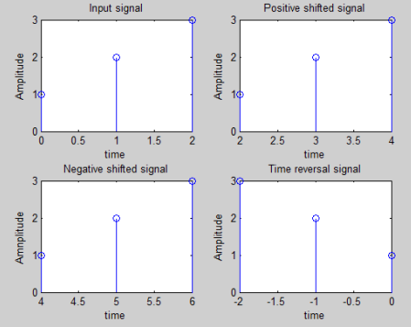
>> Solution:

Slide 19
Implementation 3:
clc; clear all; close all; %Arithmetic operations on signals %Addition and multiplication of two signals x1=input('Enter the sequence of first signal:'); x2=input('Enter the sequence of second signal:’);
subplot(2,2,1);
stem(0:l1-1,x1); xlabel('time'); ylabel('Amplitude'); title('Input sequence 1'); subplot(2,2,2); stem(0:l2-1,x2); xlabel('time'); ylabel('Amplitude'); title('Input sequence 2');
%Addition y1=x1+x2; subplot(2,2,3); stem(0:l1-1,y1); xlabel('time'); ylabel('Amplitude'); title('Addition of two signals’);
%multiplication
y2=x1.*x2; subplot(2,2,4); stem(0:l1-1,y2); xlabel('time'); ylabel('Amplitude'); title('Multiplication of two signals');

Slide 20
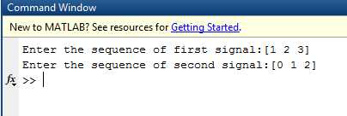
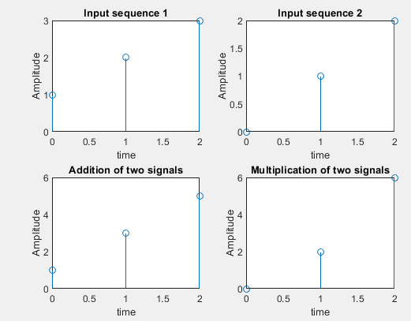
>> Solution:

Slide 21
Task:
Find the addition and multiplication of two signals:
X1[n]=[1,2,3,4]
X2[n]=[2,4,1]
Hint: don't forget using zero padding

Slide 22
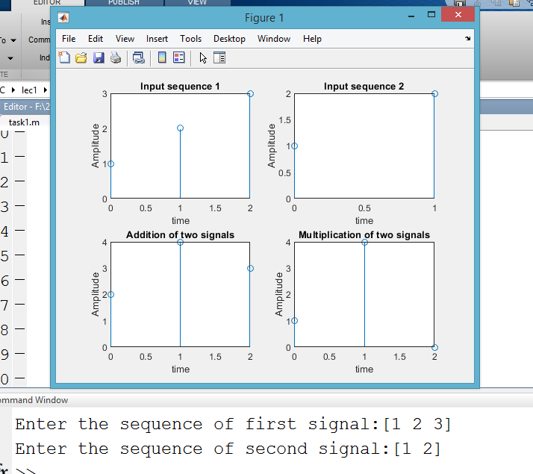
Solution:
Open task.m file

Slide 23
SAMPLING RATE CONVERSION
Sampling rate conversion is employed to generate a new sequence with a sampling rate higher or lower than that of a given sequence.
If x[n] is a sequence with a sampling rate of F Hz and it is used to generate another sequence y[n] with desired sampling rate F’ Hz, then the sampling rate alteration is given by : F’/F = R
If R > 1, the process is called interpolation and results in a sequence with higher sampling rate.
If R< 1, the process is called decimation and results in a sequence with lower sampling rate.

Slide 24
DOWNSAMPLE:
Down sampling operation by an integer factor M (M>1) on a sequence x[n] consists of keeping every Mth sample of x[n] and removing M-1 in between samples.
Example:
X[n]={1,2,3,4,5,6,7,8,9} and M=3 find Xd[n]:
Solution:
Xd[n]=X[nM]:
n=0 ,M=3 >> Xd[0]=5,
n=1 ,M=3>> Xd[n]=8,
n=2 ,M=3>>Xd[6]=Nan
n=-1, M=3>> Xd[-3]=2
N=-2 ,M=3>>Xd[-6]=nan
>>>Xd[nM]={2,5,8]

Slide 25
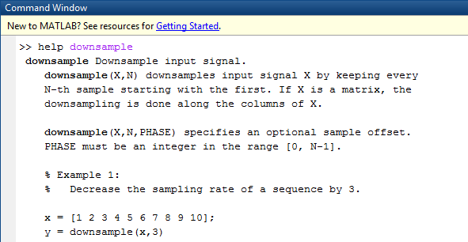
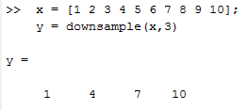

Slide 26
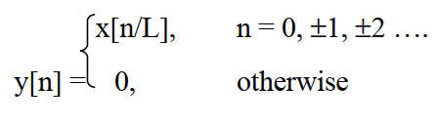
2. UPSAMPLE
Upsampling by an integer factor L (L > 1) on a sequence x[n] will insert (L–1) equidistant samples between an output sequence y[n] according to the relation:
The sampling rate of y[n] is L times that of x[n].
Example:
L=3 X[n]={1,2,3} find Xu[n]:
Solution:
L-1=2 then we will add 2 zeros after each sample :
Xu[n]={1,0,0,2,0,0,3}
Notes:
Down sample >> Decrease sampling rate
Up Sample >> Increase sampling rate .

Slide 27
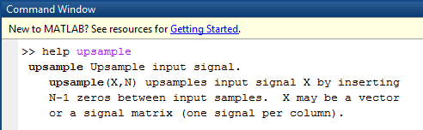
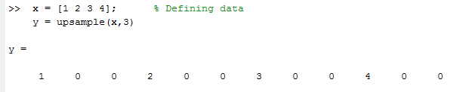

Slide 28
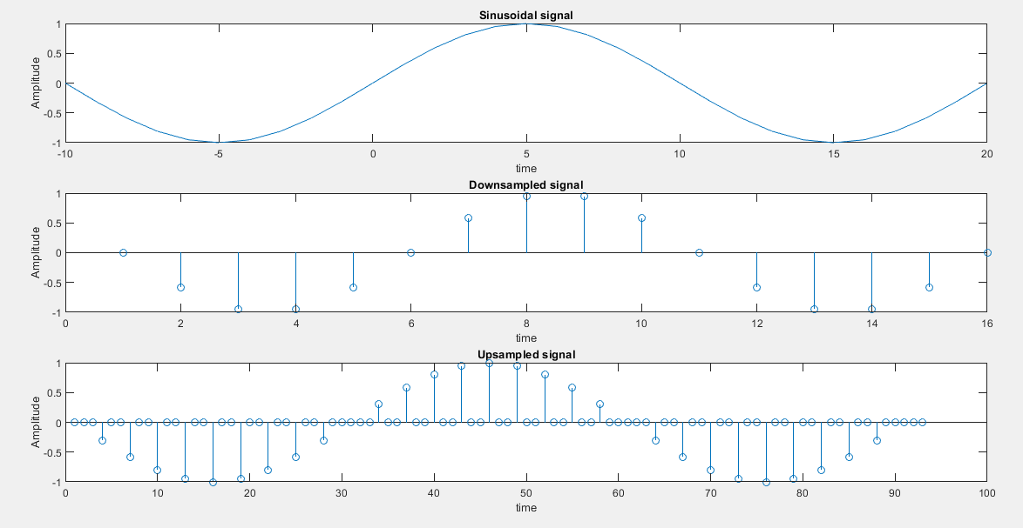
Implementation 4:
clc;
clear all;
close all;
%continuous sinusoidal signal
a=input('Enter the amplitude:');
f=input('Enter the Timeperiod:');
t=-10:1:20;
x=a*sin(2*pi*f*t);
subplot(3,1,1);
plot(t,x);
xlabel('time');
ylabel('Amplitude');
title('Sinusoidal signal’);
%downsampling the signal
y1=downsample(x,2);
subplot(3,1,2);
stem(y1);
xlabel('time');
ylabel('Amplitude');
title('Downsampled signal');
%upsampling the signal
y2=upsample(x,3);
subplot(3,1,3);
stem(y2);
xlabel('time');
ylabel('Amplitude');
title('Upsampled signal');

