Slide 1
Faculty of Engineering & Information Technology Al-AZHAR UNIVERSITY-GAZA Digital Signal Processing (DSP) (ITCC 4325)
Teacher Assistant: Eng. Dalia Tariq Alhindi Supervised by: Dr. Ali Awad

Slide 2
Objectives:
Samples
Basic operations on discreet signals

Slide 3
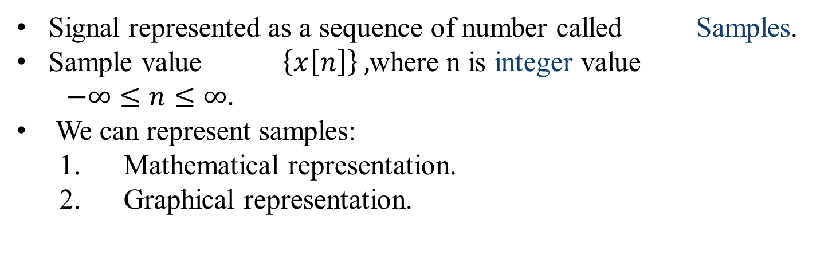
Samples:
Signal represented as a sequence of number called Samples.
Sample value $\left\{x\left[n\right]\right\} ,$where n is integer value
$−∞≤n≤∞.$
We can represent samples:
Mathematical representation.
Graphical representation.

Slide 4
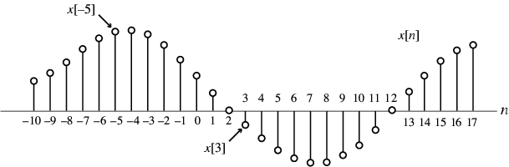
Mathematical representation:
Example:
$$\left\{x\left[n\right]\right\}=\{……,−0.2,2.2,1.1,0.2,3.7,2.9,………\}$$
NOTE:
The arrow is placed under the sample at time index n=0 .
Value of {x[n]} can be real values or complex values .
{x[n]} May be a finite or infinite length.
2. Graphical representation:

Slide 5
Basic operations on discreet signals:
Amplitude manipulation:
1.Amplitude scaling: y[n] =ax[n], where a is a constant:
If a > 1, then y[n] is amplified sequence.
If a < 1, then y[n] is attenuated sequence.
If a = - 1, then y[n] is amplitude reversal sequence.
2. Addition: Two signals x1[n] and x2[n] can also be added ,By adding the values y1[n]= x1[n] + x2[n] at each corresponding sample.
3. Multiplications: multiplying the values y2[n]= x1[n] X x2[n] at each corresponding sample.

Slide 6
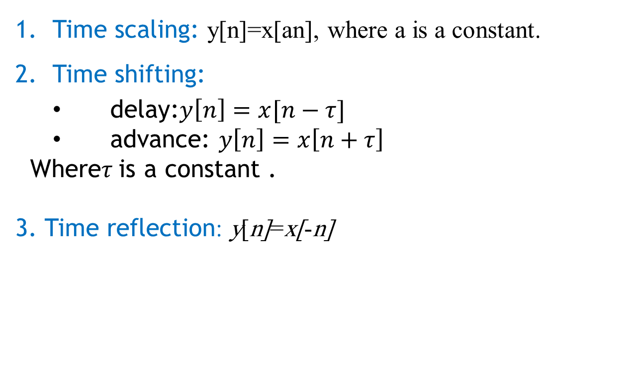
Time manipulation:
Time scaling: y[n]=x[an], where a is a constant.
Time shifting:
delay:$y\left[n\right]=x[n−τ]$
advance: $y\left[n\right]=x\left[n+τ\right]$
Where$τ$is a constant .
3. Time reflection: y[n]=x[-n]

Slide 7
Implementation 1 :
clc; clear all; close all;
%operations on the amplitude of signal
x=input('Enter input sequence:'); a=input('Enter amplification factor:'); b=input('Enter attenuation factor:'); c=input('Enter amplitude reversal factor:’);
y1=a*x; y2=b*x;
y3=c*x;
n=length(x); subplot(2,2,1); stem(0:n-1,x); xlabel('time'); ylabel('amplitude'); title('Input signal'); subplot(2,2,2); stem(0:n-1,y1); xlabel('time');
ylabel('Amplitude'); title('Amplified signal'); subplot(2,2,3); stem(0:n-1,y2); xlabel('time'); ylabel('Amplitude'); title('Attenuated signal'); subplot(2,2,4); stem(0:n-1,y3); xlabel('time'); ylabel('Amplitude'); title('Amplitude reversal signal'); %scalar addition d=input('Input the scalar to be added:'); y4=d+x; figure(2); stem(0:n-1,y4); xlabel('time'); ylabel('Amplitude'); title('Scalar addition signal');

Slide 8
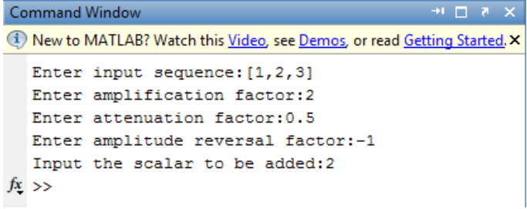
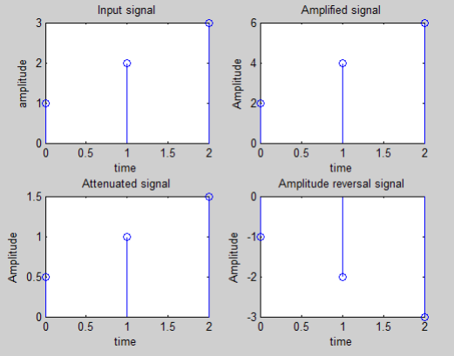
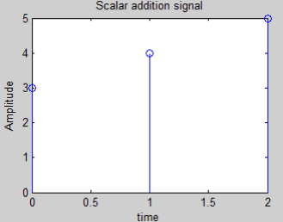
>> Solution:

Slide 9
Implementation :
clc; clear all; close all; %Operations on the independent variable %Time shifting of the independent variable x=input('Enter the input sequence:'); n0=input('Enter the +ve shift:’);
n1=input('Enter the -ve shift:'); l=length(x); subplot(2,2,1); stem(0:l-1,x); xlabel('time'); ylabel('Amplitude'); title('Input signal'); i=n0:l+n0-1; j=n1:l+n1-1; subplot(2,2,2);
stem(i,x); xlabel('time'); ylabel('Amplitude'); title('Positive shifted signal'); subplot(2,2,3); stem(j,x); xlabel('time'); ylabel('Amnplitude'); title('Negative shifted signal'); %Time reversal subplot(2,2,4); stem(-1*(0:l-1),x); xlabel('time'); ylabel('Amplitude'); title('Time reversal signal');

Slide 10

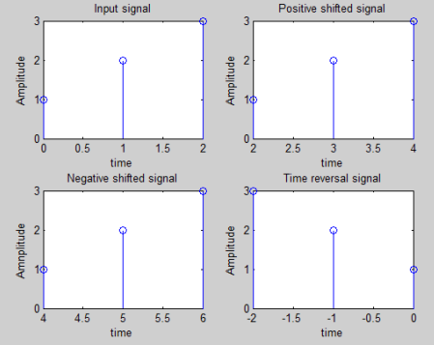
>> Solution:

Slide 11
Implementation 2:
clc; clear all; close all; %Arithmetic operations on signals %Addition and multiplication of two signals x1=input('Enter the sequence of first signal:'); x2=input('Enter the sequence of second signal:’);
subplot(2,2,1);
stem(0:l1-1,x1); xlabel('time'); ylabel('Amplitude'); title('Input sequence 1'); subplot(2,2,2); stem(0:l2-1,x2); xlabel('time'); ylabel('Amplitude'); title('Input sequence 2');
%Addition y1=x1+x2; subplot(2,2,3); stem(0:l1-1,y1); xlabel('time'); ylabel('Amplitude'); title('Addition of two signals’);
%multiplication
y2=x1.*x2; subplot(2,2,4); stem(0:l1-1,y2); xlabel('time'); ylabel('Amplitude'); title('Multiplication of two signals');

Slide 12
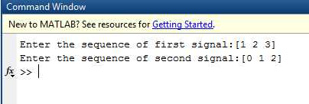
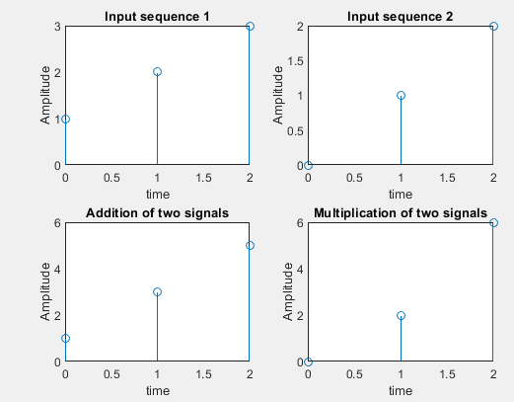
>> Solution:

Slide 13
Task:
Find the addition and multiplication of two signals:
X1[n]=[1,2,3,4]
X2[n]=[2,4,1]
Hint: don't forget using zero padding

Slide 14
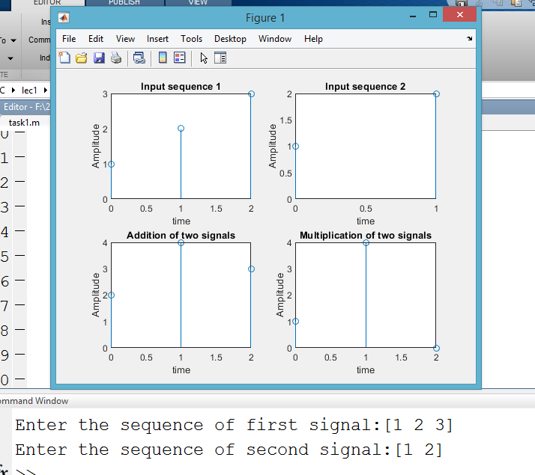
Solution:
Open task.m file

