Slide 1

QM Cloud Dispatcher powered by HANA Cloud.
Allen Qian
September 24, 2017
Notes:
Hello everyone, today I am very happy to introduce my QM application for you. Since it is deployed on HCP so it is powered by HANA Cloud.

Slide 2
Agenda
Why?
Why creates this app?
Walkthrough
Demonstration
Benefits & Comparison
Why use this app?
Suggestion and Q&A
Notes:
Today's agenda: first I would like to explain the reason why I ceated this app. Second I will show you a short real-time demo. Thirdly, I will summary the benefits you will gain from this app. Last but not least, it is welcome to express any suggestions and questions.

Slide 3

Why Create?
Notes:
First, why I created this app

Slide 4
New incident comes
7
1
Paste to BCP
Check component
LOOP!
2
6
Check RCC
Copy processors i-number
3
5
Find & Assign to engineer
4
Increase 1 in Excel
Notes:
But before I answer the question, let me just have a quick introduction to our new QM process workflow

Slide 5
New incident comes
Paste to BCP
Check component
Check RCC
Copy processors i-number
Find & Assign to engineer
Increase 1 in Excel
Notes:
Just a quick introduction to our new QM process workflow

Slide 6
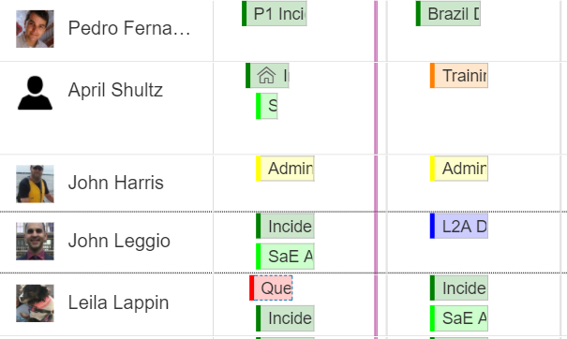
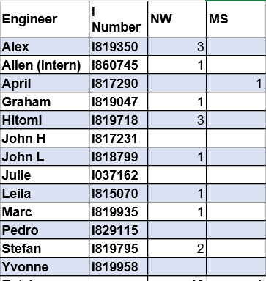



For example…
Who is unavailable today?
-- Excel doesn’t show
Check RCC every time before dispatching…

Slide 7

Why create?
Any existed application/software can help us solve these problems?

Slide 8
There are some tools so far …
1. Workload Analyzer (Java tool you know it!)
2. SAP Product Support Dispatcher
3. QMDock
Not naturally design for multiple components dispatching…
Notes:
采访中得知，目前为止有一些存在的工具
According to my investigation, there are some existed tools. The first one is Workload Analyzer, another Java tool. So many engineers knew it was horrible

Slide 9
So it comes…
Demo powered by HANA Cloud.
Notes:
So I developed the tool for the team which has multiple components, such as our team

Slide 11

Benefits & Evolution
Notes:
Then bring to the next chapter

Slide 12
HANA Cloud Platform & Cloud Computing – fast, clean, high stability
Smart Sort – program recommends for the next dispatch
AVG Q-DAY = Total / (Queue Days * %usage);
Increase/decrease bottom – easy to coordinate your operation
Vacation/Absent/Training => Unavailable
– or cancel any time
Reset supported
Score system – know where you are
Multi-component supported – designed for our team
Multi-operating system / multi-browser support – access anytime and anywhere

Slide 13
Q & A Any Suggestions?
Hope you to have a try…

Slide 14
Thank you.
Contact information:
Allen Qian
Product Support
Partner logo

