Slide 1
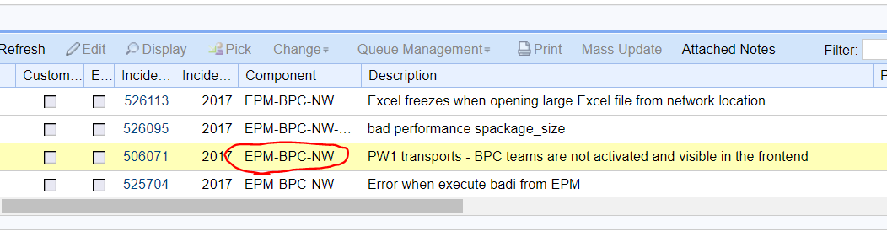
Step 1: find out the component
It’s NW

Slide 2
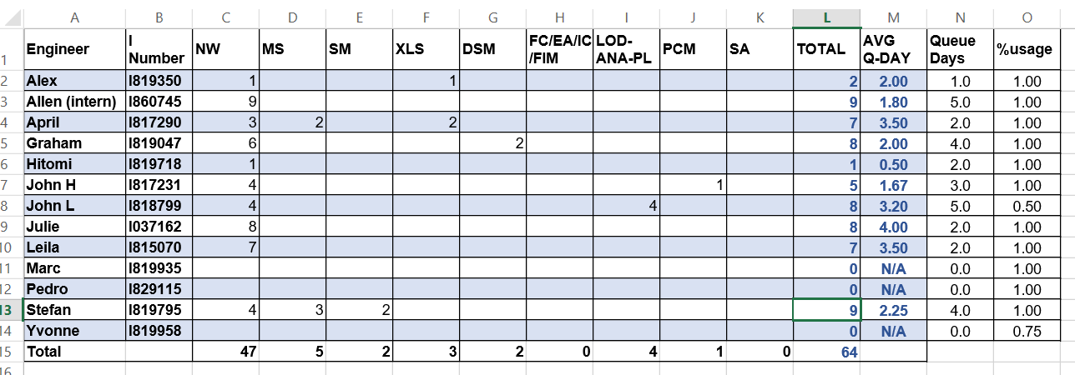
Step 2: open online Excel sheet

Slide 3
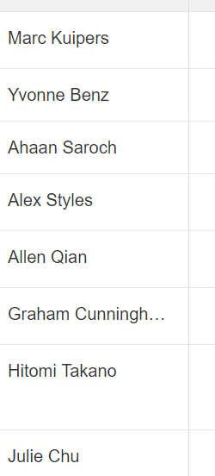
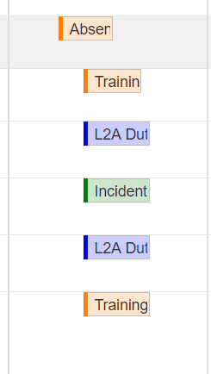
Step 3: check RCC
See who is unavailable today

Slide 4
Step 3: check these number & assign to whom
difficult to decide

Slide 5
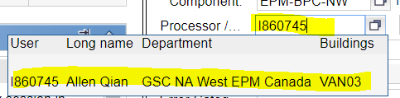
Step 4: +1 to processor
Step 5: copy processor’s i-number
Step 6: paste to BCP

Slide 6
Time consuming
Check RCC many times
Don’t know who to dispatch
Copy & paste i-number

Slide 8
Step 1: find out the component
It’s NW

Slide 9
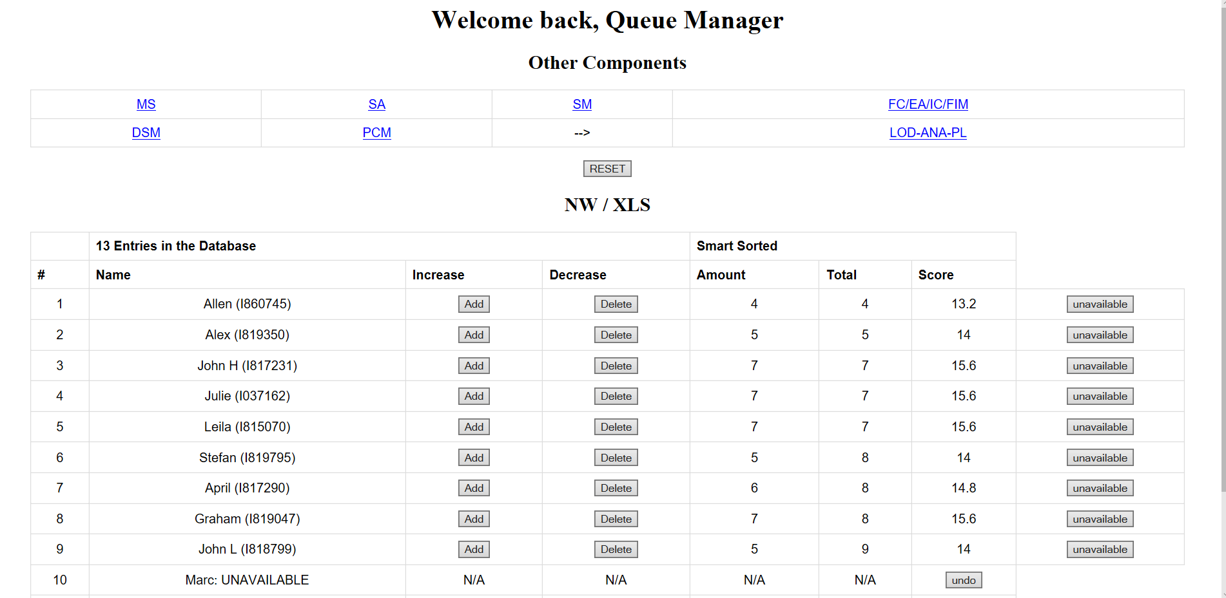
Step 2: open URL

Slide 10
Step 3: assign to candidate
Based on algorithm, the system will recommend the NEXT candidate automatically

Slide 11
Step 3: check RCC

Slide 12

Step 4: click unavailable
Automatically move to the bottom
Status to UNAVAILABLE

