Slide 1

Queue Manager Web powered by HANA Cloud.
Allen Qian
September 24, 2017

Slide 2
Agenda
Market demand
Why need this app?
Walkthrough
Demonstration
Benefits & Comparison
Why use this app?
Suggestion and Q&A

Slide 3

Market Demand

Slide 4
Why create?
Fair distribution
Preference conflict
Easy to process
Other…

Slide 5

Notes:
为了解决以上问题，派生出Qmweb。然后采访和思考了多种方式去形成qm到底为何样式

Slide 6

There are some…
Workload Analyzer (Java tool you know it!)
Import, export, crash, error, no logic, slow, meaningless, Nightmare!
Notes:
采访中得知，目前为止有一些存在的工具

Slide 7

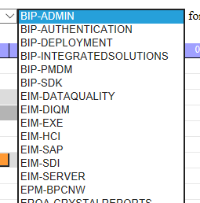
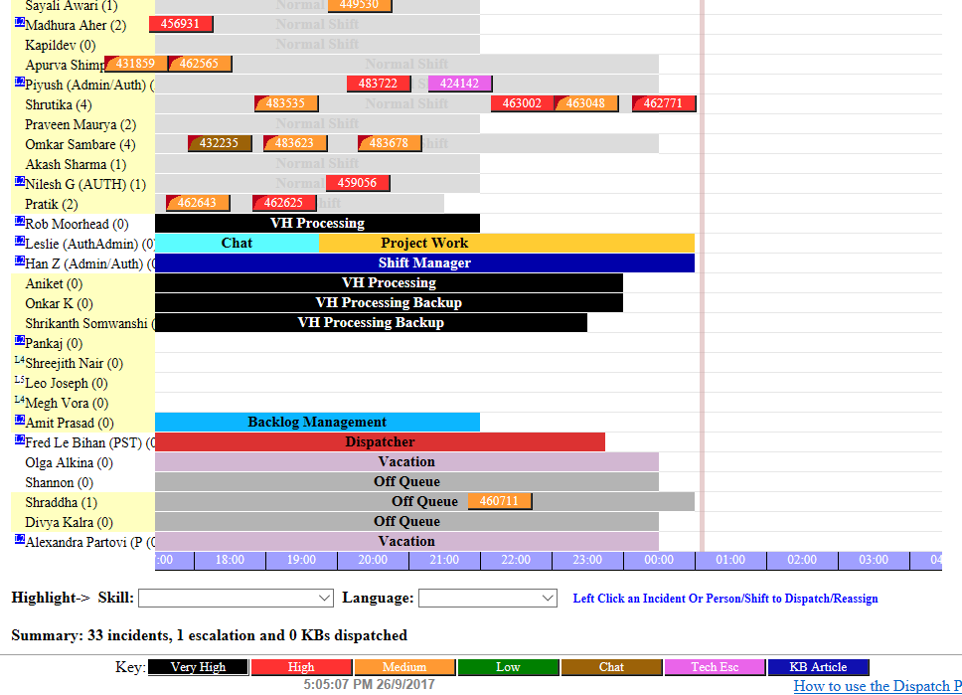
There are some…
SAP Product Support Dispatcher
Only support Single component team
Notes:
Look at these color! Not want to use it! But it only supports team that has a single component. But good for our team that per person has multiple components.

Slide 8
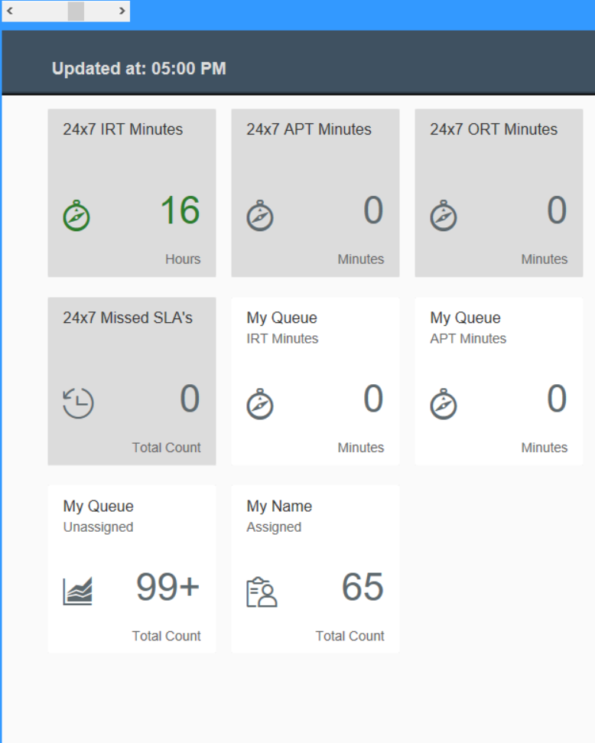
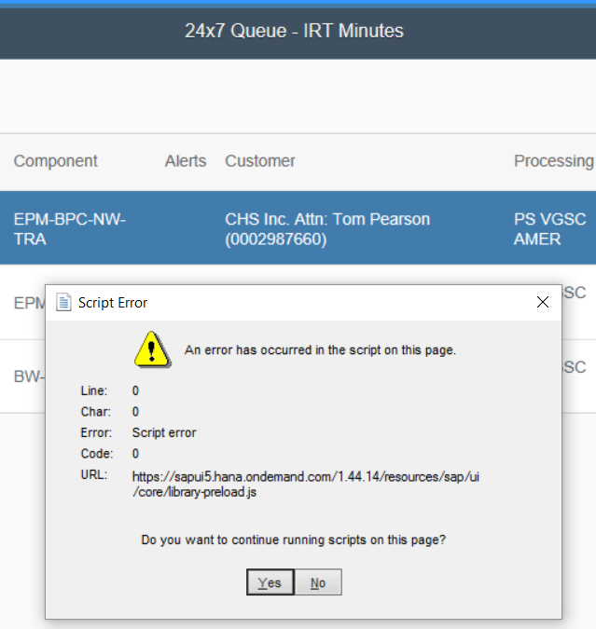
There are some…
QMDock
Good looking..
BUT….
Easily get ERROR
Number is WRONG!
What is this used for?
Notes:
Not easy to know what can we use it for?

Slide 9
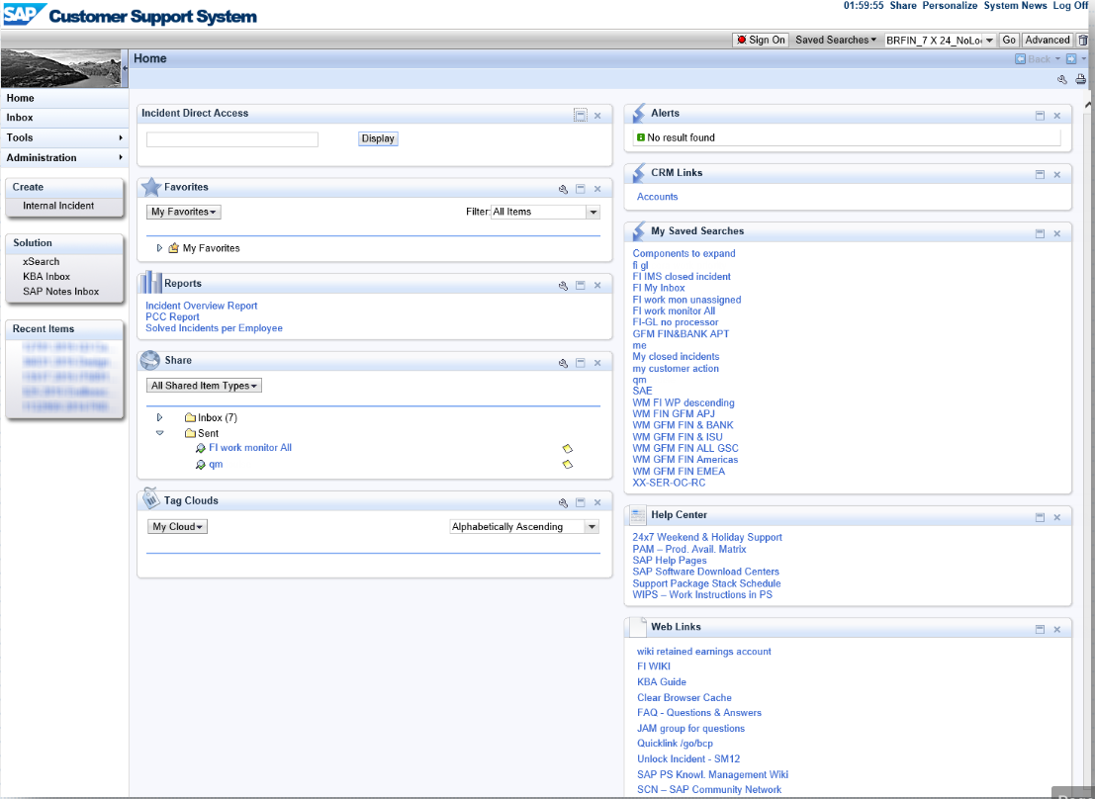
There are some…
BCP
Cannot Count!
Notes:
Not support new features naturally

Slide 10
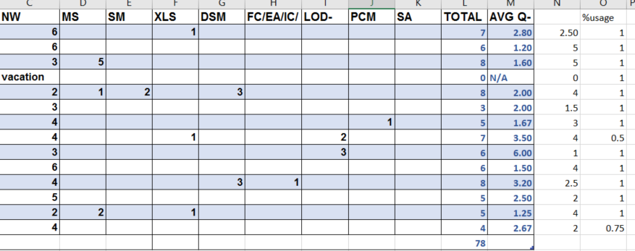
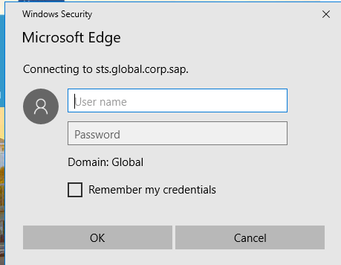
There are some…
Local / Online Excel sheet
Numbers, numbers, numbers…
Hard to decide next dispatch
Re-logon after expired session
Notes:
Distributed Numbers, numbers, numbers!

Slide 11
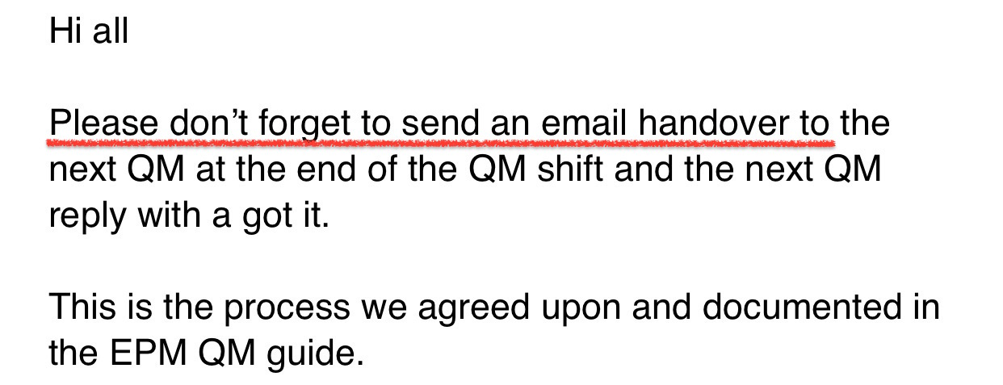
Local / Online Excel sheet
Notes:
Forgot to handover, trouble maker

Slide 12

Thinking…
Avoid?
Extend?
Notes:
How to avoid 缺陷, extends 优点？

Slide 13
Design Core
Countable + regulation
Autonomous
Fair distribution
Preference conflict
User-friendly
Know what to use
Easy to process
Notes:
总结到以上几点，xxx，Then how to combine them into one product?

Slide 14
Web
Name List
Counter
Notes:
Web: access anywhere and avoid the situation that engineer forgot to handover
Name list: easy to find engineer and maintain
Counter: know who to assign

Slide 15
HTML Table
Notes:
Separate numbers and be more clearly

Slide 16
So it comes…

Slide 17
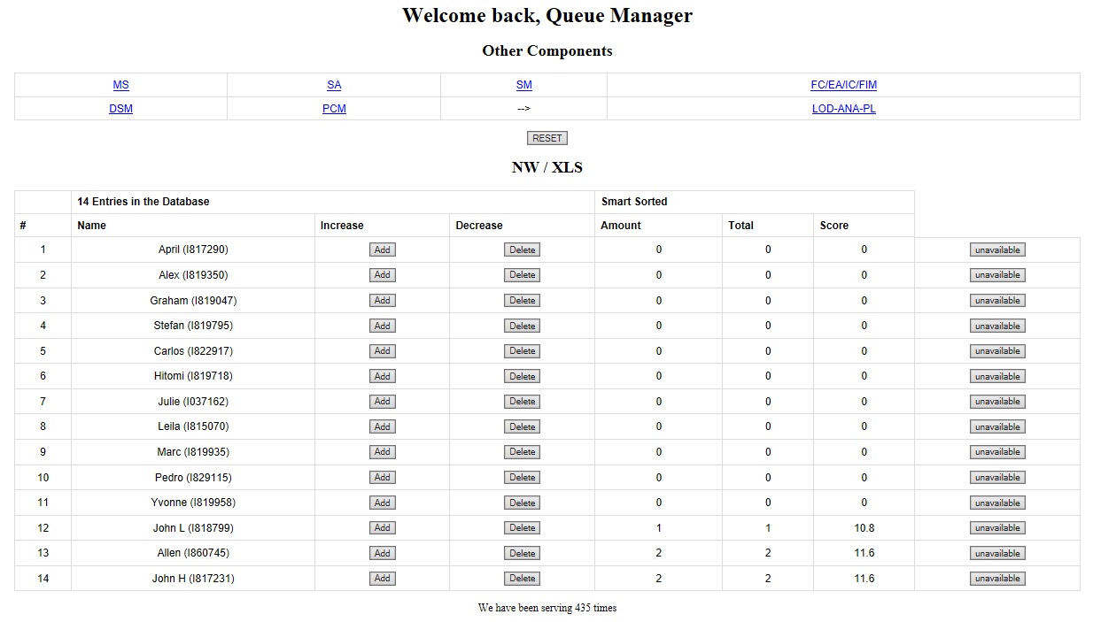
Notes:
Since all engineers support NW and EPM add-in, then this component would be on the Home Page for the fastest accessing

Slide 18
Notes:
Automatically recommend the next candidate

Slide 19
Notes:
Engineer will not be filtered if it is unavailable.

Slide 20
Notes:
Other components as hyperlinks to access

Slide 21
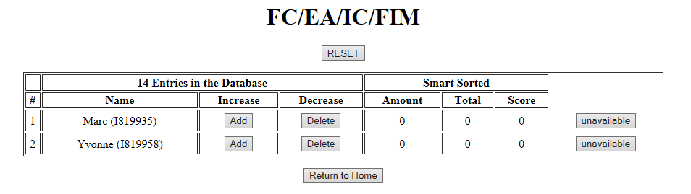
Notes:
Return to home page anytime

Slide 22
Demo powered by HANA Cloud.

Slide 24

Benefits & Evolution
Notes:
Then bring to the next chapter

Slide 25
HANA Cloud Platform & Cloud Computing – fast, clean, stable
Smart Sort – program recommend for the next dispatch
Score = localComponent# * 0.80 + (Total# - local#)/local# * 0.20 + 10;
Increase/decrease bottom – easy to coordinate your operation
Vacation/Absent/Training => Unavailable
– or cancel any time
Reset supported
Score system – know where you are
Multi-component supported – designed for our team
Multi-operating system / multi-browser support – access anytime and anywhere

Slide 26
Q & A Suggestions?

Slide 27
Thank you.
Contact information:
Allen Qian
Product Support
Address
Phone number
Partner logo

