Slide 1
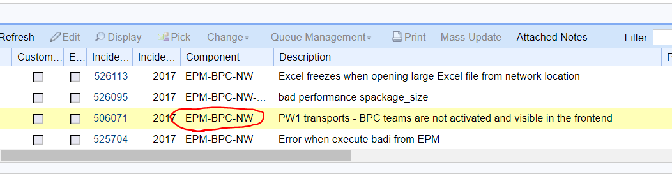
Step 1: find out the component
It’s NW

Slide 2
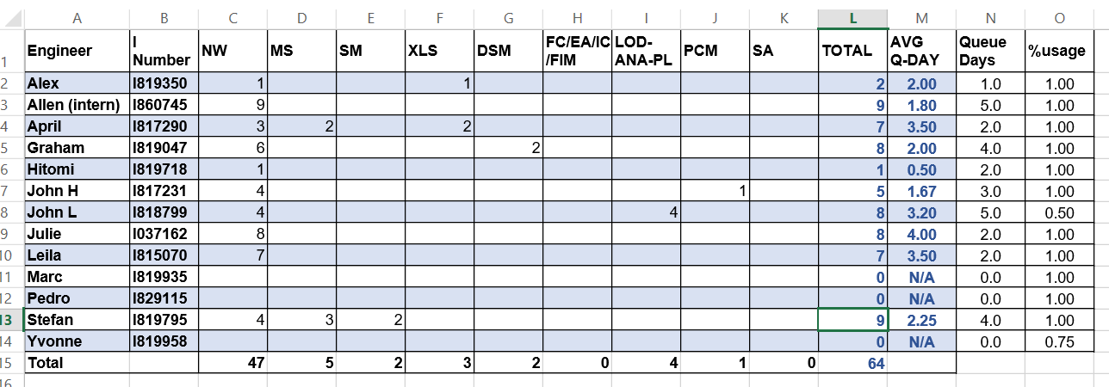
Step 2: open online Excel sheet

Slide 3
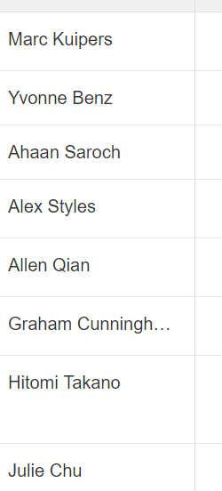
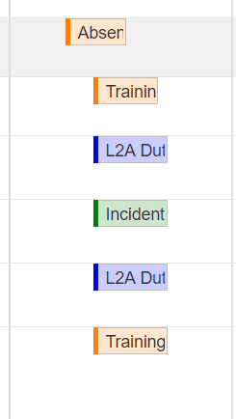
Step 3: check RCC
See who is unavailable today

Slide 4
Step 3: check these number & assign to whom
difficult to decide

Slide 5
Queue Manager Web

Slide 6
New incident comes
7
1
Check component
Paste to BCP
LOOP!
2
6
Check RCC
Copy processors i-number
3
5
Think then assign to whom
4
Increase 1 in Excel

Slide 7
New incident comes
7
1
Check component
Paste to BCP
2
6
Check RCC
Copy processors i-number
3
5
Think then assign to whom
4
Increase 1 in Excel

Slide 8
check RCC
See who is unavailable today

Slide 9
check these number & assign to whom
difficult to decide

Slide 10
So…

Slide 11
New incident comes
4
1
Check component
Paste to BCP
2
3
Increase 1 in QM_Web

Slide 12
Demo

Slide 13
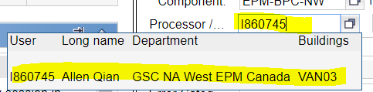
Step 4: +1 to processor
Step 5: copy processor’s i-number
Step 6: paste to BCP

Slide 14
Time consuming
Check RCC many times
Don’t know who to dispatch
Copy & paste i-number

Slide 16
Step 1: find out the component
It’s NW

Slide 17
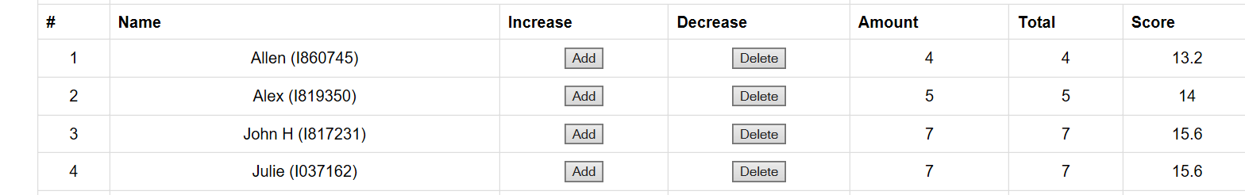
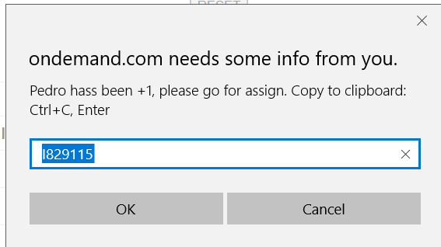


Step 2: add one
Based on algorithm, the system will recommend the NEXT candidate automatically

Slide 18
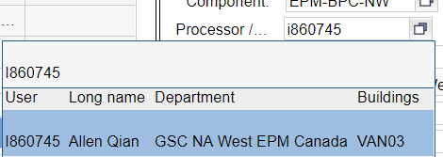
Step 3: assign to candidate

Slide 19
Step 3: check RCC

Slide 20

Step 4: click unavailable
Automatically move to the bottom
Status to UNAVAILABLE

