Slide 1

QM Cloud Dispatcher powered by HANA Cloud.
Allen Qian
September 24, 2017
Notes:
Hello everyone, today I am very happy to introduce my QM application for you. Since it is deployed on HCP so it is powered by HANA Cloud.

Slide 2
Agenda
Why?
Why creates this app?
Walkthrough
Demonstration
Benefits & Comparison
Why use this app?
Suggestion and Q&A
Notes:
Today's agenda: first I would like to explain the reason why I ceated this app. Second I will show you a short real-time demo. Thirdly, I will summary the benefits you will gain from this app. Last but not least, it is welcome to express any suggestions and questions.

Slide 3

Why Create?
Notes:
First, why I created this app

Slide 4
New incident comes
7
1
Paste to BCP
Check component
LOOP!
2
6
Check RCC
Copy processors i-number
3
5
Find & Assign to engineer
4
Increase 1 in Excel
Notes:
But before I answer the question, let me just have a quick introduction to our new QM process workflow

Slide 5
New incident comes
Paste to BCP
Check component
Check RCC
Copy processors i-number
Find & Assign to engineer
Increase 1 in Excel

Slide 6
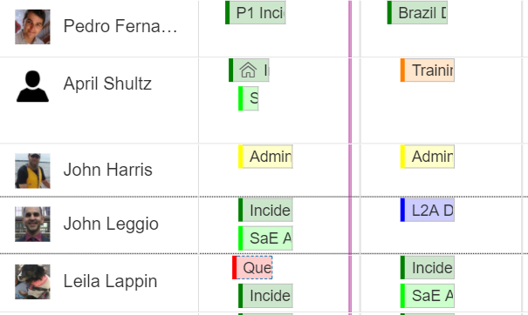
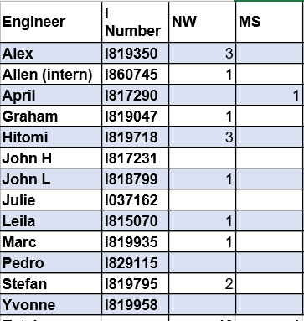



For example…
Who is unavailable today?
-- Excel doesn’t show
Check RCC every time before dispatching…

Slide 7
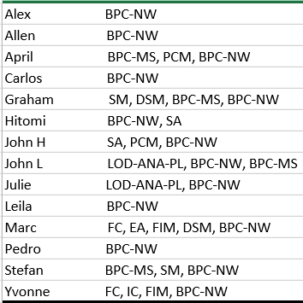
For example…
Check components
Notes:
combine

Slide 8

Why create?
Any existed application/software can help us solve these problems?

Slide 9
There are some tools so far …
1. Workload Analyzer (Java tool you know it!)
2. SAP Product Support Dispatcher
3. QMDock
Not naturally design for multiple components dispatching…
Notes:
采访中得知，目前为止有一些存在的工具
According to my investigation, there are some existed tools. The first one is Workload Analyzer, another Java tool. So many engineers knew it was horrible

Slide 10
So it comes…
Demo powered by HANA Cloud.
Notes:
So I developed the tool for the team which has multiple components, such as our team

Slide 12

Benefits & Evolution
Notes:
Then bring to the next chapter

Slide 13
HANA Cloud Platform & Cloud Computing – fast, clean, high stability
Smart Sort – program recommends for the next dispatch
AVG Q-DAY = Total / (Queue Days * %usage);
Increase/decrease bottom – easy to coordinate your operation
Vacation/Absent/Training => Unavailable
– or cancel any time
Reset supported
Score system – know where you are
Multi-component supported – designed for our team
Multi-operating system / multi-browser support – access anytime and anywhere

Slide 14
Q & A Any Suggestions?
Hope you to have a try…

Slide 15
Thank you.
Contact information:
Allen Qian
Product Support
Partner logo

