Slide 1

Queue Manager Web powered by HANA Cloud.
Allen Qian
September 24, 2017

Slide 2
Agenda
Market demand
Why need this app?
Walkthrough
Demonstration
Benefits & Comparison
Why use this app?
Suggestion and Q&A

Slide 3

Market Demand

Slide 4
Why create?
Fair distribution
Preference conflict
Easy to process
Other…

Slide 5

Notes:
为了解决以上问题，派生出Qmweb。然后采访和思考了多种方式去形成qm到底为何样式

Slide 6

There are some…
Workload Analyzer (Java tool you know it!)
Import, export, crash, error, no logic, slow, meaningless, Nightmare!
Notes:
采访中得知，目前为止有一些存在的工具

Slide 7

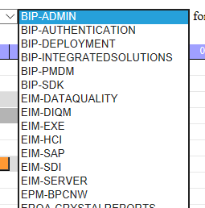
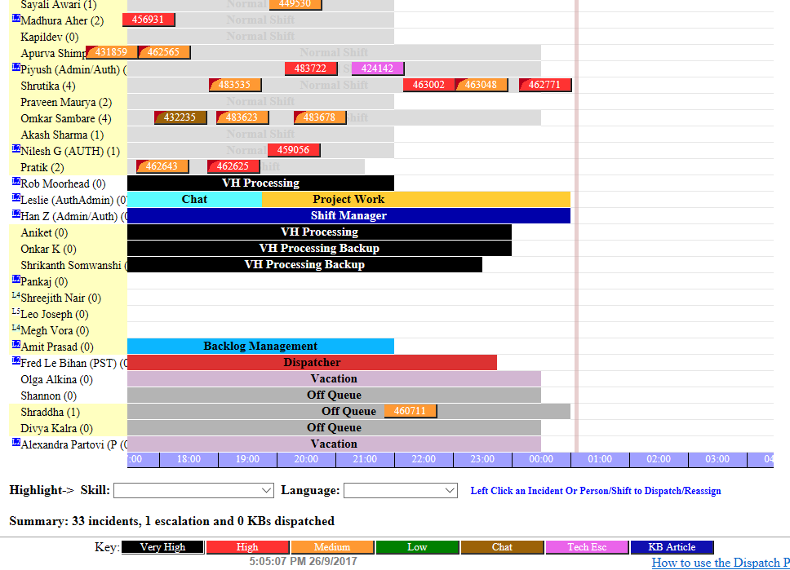
There are some…
SAP Product Support Dispatcher
Only support Single component team
Notes:
Look at these color! Not want to use it! But it only supports team that has a single component. But good for our team that per person has multiple components.

Slide 8
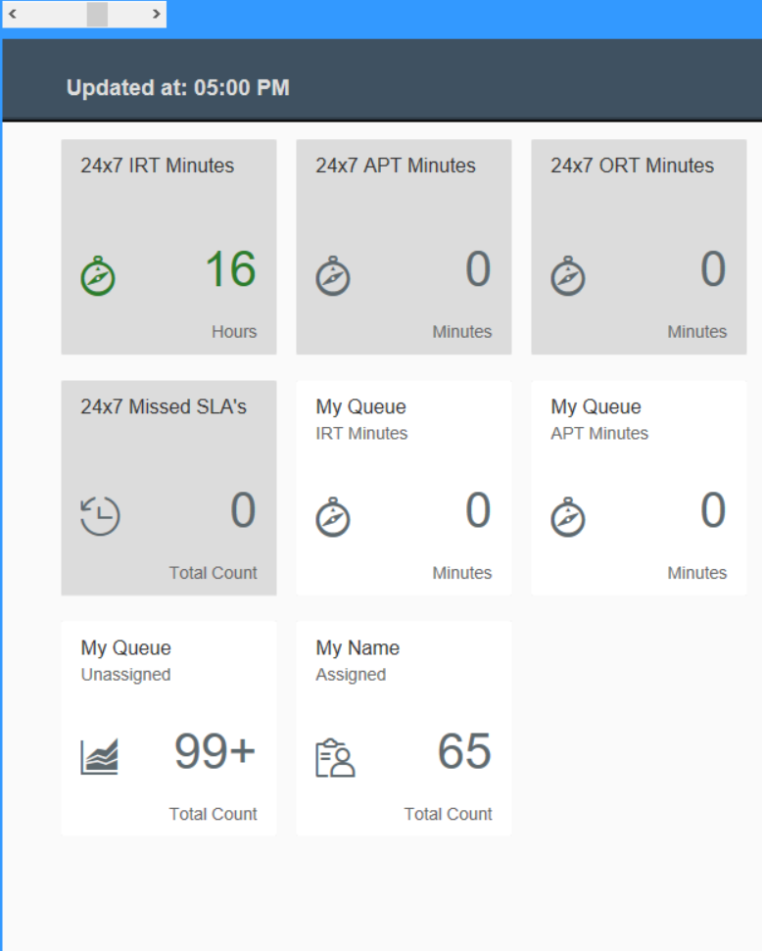
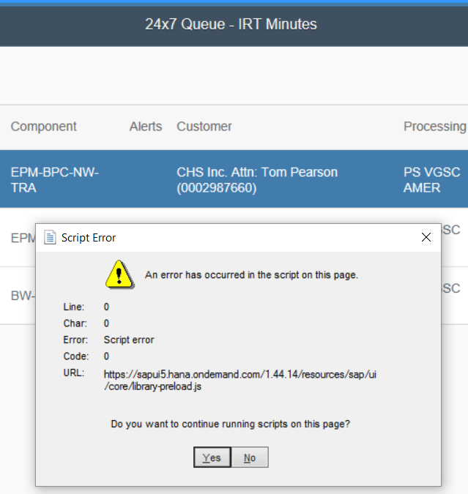
There are some…
QMDock
Good looking..
BUT….
Easily get ERROR
Number is WRONG!
What is this used for?
Notes:
Not easy to know what can we use it for?

Slide 9
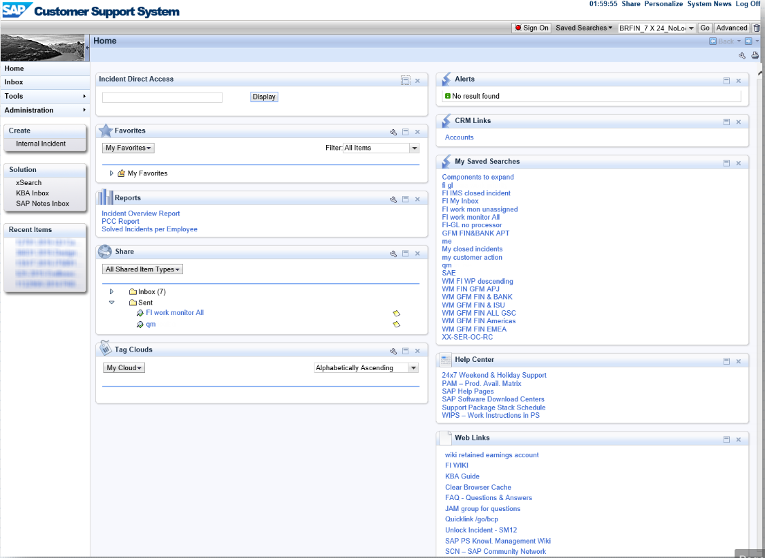
There are some…
BCP
Cannot Count!
Notes:
Not support new features naturally

Slide 10
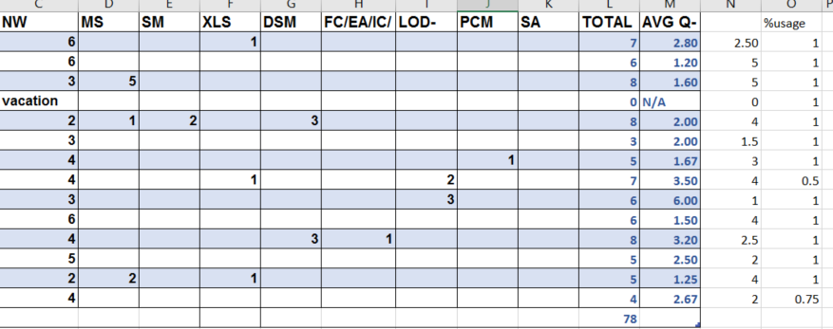
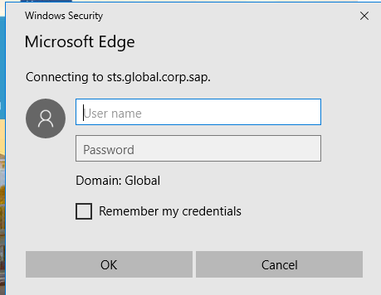
There are some…
Local / Online Excel sheet
Numbers, numbers, numbers…
Hard to decide next dispatch
Re-logon after expired session
Notes:
Distributed Numbers, numbers, numbers!

Slide 11

Thinking…
Avoid?
Extend?
Notes:
How to avoid 缺陷, extends 优点？

Slide 12
Design Core
Countable + regulation
Autonomous
Fair distribution
Preference conflict
User-friendly
Know what to use
Easy to process
Notes:
总结到以上几点，xxx，Then how to combine them into one product?

Slide 13
Web
Name List
Counter

Slide 14
HTML Table

Slide 15
So it comes…

Slide 16
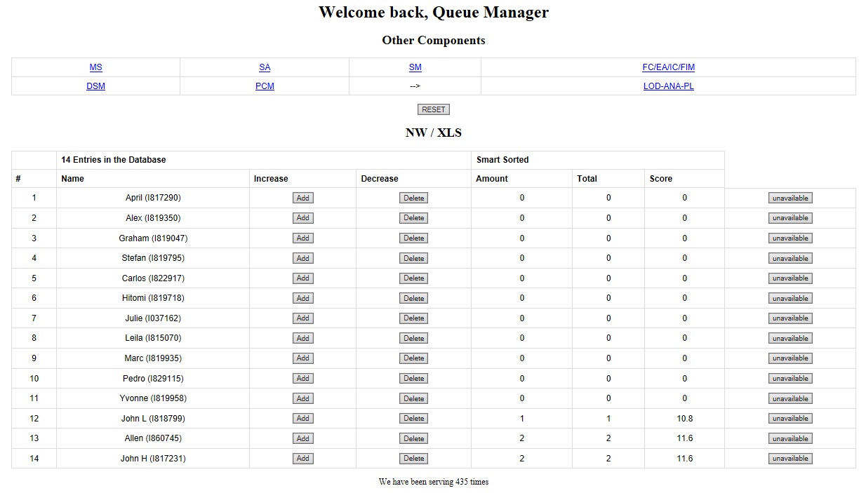

Slide 17
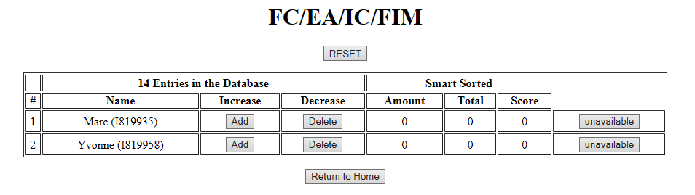

Slide 18
Demo powered by HANA Cloud.

Slide 20

Benefits & Evolution
Notes:
Then bring to the next chapter

Slide 21
HANA Cloud Platform & Cloud Computing – fast, clean, stable
Smart Sort – program recommend for the next dispatch
Increase/decrease bottom – easy to coordinate your operation
Vacation/Absent/Training => Unavailable
– or cancel any time
Reset supported
Score system – know where you are
Multi-component supported – designed for our team
Multi-operating system / multi-browser support – access anytime and anywhere

Slide 22
Q & A Suggestions?

Slide 23
Thank you.
Contact information:
F name L name
Title
Address
Phone number
Partner logo

