Slide 1

Queue Manager Web powered by HANA Cloud.
Allen Qian
September 24, 2017
Notes:
Hello everyone, today I am very happy to introduce my QM application for you. Since it is deployed on HCP so it is powered by HANA Cloud.

Slide 2
Agenda
Market demand
Why creates this app?
Walkthrough
Demonstration
Benefits & Comparison
Why use this app?
Suggestion and Q&A
Notes:
Today's agenda: first I would like to explain the reason why I ceated this app. Second I will show you a short real-time demo. Thirdly, I will summary the benefits you will gain from this app. Last but not least, it is welcome to express any suggestions and questions.

Slide 3

Market Demand
Notes:
First, why I created this app

Slide 4
Why create?
Fair distribution
Preference conflict
Easy to process
Other…
Notes:
Some issue and discussion were generated since the new QM processing deployed. Shortly, four parts. Engineers want to distribute incidents equally. Engineers want to pull tickets directly. Queue manager is different to process and handle multi-side requests. And other.

Slide 5

Notes:
为了解决以上问题，派生出Qmweb。然后采访和思考了多种方式去形成qm到底为何样式
It is better to have a document and application that can handle these issue for us. But is there any existed application that satisfy our requirements?

Slide 6

Why create?
Any existed application/software can help us solve these problems?
Notes:
It is better to have a document and application that can handle these issue for us. But is there any existed application that satisfy our requirements?

Slide 7

There are some…
Workload Analyzer (Java tool you know it!)
Import, export, crash, error, no logic, slow, meaningless, Nightmare!
Notes:
采访中得知，目前为止有一些存在的工具
According to my investigation, there are some existed tools. The first one is Workload Analyzer, another Java tool. So many engineers knew it was horrible

Slide 8

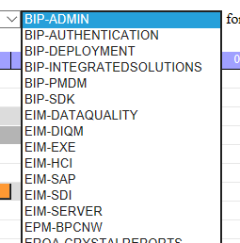
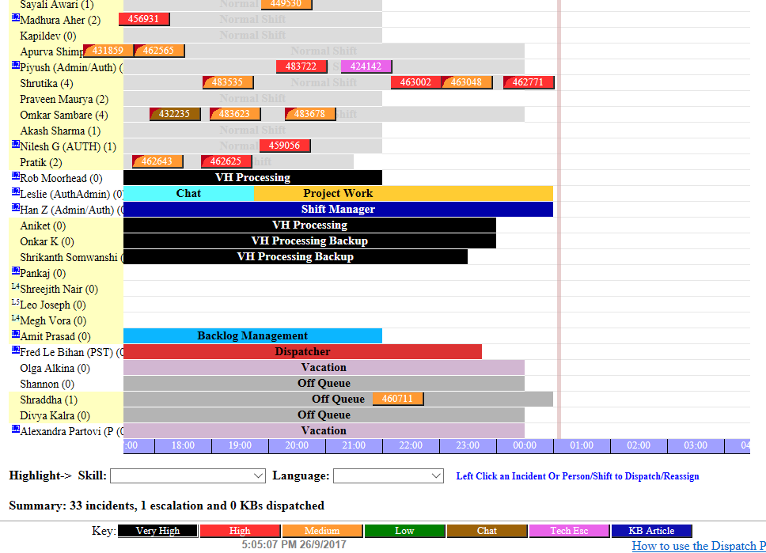
There are some…
SAP Product Support Dispatcher
Only support Single component team
Notes:
SAP Product Support Dispatcher. Look at these color. I don’t want to use it if I have choose. In addition, it only supports team that has a single component. Not good for our team since our engineers have multiple components.

Slide 9
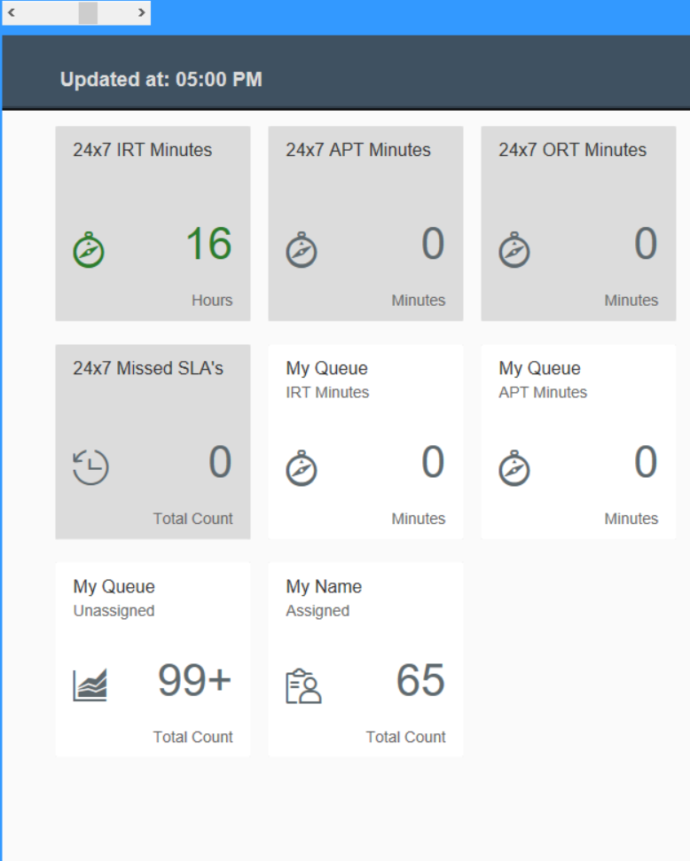
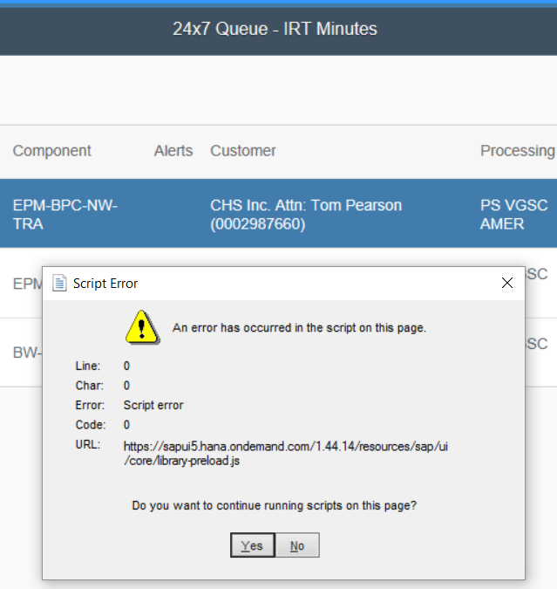
There are some…
QMDock
Good looking..
BUT….
Easily get ERROR
Number is WRONG!
What is this used for?
Notes:
QMDock. Not easy to know what can we use it for? And, supper unstable even I downloaded the latest version

Slide 10
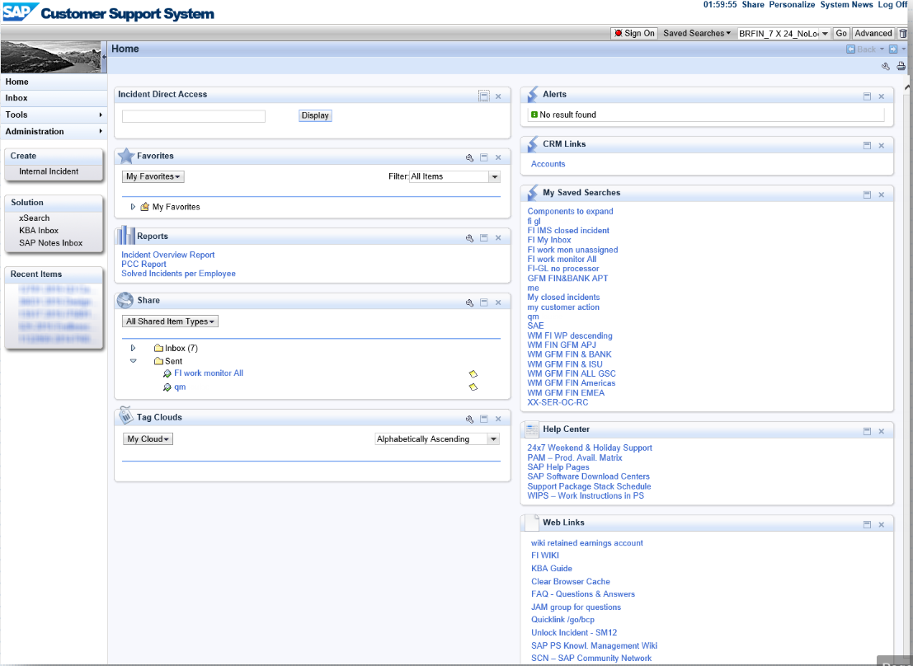
There are some…
BCP
Cannot Count!
Notes:
Our old friend, BCP. Do not have counter function.

Slide 11
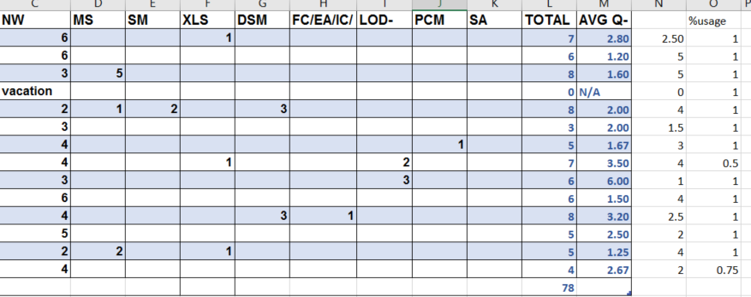
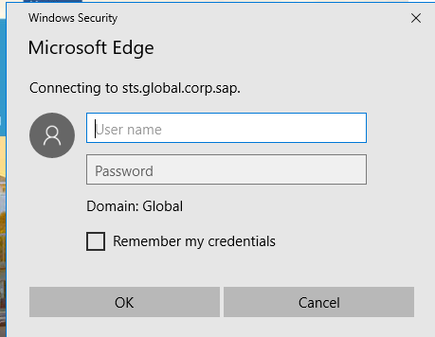
There are some…
Local / Online Excel sheet
Numbers, numbers, numbers…
Hard to decide next dispatch
Re-logon after expired session
Notes:
That is what we are using. But its disadvantages are apparently. Distributed Numbers, numbers, numbers! Repeat logon request

Slide 12
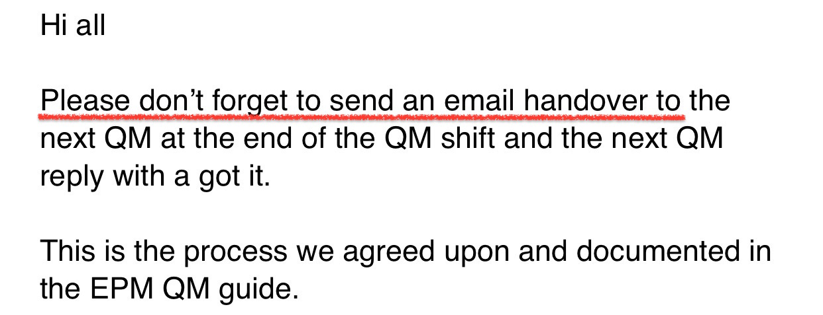
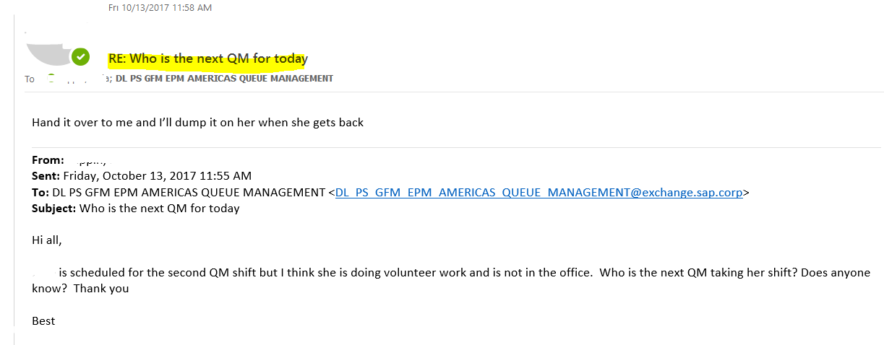
Local / Online Excel sheet
Notes:
And also, sometimes engineer would forget to handover, and next shift has to send query email to every single person

Slide 13

Thinking…
Avoid?
Extend?
Notes:
Then I was thinking, I am the programming student and why not just create one app? Then I need to decide how to avoid shortages, extends benefits from those existed applicaitons?

Slide 14
Design Core
Countable + regulation
Autonomous
Fair distribution
Preference conflict
User-friendly
Know what to use
Easy to process
Notes:
总结到以上几点，xxx，Then how to combine them into one product?

Slide 15
Web
Name List
Counter
Notes:
Web: access anywhere and avoid the situation that engineer forgot to handover
Name list: easy to find engineer and maintain
Counter: know who to assign

Slide 16
HTML Table
Notes:
Separate numbers and be more clearly

Slide 17
So it comes…

Slide 18
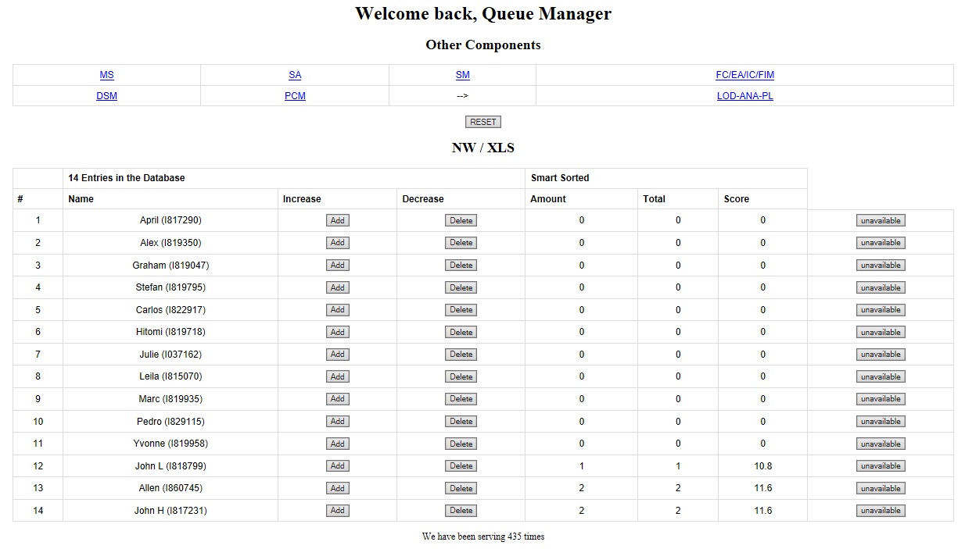
Notes:
Since all engineers support NW and EPM add-in, then this component would be on the Home Page for the fastest accessing

Slide 19
Notes:
Automatically recommend the next candidate

Slide 20
Notes:
Engineer will not be filtered if it is unavailable.

Slide 21
Notes:
Other components as hyperlinks to access

Slide 22
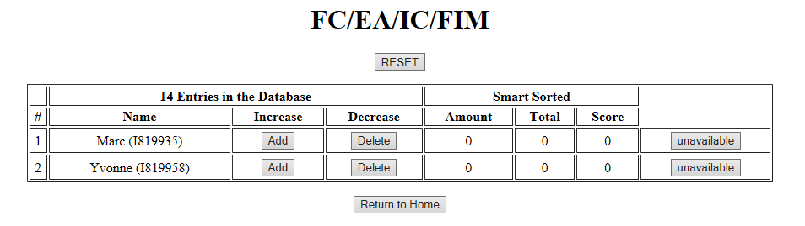
Notes:
Return to home page anytime

Slide 23
Demo powered by HANA Cloud.

Slide 25

Benefits & Evolution
Notes:
Then bring to the next chapter

Slide 26
HANA Cloud Platform & Cloud Computing – fast, clean, high stability
Smart Sort – program recommend for the next dispatch
Score = localComponent# * 0.80 + (Total# - local#)/local# * 0.20 + 10;
Increase/decrease bottom – easy to coordinate your operation
Vacation/Absent/Training => Unavailable
– or cancel any time
Reset supported
Score system – know where you are
Multi-component supported – designed for our team
Multi-operating system / multi-browser support – access anytime and anywhere

Slide 27
Q & A Any Suggestions?

Slide 28
Thank you.
Contact information:
Allen Qian
Product Support
Partner logo

