Slide 1
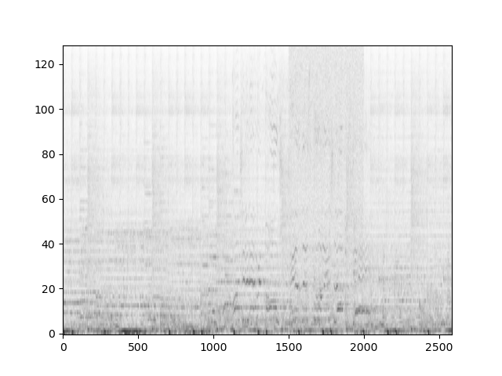
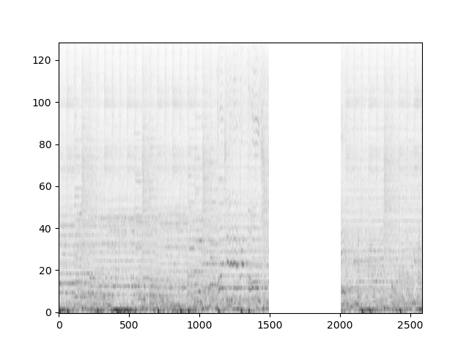
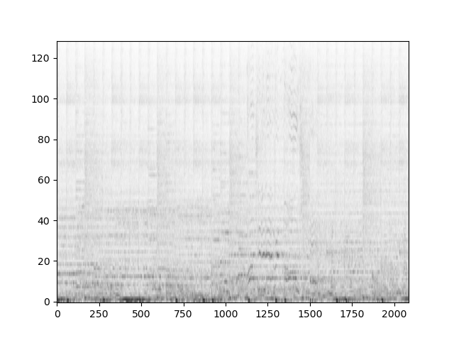
Music Audio Denoiser
Ahaan Kanaujia and Shayan Azmoodeh
Department of Computer Science, University of Illinois Urbana-Champaign
Introduction
Related Work
Our main focus is anomaly detection and replacement in audio data. Given an audio clip of music, we can detect interruptions such as a phone call, applause, and clapping, remove the segment with this noise, and impute the gap with audio that resembles the original audio clip.
We train a classifier based on a large popular dataset, remove the noise or anomalies, and use SVD/NMF, VAR models and Nearest Neighbor imputers to fill in the missing audio.
Most papers and methods in audio denoising employs deep learning-based approaches, leveraging neural networks to learn complex (but difficult to understand) mappings between noise and music audio signals. Some of the famous models are Wave-U-Net and SEGAN. But these methods required large amounts of data and time to train.
More traditional approaches such as Wiener filtering are subtractive, where certain frequencies with higher levels of background noise and subtracted from the original signal. These methods work best with deterministic signals. However, they required two audio signals, one with both speech and noise, and another with solely the background noise.
Methods
Classification
The first step of the process is training a classification model to detect common sound classes given spectrogram frames. The FSD50K dataset contains 51,197 sound clips of human labelled events distributed in 200 classes.
We consider:
14 noise and 25 music classes
Randomly sample 100 clips per class
Compute spectrogram for each clip and take a “bag-of-words” approach with spectrogram frames
Future plans: train model using all data, increasing performance
Classification models tried:
KNN: 89% accuracy
Gaussian: 63% accuracy
PCA: 54% accuracy
Model predicts class for given STFT segment, which we apply across all frames in input audio to detect noise segments.
Removal
Classifier will label segments of given audio spectrogram as noise or anomaly.
Noise segments are removed leaving gaps in spectrogram which are later imputed.
Imputation
VAR: We train a VAR model on music clips for each class. Here, we only consider the spectrogram data up to the missing data.
KNN: The KNN model is unsupervised and imputes missing values based on n nearest neighbors (spectrogram column vectors).
NMF/SVD: Instead, to use the information present in all the data, we can use the SVD imputation or the NMF approach, which takes into account all the spectrogram data.
Deep(er) Learning: We train RNN and Attention-Transformer models in hopes of better learning the context of the current audio clip to generate missing audio frames.
Figure 3. Spectrogram Prediction using VAR Model
Figure 1. Spectrogram with noise
Figure 2. Spectrogram with noise removed
Discussion
Next Steps
While our bag-of-frames approach facilitates noise detection and removal, it also increases the risk of misclassifying lower-energy frames due to reduced audio context. However, these misclassifications have minimal impact on the listener and are often corrected by neighboring high-energy frames. To further mitigate this, we apply our classifier to a surrounding window for each frame, enhancing the contextual information used for classification.
Currently we target cleaning of classical music, since the classifier is not due to a limited number of sound classes for noise which our classification model can detect.
Methods can be extended to multiple genres by training genre-specific imputers/classifiers and applying them accordingly.
We plan on making the entire pipeline unsupervised and clean an audio signal of anomalies given just the signal itself, without using a labelled dataset of anomaly sound classes. We will try drawing inspiration from how humans hear; where we can tell if a new noise sounds like an anomaly or not given a piece of music audio with contextual information from the music itself.
References
FSD50K: An Open Dataset of Human-Labelled Sound Events
Missing Data Imputation for Time-Frequency Representations of Audio Signals
Missing Data Imputation for Spectral Audio Spectrograms - P Smaragdis et. al.
A Unifying Review of Linear Gaussian Models – S Roweis and Z Ghahramani
Notes:
Prints as 33.1 x 46.8 (A0) at 100%. When printed using the library printing service, this will require trimming from 36 inch wide paper. To fill 36 inch paper roll, scale to 108.5% (prints as ~ 36 X 51).

