Slide 1

Welcome to our Presentation
Submitted to our honourable faculty
Afsana- Al- Sharmin
Senior Lecturer Department of Mathematical and Physical Sciences

Slide 2
Group members name and id
Sagar Karmoker 2020-2-60-054
Mortoja Tasrif Rashid 2016-2-80-003
Md.Jahurul Hoque 2020-2-60-055
Taslima Khan Tarin 2020-2-60-058
Sadia Parvin Tisha 2020-2-60-060
Nurtaz Ahamed 2020-2-60-062
Md.Imran Hasan Nayem 2020-2-60-063
Ahbab Bin Habib 2020-2-60-065
Abdullah Al Mahfuz 2020-2-60-066
Ruba Sazeda 2020-2-60-069
Md.Farhan Shariar Islam 2020-2-60-086
Nabiha Tahsin Tanha 2020-2-60-087
Soyoda Meenmoy 2020-2-60-088
Arifa Sultana Mily 2020-2-60-092

Slide 3
Differentiation

Slide 4
Content
What is differentiation
Why should we use differentiation
Where we use differentiation
Kinds of differentiation
Some math of different techniques
Application

Slide 5
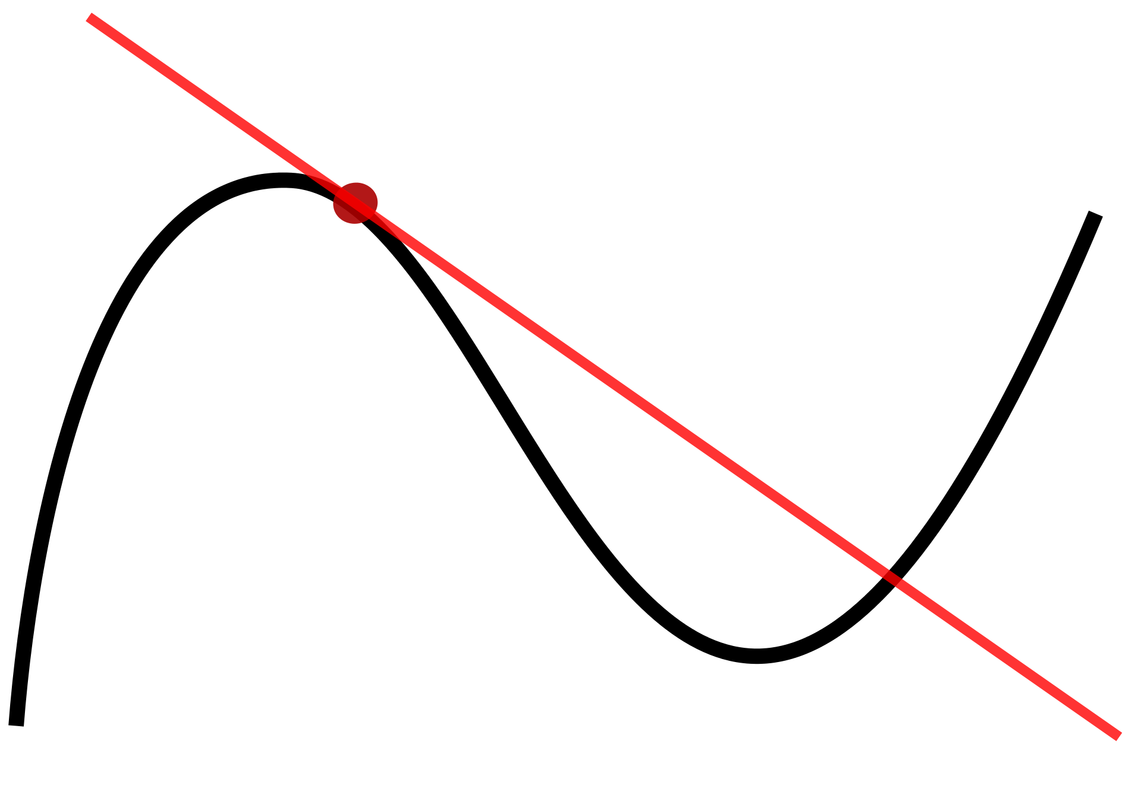
What is differentiation
process of finding the derivative, or rate of change, of a function.

Slide 6
Why should we use differentiation
reveals the rate-of-change
reveals the cumulative effect

Slide 7
Where we use differentiation
Increasing and Decreasing Functions
Stationary Points
Solving Practical Problems
Maximum, Minimum or Point of Inflection?

Slide 8
Kinds of differentiation
Product rule
Chain rule
Partial derivate
Power rule
Reciprocal Rule
Quotient Rule
Subtraction rule
Implicit
L’ Hopital rule

Slide 9
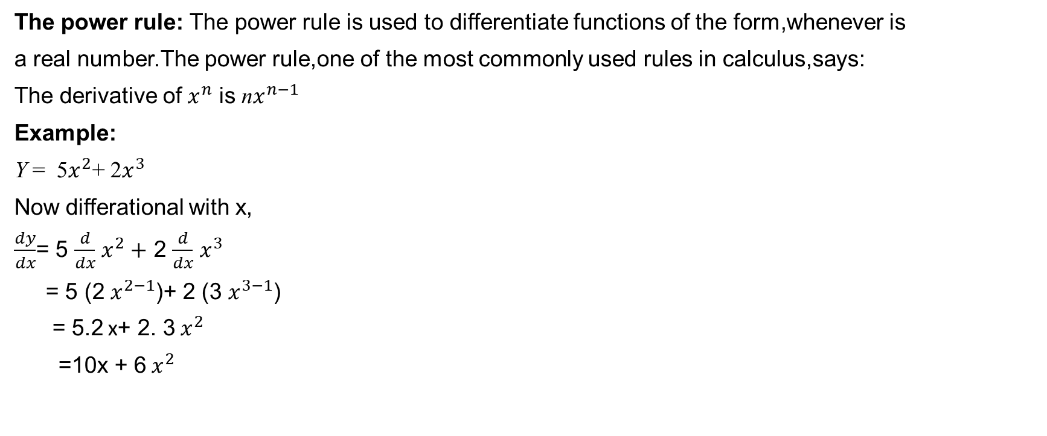
Some problems
The power rule: The power rule is used to differentiate functions of the form,whenever is
a real number.The power rule,one of the most commonly used rules in calculus,says:
The derivative of $x^{n}$ is n$x^{n−1}$
Example:
Y = 5$x^{2}$+ 2$x^{3}$
Now differational with x,
$\frac{dy}{dx}$= 5 $\frac{d}{dx}$ $x^{2}+$ 2 $\frac{d}{dx}$ $x^{3}$
= 5 (2 $x^{2−1}$)+ 2 (3 $x^{3−1}$)
= 5.2 x+ 2. 3 $x^{2}$
=10x + 6 $x^{2}$

Slide 10
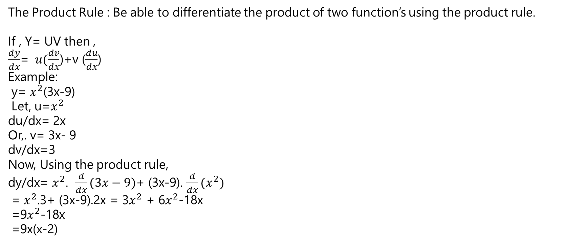
Some problems
The Product Rule : Be able to differentiate the product of two function’s using the product rule.
If , Y= UV then ,
$\frac{dy}{dx}$= $u(\frac{dv}{dx}$)+v ($\frac{du}{dx}$)
Example:
y= $x^{2}$(3x-9)
Let, u=$x^{2}$
du/dx= 2x
Or,. v= 3x- 9
dv/dx=3
Now, Using the product rule,
dy/dx= $x^{2}$. $\frac{d}{dx}(3x−9)$+ (3x-9). $\frac{d}{dx}(x^{2})$
= $x^{2}$.3+ (3x-9).2x = 3$x^{2}$ + 6$x^{2}$-18x
=9$x^{2}$-18x
=9x(x-2)

Slide 11
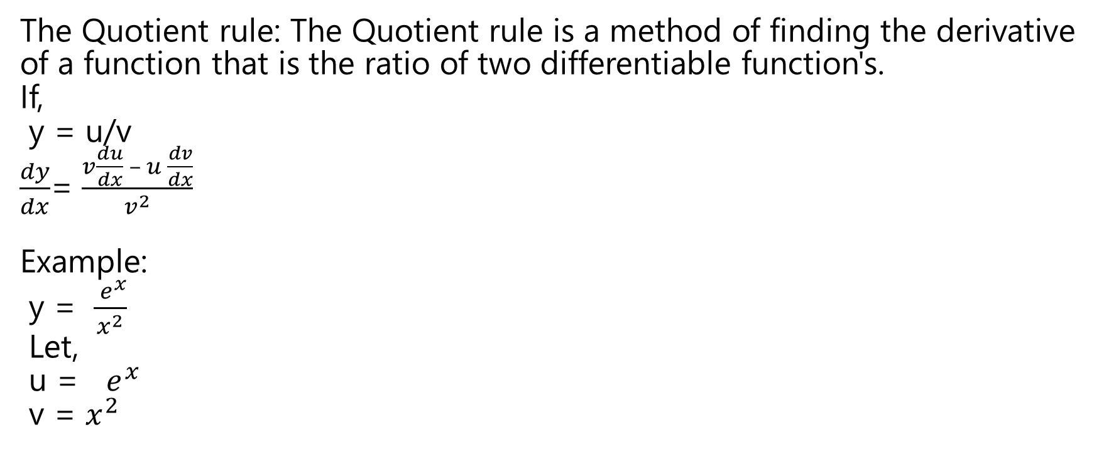
Some problems
The Quotient rule: The Quotient rule is a method of finding the derivative of a function that is the ratio of two differentiable function's.
If,
y = u/v
$\frac{dy}{dx}$= $\frac{v\frac{du}{dx} – u \frac{dv}{dx}}{v^{2}}$
Example:
y = $\frac{ e^{x}}{x^{2}}$
Let,
u = $e^{x}$
v = $x^{2}$

Slide 12

Some problems
Using the Quotient rule’s ,
$\frac{dy}{dx}$=$\frac{ x^{2}\frac{d}{dx} e^{x} −e^{x} \frac{d}{dx} x^{2} }{(x^{2})^2}$
=$\frac{ e^{x}∗ x^{2}−e^{x} ∗2x }{x^{4}}$
=$\frac{ e^{x} ∗x(x−2) }{e^{x}}$
=$\frac{ e^{x } (x−2) }{x^{3}}$

Slide 13
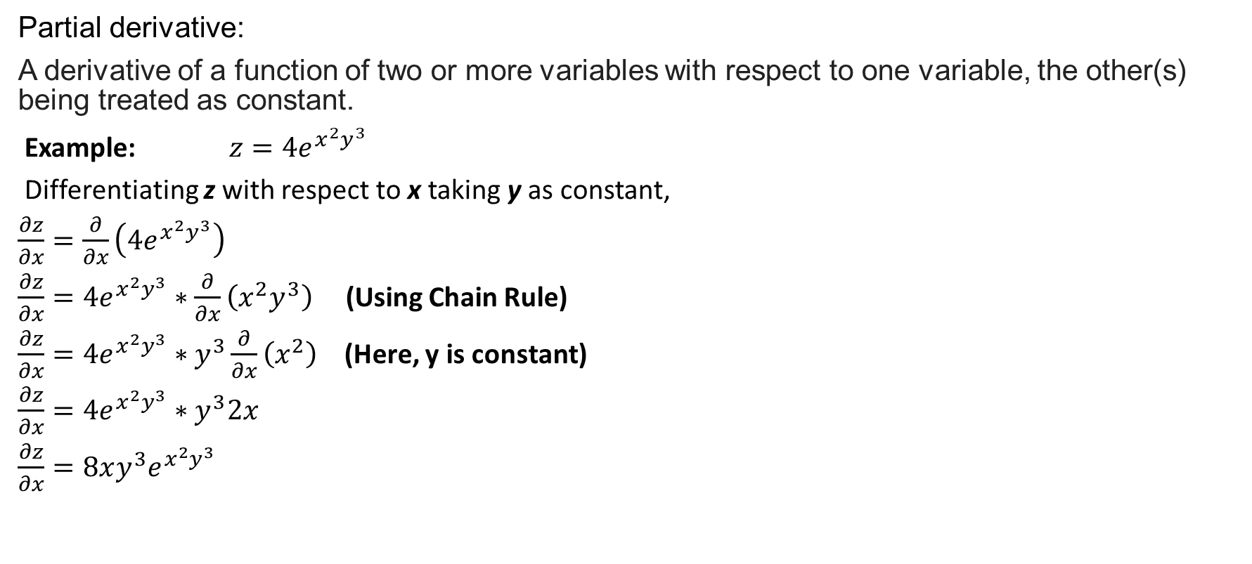
Some problems
Partial derivative:
A derivative of a function of two or more variables with respect to one variable, the other(s) being treated as constant.
Example: $z=4e^{x^{2}y^{3}}$
Differentiating z with respect to x taking y as constant,
$\frac{∂z}{∂x}=\frac{∂}{∂x}\left(4e^{x^{2}y^{3}}\right)$
$\frac{∂z}{∂x}=4e^{x^{2}y^{3}}∗\frac{∂}{∂x}\left(x^{2}y^{3}\right)$ (Using Chain Rule)
$\frac{∂z}{∂x}=4e^{x^{2}y^{3}}∗y^{3}\frac{∂}{∂x}\left(x^{2}\right)$ (Here, y is constant)
$\frac{∂z}{∂x}=4e^{x^{2}y^{3}}∗y^{3}2x$
$\frac{∂z}{∂x}=8xy^{3}e^{x^{2}y^{3}}$

Slide 14
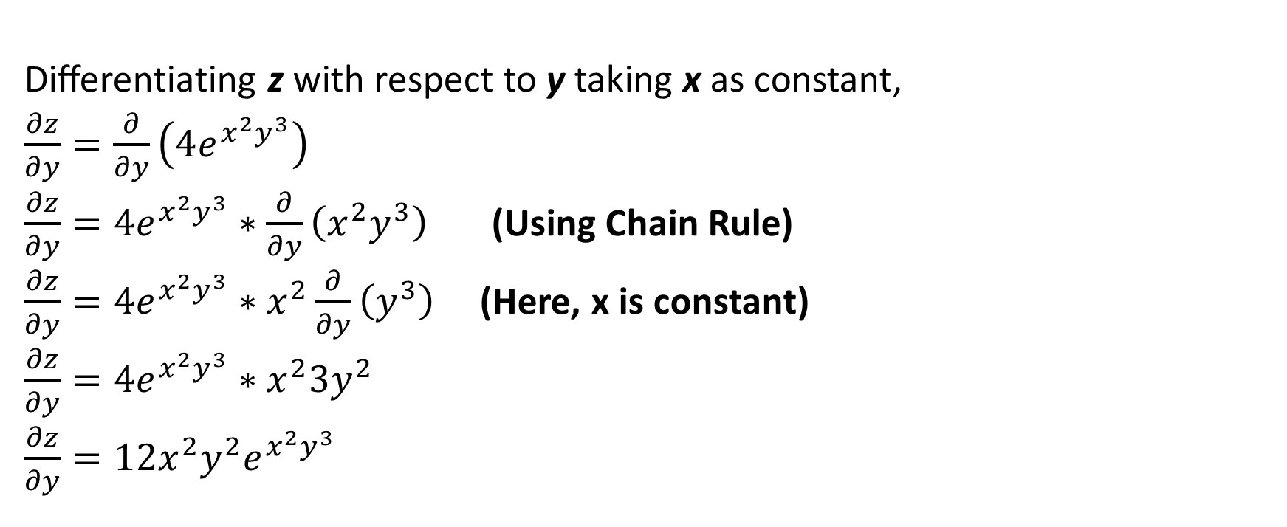
Some problems
Differentiating z with respect to y taking x as constant,
$\frac{∂z}{∂y}=\frac{∂}{∂y}\left(4e^{x^{2}y^{3}}\right)$
$\frac{∂z}{∂y}=4e^{x^{2}y^{3}}∗\frac{∂}{∂y}\left(x^{2}y^{3}\right)$ (Using Chain Rule)
$\frac{∂z}{∂y}=4e^{x^{2}y^{3}}∗x^{2}\frac{∂}{∂y}\left(y^{3}\right)$ (Here, x is constant)
$\frac{∂z}{∂y}=4e^{x^{2}y^{3}}∗x^{2}3y^{2}$
$\frac{∂z}{∂y}=12x^{2}y^{2}e^{x^{2}y^{3}}$

Slide 15
L’HOPITAL RULE
In mathematics, more specifically calculus, L'Hôpital's rule or L'Hospital's rule provides a technique to evaluate limits of indeterminate forms. Application of the rule often converts an indeterminate form to an expression that can be easily evaluated by substitution.

Slide 16
When we use lt-
7 types Indeterminate form-
Indererminate froms of type = $\frac{0}{0}$
Indererminate froms of type = 0$×∞$
Indererminate froms of type = $∞−∞$
Indererminate froms of type = $\frac{∞}{∞}$
Indererminate froms of type = $0^{0} ,$ $∞^{∞} ,1^{∞}$

Slide 17

Some problems
$\lim_{x→+∞}{\frac{x}{e^{x}}}$ =$\frac{∞}{e^{∞}}$ =$\frac{∞}{∞}$
The numerator and denominator have a limit of ∞, so the limit is an indeterminate from of type ∞ /∞ .
Appling L’Hopital’s rules yields.
$\lim_{x→+∞}{\frac{x}{e^{x}}}$
$=\lim_{x→+∞}{\frac{\frac{d}{dx}(x)}{\frac{d}{dx}(e^{x})}}$
(note that the derivative of$e^{x}$ is $e^{x}$)
=$\lim_{x→+∞}{\frac{1}{e^{x}}}$
=$\frac{1}{e^{∞}}$
=$\frac{1}{∞}$
=∞
Answer=∞

Slide 18
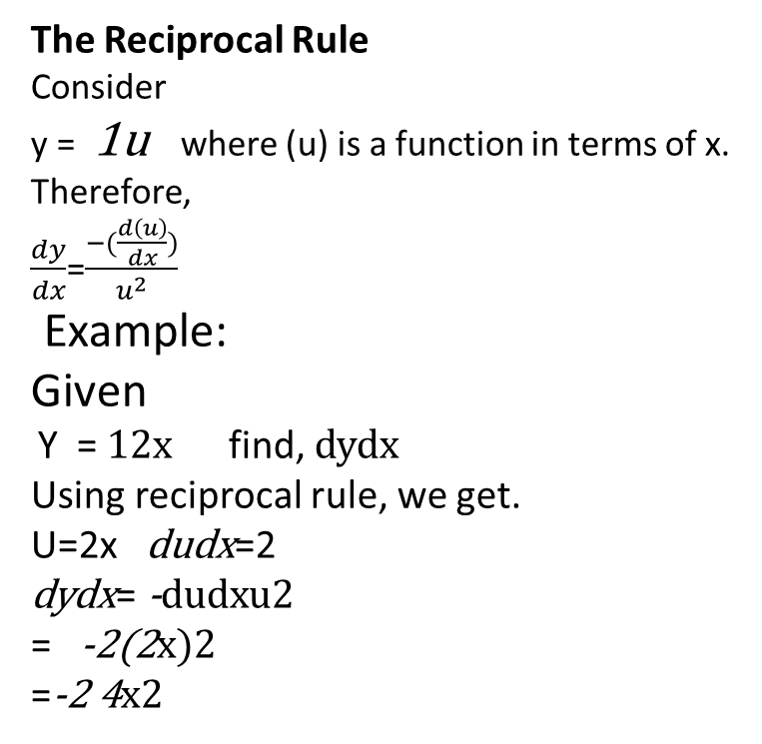
Some problems
The Reciprocal Rule
Consider
y = 1u where (u) is a function in terms of x.
Therefore,
$\frac{dy}{dx}$=$\frac{−(\frac{d\left(u\right)}{dx})}{u^{2}}$
Example:
Given
Y = 12x find, dydx
Using reciprocal rule, we get.
U=2x dudx=2
dydx= -dudxu2
= -2(2x)2
=-2 4x2

Slide 19
Implicit differentiation
Implicit differentiation involves differentiating both sides of the equation with respect to x and then solving the resulting equation for y’.
Example:
If x²+y²=16,find $\frac{dy}{dx}$
Solution: $\frac{d}{dx}\left(x2+y2\right)=\frac{d}{dx} \left(16\right)$
$\frac{d}{dx}\left(x2\right)+\frac{d}{dx}\left(y2\right)=0$
$2x+2y\frac{dy}{dx}=0$
$2y\frac{dy}{dx}=−2x$
$\frac{dy}{dx}=−\frac{2x}{2y}$
solving for $\frac{dy}{dx}$ we obtain
$\frac{dy}{dx}=−\frac{x}{y}$
Differentiating both sides of the equation
The chain rule was used here because y is a function of x

Slide 20
Application
To calculate the profit and loss in business using graphs.
To check the temperature variation.
To determine the speed or distance covered such as miles per hour, kilometre per hour etc.
Derivatives are used to derive many equations in Physics.
In the study of Seismology like to find the range of magnitudes of the earthquake.

